Slide 1
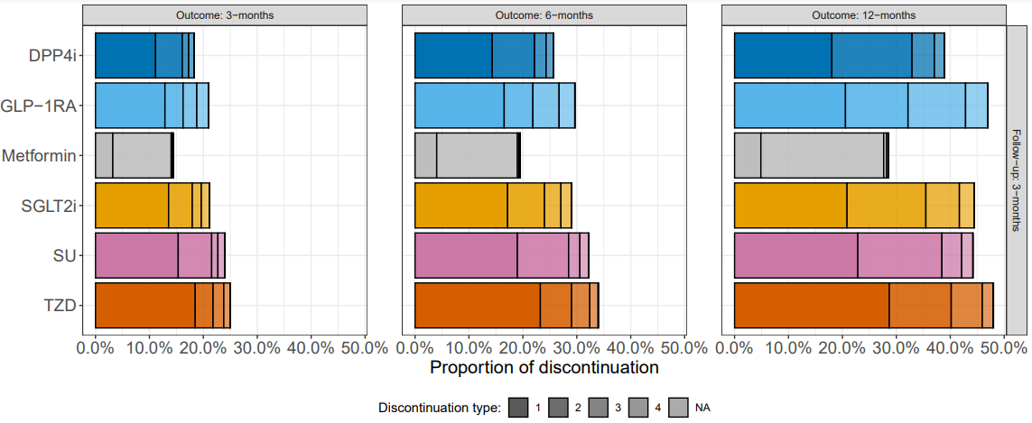
Rules:
0. timeondrug bigger than 91 / 183 / 365 (not represented here)
1. timeondrug less than 91 / 183 / 365
2. nextremdrug = NA (represents a break in the current drug before restarting)
3. nextremdrug = different drug removed from row drug class
4. timetolastpx – timeondrug < 91 / 183
NA. anything else (what thought??)
Old Rules:
These would be NA

Slide 2
Metformin
 | Drug periods recorded
Discontinuation | 1 | 2 | 3 | 4 | 5 | 6 | 7 | 8
0 (n=149,123) | 88.57 | 8.97 | 1.80 | 0.49 | 0.13 | 0.03 | 0.01 | 0.00
1 (n=5,585) | 74.06 | 21.97 | 3.15 | 0.64 | 0.14 | 0.02 | 0.02 | 0.00
2 (n=18,863) | 55.46 | 32.00 | 8.40 | 2.89 | 0.95 | 0.22 | 0.06 | 0.02
3 (n=300) | 50.00 | 31.00 | 12.67 | 4.00 | 1.67 | 0.67 | 0.00 | 0.00
4 (n=362) | 100.00 | 0.00 | 0.00 | 0.00 | 0.00 | 0.00 | 0.00 | 0.00
NA (n=5) | 100.00 | 0.00 | 0.00 | 0.00 | 0.00 | 0.00 | 0.00 | 0.00
Rules:
0. timeondrug bigger than 91 / 183 / 365 (not represented here)
1. timeondrug less than 91 / 183 / 365
2. nextremdrug = NA (represents a break in the current drug before restarting)
3. nextremdrug = different drug removed from row drug class
4. timetolastpx – timeondrug < 91 / 183
NA. anything else (what thought??)
Old Rules:
These would be NA

Slide 3
DPP4
 | Drug periods recorded
Discontinuation | 1 | 2 | 3 | 4 | 5 | 6 | 7
0 (n=79,761) | 92.75 | 6.38 | 0.71 | 0.13 | 0.02 | 0.01 | 0.00
1 (n=10,875) | 67.34 | 28.30 | 3.62 | 0.62 | 0.06 | 0.05 | 0.02
2 (n=4,830) | 86.96 | 9.92 | 2.13 | 0.77 | 0.19 | 0.04 | 0.00
3 (n=1,147) | 83.87 | 13.25 | 1.83 | 0.70 | 0.35 | 0.00 | 0.00
4 (n=1,009) | 100.00 | 0.00 | 0.00 | 0.00 | 0.00 | 0.00 | 0.00
NA (n=6) | 100.00 | 0.00 | 0.00 | 0.00 | 0.00 | 0.00 | 0.00
Rules:
0. timeondrug bigger than 91 / 183 / 365 (not represented here)
1. timeondrug less than 91 / 183 / 365
2. nextremdrug = NA (represents a break in the current drug before restarting)
3. nextremdrug = different drug removed from row drug class
4. timetolastpx – timeondrug < 91 / 183
NA. anything else (what thought??)
Old Rules:
These would be NA

Slide 4
SGLT2
 | Drug periods recorded
Discontinuation | 1 | 2 | 3 | 4 | 5 | 6
0 (n=52,263) | 92.02 | 7.05 | 0.80 | 0.09 | 0.03 | 0.00
1 (n=8,980) | 72.03 | 24.52 | 2.91 | 0.49 | 0.04 | 0.01
2 (n=2,914) | 91.28 | 6.35 | 1.58 | 0.58 | 0.10 | 0.10
3 (n=1,104) | 87.32 | 10.14 | 1.63 | 0.72 | 0.09 | 0.09
4 (n=1,016) | 100.00 | 0.00 | 0.00 | 0.00 | 0.00 | 0.00
NA (n=3) | 100.00 | 0.00 | 0.00 | 0.00 | 0.00 | 0.00
Rules:
0. timeondrug bigger than 91 / 183 / 365 (not represented here)
1. timeondrug less than 91 / 183 / 365
2. nextremdrug = NA (represents a break in the current drug before restarting)
3. nextremdrug = different drug removed from row drug class
4. timetolastpx – timeondrug < 91 / 183
NA. anything else (what thought??)
Old Rules:
These would be NA

Slide 5
GLP1
 | Drug periods recorded
Discontinuation | 1 | 2 | 3 | 4 | 5 | 6 | 7
0 (n=19,018) | 89.62 | 8.94 | 1.19 | 0.23 | 0.01 | 0.01 | 0.01
1 (n=3,099) | 74.64 | 22.04 | 2.90 | 0.29 | 0.13 | 0.00 | 0.00
2 (n=808) | 95.05 | 3.84 | 0.62 | 0.25 | 0.25 | 0.00 | 0.00
3 (n=613) | 91.52 | 7.01 | 1.31 | 0.00 | 0.16 | 0.00 | 0.00
4 (n=530) | 100.00 | 0.00 | 0.00 | 0.00 | 0.00 | 0.00 | 0.00
NA (n=4) | 100.00 | 0.00 | 0.00 | 0.00 | 0.00 | 0.00 | 0.00
Rules:
0. timeondrug bigger than 91 / 183 / 365 (not represented here)
1. timeondrug less than 91 / 183 / 365
2. nextremdrug = NA (represents a break in the current drug before restarting)
3. nextremdrug = different drug removed from row drug class
4. timetolastpx – timeondrug < 91 / 183
NA. anything else (what thought??)
Old Rules:
These would be NA

Slide 6
SU
 | Drug periods recorded
Discontinuation | 1 | 2 | 3 | 4 | 5 | 6 | 7 | 8
0 (n=47,893) | 88.41 | 9.70 | 1.53 | 0.29 | 0.05 | 0.01 | 0.00 | 0.00
1 (n=9,665) | 72.74 | 22.58 | 3.87 | 0.62 | 0.12 | 0.05 | 0.02 | 0.00
2 (n=3,906) | 83.18 | 12.31 | 3.00 | 0.84 | 0.49 | 0.13 | 0.03 | 0.03
3 (n=733) | 83.08 | 12.41 | 3.41 | 0.68 | 0.27 | 0.00 | 0.14 | 0.00
4 (n=803) | 100.00 | 0.00 | 0.00 | 0.00 | 0.00 | 0.00 | 0.00 | 0.00
NA (n=11) | 100.00 | 0.00 | 0.00 | 0.00 | 0.00 | 0.00 | 0.00 | 0.00
Rules:
0. timeondrug bigger than 91 / 183 / 365 (not represented here)
1. timeondrug less than 91 / 183 / 365
2. nextremdrug = NA (represents a break in the current drug before restarting)
3. nextremdrug = different drug removed from row drug class
4. timetolastpx – timeondrug < 91 / 183
NA. anything else (what thought??)
Old Rules:
These would be NA

Slide 7
TZD
 | Drug periods recorded
Discontinuation | 1 | 2 | 3 | 4 | 5
0 (n=5,035) | 93.90 | 5.48 | 0.54 | 0.06 | 0.02
1 (n=1,241) | 88.64 | 10.23 | 0.73 | 0.32 | 0.08
2 (n=222) | 86.94 | 9.46 | 2.70 | 0.45 | 0.45
3 (n=133) | 87.97 | 9.77 | 2.26 | 0.00 | 0.00
4 (n=78) | 100.00 | 0.00 | 0.00 | 0.00 | 0.00
NA (n=4) | 100.00 | 0.00 | 0.00 | 0.00 | 0.00
Rules:
0. timeondrug bigger than 91 / 183 / 365 (not represented here)
1. timeondrug less than 91 / 183 / 365
2. nextremdrug = NA (represents a break in the current drug before restarting)
3. nextremdrug = different drug removed from row drug class
4. timetolastpx – timeondrug < 91 / 183
NA. anything else (what thought??)
Old Rules:
These would be NA

