Slide 1
CPRD TTG and TSH

Slide 2
TTG Codelist
Contains 2 immunoglobulins
IgA
IgG
Searched for any terms with:
"ttg", "tissue", "ttg-iga", "transglutaminase”
No automated search term removal

Slide 3
Full TTG codelist:
MedCodeId Term
216618018 Anti-tissue transglutaminase level
2478448011 Tissue transglutaminase IgA level
6831741000006112 Tissue transglutaminase IgG level
6831711000006113 Tissue transglutaminase IgA level
4510971000006114 Anti-tissue transglutnase lev
6831721000006117 Tissue transglutaminase immunoglobulin A measurement
6831701000006110 Tissue transglutaminase IgA measurement
6522601000006111 Serum tissue transglutaminase level
1485461017 Serum tissue transglutaminase level
2478449015 Tissue transglutaminase IgG level
6831731000006119 Tissue transglutaminase IgG measurement
6522611000006114 Ser tiss transglutaminase lev
1824361000006112 Test request : Serum tissue transglutaminase level
6831751000006114 Tissue transglutaminase immunoglobulin G measurement
4510961000006119 Anti-tissue transglutaminase level

Slide 4
TSH
Searched for Any terms with:
"thyroid stimulating hormone", "tsh", "thyroid stimulating
Excluded any terms with:
“antibodies”, “antib”

Slide 5
Full TSH codelist:
MedCodeId Term
1864181000006112 Test request : Serum TSH level
6038991000006112 Measurement of plasma thyroid stimulating hormone concentration 90 minutes after challenge
6039851000006115 30 minute serum TSH measurement
6038021000006111 Measurement of serum thyroid stimulating hormone concentration 90 minutes after challenge
6030131000006113 Plasma TSH level
6038161000006118 Measurement of plasma thyroid stimulating hormone concentration 150 minutes after challenge
6030121000006110 Plasma TSH measurement
6038971000006111 90 minute plasma TSH measurement
6038091000006113 60 minute plasma TSH level
6648591000006110 Blood spot TSH level
6038041000006116 90 minute serum TSH measurement
6037991000006111 Measurement of serum thyroid stimulating hormone concentration 60 minutes after challenge
6038941000006115 Measurement of serum thyroid stimulating hormone concentration 120 minutes after challenge
457336018 Serum TSH (thyroid stimulating hormone) level
458045010 60 minute serum thyroid stimulating hormone level
458046011 90 minute serum thyroid stimulating hormone level
458050016 60 minute plasma thyroid stimulating hormone level
458105015 120 minute serum thyroid stimulating hormone level
458167013 30 minute serum thyroid stimulating hormone level
1780303012 Blood spot TSH (thyroid stimulating hormone) level
6038141000006117 150 minute plasma TSH measurement
6030101000006117 Measurement of serum thyroid stimulating hormone
6030141000006115 Measurement of plasma thyroid stimulating hormone
6038011000006115 60 minute serum TSH level
6038081000006110 60 minute plasma TSH measurement
6038151000006115 150 minute plasma TSH level
6038121000006112 120 minute plasma TSH level
6038101000006119 Measurement of plasma thyroid stimulating hormone concentration 60 minutes after challenge
458054013 150 minute plasma thyroid stimulating hormone level
6038001000006118 60 minute serum TSH measurement
6039171000006117 30 minute plasma TSH level
6648601000006119 Blood spot thyroid stimulating hormone level
458053019 120 minute plasma thyroid stimulating hormone level
458118011 30 minute plasma thyroid stimulating hormone level
6038071000006112 150 minute serum TSH level
6038961000006116 120 minute serum TSH level
6038981000006114 90 minute plasma TSH level
6038951000006118 120 minute serum TSH measurement
6038061000006117 150 minute serum TSH measurement
6030111000006119 Serum thyroid stimulating hormone measurement
458049016 150 minute serum thyroid stimulating hormone level
458106019 90 minute plasma thyroid stimulating hormone level
88771000006117 TSH (thyroid stimulating hormone) level
6039861000006118 30 minute serum TSH level
6038051000006119 Measurement of serum thyroid stimulating hormone concentration 150 minutes after challenge
457339013 Plasma TSH (thyroid stimulating hormone) level
6038111000006116 120 minute plasma TSH measurement
6039841000006117 Measurement of serum thyroid stimulating hormone concentration 30 minutes after challenge
6030091000006111 Serum TSH level
6038131000006110 Measurement of plasma thyroid stimulating hormone concentration 120 minutes after challenge
6030151000006118 Plasma thyroid stimulating hormone measurement
6030081000006113 Serum TSH measurement
6039161000006112 Measurement of plasma thyroid stimulating hormone concentration 30 minutes after challenge
6038031000006114 90 minute serum TSH level
6039181000006119 30 minute plasma TSH measurement

Slide 6
Data Integrity
6 key variables per datapoint:
patid = patient ID
obsdate = date of test/observation
medcodeid = clinical origin/info of datapoint
testvalue = result of TSH/TTG antibody test
numunitid = type of test
numrangehigh = threshold for positive result
TTG (n=216,704) Data issues:
73,628 testvalue = NA
110,803 numrangehigh = NA
TSH (n= 12,752,215) Data issues:
889,520 testvalue = NA
1,651,530 numrangehigh = NA

Slide 7
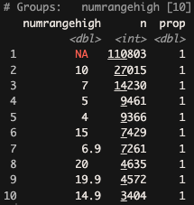
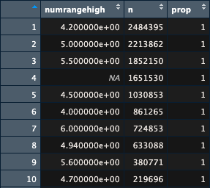
Correcting Data Integrity
TTG
If testvalue = NA, test assumed negative
If testvalue > numrangehigh, test positive
If numrangehigh = NA but numunitid != NA:
Calculated Mode of numrangehigh by numunitid
Applied Mode numrangehigh to datapoints with numunitid
TTG with outcome determined from mode_numunitid: n = 36,595
TSH with outcome determined from mode_numunitid: n = 551,235
If numrangehigh = NA & numunitid != NA:
Calculated Mode numrangehigh for all datapoints (See images right)
TTG testvalue >= 10 assumed positive
numrangehigh = 10 = ~27K/216K datapoints
TSH testvalue >= 4.2 assumed positive
numrangehigh = 4.2 = ~2.5M/12M datapoints
TSH

Slide 8
Cohort
Datapoints must:
Have either TTG or TSH test
Classified with Type 1 diabetes (Katie Young’s definition)
See Robust (and lengthy) classification algorithm
Basic Descriptives:
Observations (datapoints) n = 634,948
Patients (unique patid) n = 68,261
Diagnosed < 18 = 29,006

Slide 9
Basic Descriptives
DATAPOINTS | Positive | Negative
TTG (n = 207,818) | 8,245 (4%) | 199,573 (96%)
TSH (n = 634,626) | 66,601 (10.5%) | 568,025 (89.5%)
PATIENTS | Positive | Negative
TTG (n = 10,749) | 570 (5%) | 10,179 (95%)
TSH (n = 68,026) | 14,174 (21%) | 53,851 (79%)
“Quirk” of the data:
10-20x tests per patient?
Investigated 1 patient:
17 tests over life-time
Some tests (4 max) were on same day
Time between tests varied hugely: 0.37 years difference to ~6 years diff
Multiple tests on same day likely due to codelist:
“TSH 30 mins after Challenge”, “TSH 45 mins after Challenge”, “TSH 60 mins after Challenge”, etc.

Slide 10
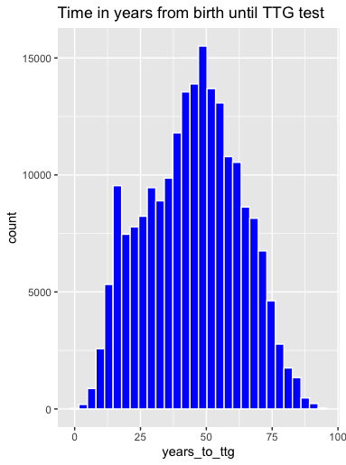
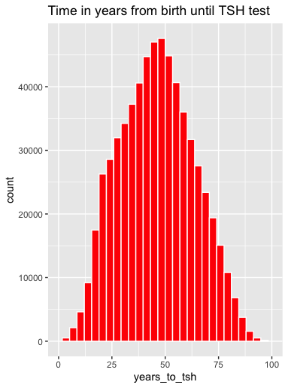
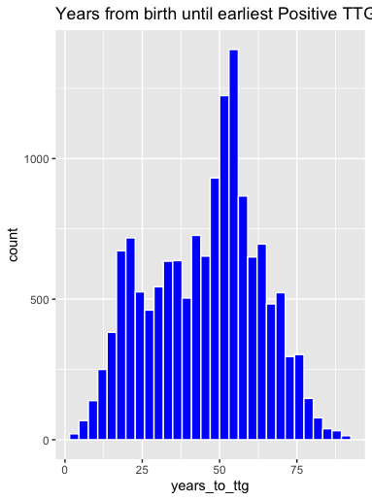
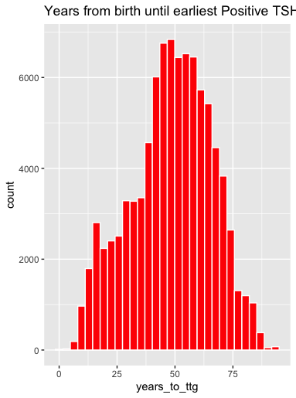
AGE at TTG/TSH Test
* ALL DATAPOINTS, multiple tests per patient
Earliest POSITIVE TTG/TSH tests

Slide 11
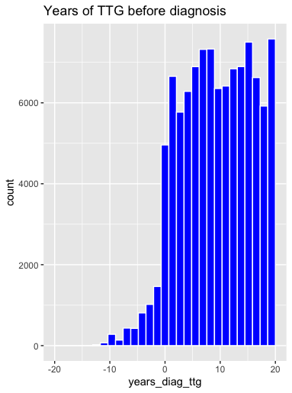
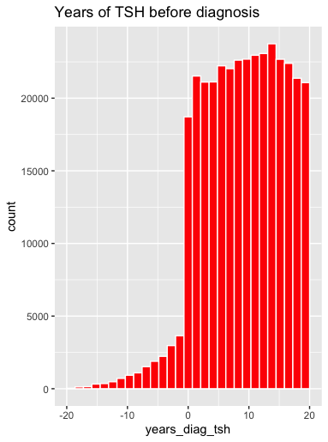
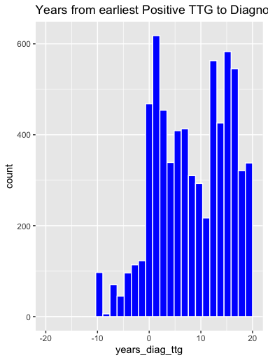
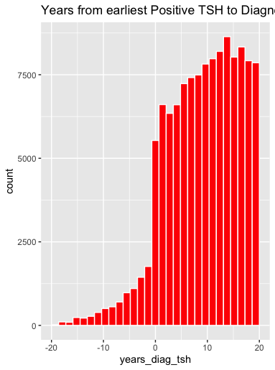
Time to TTG/TSH Test from DIAGNOSIS in Years
* ALL DATAPOINTS, multiple tests per patient
Earliest POSITIVE TTG/TSH tests

Slide 12
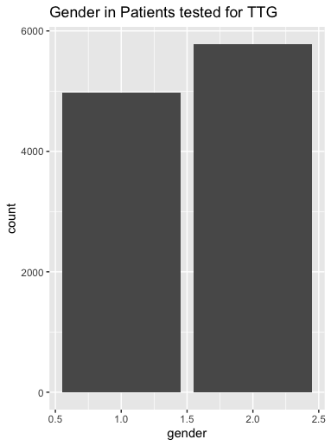
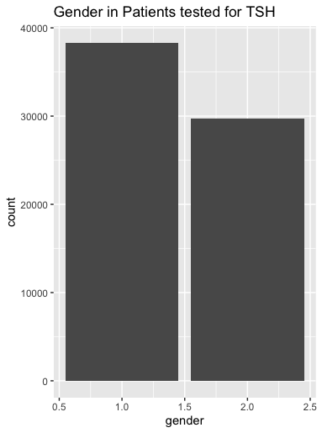
Gender by TTG/TSH !
1 = male
2 = female

