Slide 1
Summer BRC Internship

Slide 2
Code list creation
Created code lists:
Foot infections and ulcers
Gastroparesis
Retinopathy
Split into severe and non-severe
Vitreous haemorrhage
Quickly made this and checked number of observations to see whether it was minor enough to include within retinopathy code list

Slide 3
Using CPRD data to look at number of observations of retinopathy
Cohort | Any retinopathy code | Non-severe retinopathy code | Severe retinopathy code | Severe retinopathy code and no non-severe code
Entire cohort | 829075 | 823977 | 67929 | 5098
Diabetes (T1 and T2) cohort | 800770 | 796050 | 66073 | 4720
Created tables of the cohort’s earliest non-severe and severe retinopathy code
And looked at how many patients had only one code for non-severe and severe retinopathy (271012 and 31612 respectively)

Slide 4
Survival Analysis
Learned what survival analysis is and how to conduct it
Censoring
Kaplan-Meier curves
Cox proportional hazards models
Stepwise model selection
Looked at time from diabetes diagnosis to earliest non-severe retinopathy code
Read up on each of the covariates to find out what was expected

Slide 5
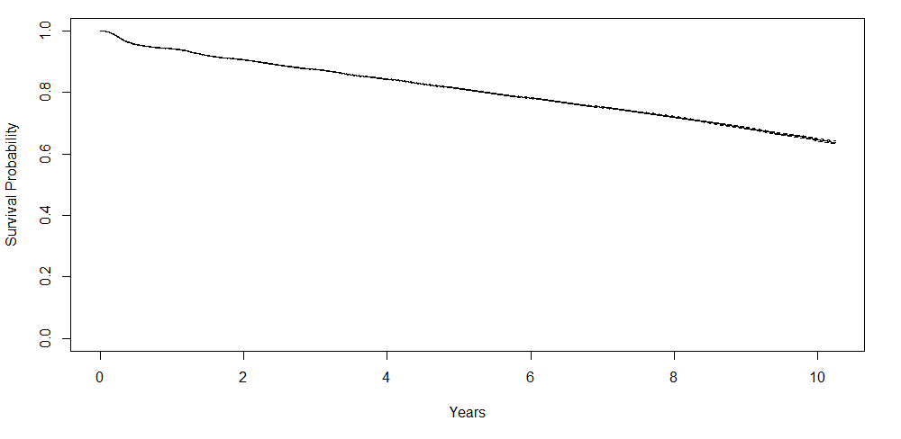
Kaplan-Meier survival curve: Time from diabetes diagnosis to non-severe retinopathy code

Slide 6
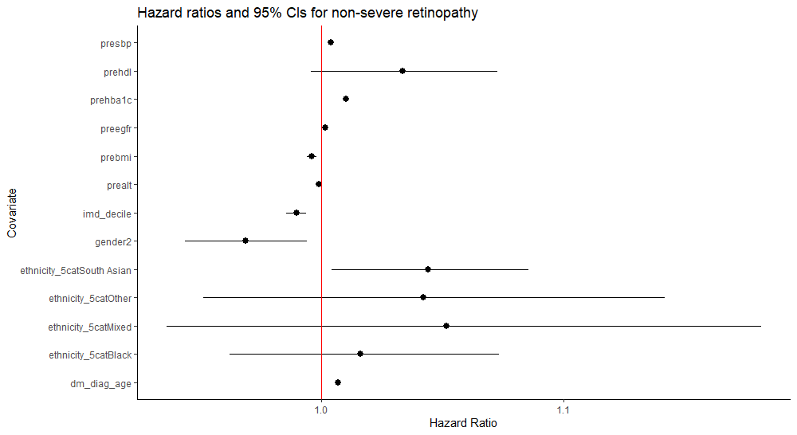
Results of Cox proportional hazards model for non-severe retinopathy

Slide 7
Cox proportional hazards model results for non-severe retinopathy
Covariate | Hazard Ratio | Lower CI | Upper CI | P value
Age at diagnosis | 1.0069759 | 1.0056 | 1.0084 | < 2e-16
Gender | 0.9687688 | 0.9441 | 0.9941 | 0.01587
Ethnicity – South Asian | 1.0441988 | 1.0044 | 1.0856 | 0.02926
Ethnicity – Black | 1.0163023 | 0.9624 | 1.0733 | 0.56117
Ethnicity - Other | 1.0422180 | 0.9515 | 1.1416 | 0.37333
Ethnicity – Mixed | 1.0517938 | 0.9365 | 1.1813 | 0.39396
IMD decile | 0.9897812 | 0.9856 | 0.9940 | 2.18e-06
HbA_{1c} | 1.0103033 | 1.0098 | 1.0109 | < 2e-16
BMI | 0.9961876 | 0.9943 | 0.9981 | 9.56e-05
eGFR | 1.0016262 | 1.0008 | 1.0025 | 0.00013
HDL | 1.0336024 | 0.9960 | 1.0727 | 0.08069
ALT | 0.9991194 | 0.9985 | 0.9997 | 0.00281
SBP | 1.0041727 | 1.0034 | 1.0049 | < 2e-16
* n = 167184, number of events = 27832

Slide 8
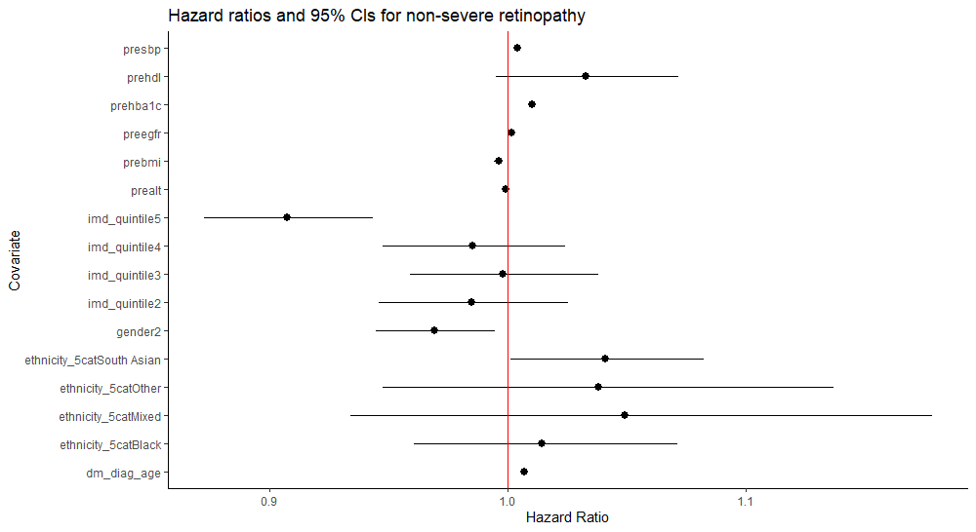
Results after coding gender and IMD (quintile) as categorical variables

Slide 9
Results after coding gender and IMD as categorical variables
Covariate | Hazard Ratio | Lower CI | Upper CI | P-value
Age at diagnosis | 1.0069462 | 1.0056 | 1.0083 | < 2e-16
Gender – female | 0.9691664 | 0.9445 | 0.9945 | 0.017283
Ethnicity – South Asian | 1.0408411 | 1.0011 | 1.0821 | 0.043783
Ethnicity – Black | 1.0144725 | 0.9606 | 1.0714 | 0.605931
Ethnicity – Other | 1.0379445 | 0.9476 | 1.1369 | 0.422786
Ethnicity – Mixed | 1.0488822 | 0.9339 | 1.1780 | 0.420494
IMD quintile – 2 | 0.9848117 | 0.9461 | 1.0251 | 0.454850
IMD quintile – 3 | 0.9978081 | 0.9590 | 1.0381 | 0.913558
IMD quintile – 4 | 0.9850278 | 0.9475 | 1.0240 | 0.446371
IMD quintile – 5 | 0.9073811 | 0.8727 | 0.9434 | 9.86e-07
HbA_{1c} | 1.0102981 | 1.0097 | 1.0109 | < 2e-16
BMI | 0.9961798 | 0.9943 | 0.9981 | 9.24e-05
eGFR | 1.0016402 | 1.0008 | 1.0025 | 0.000114
HDL | 1.0327821 | 0.9952 | 1.0718 | 0.088287
ALT | 0.9991197 | 0.9985 | 0.9997 | 0.002814
SBP | 1.0041610 | 1.0034 | 1.0049 | < 2e-16
* n = 167184, number of events = 27832

Slide 10
Unexpected results
An increase in age at diagnosis was associated with a (slight) increase in risk
Generally, research shows that people with earlier onset T2 are at a greater risk of developing diabetic retinopathy (DR)
An increase in social deprivation was associated with a decrease in risk
This actually wasn’t too unexpected after looking into it – deprivation can be a risk factor for late presentation of proliferative DR
Also, deprivation is associated with poorer retinopathy screening uptake

Slide 11
Unexpected results - biomarkers
An increase in BMI was associated with a (slight) decrease in risk
Generally, obesity is associated with increased prevalence of DR and an MR study even showed that genetically predicted BMI was linked to increased risk of DR
An increase in eGFR was associated with a (slight) increase in risk
Research shows that reduced eGFR tends to be associated with DR
An increase in HDL (good cholesterol) was associated with an increase in hazard (but it wasn’t significant)
Research seems to be somewhat mixed; some studies show that HDL is not an independent risk factor for DR, so the result isn’t too unexpected
An increase in ALT was associated with a (slight) decrease in risk
ALT is usually elevated in non-alcoholic fatty liver disease however this disease has not been found to be associated with DR; so result is not too unexpected

Slide 12
Stepwise model selection: Non-severe retinopathy
Used sequential replacement to assess the combination of covariates that created the best fitting model
The best model included all covariates except ethnicity both before and after coding gender and IMD as categorical:
Surv(time, event) ~ age at diagnosis + gender + IMD + HbA_{1c} + BMI + eGFR + HDL + ALT + SBP

Slide 13
Stepwise model selection: Non-severe retinopathy with categorical gender and IMD
Used sequential replacement again to assess the combination of covariates that created the best fitting model
Just as previously, the best model excluded ethnicity as a variable:
Surv(time, event) ~ age at diagnosis + gender + IMD quintile + HbA_{1c} + BMI + eGFR + HDL + ALT + SBP

