Slide 1


An Introduction to R
Q-Step Workshop – 09/01/2019
Lewys Brace
l.brace@Exeter.ac.uk

Slide 2
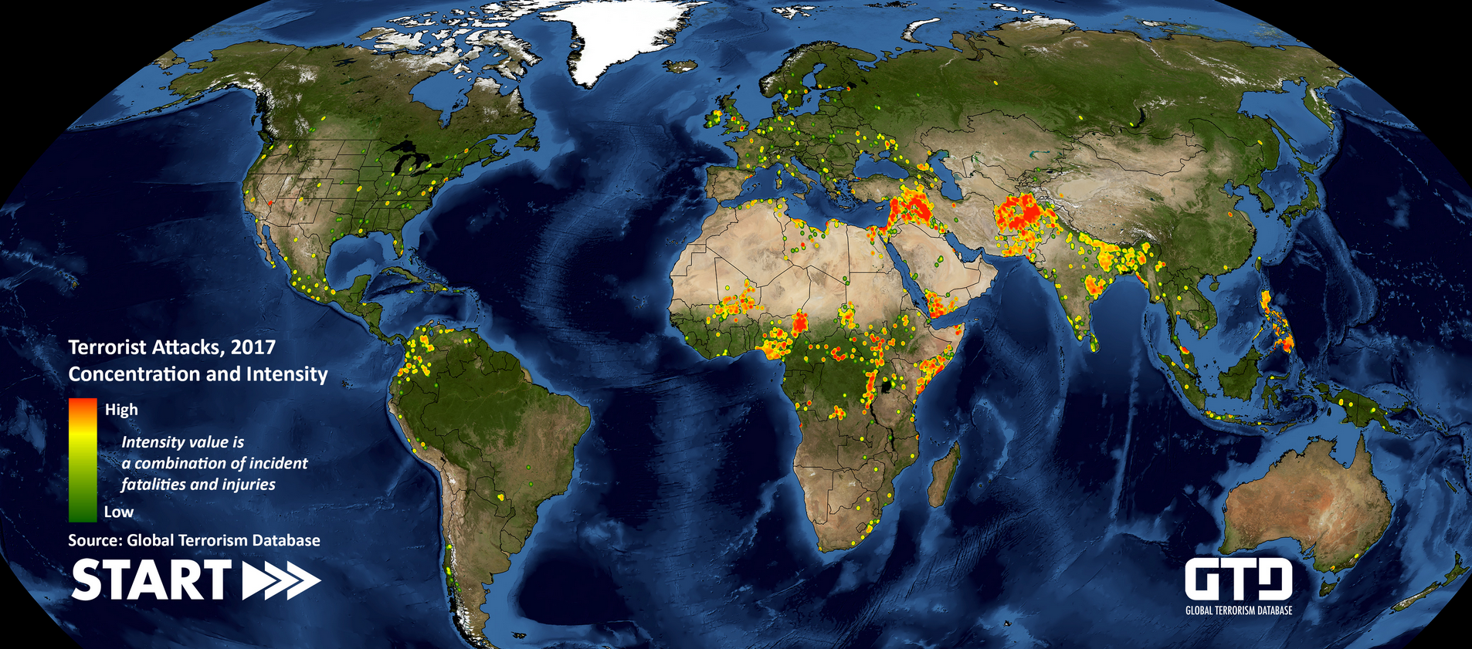
The Global Terrorism Database (GTD)
http://www.start.umd.edu/gtd/
Open-source database.
Includes terrorist events between 1970-2017 (annual updates).
Includes domestic and international incidents.

Slide 3


What is R?
An open-source package for statistical analysis.
Widely supported.
The initial ‘learning curve’ for R is steep, it is worth learning in the long run for a host of reasons.
You will get stuck at times, we all do.
Thus, your best friend will be….

Slide 4
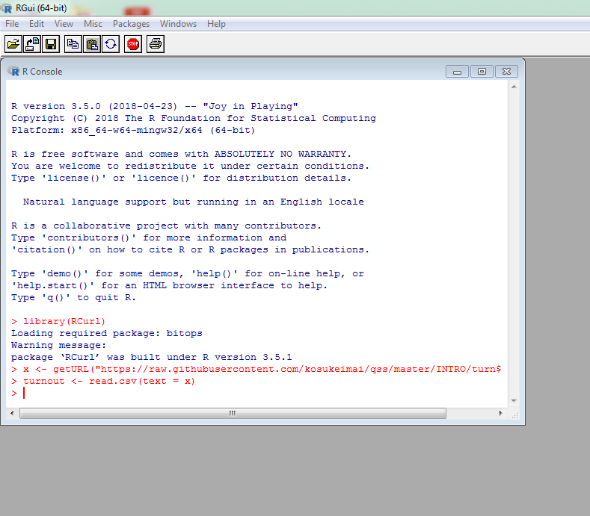
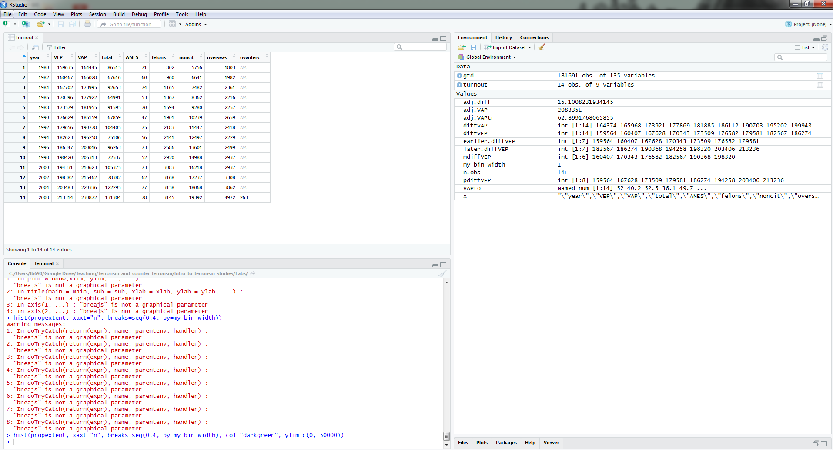
R and R Studio
R Can be downloaded from:
https://www.r-project.org/
R Studio can be downloaded from:
https://www.rstudio.com/products/rstudio/download/
Note: You will need to install base R before you can use R Studio.

Slide 5
Opening the dataset and loading it into R
First, unzip the folder and save the entire GTD as a csv file.
Then, we’ll load it into R.
This is most commonly done by:
Assignment operator
You can also load in data files in the following manner:
Load the complete GTD into R and assign it to the variable ‘entire_gtd’.

Slide 6
The dataframe
R has now loaded the csv data file and created a dataframe out of it.
These are commonly abbreviated to df.
It’s the default way that data-focused software deals with data.
For example:
Case ID | Variable one | Variable two | Variable 3
1 | 123 | ABC | 10
2 | 456 | DEF | 20
3 | 789 | XYZ | 30

Slide 7
Exploring a data set in R
R offers a lot of functions with which to explore datasets:
- summary(x) = Provide summary statistics for dataframe.
- head(x) = Displays the top 6 records in the dataframe.
- tail(X) = Displays the bottom 6 records of the dataframe.
- nrow(X) = Displays the number of rows in the dataframe.
- ncol(X) = Displays the number of columns (variables) in the dataframe.
- dim(X) = Returns the dimension of the dataframe (the number of rows and number of columns).
Note: in each command, replace X with the name of your dataframe or the column od data you’re interested in.

Slide 8
Exercise 2 - Exploring the dataset
We now have a dataset loaded into the R environment as a dataframe.
There are some natural questions to ask about these data:
1. What is the unit of analysis (what does each row represent)?
2. How many cases are in the dataset?
3. How many variables are in the dataset?

Slide 9
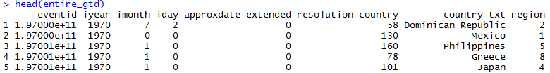
1. What is the unit of analysis?
So, the unit of analysis is terrorist events.
In other words, each row represents a different terrorist incident.

Slide 10
2. How many cases are in the dataset?
3. How many variables are in the dataset?
You could have equally done:

Slide 11

Exploring variables
You can use the $ symbol to address a single column (variable) in a dataframe:
Equally, you could use the attach() function, which then allows you to refer to a variable without having to reference the dataframe:

Slide 12
R has a number of different functions for exploring individual variables:
- min(X) = Displays the minimum value.
- max(X) = Displays the maximum value.
- sum(X) = Sums the input data range.
- mean(X) = Provides the arithmetic mean of the input range. Similar functions exist for the median, variance, std dev, etc.
- unique(X) = Displays all of the different values for the input data range.
- length(X) = Returns the number of non-missing records in a variable.
- which(X) = Returns the indices of elements that are TRUE, given a criteria

Slide 13

Logical operators:
== Is equal to
!= Is not equal to
> Greater than
< Less than
>= Greater than or equal to
<= Less than or equal to is.na(X) is a missing value
is.null(X) Is a null value
You can use logical operators in conjunction with some functions in order to explore data:
- How many non-missing observations do we have in ‘event id’?:
- Are any of the incident months greater than 12?:
- Which observations involve North America?:

Slide 14
Exercise 3 – Combining functions
1. Work out how many terrorist incidents took place in Egypt. - Hint: You may need to concatenate two functions.
- min(X) = Displays the minimum value.
- max(X) = Displays the maximum value.
- sum(X) = Sums the input data range.
- mean(X) = Provides the arithmetic mean of the input range. Similar functions exist for the median, variance, std dev, etc.
- unique(X) = Displays all of the different values for the input data range.
- length(X) = Returns the number of non-missing records in a variable.
- which(X) = Returns the indices of elements that are TRUE, given a criteria
Answer:

Slide 15

Exercise 4 – Bringing the basics together
1. Calculate the percentage of successful incidents and the percentage of unsuccessful incidents in the data set.
$$percentage= \frac{Total number of observations that fulfil criteria}{Total number of observations}∗100$$

Slide 16
Sub-setting data
Sometimes, you’ll want to look at a subset of the entire dataframe.
R’s subset function creates a new dataframe, which is a subset of the entire dataframe, in accordance with the conditions you specify.
For example, if we wanted to look at the GTD data just for Russia:
country | var2 | var3 | var4
Romania | 123 | 312 | 798
Romania | 536 | 123 | 753
Russia | 545 | 654 | 951
Russia | 666 | 456 | 645
Russia | 896 | 897 | 289
Rwanda | 235 | 448 | 143
Rwanda | 232 | 556 | 561
Country | Var2 | Var3 | Var4
Russia | 454 | 654 | 951
Russia | 666 | 456 | 645
Russia | 896 | 897 | 289

Slide 17
Graphical data exploration
Graphing data is one of the most important parts of data analysis, and is the first thing you should do after cleaning your data.
Graphing data offers a number of functions:
It allows your to explore your data, by allowing you to easily identify unusual values and often aiding in the decision of what kind of analysis to subject the data to.
Enables you to ensure that your chosen model is a realistic fit to the data.
Allows you to communicate the nature of your data by summarising numerical information.

Slide 18
Graphs for EDA
EDA should always be carried out prior to any formal statistical analysis.
EDA allows you to check your data for:
To ensure you have meaningful data.
Detect errors that were made during data entry.
To detect patterns in the data that may go undetected by the statistical analysis that you use.
To ensure that the assumptions of your data are met.
To interpret the departures from the assumptions.
To detect unusual values, which are known as ‘outliers’.
Graphing is the most important part of this exploration.

Slide 19
How to present data
Graphs should, among other things:
Show the data.
Induce the reader to think about the data being presented, rather than focusing on the graph itself; i.e. what colour the bars are, etc.
Avoid distorting the data.
Present many numbers with minimal ink.
Make large data sets, if that’s what you’re working with, coherent.
Encourage the reader to compare different pieces of data.
Reveal data.

Slide 20
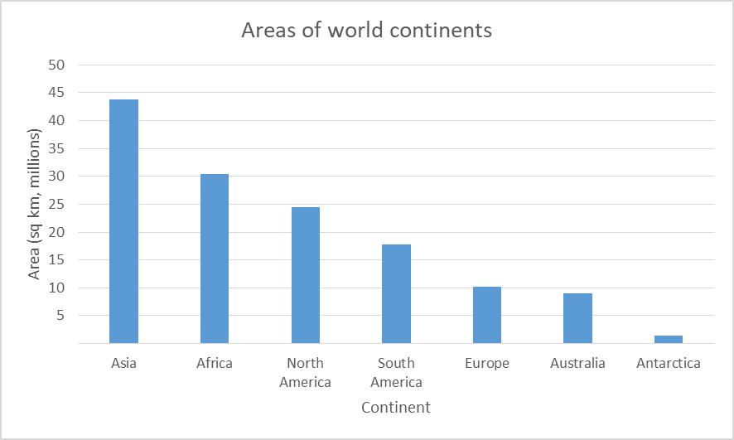
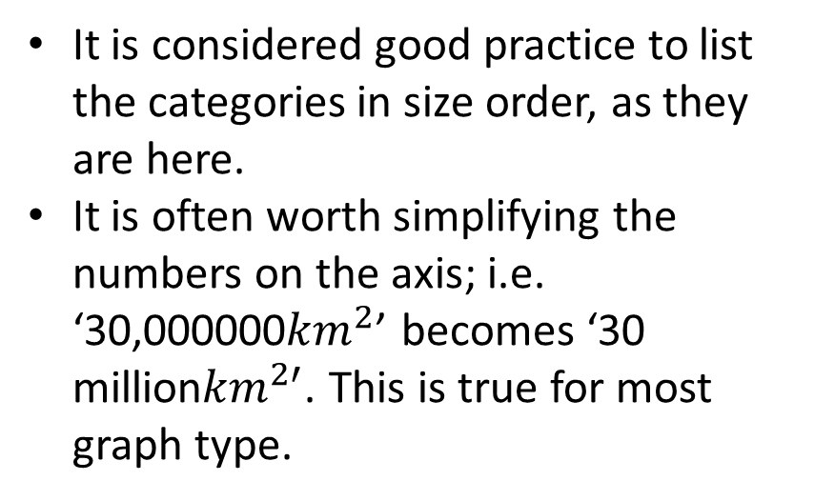
Bar charts
It provides an instant picture of the relative sizes of different categories.
It is considered good practice to list the categories in size order, as they are here.
It is often worth simplifying the numbers on the axis; i.e. ‘30,000000${km}^{2}$’ becomes ‘30 million${km}^{2′}$. This is true for most graph type.

Slide 21
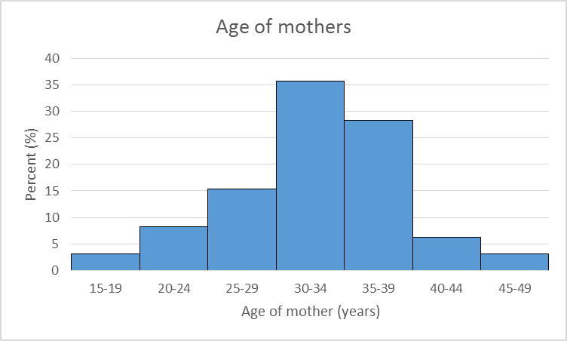
Histograms
Here, all of the bars are touching, indicating that horizontal axis represents a continuous number scale.
Often is to summarise a distribution.

Slide 22
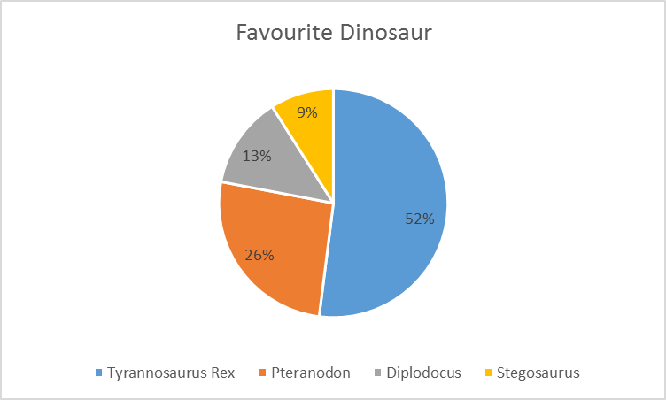
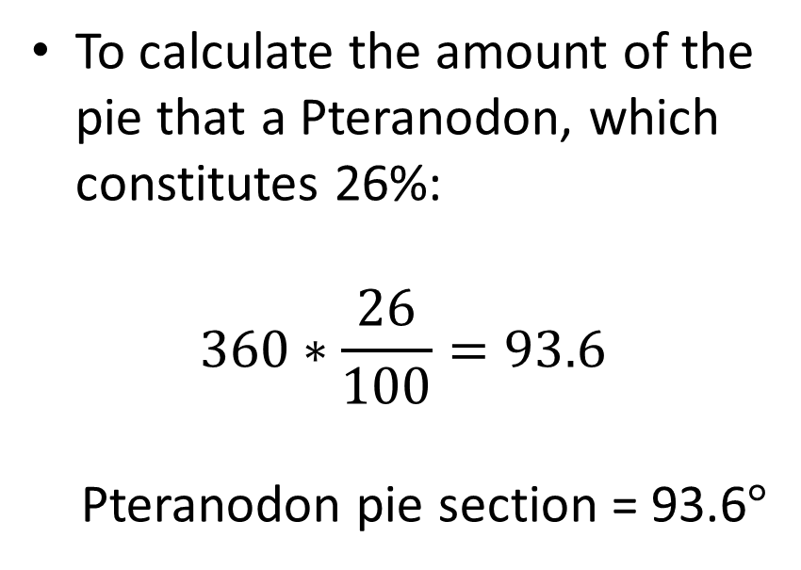
Pie charts
Frowned upon in some circles, but total valid if used correctly.
They are valid if you have a complete set, the component parts of which add up to 100% of the ‘pie’
To calculate the amount of the pie that a Pteranodon, which constitutes 26%:
$$360∗\frac{26}{100}=93.6$$ Pteranodon pie section = 93.6$°$

Slide 23
Choosing the correct graph
Three things to consider when deciding which graph to use:
The type of data being represented.
The type of statistical judgement which you hope the graph will help you to make.
And…

Slide 24
Discrete and continuous data
Discrete:
Investigation | Typical items of data
Types of wildflower | Bluebell, marigold, meadow-sweet
Household size | 1 person, 2 people, 3 people, 4 people
Environmental problems | Oil spills, acid rain, dog fouling
Vehicle colour | Red, green, blue
Continuous:
Investigation | Typical items of data
Babies’ birth weight | 3120g, 3760g, 2700g
Temperature survey | 18.6◦c, 21.4◦c, 19.0◦c
Survey of commuting times | 23 mins, 11 mins, 70 mins

Slide 25
Types of data
Categorical (entities are divided into distinct categories):
Binary variable (There are only two categories (i.e. dead or alive).
Nominal variable: There are more than two categories (i.e. whether someone is an omnivore, vegetarian, vegan, or fruitarian).
Ordinal variable: -The same as a nominal variable, but the categories have a logical order (i.e. whether a student got a fail, pass, merit, or distinction in an exam).
Continuous (entities get a distinct score):
Interval variable: Equal intervals on the variable represent equal differences in the property being measured (i.e. the difference between 6 and 8 is equivalent to the difference between 13 and 15).
Ratio variable: The same as an interval variable, but the ratios of scores on the scale must also make sense (i.e. a score of 16 on an anxiety scale means that the person is, in reality, twice as anxious as someone scoring 8).

Slide 26
Class test
Data item | Type of data: D or C?
M27, M5, M1
1929, 1930, 1931
1.2m, 1.3m, 1.4m
4.5, 4.6, 4.7
Ant, Butterfly, Bee
Discrete
Continuous
Continuous
Continuous
Discrete

Slide 27
Graphs in R
R has a base graphics package.
But ggplot2 is the library that most people use when graphing in R.
This involves becoming familiar with R packages.

Slide 28

R packages
Check which libraries are already installed:
installed
In:
Out:
ggplot2 is installed automatically as part of the default R installation.
Not all packages are loaded during R start up; ggplot2 is one of these.
loaded
We load a package into R by:

Slide 29
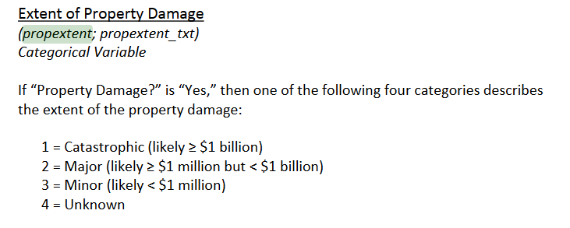
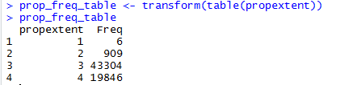
Frequency table
The propextent variable measures the amount of property damage that resulted from a terrorist incident.
For data like these, sometimes the easiest way to get an understanding of what is being shown is through a frequency table:
This is useful, but sometimes we require a graphical representation of this information.

Slide 30
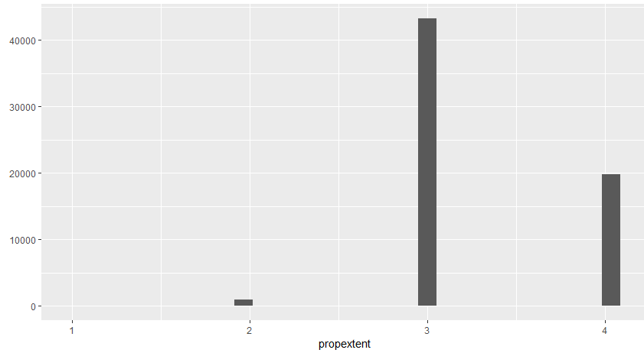
Histograms
Histograms are a great way to visualise the frequency distribution of a variable.
Creating histograms in R is easy and done with the hist() function.
What is the problem with this graph?

Slide 31
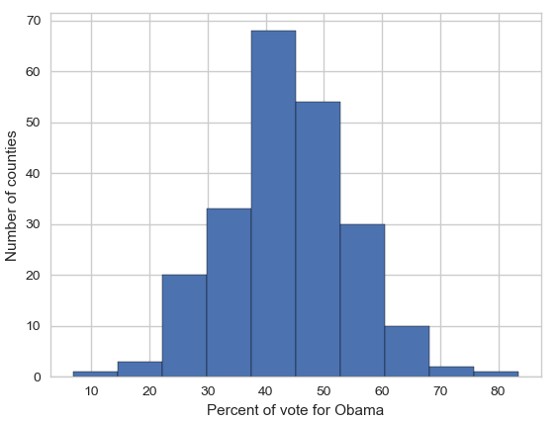
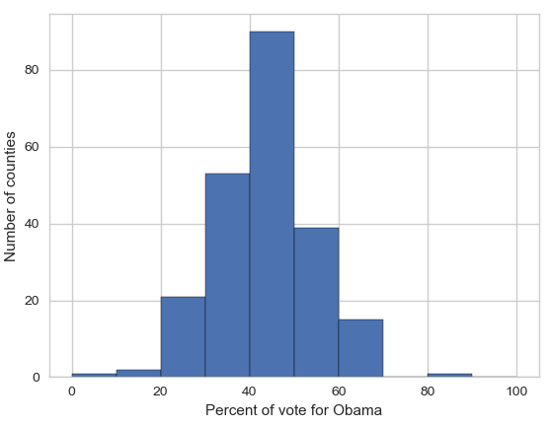
Bins
This is because R is using its default bins, which aren’t quite right for the data we’ve used as input.
Binning is important to think about when producing histograms in any language.
As an example, the two histograms below show the exact same data, but the graphs have different bin values.

Slide 32
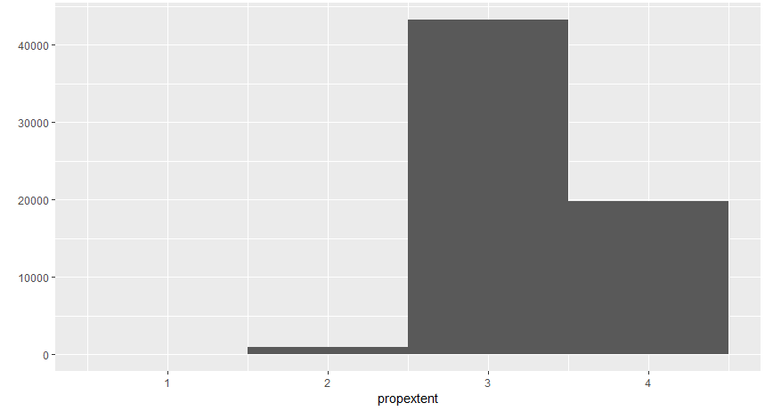
So, we re-run the piece of code we just created, but this time, we specify the bin width:

Slide 33
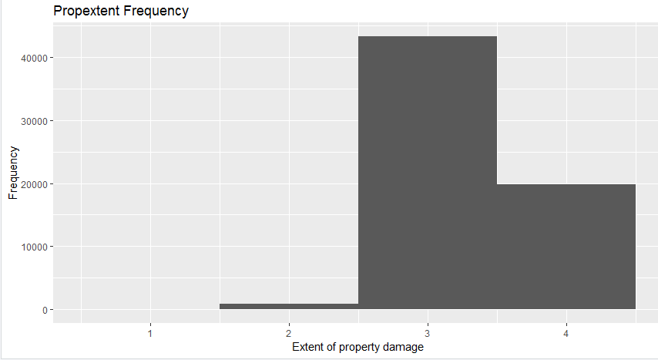
Let’s add a title and customise the x and y axis labels:

Slide 34
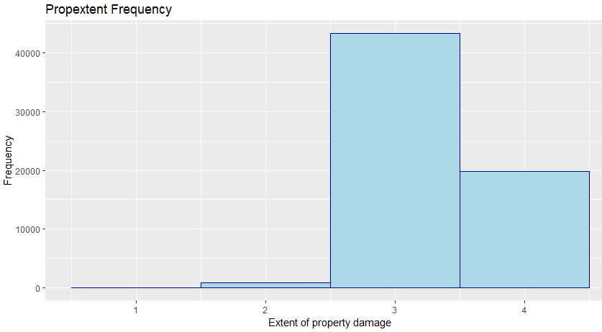
Making it pretty

Slide 35
Summarising
A crucial human skill is to be selective about the data that we choose to analyse and, where possible, to summarise this information as concisely as possible.
There are two useful questions to think about when summarising data:
1. What is a typical, or average, value of the data?
2. How widely spread out are the data values?

Slide 36
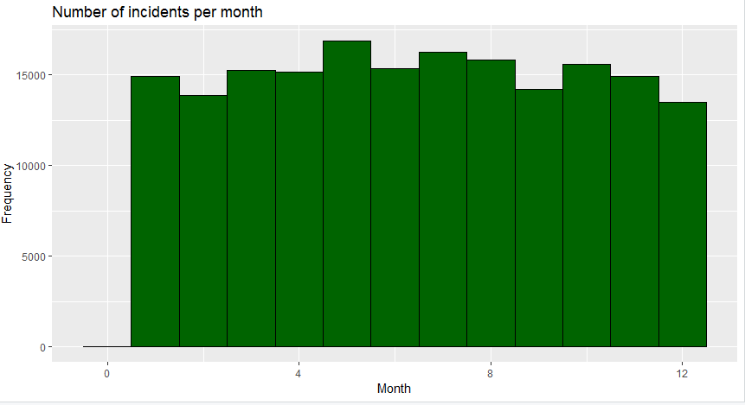
A distribution of incidents over months

Slide 37
What is a distribution?
For now, think of a distribution as just a set of measurements, numbers, or data points.
We could talk about a distribution as being the result of a game of heads and tails being played multiple times; i.e. the results obtained when tossing a coin many times.
Another distribution might be the final exam scores of every student in a particular school system.
A third would be the predictions of global population in 2100 from 50 runs of a demographic simulation, each with a different random seed value.

Slide 38
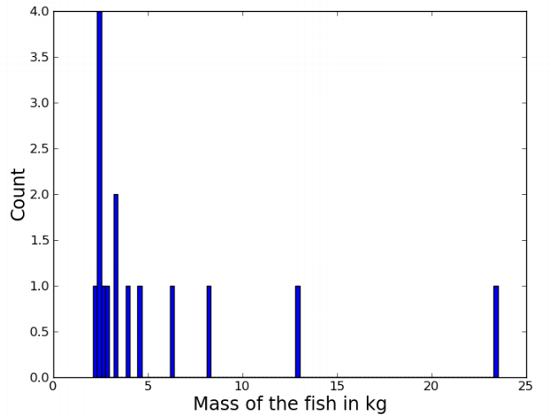
An example
Let's grab a sample distribution to work with:
[ 2.1, 2.4, 2.4, 2.4, 2.4, 2.6, 2.9, 3.2,
3.2, 3.9, 4.5, 6.3, 8.2, 12.8, 23.5]
These 15 numbers could be anything.
Let's say that they represent the mass in kilograms of some fish we've caught from a specific location.
Note that our scales are accurate to the nearest 100g.

Slide 39
Questions to ask about the distribution
Some natural questions to ask about any distribution are:
What's a typical score?
What's the range of the scores?
How spread-out are the scores?
Are the scores distributed evenly/symmetrically?

Slide 40
What is a typical score?
How heavy is a typical fish? In other words, where do our fish mass scores tend to cluster on the number line?
We need a number to represent the ‘middle’ score, or a measure of central tendency.
Options include:
- The mean, also known as the average, or the arithmetic mean.
- The median, the middle score in the range of data.
- The mode, the most frequently occurring score.

Slide 41
The mode
The mode is merely the data value that is most common, or most frequent, in the data set.
In our fish example: 2.1, 2.4, 2.4, 2.4, 2.4, 2.6, 2.9, 3.1, 3.2, 3.9, 4.5, 6.3, 8.2, 12.8, 23.5
mode = 2.4

Slide 42


Calculating mode in R
R doesn’t have a built in function for calculating the mode.
We therefore create a function to do it for us.
If there is a calculation that you know you’re going to have to do regularly, creating a function to do it for you is a great time saver.
You can call a function that you created the same way in which you call the built-in R functions:

Slide 43
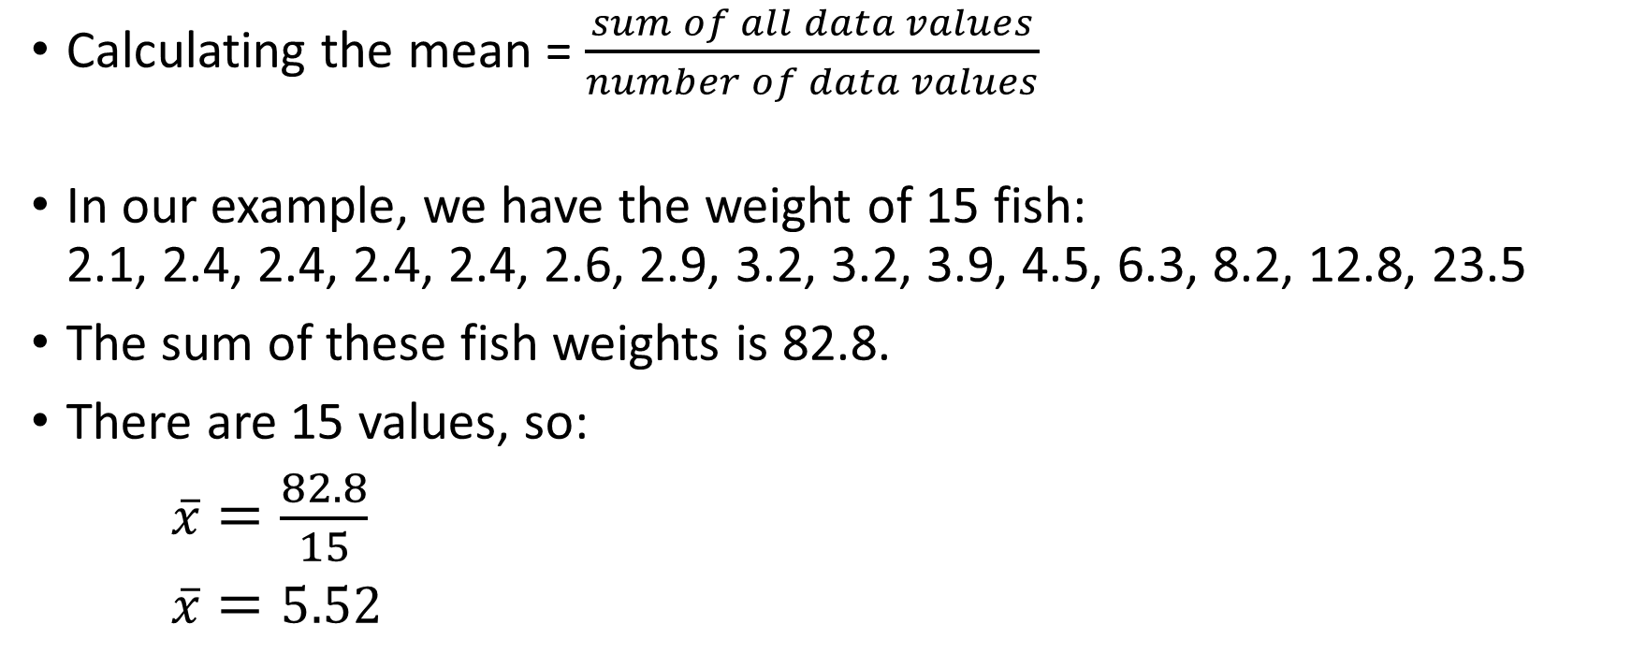

The mean ($\overline{x}$)
Calculating the mean = $\frac{sum of all data values}{number of data values}$
In our example, we have the weight of 15 fish: 2.1, 2.4, 2.4, 2.4, 2.4, 2.6, 2.9, 3.2, 3.2, 3.9, 4.5, 6.3, 8.2, 12.8, 23.5
The sum of these fish weights is 82.8.
There are 15 values, so:
$\overline{x}=\frac{82.8}{15}$
$\overline{x}=5.52$

Slide 44
Calculating the mean in R
The mean can be calculated easily in R with the mean() function.
Remember, we first want to make sure that we don’t have any missing values in the data we are exploring:
When printing the value to the screen, you can use the prettyNum() function to make the result more readable:

Slide 45
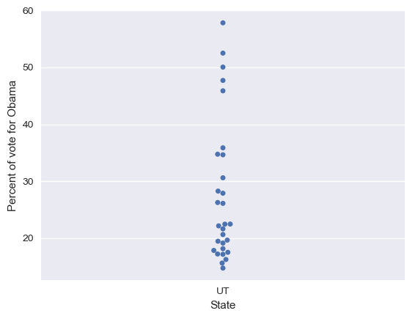
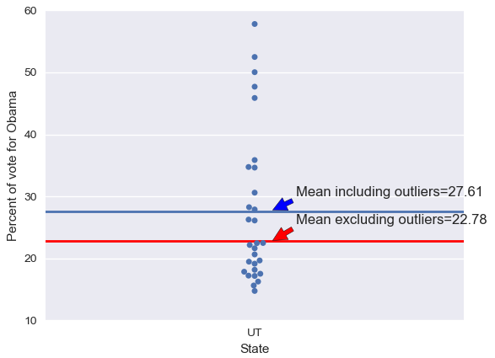
Outliers
Outliers are data points whose value is far greater or far less than the rest of the data points.
If we take a look at the data set on the right, we see that there are 5 outliers.
Outliers, or extreme values, heavily influence the value of the mean.

Slide 46
The median
To calculate the median, order all data values in regards to their values from smallest to largest. The median value is then the middle value in the range of scores.
In our fish example: 2.1, 2.4, 2.4, 2.4, 2.4, 2.6, 2.9, 3.1, 3.2, 3.9, 4.5, 6.3, 8.2, 12.8, 23.5
median = 3.1

Slide 47
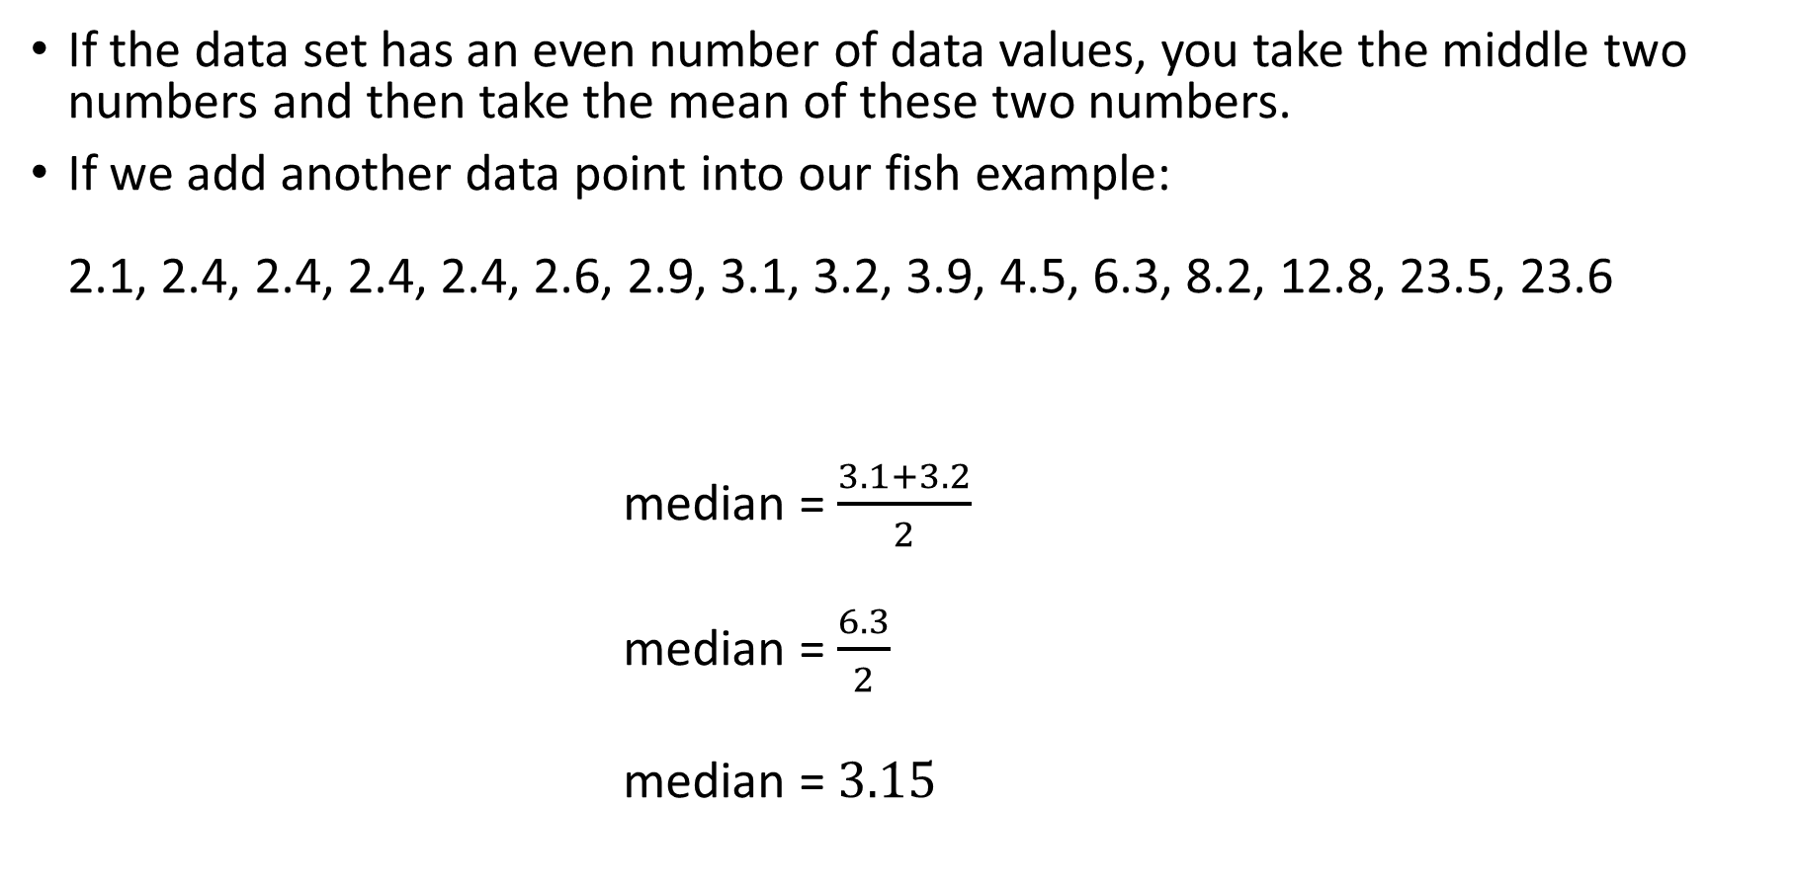
If the data set has an even number of data values, you take the middle two numbers and then take the mean of these two numbers.
If we add another data point into our fish example: 2.1, 2.4, 2.4, 2.4, 2.4, 2.6, 2.9, 3.1, 3.2, 3.9, 4.5, 6.3, 8.2, 12.8, 23.5, 23.6
median = $\frac{3.1+3.2}{2}$
median = $\frac{6.3}{2}$
median = $3.15$

Slide 48
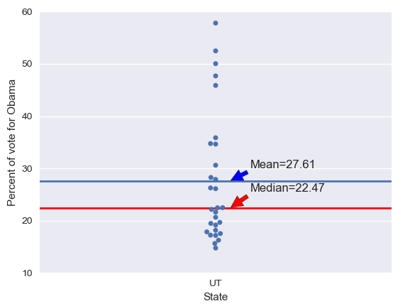

Calculating the median in R
We can see here that the median is not ‘tugged up’ by the 5 outliers because it is immune to extreme outliers.
This is because the median is calculated in regards to the relative positon of the data points and not the data values themselves.
Calculating the median in R is done in the same way as the mean:

Slide 49
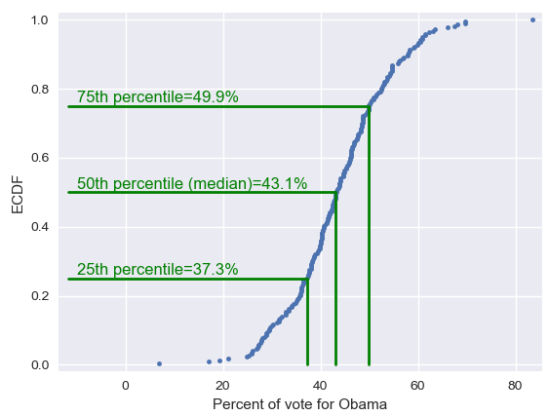
Percentiles
The median is a special name for the 50th percentile.
This means that 50% of the data are less than the median.
Similarly, the 25th percentile is the data point that is equal to 25% of the data.
And so on for 75th percentile, etc.

Slide 50
Percentiles are useful summary statistics.
They can easily be computed in R with the summary() function:
We now have three summary statistics.
However, the point of summary statistics is to keep things concise, but we are starting to get a lot of different numbers here.
This is where quantitative EDA meets graphical EDA.

Slide 51
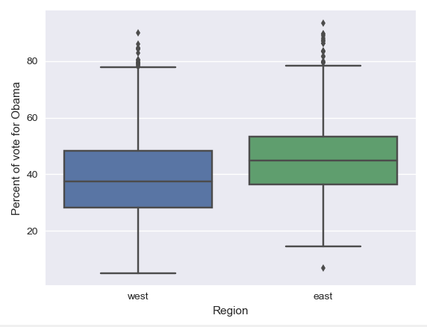
Box plots
These were invented by John Tukey in order to display salient features of a dataset based on percentiles.

Slide 52
What does a box plot show?
Interquartile range (IQR) = middle 50% of the data.
Outliers
The whiskers extend a distance of 1.5 times the IQR, or the extent of the data; whichever is less extreme.
1.5 IQR
75th percentile
50th percentile (median)
IQR
25th percentile
All points outside of the whiskers are plotted as individual points, which is the common criterion for defining an outlier.
Extent of data

Slide 53
Plotting a box plot in R
Ensure that ggplot2 is in your working space:
We need some data to plot. Here we’ll is the ‘imonth’ variable again.
It’s easier to plot a dataframe than a vector, so we convert our variable of interest into a df:

Slide 54
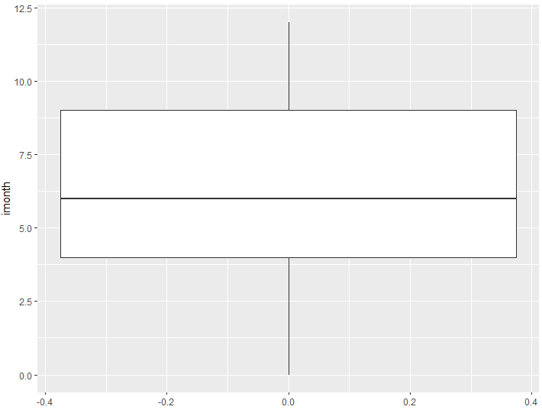
We then feed in the df to the following command:
Where to get the data from
Which column of the df do you want too plot?
We want a box plot.

Slide 55
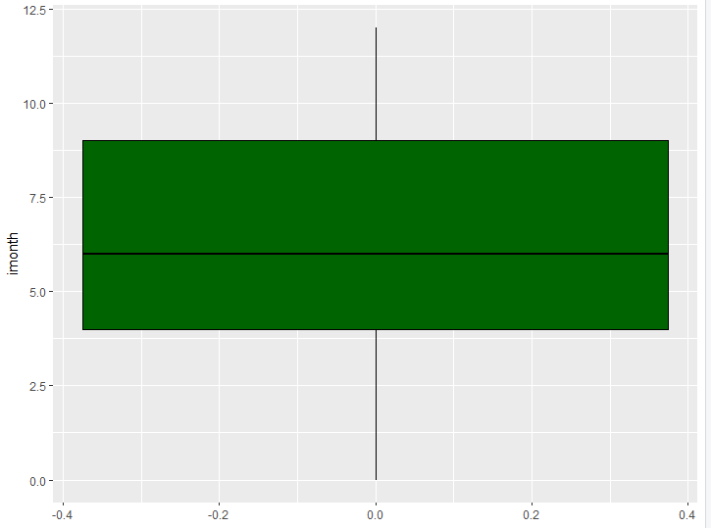
Making it pretty

Slide 56
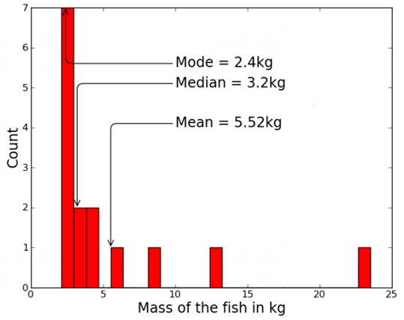
So… Which measure is best?
There's no perfect way to report the central tendency of a distribution. Each of the measures tell us something.
The median (central score) is a good all-purpose measure, and is not overly influenced by values at the extremes.
The mean is very popular because of some of its mathematical properties, as we will see later on. But it's very sensitive to outliers (extreme values).
As another example, look what happens if the last fish in our fish distribution is a 235kg monster.

Slide 57
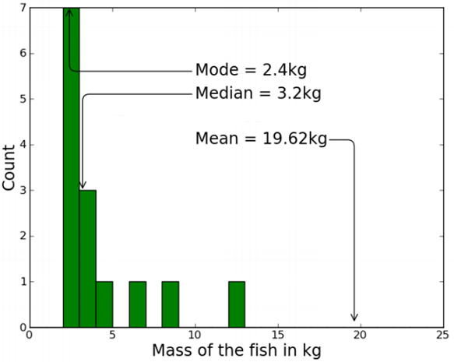

Slide 58
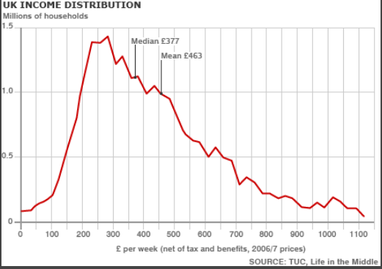
If the distribution is lop-sided, as for income (below) and our fish weights example, the median "feels better" as a measure of typicality.
But the mean is the expected value of the distribution: useful if we want to calculate the expected tonnage of 1000 fish.

Slide 59
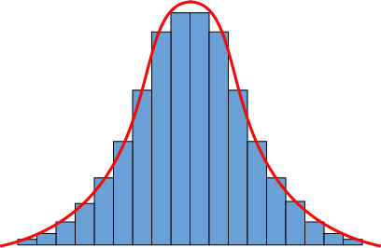
The mean is not "in the middle"
There is a common misconception that confuses the mean with the median in everyday language:
"You know how stupid the average person is? Well, 50% of people are dumber than that!"
Not necessarily so!
Mean and median are roughly equal in symmetrical distributions (right), but if intelligence is distributed in a lop-sided way (previous slide), it will be either more or less than 50% of people who are "dumber than average".

Slide 60
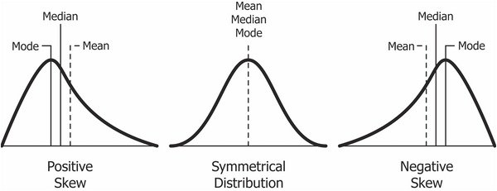
Skewness
Skewness refers to the direction and degree of lop-sidedness in a distribution. Think of a left- or negative-skewed distribution as "right-walled", and vice versa.
A common reason for a right-skewed distribution is when the values are bounded by zero at one end, e.g., for our fish weights, or for the duration of some event.
Normal distribution. Also known as the bell curve.

Slide 61
Measuring variation
It's also natural to ask how wide a distribution is. In other words, how spread-out are the scores? How much variation is there?

Slide 62
The range
We could note the minimum and maximum values: between 2.1kg and 23.5kg in the fish case.
Using these values, we see that there is 21.4kg difference between the two values.
This is called the range.
It’s not a terrible summary of the spread in the fish data, but like the mean, the range is obviously very sensitive to extreme values.

Slide 63
Calculating the range in R
Done in the same manner as calculating the mean, median, etc.

Slide 64
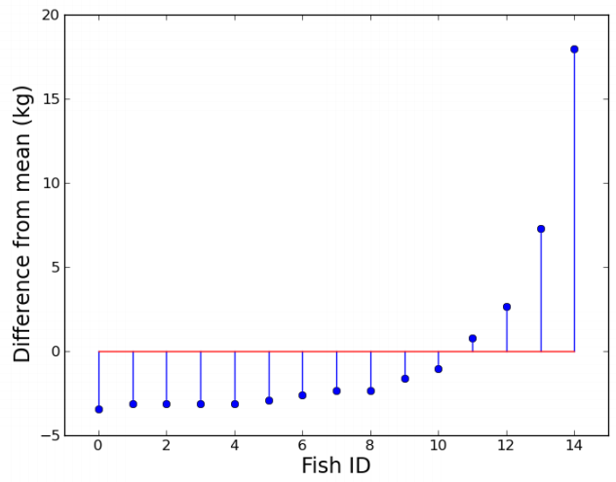
We could be a bit more sophisticated, and start looking at how far our scores differ from the mean.
If we take each fish weight from our example, and subtract the mean of 5.52 from them, we get this new distribution of differences from the mean:
[ -3.42, -3.12, -3.12, -3.12, -3.12, -2.92, -2.62, -2.32, -2.32, -1.62, -1.02, 0.78, 2.68, 7.28, 17.98 ]
Could we use the average of these numbers to describe how much the distribution varies?

Slide 65
Average distance from the mean?
The trouble is that the average distance from the mean is always zero, because the sum of the differences from the mean is zero. (Implicit in the definition of the mean.)
OK, so ignore the signs and take the absolute value of the differences. After all, distance is not usually treated as a signed quantity...
This can work. In the fish case, we get a value of 3.83.
[ -3.42, -3.12, -3.12, -3.12, -3.12, -2.92, -2.62, -2.32, -2.32, -1.62, -1.02, 0.78, 2.68, 7.28, 17.98 ]
[ -3.42, -3.12, -3.12, -3.12, -3.12, -2.92, -2.62, -2.32, -2.32, -1.62, -1.02, 0.78, 2.68, 7.28, 17.98 ]

Slide 66
So, on average, a particular fish we catch is 3.83kg away from the overall average of the distribution.
This is known as the average absolute deviation.
It is a sensible-enough measure of variation, but it's not one that is popularly used.

Slide 67
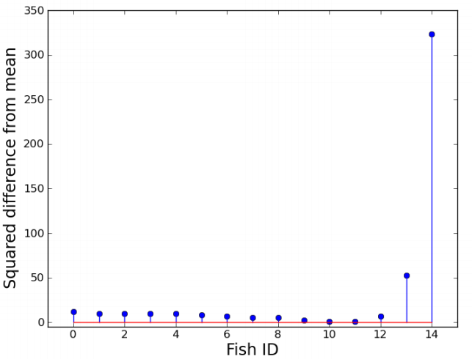
The variance
Another way of getting around the average-deviation-adds-to-zero problem is to take the squares of the deviations.
This move turns out to have a lot of useful properties.
If we take the average of these squared differences from the mean, this is called the variance.
In the fish case, the variance is 30.97.

Slide 68
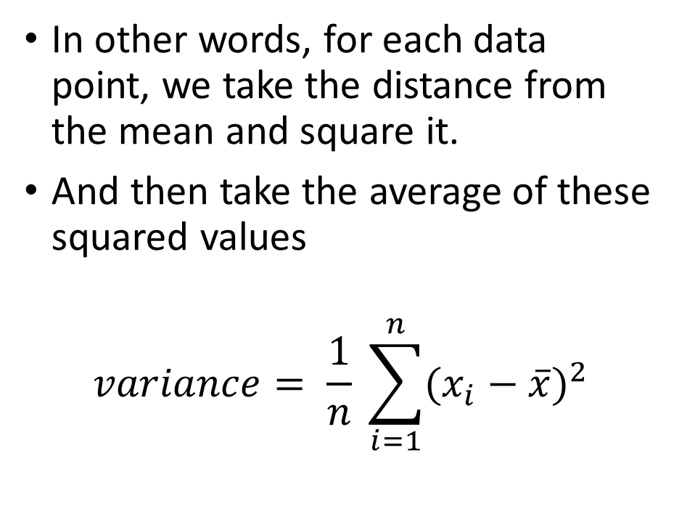
Calculating the variance
In other words, for each data point, we take the distance from the mean and square it.
And then take the average of these squared values
$$variance= \frac{1}{n} \sum_{i=1}^{n}{(x_{i}−\overline{x})^{2}}$$
Distance from the mean

Slide 69
Calculating the variance in R
Done the same was as the mean and median:

Slide 70
This is a good measure of variation: if someone else's fish catch had a variance of 40, we would know that their fish weights were more spread-out than ours.
However, the variance is in the odd unit of kilograms squared...

Slide 71
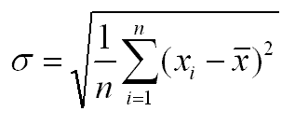
The standard deviation
We solve this problem by taking the square root of the variance to get a new measure called the standard deviation.
We are now back in the familiar units of kilograms.
The standard deviation in the fish case is 5.56kg, a bit higher than the mean absolute deviation of 3.83kg.
The standard deviation is by far the most popular measure of variation in a distribution.

Slide 72

Calculating std dev in R.
Done the same was as the mean, median, and variance:

Slide 73
Any questions?

