Slide 1


Introduction to SQL for Data Science
Q-Step Workshop – 20/03/2019
Lewys Brace
l.brace@Exeter.ac.uk

Slide 2
Introduction
The role of a data scientist is to turn raw data into actionable insights.
Much of the world's raw data, such as electronic medical records and customer transaction histories, lives in organized collections of tables called relational databases.
Therefore, to be an effective data scientist, you must know how to wrangle and extract data from these databases using a domain-specific language called SQL (Structured Query Language).

Slide 3
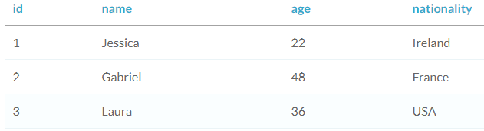
Relational databases
You can think of a relational database as a collection of tables.
A table is just a set of rows and columns, like a spreadsheet, which represents exactly one type of entity; i.e. a table might represent employees in a company or purchases made, but not both.
Each row, or record, of a table contains information about a single entity; i.e. in a table representing employees, each row represents a single person.
Each column, or field, of a table contains a single attribute for all rows in the table; i.e. in a table representing employees, we might have a column containing first and last names for all employees.

Slide 4
The practice database
For this course, we are going to be writing and implementing our SQL code within Microsoft Access.
We’ll be using a database that details various aspects of different dinosaur species.
This database can be downloaded from https://github.com/LewBrace/Q-Step_SQL_workshop.
Download and open this database

Slide 5
Selecting a single column
While SQL can be used to create and modify databases, the focus of this course will be querying databases.
A query is a request for data from a database table, or combination of tables.
Querying is an essential skill for a data scientist, since the data you need for your analyses will often live in databases.

Slide 6
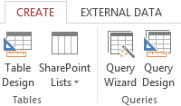

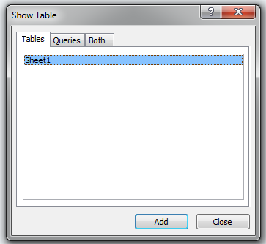
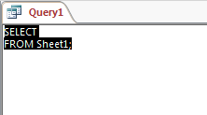
Opening the SQL editor
1
5
2
6
The SQL View Object tab has made the (very rational) assumption that you want to retrieve some information from the Sheet1 table, so it has written the first part for you. It doesn’t know exactly what you want to retrieve, so it displays only the part it feels confident about.
3
4

Slide 7


Selecting a single column
In SQL, you can select data from a table using a SELECT statement; i.e. the following query selects the Species column from the Sheet1 table.
The semi-colon tells SQL where the end of your query is.
In SQL, SELECT and FROM are keywords.
Keywords in SQL are not case-sensitive, which means that the following would also work.
However, convention dictates that writing keywords in uppercase is `best practice’.

Slide 8
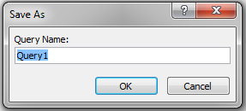

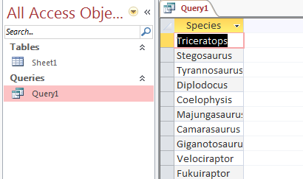
Once you’re done coding your query, save it.
1
2
Your query can then be executed by clicking on the corresponding query tab in the left-hand panel.
3

Slide 9

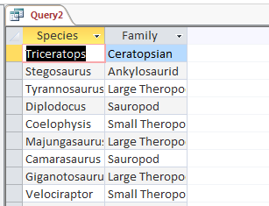

Selecting multiple columns
Selecting multiple columns is easy enough.
Just add the extra column names to the code, separated by commas.
In:
Out:
You can select all columns in a table by using *.
In:
Out:

Slide 10

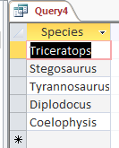
Retrieving a range of records
You can run a query for the top x rows of data by using the SELECT TOP keyword.
In:
Out:

Slide 11

The DISTINCT keyword
If your data includes duplicate values and you only want to return all of the unique values from a column, you can use the DISTINCT keyword.

Slide 12


Counting
You can count the number of rows in your table by using the COUNT keyword; i.e. count the number of species.
In:
Out:

Slide 13




While COUNT(*) tells you the number of rows in a table, if you want to know the number of non-missing values in a specific column, you can use COUNT.
This is useful if you have missing values in one or more of your columns.
In:
Out:
It’s also common to combine COUNT with DISTINCT to count the number of distinct values in a column.
In:
Out:

Slide 14

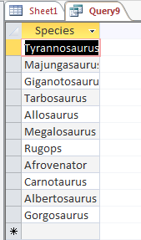
Filtering results
The WHERE keyword allows you to filter your results based on their values.
Operators: = Equal to
<> Not equal < Less than
> Greater than <= Less than or equal to >= Greater than or equal to
In:
Out:

Slide 15


Filtering by numerical values
Using the COUNT keyword, it is also possible to count the number of records that fulfil a specific criteria.
In:
Out:

Slide 16

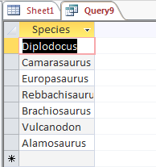
Filtering by text
The WHERE keyword also enables you to filter by text values.
In:
Out:

Slide 17

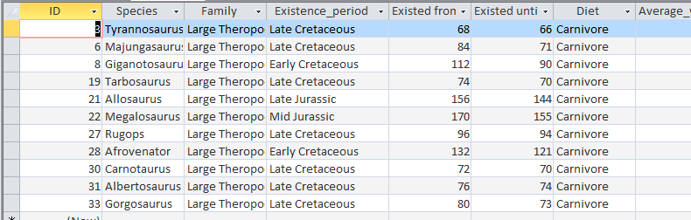
Selecting data based on multiple conditions
You may need to select data based on multiple conditions.
You can do this by combining your WHERE queries with the AND keyword.
In:
Out:

Slide 18



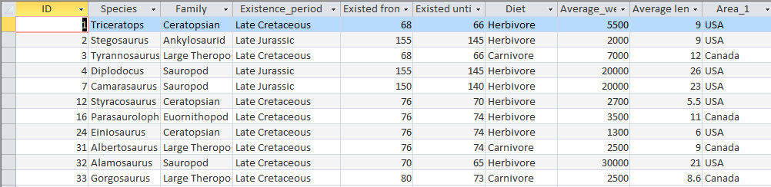
The OR keyword
If you wanted to select rows based on multiple conditions where some but not all of the conditions need to be bet, you can use the OR keyword.
In:
Out:
When using AND and OR, ensure that you enclose the individual clauses in parentheses.
In:
Out:

Slide 19

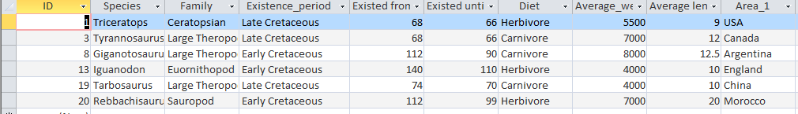
The BETWEEN keyword
If you wanted to get the records where the average weight is between two values, you don’t have to use < and >.
Instead, you can use BETWEEN.
In:
Out:

Slide 20

You can use the BETWEEN keyword with multiple clauses in the same way you use the WHERE keyword.
In:
Out:

Slide 21

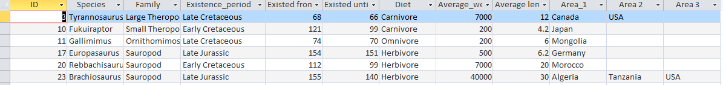
The IN keyword
If you want to select rows based upon three or more different values from a single column, the WHERE keyword can start to become unwieldly.
This is where the IN keyword comes in useful.
In:
Out:

Slide 22

NULL and IS NULL
NULL represents a missing or unknown value.
You can check values using the expression IS NULL.
The IS NULL is useful when combined with the WHERE keyword to figure out what data you’re missing.
If you want to filter out missing values so that you only get results which are not NULL. To do this, you can use the IS NOT NULL keyword.
In:
Out:

Slide 23
The LIKE and NOT LIKE keywords
When filtering by text, the WHERE command only allows you to filter by text that matches your search criteria exactly.
However, in the real world, you often want to search for a pattern rather than a specific match.
This is where the LIKE keyword comes in.
LIKE allows you to search for a pattern in a column.
The LIKE command requires you to use a wildcard placeholder for some other values. There are two of these you can use with the LIKE command.

Slide 24


The % wildcard will match zero, one, or many characters in text; i.e. the following would return ‘Data’, ‘DataC’, ‘DataCamp’, ‘DataMind’, and so on.
The _ wildcard will match a single character; i.e. the following query matches companies like ‘DataCamp’, ‘DataComp’, and so on.
You can also use the NOT LIKE operator to find records that don’t match the pattern you specify.

Slide 25




Aggregate function
You can perform some calculation on the data contained within a database.
You can use SQL’s in-built aggregate functions in order to do this.
A few examples are:
Calculate the average value:
Calculate the maximum value:
In:
Out:
In:
Out:
Calculate the summed value:
In:
Out:

Slide 26


Using aggregate functions with the WHERE command
Aggregate functions can be combined with the WHERE clause in order to gain further insights from your data.
In:
Out:

Slide 27





A note on arithmetic
In addition to aggregate functions, you can also perform basic arithmetic using the standard symbols; +, -, *, /.
In:
Out:
Be careful when dividing. While the SQL editor in Access handles division correctly; i.e:
In:
Out:
However, some other editors assume that, if you feed in an integer, you want an integer as output. So you’d get 1 as a result to the above.
If you want to get the proper result when using one of these editors, you can use:

Slide 28




Aliases
When using aggregate functions, such as ANG() and MAX(), SQL automatically creates an alias name; i.e:
In:
Out:
You can use the AS keyword to create an alias that specifies the name given to the result column.
In:
Out:

Slide 29

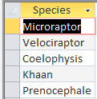

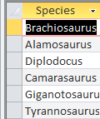
Sorting results
The ORDER BY keywords sorts the values of a column in either ascending or descending order.
In:
Out:
By default, it will sort in ascending order. You use the DESC keyword to sort in descending order.
In:
Out:

Slide 30

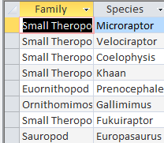
Sorting multiple columns
The ORDER BY keyword can also be used to sort multiple columns.
When doing this, SQL will first sort by the first specified column, then the second, and so on.
In:
Out:

Slide 31

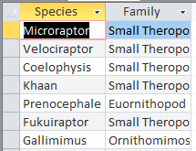
Sorting by multiple columns
The ORDER BY command can also be sued to sort multiple columns.
SQL will sort by the first specific column, and then by the second specified column, and so on.
In:
Out:

Slide 32

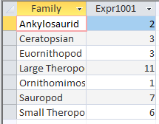
The GROUP BY keyword
You may often want to aggregate your sorted results; i.e. if you have a data base of UK house holds, you may want to count the number of males and number of females.
You can use the GROUP BY keyword to do this.
In:
Out:

Slide 33


Filtering results of aggregate functions
In SQL, aggregate functions cannot be used in WHERE clauses.
Therefore, this means that, if you want to filter based on the result of an aggregate function, you have to use the HAVING clause.
In:
Out:

Slide 34
Any questions?

