Slide 1
Named Entity Recognition
Group 6 - Team Octane
202318005 🡪 Aditi Singh
202318032 🡪 Kruti Patel
202318044 🡪 Hani Soni
202318061 🡪 Garvika Singh

Slide 2
Problem Statement
In the era of rapidly expanding domain-specific data, efficient extraction of meaningful entities from unstructured text is crucial for knowledge discovery and decision-making.
Existing NER models are trained on general datasets and fail to capture domain-specific terminologies, resulting in poor performance in specialized fields.This project focuses on developing and training a Named Entity Recognition (NER) model for two distinct domains: Medical and Solar Panel Technology Patents.
For the Medical domain, entities such as "Chemicals," "Phenotypes," and "Anatomical Structures" are critical for applications like biomedical research, drug discovery, and clinical data analysis.
For the Solar Panel Technology domain, entities like "Components," "Manufacturing Process," and "Performance Metrics" are essential for understanding technological innovations and patent trends.

Slide 3

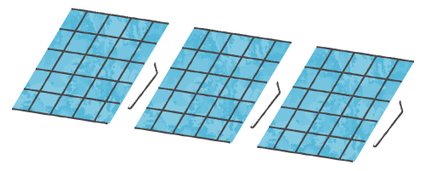
Exploing Differet Datasets
Medical Domain Data
2. Solar Patent Data
https://huggingface.co/datasets/knowledgator/biomed_NER
Ectracted from Google Patents

Slide 4
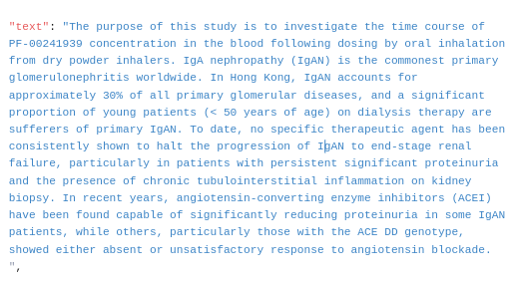
Medical Domain Data Text Snippet

Slide 5
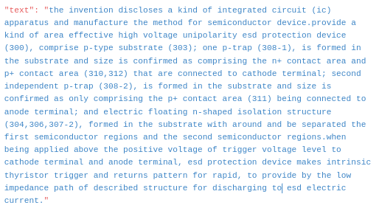
Solar Patent Data Text Snippet

Slide 6
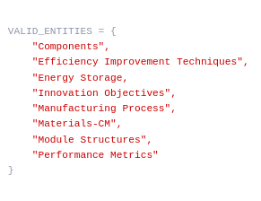
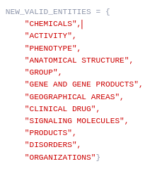
Entities Medical Entities Solar

Slide 7
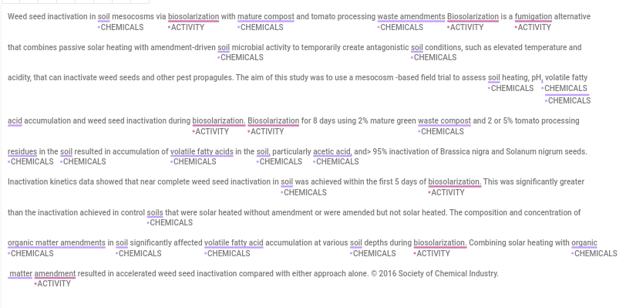

Slide 8
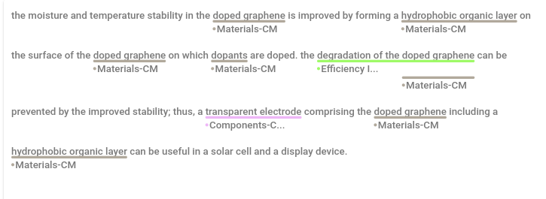

Slide 9
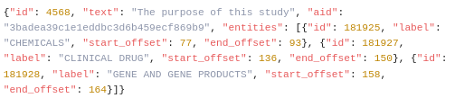
Entities Medical Summary Entities Solar Summary
Avg text length: 42 tokens per text
Avg text length: 38 tokens per text
Corpus Size: 4k texts - Fully Labelled
Corpus Size: 20k texts - 680 Labelled
Total Entities: 12
Total Entities: 8
Data Format

Slide 10
Data Annotations Using Active Learnig
When to use active learning approach
Domain Expertise Required for Annotation:
High Annotation Cost
Limited Labeled Data Availability

Slide 11
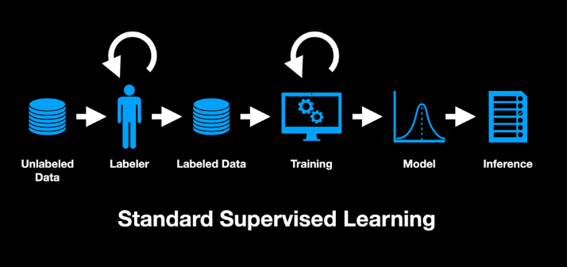

Slide 12
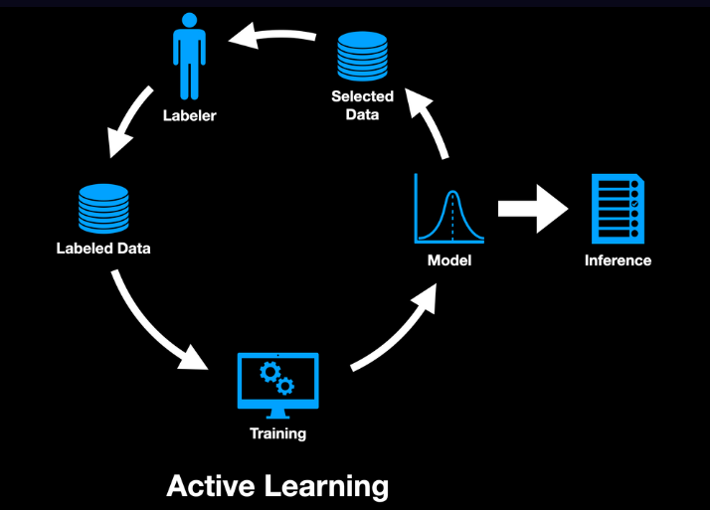

Slide 13
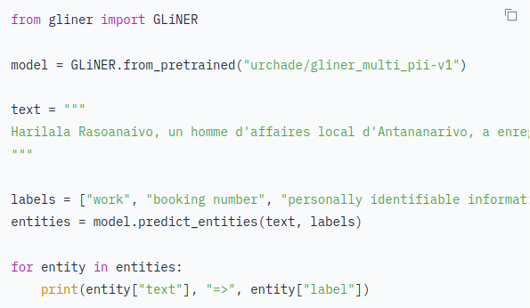
GLiNER:
GLiNER is designed for lightweight, efficient Named Entity Recognition (NER) tasks
Resource-constrained environments.
Zero Shot Learning on custom defined entities.
Pre-Trained on synthetic data generated by chatgpt

Slide 14

Our Problem - 100% of solar patent data was unlabelled
Kick started inital 200 annotations using GLiNER zero shot

Slide 15
200 Mannualy Verified Samples
Model Training
Model Inference on Unlabelled Corpus

Slide 16
Least Confidence Sampling bottom 200 least confident sentences
Manual Validation of these sentences
Model Training on (All Prev + Curr) batch sentences

Slide 17

NER trainig with Spacy
{"text": "The pump source is efficient.", "entities": [(4, 15, "COMPONENT")]}
We used spacy’s automated pipeline with defaut config and custome label and model
Steps -
Data Preparation
Pipeline Configuration
Model Initialization
Fine-tuning
Evaluation
Inference
Tokenization - tok2vec - taken care of by spacy
config setup - model, learning rate etc
model we used - distilbert-base-uncased
Train
Precision, Recall, F1-score.

Slide 18
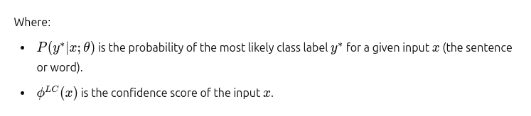

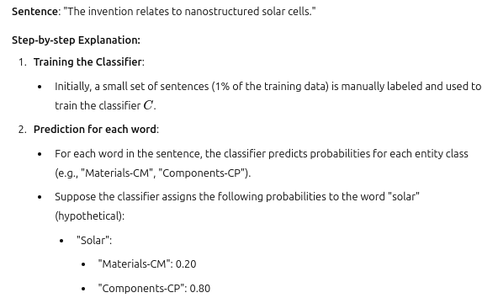
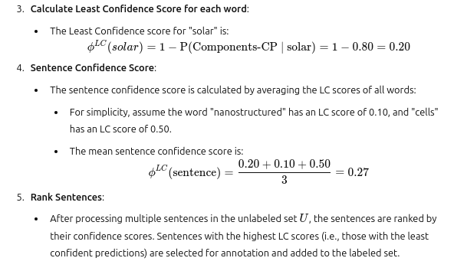
Least Confidence Sampling

Slide 19
Evalation
Medical Data
Solar Data
batch: 7
batch: 4
"overall": {
"precision": 0.5137046861184792,
"recall": 0.27444496929617385,
"f1": 0.3577586206896552,
"sup":1310
"predicted": 1131
}
"overall": {
"precision": 0.7537,
"recall": 0.6044,
"f1": 0.6727,
"sup": 2117,
"predicted": 1731
}

Slide 20
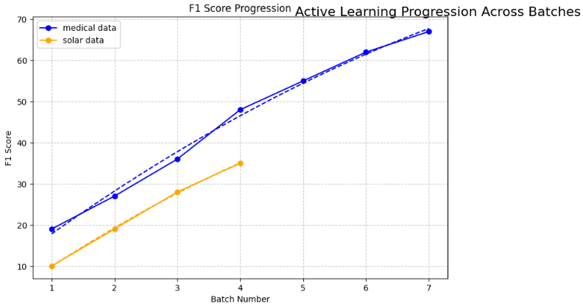
Link to inferece

