Slide 1

How you can find dragons
Static Analysis for beginners

Slide 2

whoamy
    Just another Programmer
    Security Engineer
    Ten years experience
    About me: Github.com/CoolerVoid
    Twitter: @Cooler_freenode
    Contact: coolerlair@gmail.com

Slide 3

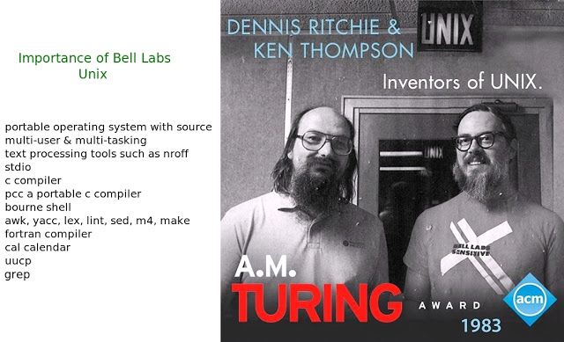
Etymology

Slide 4
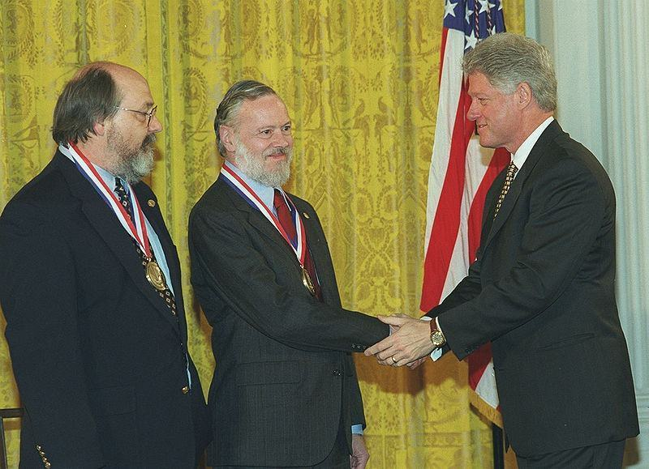
Etymology
theguardian.com/technology/2011/oct/13/dennis-ritchie
economist.com/obituary/2011/11/05/dennis-ritchie-and-john-mccarthy

Slide 5

Etymology
Plan9
Plan 9 from Bell Labs was originally developed, starting in the late 1980s.
members of the Computing Science Research Center at Bell Labs
the same group that originally developed Unix and the C programming language. The Plan 9 team was initially led by Rob Pike, Ken Thompson, Dave Presotto and Phil Winterbottom, with support from Dennis Ritchie as head of the Computing Techniques Research Department.
First release in 1993

Slide 6

Etymology
Compare logo

Slide 7

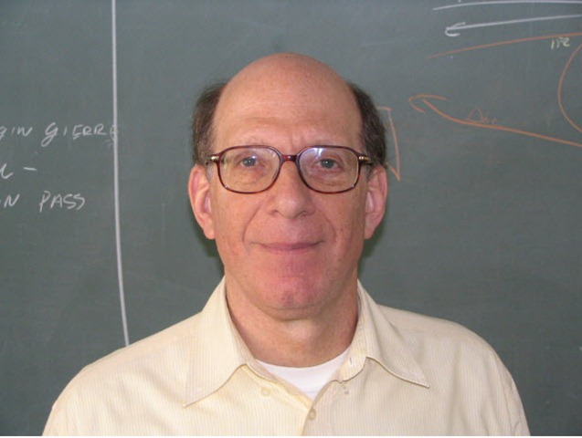


Slide 8
Minix 1987
Linux 1991
Plan9 1993

Slide 9
Minix 1987
Linux 1991
Plan9 1993

Slide 10

Linux/Git creation
Version control
Manual Codereview
New tools for static analysis in Kernel or drivers to make auto patch etc...

Slide 11
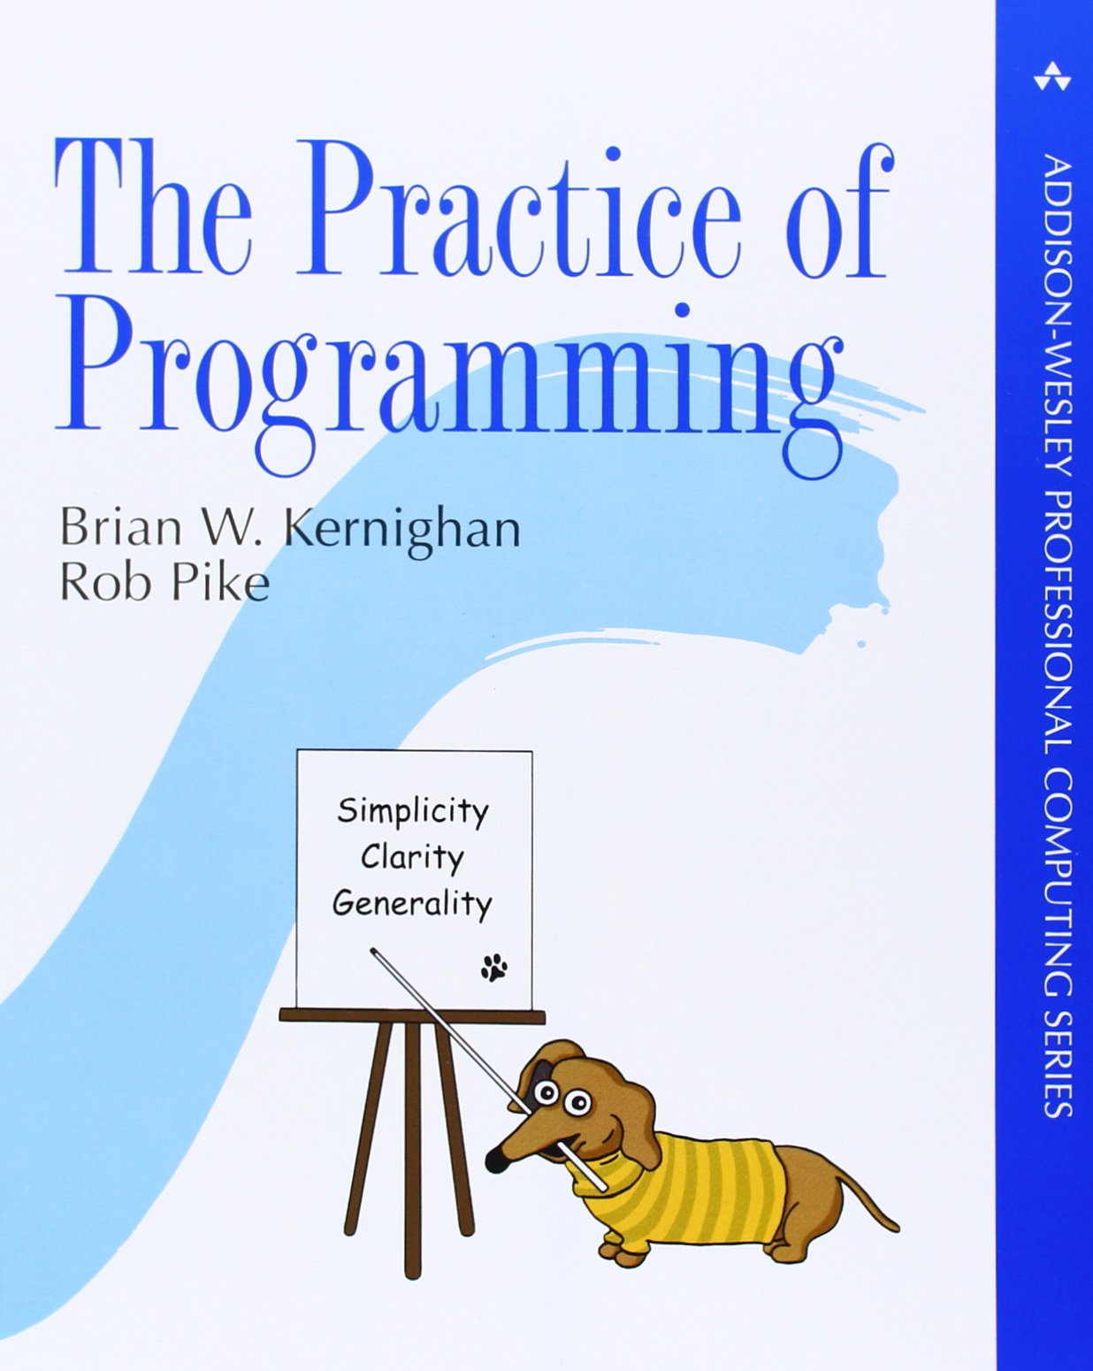
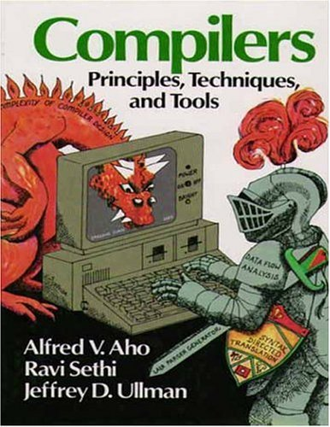
The root of study

Slide 12
Rob Pike's 5 Rules of Programming
Rule 1 - You can't tell where a program is going to spend its time. Bottlenecks occur in surprising places, so don't try to second guess and put in a speed hack until you've proven that's where the bottleneck is.
Rule 2 - Measure. Don't tune for speed until you've measured, and even then don't unless one part of the code overwhelms the rest.
Rule 3 - Fancy algorithms are slow when n is small, and n is usually small. Fancy algorithms have big constants. Until you know that n is frequently going to be big, don't get fancy. (Even if n does get big, use Rule 2 first.)
Rule 4 - Fancy algorithms are buggier than simple ones, and they're much harder to implement. Use simple algorithms as well as simple data structures.
Rule 5 - Data dominates. If you've chosen the right data structures and organized things well, the algorithms will almost always be self-evident. Data structures, not algorithms, are central to programming.
Pike's rules 1 and 2 restate Tony Hoare's famous maxim "Premature optimization is the root of all evil." Ken Thompson rephrased Pike's rules 3 and 4 as "When in doubt, use brute force.". Rules 3 and 4 are instances of the design philosophy KISS. Rule 5 was previously stated by Fred Brooks in The Mythical Man-Month. Rule 5 is often shortened to "write stupid code that uses smart objects".

Slide 13
The root of study
The Dragon Book
Flex
Bison
AST
Trees
Tokenizer

Slide 14
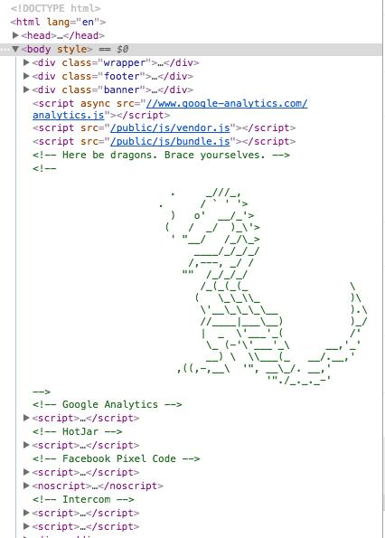
Here be dragons !
Find Pitfalls
Fix each point
Mitigate
Sometimes its hard…
Education ???

Slide 15
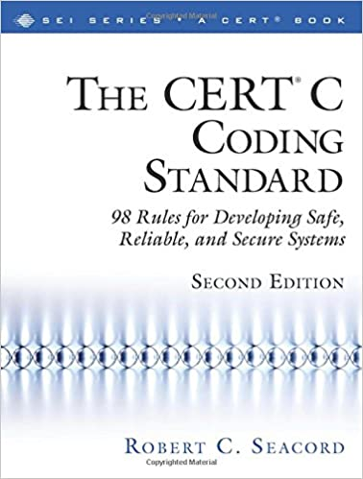
Security focus
Find Pitfalls
Fix each point
Mitigate
Sometimes its hard…
Education ???
Search dragons !

Slide 16
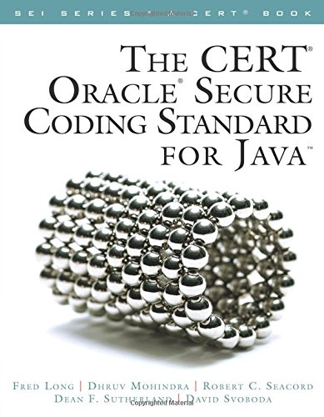
Security focus
Find Pitfalls
Fix each point
Mitigate
Sometimes its hard…
Education ???
Search dragons !

Slide 17

Security focus
Mitre
OWASP
Other resources…
Owasp.org
cve.mitre.org

Slide 18
File system Pitfalls
File system problems
Call Open() but not call close()
Load config file, but don’t have lock…
Don’t check permissions to open file
Don’t check existence of file
Race condition (TOCTOU)
Mistake in permissions

Slide 19
Pitfall example 1
File system problems
Call Open() but not call close()
Load config file, but don’t have lock…
Don’t check permissions to open file
Don’t check existence of file
Race condition (TOCTOU)
Mistake in permissions

Slide 20
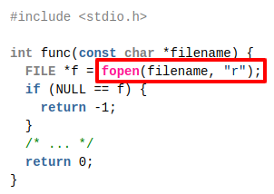
Pitfall example 1
This code example is noncompliant because the file opened by the call to fopen() is not closed before function func() returns:

Slide 21
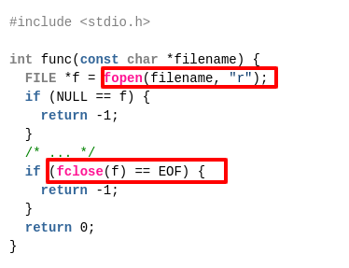
Pitfall example 1
This code example is right way, because open and close file:

Slide 22
Detection
Do you remember the dragon book ?
You can use DFA(Deterministic Finite Automaton) to solve this with rank points.
You can tokenize each word and save in nodes, you can load data structure and walk to collect each rule, the data structure you can use Tree, AST, graph(this is common but more complex).
You can use Flex+Bison to generate input extractor and parser…
You can use regex(regular expression), but don’t have a good performance! Its not better path!
Relax here! have other paths to following…

Slide 23
Detection
Do you remember the dragon book ?
You can use DFA(Deterministic Finite Automaton) to solve this with rank points.
You can tokenize each word ans save in nodes, you can load data structure and walk to collect each rule, the data structure you can use Tree, AST, graph(this is common but more complex).
You can use Flex+Bison to generate input extractor and parse rules…
You can use regex(regular expression), but don’t have a good performance! Its not better path!
Relax here! have other paths to following…

Slide 24
Detection Ex 1
Its OK my choice is use Re2c to solve the problem!
Re2c is a free and open-source lexer generator for C, C++ and Go. It compiles regular expressions to determinisitic finite automata and encodes the automata in the form of a program in the target language.
The main advantages of re2c are speed of the generated code and a flexible user interface that allows one to adapt the generated lexer to a particular environment and input model.
Re2c supports fast and lightweight submatch extraction with either POSIX or leftmost greedy semantics.

Slide 25
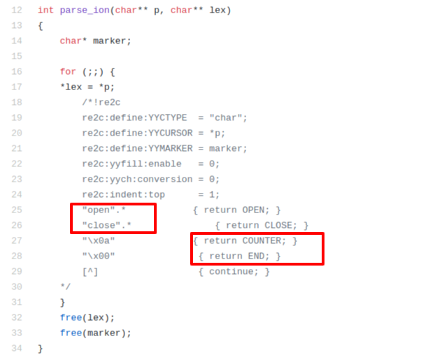
Detection Ex 1
github.com/CoolerVoid/heap_detective/tree/master/doc/PoC1
doc/PoC1/rule.c
Rule to generate
Need Re2c tool
Need GCC

Slide 26
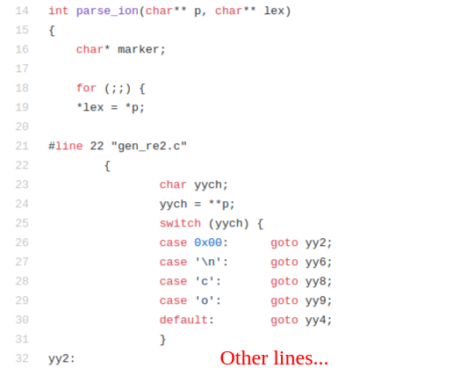
Detection Ex 1
github.com/CoolerVoid/heap_detective/tree/master/doc/PoC1
doc/PoC1/gen_re2.c
Rule to generate
Need Re2c tool
Need GCC

Slide 27
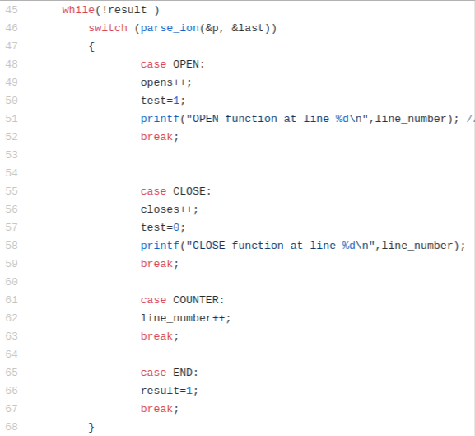
Detection Ex 1
github.com/CoolerVoid/heap_detective/tree/master/doc/PoC1

Slide 28
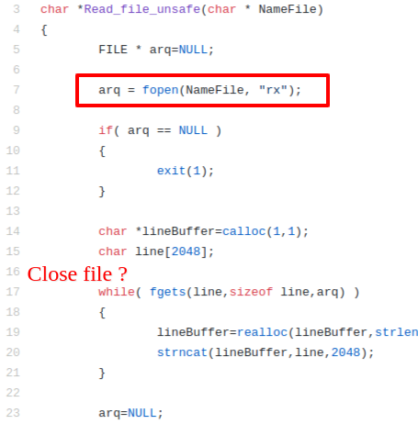
Detection Ex 1
github.com/CoolerVoid/heap_detective/tree/master/doc/PoC1/extest.c

Slide 29
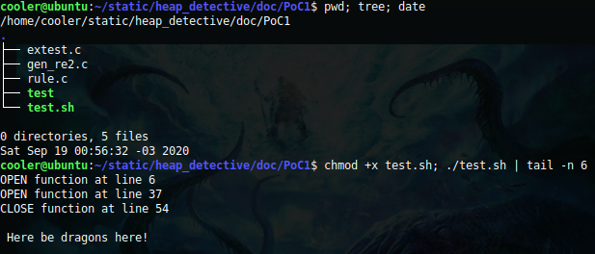
Detection Ex 1
github.com/CoolerVoid/heap_detective/tree/master/doc/PoC1/test.sh
Note need re2c and gcc! (apt-get install re2c gcc)

Slide 30

Detection Ex 1
The logic its simple !

Slide 31
Detection Ex 1
github.com/CoolerVoid/heap_detective/tree/master/doc/PoC1/test.sh
Note need re2c and gcc! (apt-get install re2c gcc)

Slide 32
Detection
Do you remember the dragon book ?
You can use DFA(Deterministic Finite Automaton) to solve this with rank points.
You can tokenize each word ans save in nodes, you can load data structure and walk to collect each rule, the data structure you can use Tree, AST, graph(this is common but more complex).
You can use Flex+Bison to generate input extractor and parse rules…
You can use regex(regular expression), but don’t have a good performance! Its not better path!
Relax here! have other paths to following…

Slide 33
Detection
Do you remember the dragon book ?
You can use DFA(Deterministic Finite Automaton) to solve this with rank points.
You can tokenize each word ans save in nodes, you can load data structure and walk to collect each rule, the data structure you can use Tree, AST, graph(this is common but more complex).
You can use Flex+Bison to generate input extractor and parse rules…
You can use regex(regular expression), but don’t have a good performance! Its not better path!
Relax here! have other paths to following…

Slide 34
Heap detective
All languages uses heap memory
In C its commom when you use functions like malloc(), calloc(), realloc(), strdup() etc…
In C++ its common when you use “new”.
Heap use can have a lot pitfalls if you not follow good practices.
Memory leak, double free, use after free, wild pointer, heap overflow, crash(DoS) other pitfalls…
Some languages like Java have garbage collector to clean the heap memory to manage this, but if programmer don’t know good practices the problem with memory leak or crash can be found.

Slide 35

Heap detective
How you can map heap memory use ?

Slide 36
Heap detective
How you can map heap memory usage in static analysis ?
Use my Tool heap detective
https://github.com/CoolerVoid/heap_detective

Slide 37
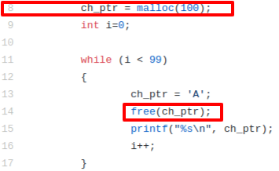
Heap detective
How you can map heap memory use ?
List the functions that use heap memory
List functions to liberate heap

Slide 38
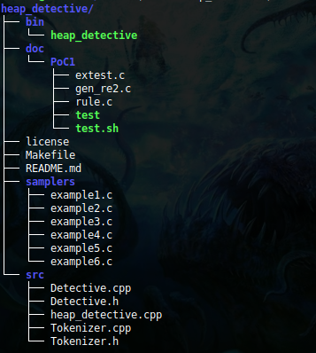
Overview

Slide 39
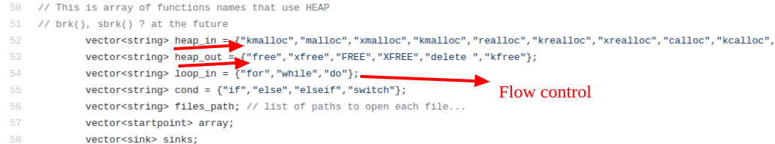
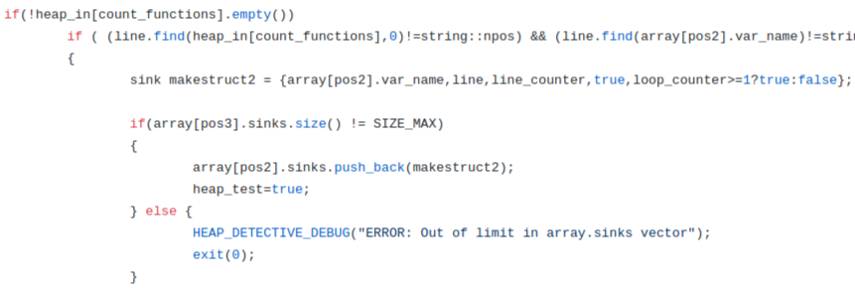
Heap detective

Slide 40
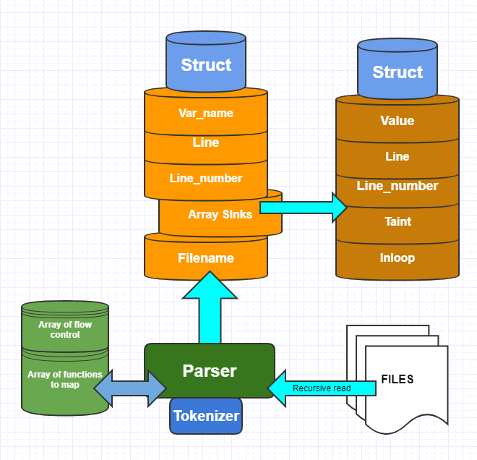
Heap detective

Slide 41
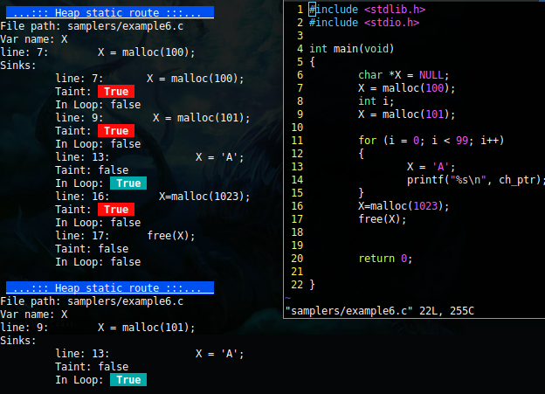
Heap detective

Slide 42
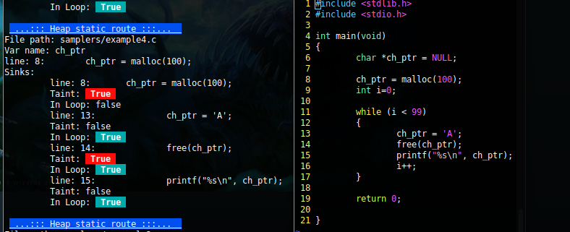
Heap detective

Slide 43
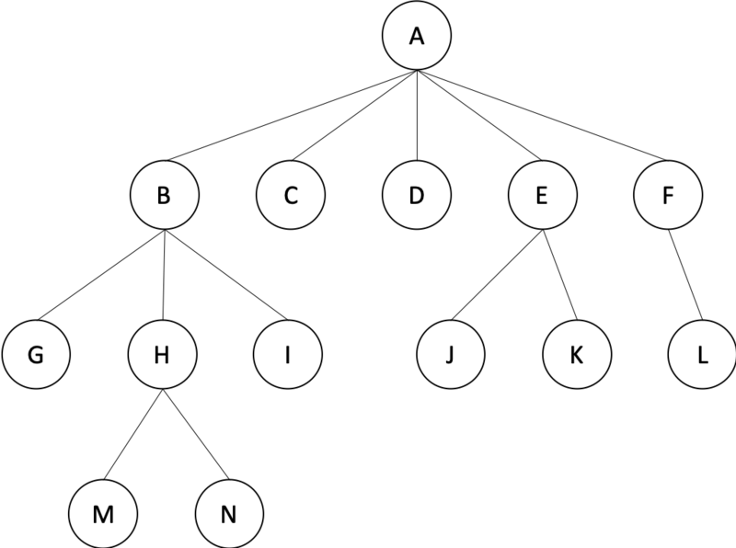
Cool stuff
My Tree library in C
Ice n-ary tree based on glib tree functions
https://github.com/CoolerVoid/icenarytree

Slide 44
Other projects
Code walk, code search, regex with rule based…
github.com/CoolerVoid/codewarrior
github.com/CoolerVoid/codecat
https://semgrep.dev (very cool)

Slide 45

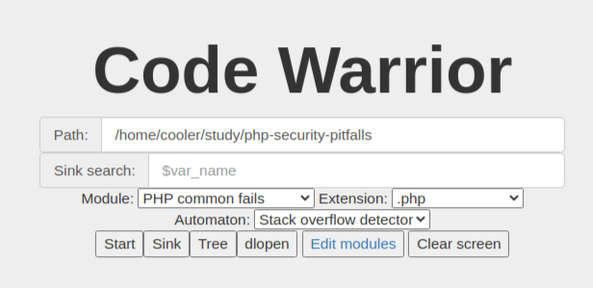

Slide 46
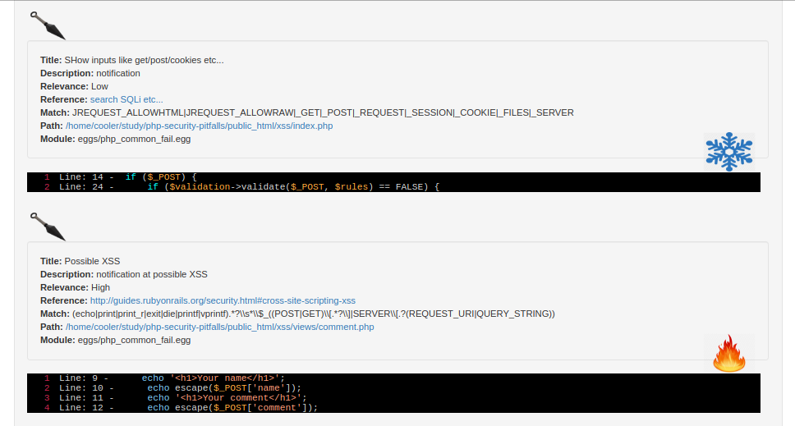
Codewarrior

Slide 47
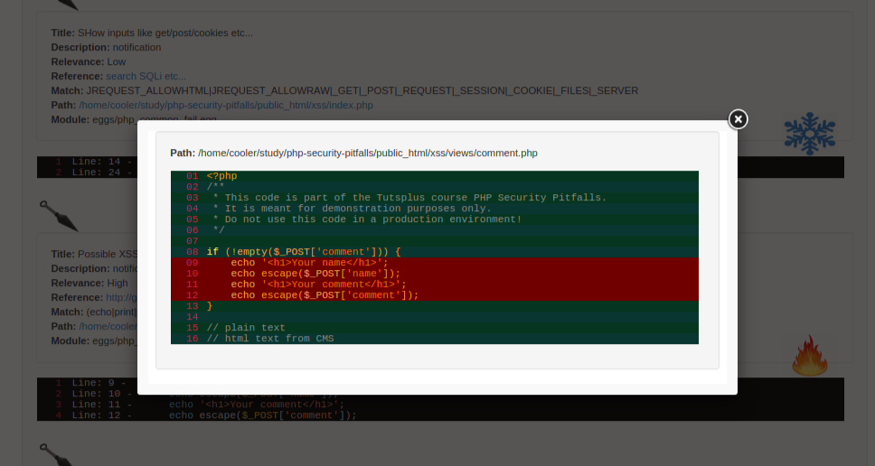
Codewarrior

Slide 48

Questions ?

Slide 49
Thank you!
Credits: CoolerVoid
Contact: coolerlair@gmail.com

