Slide 1
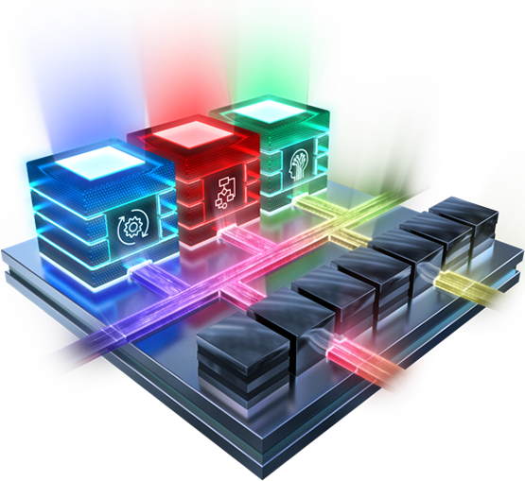

Computer-Aided Design Introduction
Mahdi Aminian

Slide 2
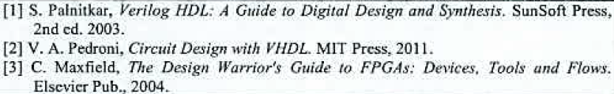
Computer-Aided Design
Course: 3 hours/week
Textbooks:
طراحی کامپیوتری سیستم‌های دیجیتال، دکتر صاحب الزمانی
Any Notes about VHDL, FPGA, and Digital Design Automation
http://esd.cs.ucr.edu/labs/tutorial/
P.P. Chu, RTL Hardware Design Using VHDL: Coding for Efficiency, Portability, and Scalability, Wiley-Interscience, 2006.
A. Rushton, VHDL for Logic Synthesis, 3rd ed.: Wiley, 2011.
Ulrich Heinkel, et al, “The VHDL Reference: A Practical Guide to Computer-Aided Integrated Circuit Design including VHDL-AMS,” Wiley, 2000.
Z. Salcic, A. Smailagic, “Digital Systems Design and Prototyping Using Field-Programmable Logic and Hardware Description Languages”, 2nd Edition, 2000

Slide 3
Computer-Aided Design
Grading policy
Homework 20%
Delay (<1 week) → -50%, >1 week → “0”
Project 25%
Midterm 25%
Final exam: 30%
توجه مهم: کسب حداقل 40% امتحان پایان ترم و پروژه الزامی است
توجه مهم: هرگونه شباهت در تمرینات، نمرات منفی بالایی خواهد داشت
توجه: عدم حضور باعث حذف تمام نمرات ارفاقی می‌شود

Slide 4
Contacts
Email 1: mhd.aminian@gmail.com
Email 2: mahdi.aminian@guilan.ac.ir
Website: https://guilan.ac.ir/~mahdi.aminian
TAs:
Mr. Mohammad Mahdi Rezazadeh
Mr. Mostafa KhoshSiar
Mrs. Ava Moshfegh
Mr. Mehdi SadeghiNejad

Slide 5
Computer-Aided Design
Slides Address:
https://www.dropbox.com/sh/renz9eljm8x1crt/AAB52LOzVYujT1SzXN45kg9ia?dl=0
Assignments Upload Address:
https://www.dropbox.com/request/3knDRN3iOOxdTWABo7Nh
Note: name starts with “CAD”+…

Slide 6
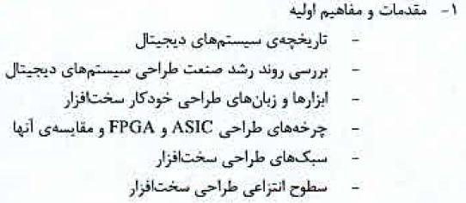




Syllabus

Slide 7
Introduction

Slide 8
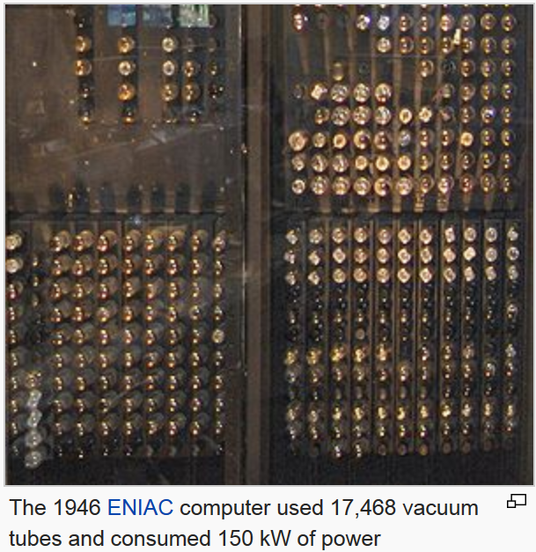
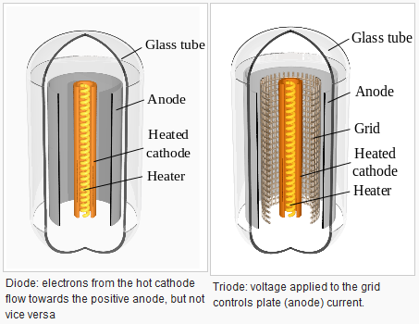
Vacuum Tube

Slide 9
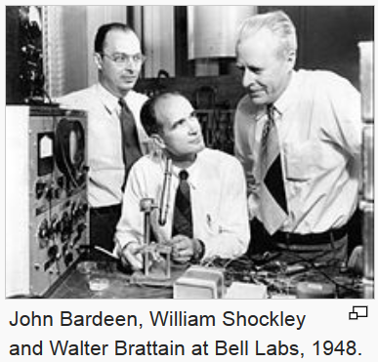
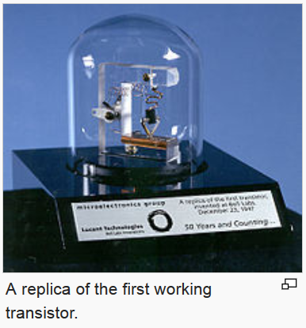
First Transistors - 1947

Slide 10
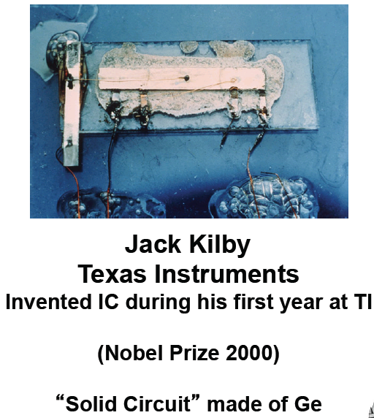
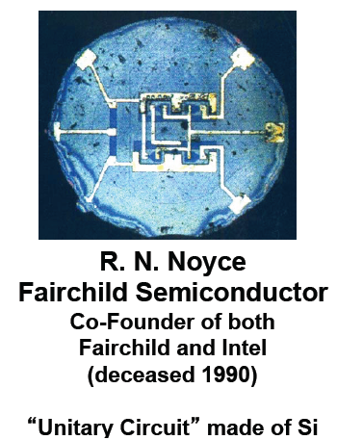
First IC - 1958

Slide 11
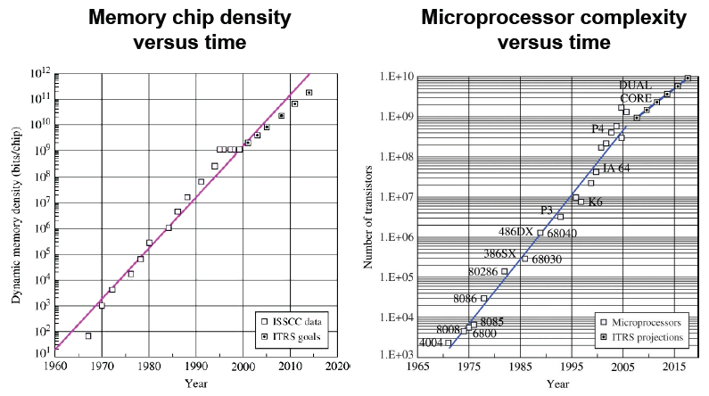
Moore’s Law

Slide 12
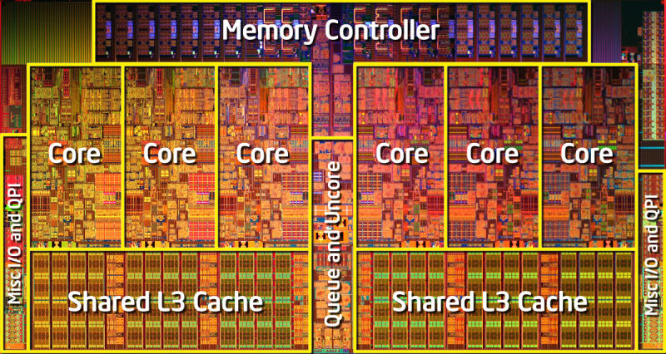
Intel Core i7-980X (6 cores)
Intel i7-980X, (12MB Cache, 3.33 GHz)
6 cores, 32 nm, 240 mm², 1.17 billion transistors
Most powerful processor has about 10B transistors today.
Most powerful FPGA has 20B+ transistors.
http://en.wikipedia.org/wiki/Transistor_count

Slide 13
Digital Circuits
Logic
Standard
Logic
ASIC
Programmable
Logic Devices
(FPLDs)
Gate
Arrays
Cell-Based
ICs
Full Custom
ICs
SPLDs
(e.g., PALs)
CPLDs
FPGAs
Microprocessor
& RAM
Acronyms
SPLD = Simple Programmable Logic Device
PAL = Programmable Array Logic
CPLD = Complex PLD
FPGA = Field Programmable Gate Array
ASIC = Application Specific IC
Common Resources
Configurable Logic Blocks (CLB)
Memory Look-Up Table (LUT)
AND-OR planes
Simple gates
Input / Output Blocks (IOB)
Bidirectional, latches, inverters, pullup/pulldowns
Interconnect or Routing
Local, internal feedback, and global

