Slide 1

Path Planning

Slide 2
Table of Contents
Part.1 Graph Searching Algorithm
Basics of Graph Theory
Queue and Priority Queue
Graph Search Algorithms
Dijkstra’s Algorithm
A* Algorithm
Application of graph searching in path planning
Part.2 Path Planning
Path planning with limited sensor range in unexplored environment
Application of OpenCV

Slide 3
Part.1 Graph Searching Algorithms

Slide 4
Basics of Graph Theory
v₁
v₂
A Graph denoted as G=(V,E) is the combination of a set of vertices V, and a set of edges E.
Each element in E is a pair (v,w) where v,w∈V such that:
If G is undirected, there is an edge in G between v and w.
If G is directed, there is an edge in G going from v to w.
In a weighted graph, each edge is assigned a weight or cost.
A Path in G from v₁ to v_{N} is a sequence of vertices v₁, v₂, …, v_{N} in V such that (v_{i}, v_{i+1}) is in E for all i∈[0, N-1].
In a weighted graph, the cost of a path is the sum of all edges (v_{i}, v_{i+!}).
v₃
v₄
fig 3.1 An undirected graph
v₁
v₂
114
514
1919
v₃
v₄
810
fig 3.2 A weighted directed graph

Slide 5
Queue and Priority queue
Queue
A FIFO (First In, first out) data structure
Elements stored in chain
Operations:
Push: Add a new element to the end of the chain
Pop: Read and remove the element at the front of the chain
Priority queue
Each element has a key value
The priority queue is maintained such that the elements are ranked with increasing key value
Supported Operations:
Push: Add a new element to a proper location in the chain, maintaining the increasing key value in the queue
Pop: Read and remove the element with the smallest key value from the queue
D
Pop will get A
A
B
C
Push will put new element D after C
Front
End
Queue
6
Pop will get 5
Element with key 6 will be inserted between 5 and 8
5
8
9
Front
End
Priority Queue

Slide 6
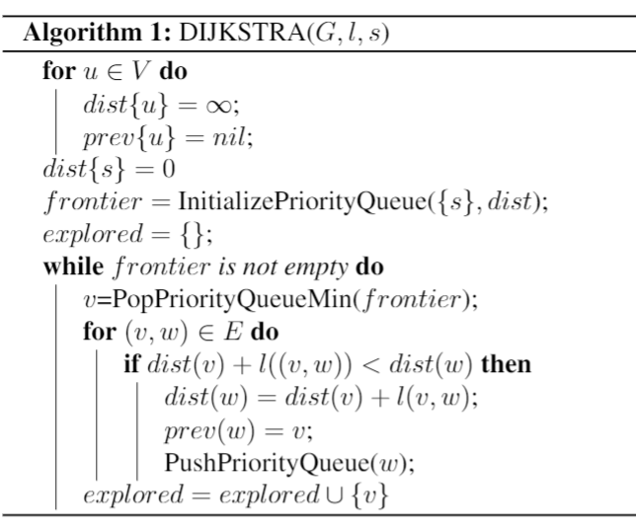
Dijkstra’s Algorithm
Finds shortest path between vertices in a weighted graph
Input:
A weighted graph G=(V,E)
A list of edges’ weights l
A start vertex s
Output:
For each vertex v, the shortest path from s to v in G
After running the algorithm,
dist(v) will be set to the cost of shortest path from s to v
backtrace using prev(v) all the way to s to get the actual path

Slide 7
Dijkstra Example:
Suppose we want to find the least cost path from A to F
B
1
D
4
2
A
10
F
1
2
4
2
C
3
E
G
10
Explored
Currently Exploring
Frontier
Unvisited

Slide 8
Dijkstra Example:
Vertex | Dist | Prev
A | 0 | nil
B | ∞ | nil
C | ∞ | nil
D | ∞ | nil
E | ∞ | nil
F | ∞ | nil
G | ∞ | nil
B
1
D
4
2
A
10
F
1
2
4
2
C
3
E
G
10
Explored
Currently Exploring
Frontier
Unvisited
Frontier: (A, 0)

Slide 9
Dijkstra Example:
Vertex | Dist | Prev
A | 0 | nil
B | ∞ | nil
C | ∞ | nil
D | ∞ | nil
E | ∞ | nil
F | ∞ | nil
G | ∞ | nil
B
1
D
4
2
A
10
F
1
2
4
2
C
3
E
G
10
Explored
Currently Exploring
Frontier
Unvisited
Frontier: (A, 0)

Slide 10
Dijkstra Example:
Vertex | Dist | Prev
A | 0 | nil
B | 4 | A
C | 2 | A
D | ∞ | nil
E | ∞ | nil
F | ∞ | nil
G | ∞ | nil
B
1
D
4
2
A
10
F
1
2
4
2
C
3
E
G
10
Explored
Currently Exploring
Frontier
Unvisited
Frontier: (C, 2), (B, 4)

Slide 11
Dijkstra Example:
Vertex | Dist | Prev
A | 0 | nil
B | 4 | A
C | 2 | A
D | ∞ | nil
E | ∞ | nil
F | ∞ | nil
G | ∞ | nil
B
1
D
4
2
A
10
F
1
2
4
2
C
3
E
G
10
Explored
Currently Exploring
Frontier
Unvisited
Frontier: (C, 2), (B, 4)

Slide 12
Dijkstra Example:
Vertex | Dist | Prev
A | 0 | nil
B | 3 | C
C | 2 | A
D | ∞ | nil
E | 5 | C
F | ∞ | nil
G | ∞ | nil
B
1
D
4
2
A
10
F
1
2
4
2
C
3
E
G
10
Explored
Currently Exploring
Frontier
Unvisited
Frontier: (B, 3), (B, 4), (E, 5)

Slide 13
Dijkstra Example:
Vertex | Dist | Prev
A | 0 | nil
B | 3 | C
C | 2 | A
D | ∞ | nil
E | 5 | C
F | ∞ | nil
G | ∞ | nil
B
1
D
4
2
A
10
F
1
2
4
2
C
3
E
G
10
Explored
Currently Exploring
Frontier
Unvisited
Frontier: (B, 3), (B, 4), (E, 5)

Slide 14
Dijkstra Example:
Vertex | Dist | Prev
A | 0 | nil
B | 3 | C
C | 2 | A
D | 4 | B
E | 5 | C
F | 13 | B
G | ∞ | nil
B
1
D
4
2
A
10
F
1
2
4
2
C
3
E
G
10
Explored
Currently Exploring
Frontier
Unvisited
Frontier: (B, 4), (D, 4), (E, 5), (F, 13)

Slide 15
Dijkstra Example:
Vertex | Dist | Prev
A | 0 | nil
B | 3 | C
C | 2 | A
D | 4 | B
E | 5 | C
F | 13 | B
G | ∞ | nil
B
1
D
4
2
A
10
F
1
2
4
2
C
3
E
G
10
Explored
Currently Exploring
Frontier
Unvisited
Frontier: (E, 5), (F, 13)
B is already explored, (B, 4)can be popped directly

Slide 16
Dijkstra Example:
Vertex | Dist | Prev
A | 0 | nil
B | 3 | C
C | 2 | A
D | 4 | B
E | 5 | C
F | 6 | D
G | ∞ | nil
B
1
D
4
2
A
10
F
1
2
4
2
C
3
E
G
10
Explored
Currently Exploring
Frontier
Unvisited
Frontier: (E, 5), (F, 6), (F, 13)

Slide 17
Dijkstra Example:
Vertex | Dist | Prev
A | 0 | nil
B | 3 | C
C | 2 | A
D | 4 | B
E | 5 | C
F | 6 | D
G | ∞ | nil
B
1
D
4
2
A
10
F
1
2
4
2
C
3
E
G
10
Explored
Currently Exploring
Frontier
Unvisited
Frontier: (E, 5), (F, 6), (F, 13)

Slide 18
Dijkstra Example:
Vertex | Dist | Prev
A | 0 | nil
B | 3 | C
C | 2 | A
D | 4 | B
E | 5 | C
F | 6 | D
G | 15 | E
B
1
D
4
2
A
10
F
1
2
4
2
C
3
E
G
10
Explored
Currently Exploring
Frontier
Unvisited
Frontier: (F, 6), (F, 13), (G, 15)

Slide 19
Dijkstra Example:
Vertex | Dist | Prev
A | 0 | nil
B | 3 | C
C | 2 | A
D | 4 | B
E | 5 | C
F | 6 | D
G | 15 | E
B
1
D
4
2
A
10
F
1
2
4
2
C
3
E
G
10
Explored
Currently Exploring
Frontier
Unvisited
Frontier: (F, 6), (F, 13), (G, 15)

Slide 20
Dijkstra Example:
We can stop here as we popped F from the priority queue.
When we pop a vertex with distance value of x, it means that there exist a path to the vertex with a total cost of x.
Any path that are found in the future will all have a cost larger or equal to x. (Non decreasing cost)
B
1
D
4
2
A
10
F
1
2
4
2
C
3
E
G
10
Explored
Currently Exploring
Frontier
Unvisited
Frontier: (F, 6), (F, 13), (G, 15)

Slide 21
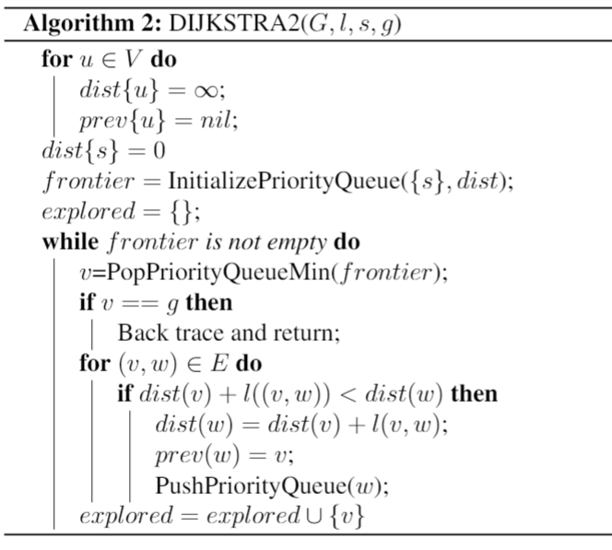
Dijkstra for given goal
Exiting when popping goal vertex will give the shortest path to it.
Input:
A weighted graph G=(V,E)
A list of edges’ weights l
A start vertex s
A goal vertex g
Output:
The shortest path from s to g in G

Slide 22
Using Dijkstra’s algorithm in path planning
Scenario:
Known:
A occupancy grid map of the environment
A start and goal coordinate
Need to find:
A path from start to goal that does not cross any obstacles
Inputs to Dijkstra’s algorithm:
Graph: Translated from occupancy grid map
Vertex: Observed unoccupied grid cells
Edge: Present between vertices when the grid cells are right next to each other.
Cost of edge:
1 if the grid cells share a side
√2 if the grid cells share a corner
Start
The grid cell that holds the start coordinate
Goal
The grid cell that holds the goal coordinate
Start
 |  |  | Goal
S
G

Slide 23
Problem with Dijkstra
The explored area expands uniformly towards all directions.
Some directions heading away from the goal is not worth checking!

Slide 24
Introducing A*

Slide 25
A* Algorithm
Cell A
Cell B
Very similar to Dijkstra’s Algorithm
One extra information:
we know roughly how far each vertex is from the final goal
When exploring the first (yellow) cell, both cell A and B enters the priority queue.
From a quick calculation, cell A is farther away from the final goal than cell B, so B is more likely to yield a least cost path to the final goal.
Key to A* algorithm: prioritize vertices that are potentially closer to to the final goal.

Slide 26
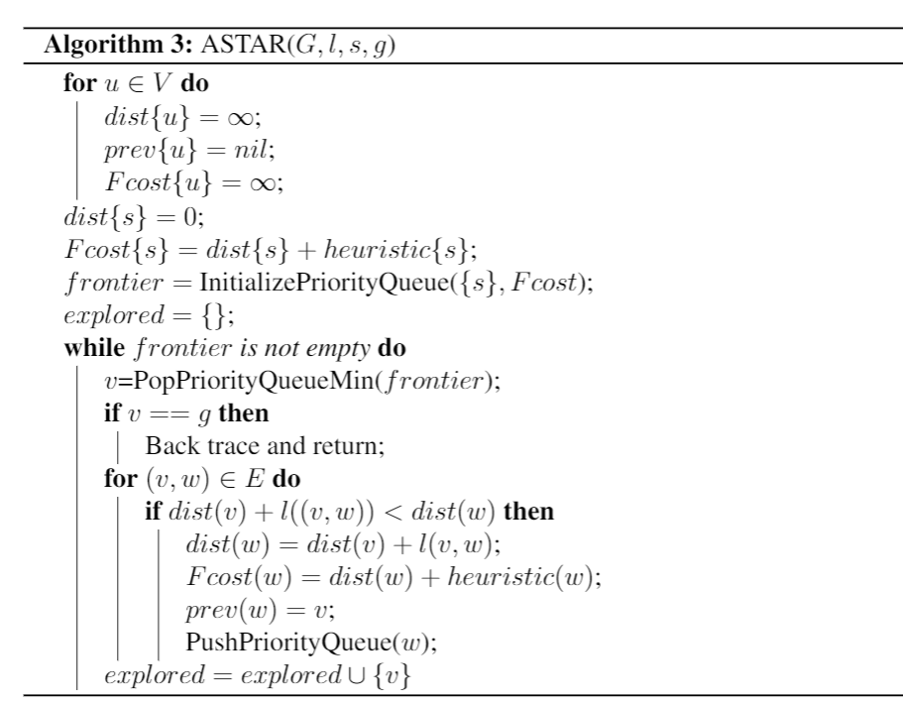
A* implementation
Order of exploration in Dijkstra is determined by distance to the start
F = G
F: Total cost, used to rank vertices in the priority queue
G: Real cost, cost from start to current vertex
In A*, we add a heuristic value to prioritize vertices that are potentially closer to goal
F=G+H
H: Heuristic cost, an estimation of cost from current vertex to goal

Slide 27
Choosing Heuristic function
A* algorithm always gives least cost path if heuristic function is admissible:
H(n) ≤ Real cost from n to goal
What happens if heuristic cost is larger than the actual cost?
Assume the least cost path from S to C is (S, A, C)
If H(A) is larger than c(A, G), F(A) wil be larger than the real cost of path (S, A, C)
If cost of path (S, B, C) is smaller than F(A), C could be explored before A. This is because the order of exploring vertices is a result of popping from the priority list, and the popped vertices’ F-cost is non-decreasing.
In this case, when C gets explored, it’s prev is B. So the path we find is not going to to have the least cost.
A
c(A,G)
S
C
B
c(B,G)

Slide 28
Choosing Heuristic function
How can we find an admissible heuristic estimation H(v) for vertex v such that H(n) ≤ Real cost from n to goal?
Hint: Real cost from n to goal means the length of path from grid cell n to goal
H(n) = straight line distance from n to goal
Euclidean distance

Slide 29
A* implementation
For our problem, we can calculate heuristic by Pythagorean theorem.
H(v) = sqrt( (x_{v} - x_{Goal})² + (y_{v} - y_{Goal})² )
Now you should be able to find the least cost path from start to goal given an occupancy map

Slide 30
Part.2 Path Planning

Slide 31
Scenario
Robot put into an unknown, arbitrary environment
Robot equipped with lidar with limited range
Known
Start and goal’s relative coordinates
Unknown
Map of the environment
Goal
Find an efficient path to goal, avoiding obstacles in the way

Slide 32
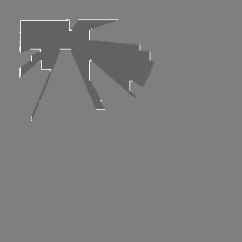
Known area is limited
We have to gain more information about the map before computing an efficient path to the final goal.
We cannot stay at the same place
Lidar reading will be the same for robot at the same location and angle
Robot needs to move to a location that is:
Reachable according to the current information
Likely to yield information about a path to the final goal
This location is referred to as a temporary goal

Slide 33
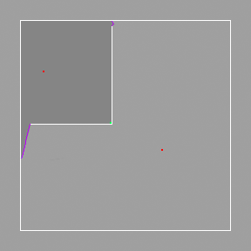
The Frontier-based Approach
Frontier as the Temporary Goal
The free grid cells that are right next to unexplored regions
Provides the most information about the uncharted territory
The frontier cell that is closest to the final goal is more likely to be a part of an efficient path from current location to the final goal
Example:
The obstacles are like the walls of a room and frontiers are exits to it.
If the robot want to find and reach a goal outside the room, it has to go through one of the exits.
The exit that is closest to the final goal is preferred since it is more likely to lead the robot to the final goal.

Slide 34
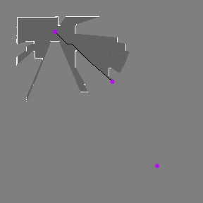
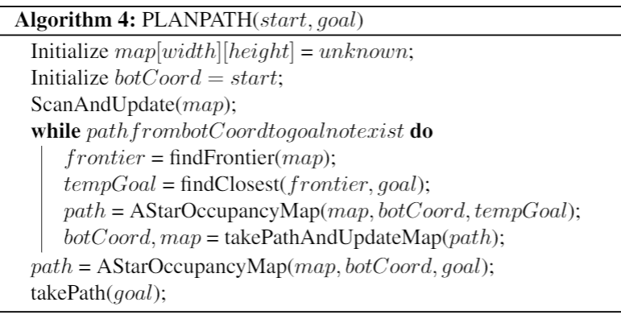
Explore and plan path
1st tempGoal

Slide 35
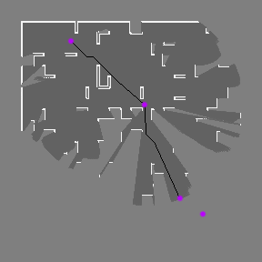
Explore and plan path
1st tempGoal
2nd tempGoal

Slide 36
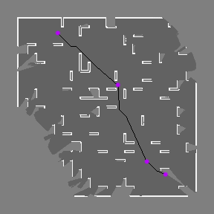
Explore and plan path
1st tempGoal
2nd tempGoal
Goal

Slide 37
Put it all together

Slide 38
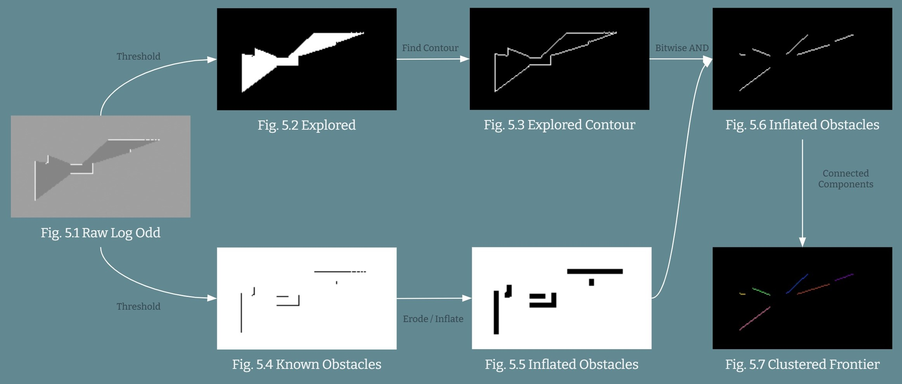
Using OpenCV to process map

Slide 39
Thank you!

