Slide 1


SYSTEMS ARCHITECTURE & GOVERNANCE
EXECUTIVE BRIEFING
CAREER MOBILITY GOVERNANCE FRAMEWORK
A Governed Integration Architecture for Military Learner Mobility
AI as Deterministic Constraint Infrastructure — Not Decision Automation
SCAN ME!
Robert McCoy
Indiana Wesleyan University
CCME 2026 SYMPOSIUM
M.S. Candidate, AI & Data Analytics
The Future Is Now: Educate, Engage, Empower
April 1, 2026
Track 1 — Military Learner Mobility

Slide 2
Scenario 68W to Civilian
https://robertmccoyprojects.com/research/cmgf

Slide 3
Presentation Footing
How will AI be used in the Future?
Today I’m not presenting a product or a program proposal.
I’m presenting a design question.
If artificial intelligence is going to enter the military education and transition ecosystem, and it will, how do we do that in a way that preserves human authority, respects policy boundaries, and increases transparency rather than obscuring it?
The Career Mobility Governance Framework is one possible answer to that question.
02

Slide 4
Presentation Footing
How will AI be used in the Future?
Think of CMGF as an advisor’s research assistant. It pulls together policy rules, credential pathways, and labor data, checks them against a service member’s goals, and shows where the plan works—or where the constraints are
And then it produces a transparent report so the advisor can focus on guiding the decision instead of hunting through policies.
02

Slide 5






Evidence Behind the Five Pillars
Documented fragmentation across systems requires governed integration
Military Learner Transitions
Career Mobility & Alignment
Credential Translation
Advising Tools & Support
Voice of the Veteran
Fragmentation documented across DoD, VA, and Labor transition systems creates navigation friction.
Empirical variability in wage outcomes and credential signaling across different regions.
Decentralized authority creates inconsistent employer recognition patterns for military skills.
Limited cross-system integration and outcome visibility for advisors supporting transitions.
Documented barriers in translation, navigation, and equitable access to opportunities.
Grounded in national research, federal reporting, and AI governance guidance.
02

Slide 6
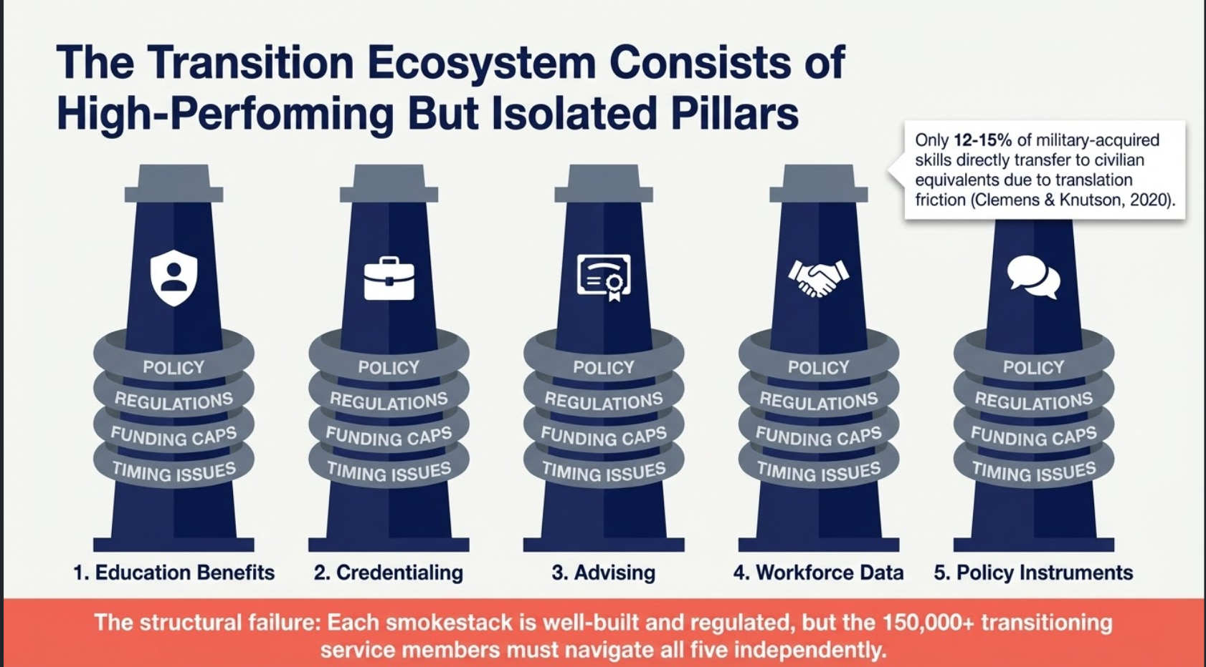

Slide 7
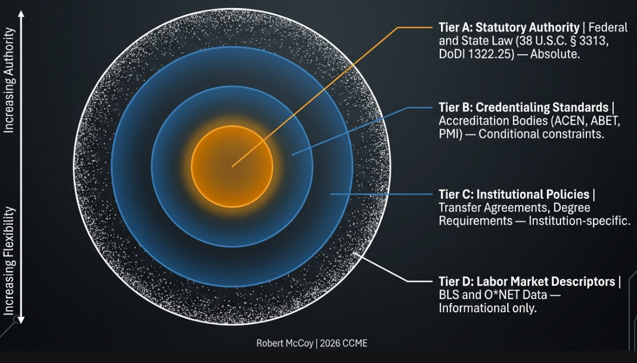
The Foundation: Authority Decomposition Model
Governed Constraint Hierarchy for Military Education and Career Mobility Systems

Slide 8

Governance Alignment: Three Active Federal Pillars
Ensuring compliance with current national AI policy and risk management standards
EO 14179
OMB M-25-21
NIST AI RMF
REMOVING BARRIERS TO AMERICAN LEADERSHIP IN AI
ACCELERATING FEDERAL USE OF AI THROUGH INNOVATION & TRUST
AI RISK MANAGEMENT FRAMEWORK
Trustworthiness & Accountability
January 20, 2025
April 3, 2025
CMGF ALIGNMENT
CMGF ALIGNMENT
CMGF ALIGNMENT
Governance controls, audit logging, and deterministic policy enforcement structured explicitly around the NIST AI RMF Govern-Map-Measure-Manage lifecycle.
Deterministic constraint architecture with preserved human decision authority, aligned to the Administration's mandate to accelerate responsible AI deployment while maintaining safety.
Authority-tagged signals with traceable constraint logic, mandatory human-in-the-loop authority, and full audit visibility — directly satisfying M-25-21 governance requirements.
Governance Assurance: Every system signal is traceable to authoritative policy sources while preserving human decision authority. Alignment reduces institutional adoption risk.

Slide 9
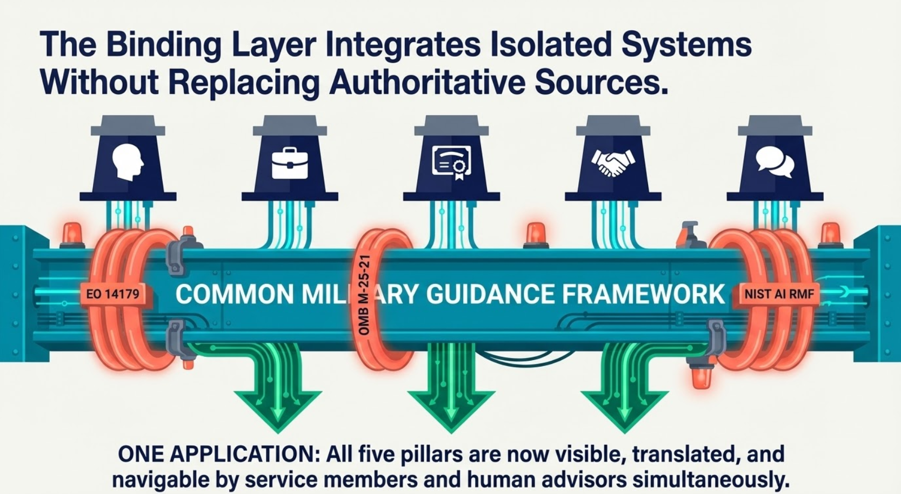

Slide 10





CMGF Architecture: From Fragmentation to Integration
Binding independent authoritative domains into a coherent decision environment
FRAGMENTED ECOSYSTEM
CMGF INTEGRATION LAYER
INTEGRATED ENVIRONMENT
Federal Statutory (DoD, VA)
Advisory & Guidance Flow
Coordinated Pathway Visibility
Processes individual scenarios against governed constraints
Policy-Aligned Decision Support
State Regulatory Boards
Governance Binding Infrastructure
Governed Signal Derivation
Institutional Education
Encodes law, policy, and rules into deterministic logic
Policy Feedback Visibility
Credentialing Bodies
Aggregate Insight
Provides macro-level visibility into system performance
Benefits Systems
Labor Market Data
No Predictive Modeling
No Automated Decisions
No Optimization Objectives
AUTHORITY
POLICY
DATA
TRUST
Independent authorities operating without coordinated mediation.
Controlled Source of Truth Through Governed Federation
GOVERNANCE CONTROLS ACTIVE
"Truth originates from authoritative systems of record. CMGF mediates, validates, and explains without creating new authority."

Slide 11




Platform Modules
Functional components of the Career Mobility Governance Framework
PLANNED
CONCEPT
ACTIVE
Service Member Hub
AI Services Layer
ISR System
Self-service portal for education and career planning milestones.
Intelligent services providing governed translation and correlation.
Primary platform for career counselors to manage transition lifecycles.
PRIMARY USERS
PRIMARY USERS
PRIMARY USERS
Service Members | Veterans
System Services | ISR | Hub
Career Advisors | Counselors
KEY FEATURES
KEY FEATURES
KEY FEATURES
•
Personal transition dashboard
•
Military-to-civilian translation
•
Service member pipeline view
•
Progress milestone tracking
•
Career pathway matching
•
Detailed profile access
•
Skill translation tools
•
Resume content analysis
•
Session notes & audit logging

Slide 12





DEMONSTRATION AND RESOURCES
Career Mobility Governance Framework (CMGF)
Interactive Demo and Downloads
robertmccoyprojects.com/research/cmgf
Interactive CMGF advisory environment
Governance and design methodology artifacts
Architecture documentation (CMGF-00 through CMGF-03)
Presentation materials and supporting research
SCAN ME!
Robert McCoy
Indiana Wesleyan University AI Governance & Military Transition Research

