Slide 1
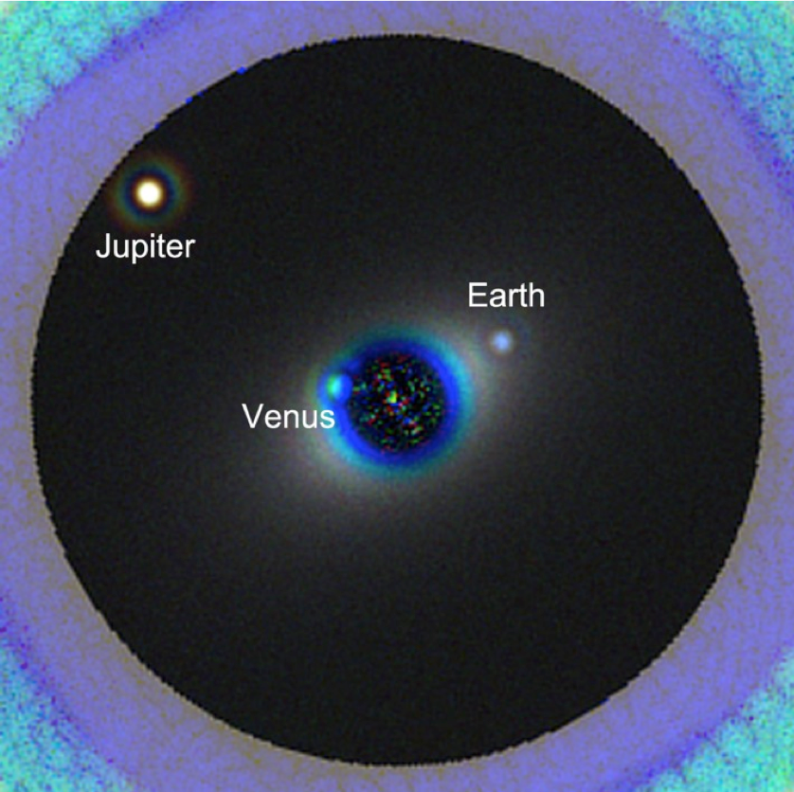
UK Exoplanet Community HWO survey
Suzanne Aigrain, Jo Barstow, Beth Biller, Jayne Birkby, Sasha Hinkley, Annelies Mortier, Hannah Wakeford, Vincent Van Eylen
Credit: L. Pueyo / M. N’Diaye / A. Roberge

Slide 2
The goal of the survey:
Determine the interests and priorities of the UK exoplanet community with respect to HWO
Assess the level of participation in the UK in the ongoing GOMaP-START efforts.
Areas of consensus across the community in the survey may identify scientific / technical areas where the UK could provide a substantial national contribution and thus serve as a basis for organisation of the community.

Slide 3
Who we are:
We are a group of people interested in exoplanet science with HWO, and we want to ensure that the UK Exoplanet Community is well represented in the current ongoing discussions, as this may be important for potential future UK hardware/science contributions to the mission. This survey is designed to ensure we capture the opinions of the whole community and at all career stages, rather than the subset we represent.

Slide 4
Survey details:
Designed to take <5 minutes to respond, with 4 questions regarding important science questions and required instrumentation, 3 questions regarding participation in GOMaP-START working groups, and a chance to share any addition comments.
Open from late August until 15 November, received a total of 30 responses

Slide 5
Some sample survey responses

Slide 6
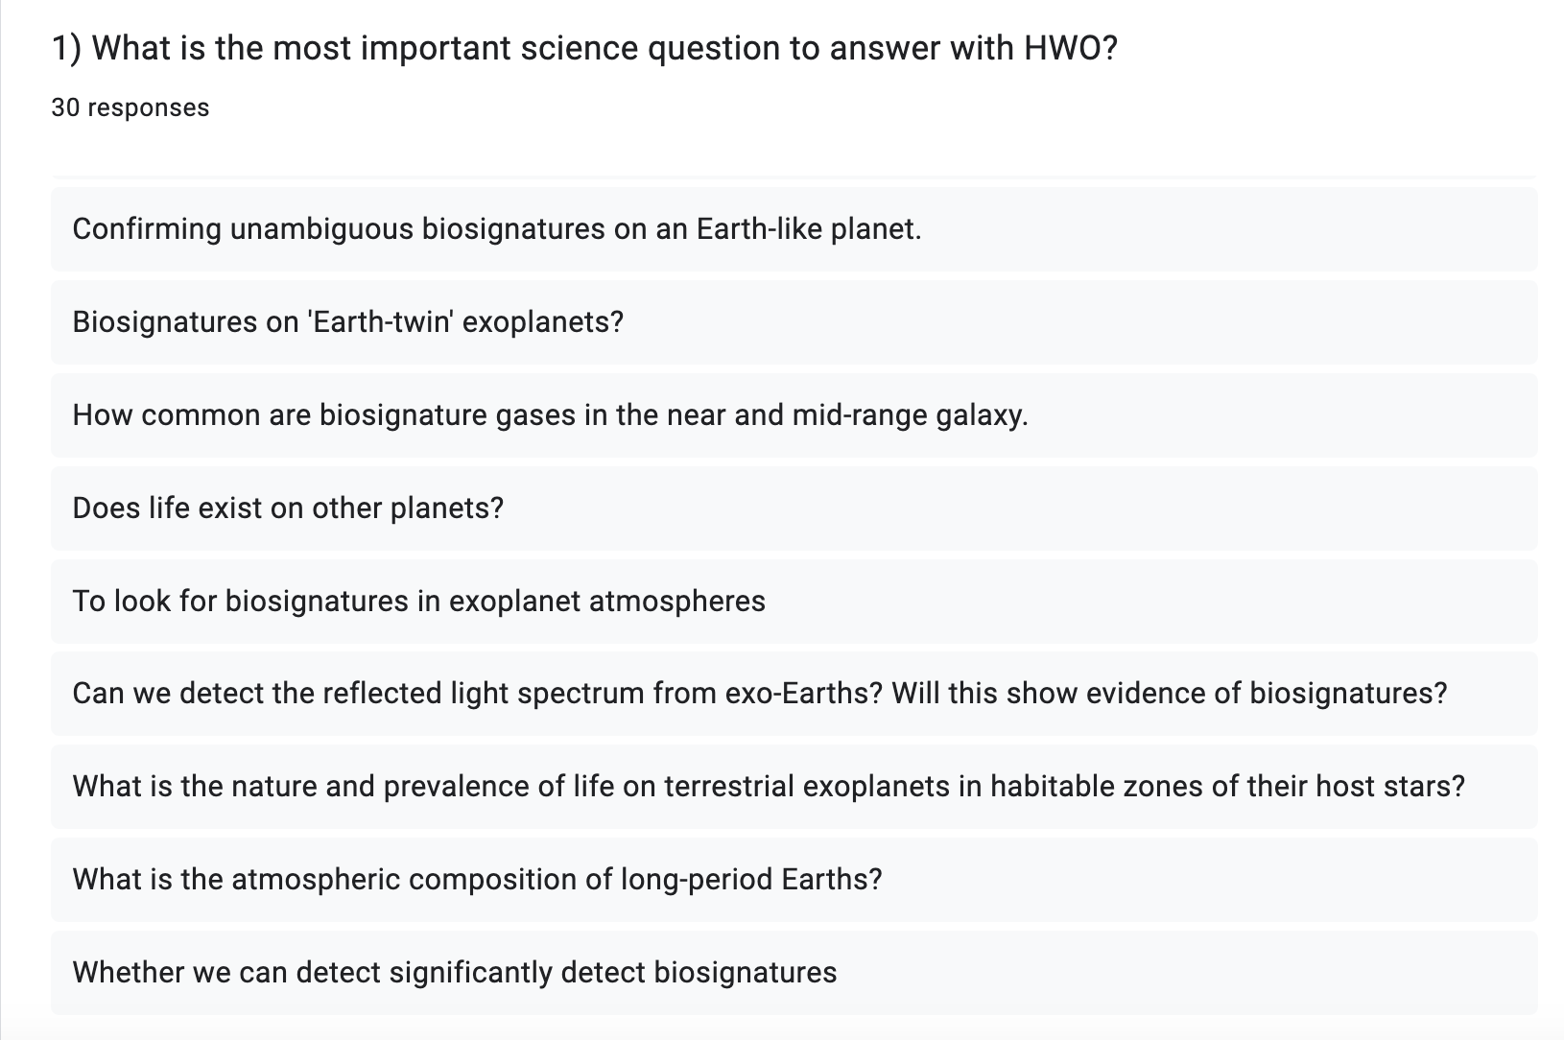

Slide 7
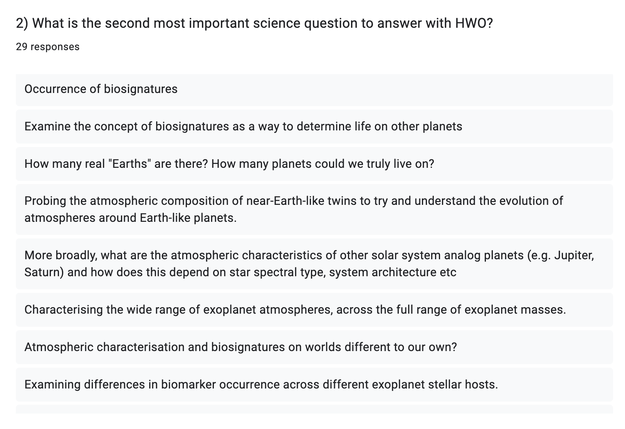

Slide 8
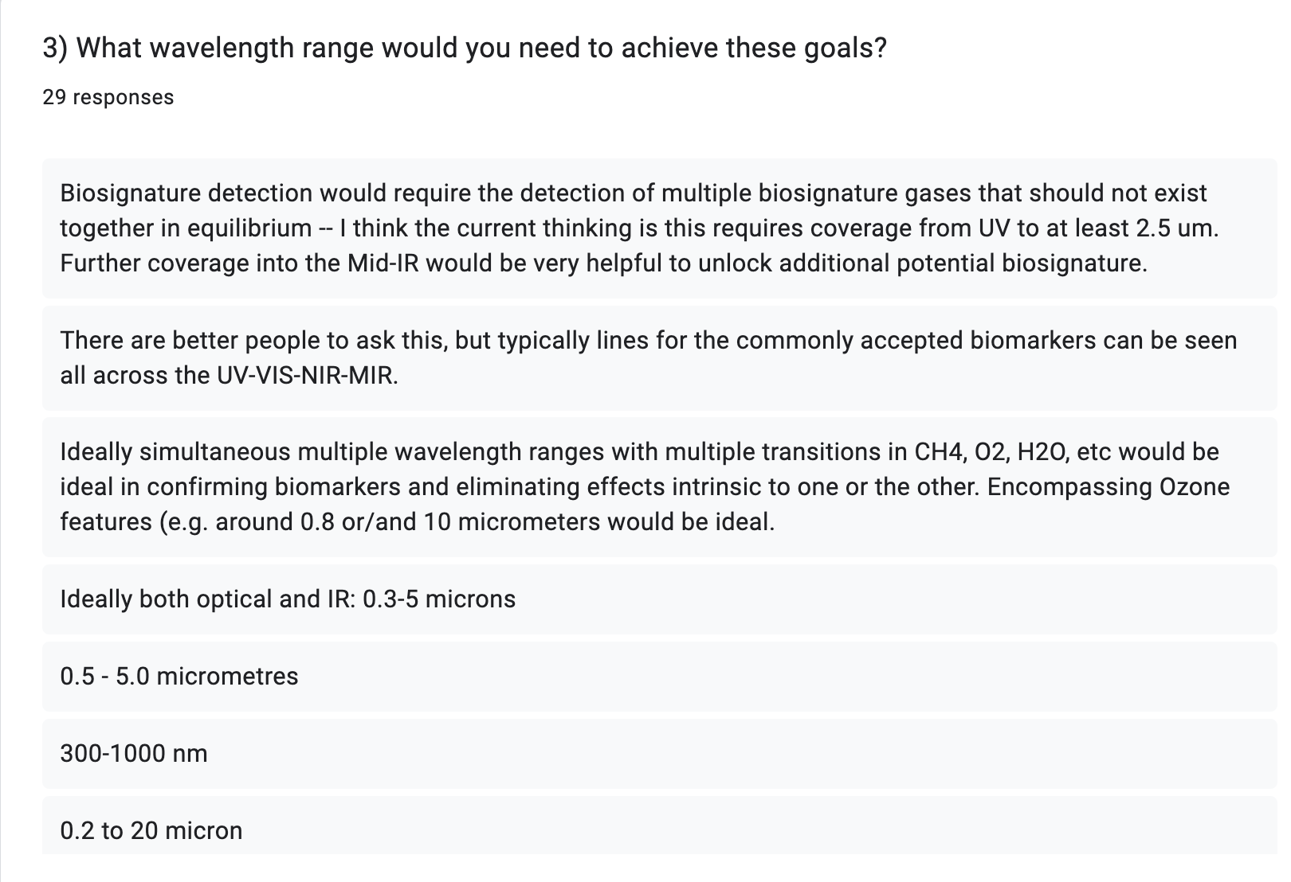

Slide 9
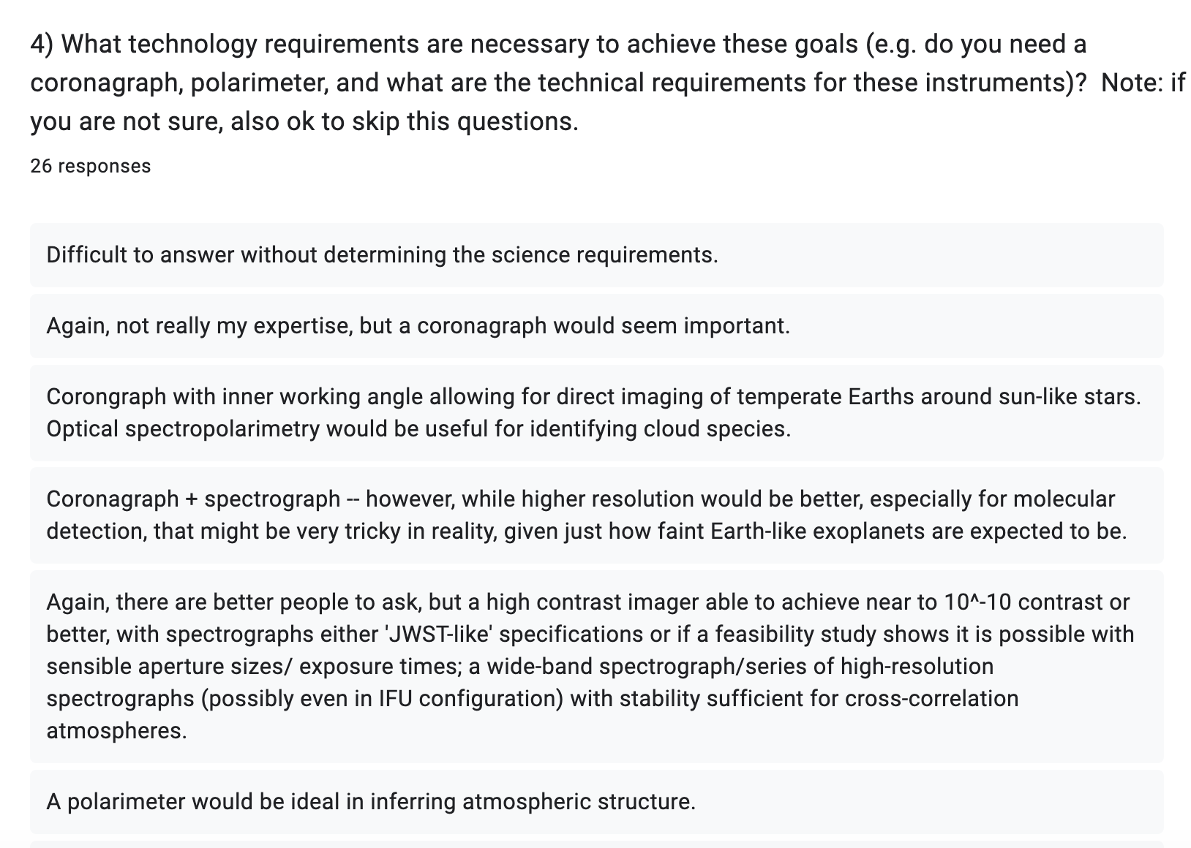

Slide 10
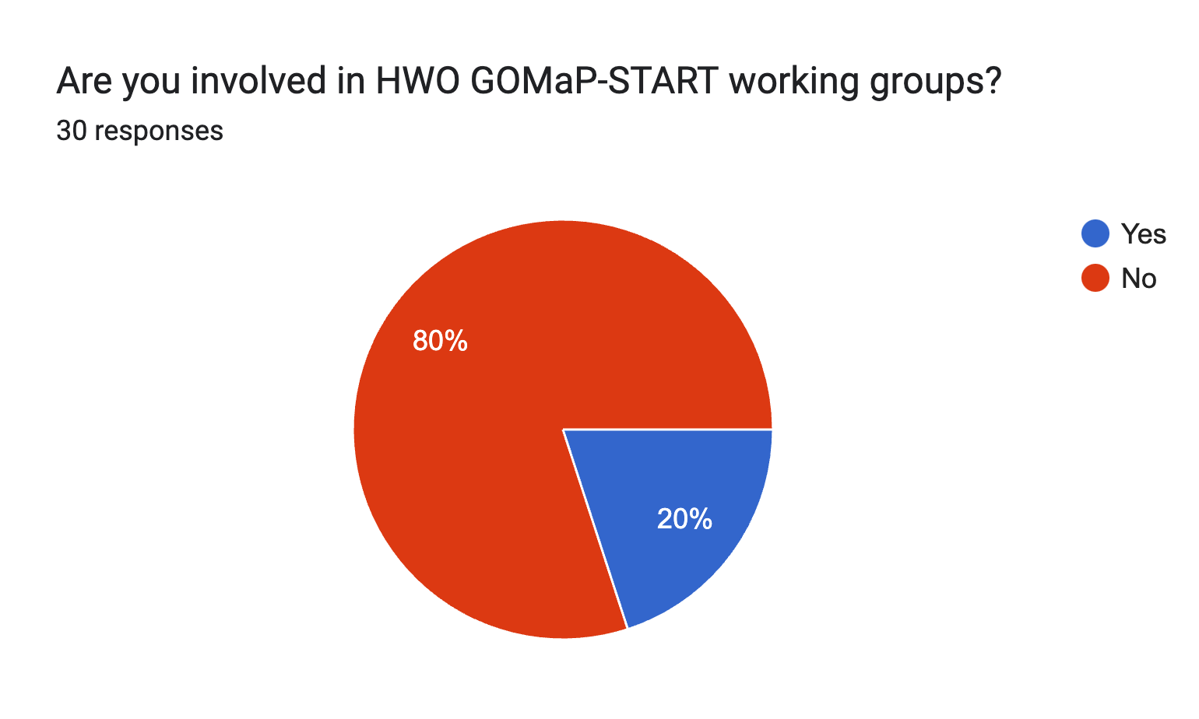

Slide 11

Take-aways:
Most common top science question: detection of biosignatures in reflected light spectra of exo-Earths.
Most common second science question: also biosignatures, but some responses suggested also characterising a wider range of exoplanet types.
The UK community is relatively uninvolved with the GOMaP-START working groups.

Slide 12
Results from survey presented at UK HWO workshop
Workshop at Milton Keynes in Autumn 2024, with participants from UKSA, NASA, and from across the UK.

Slide 13
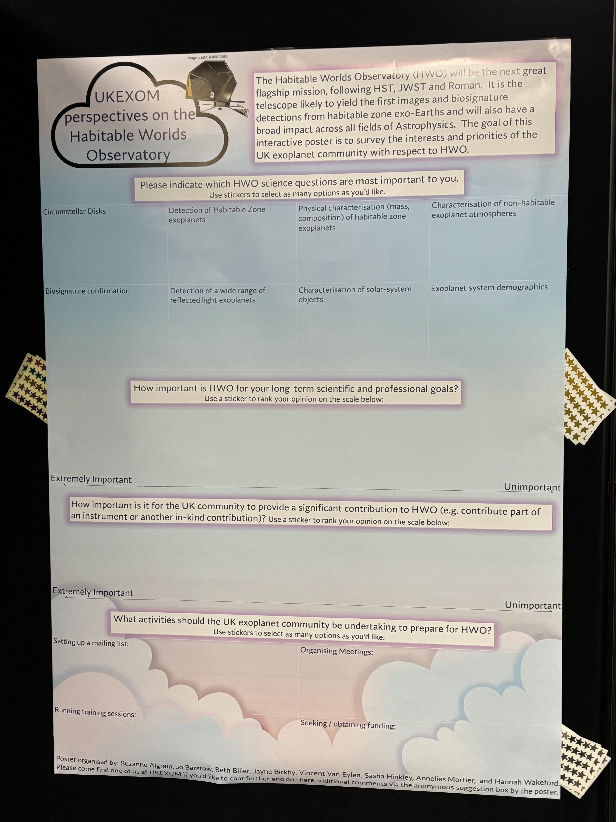
The goal of the UKEXOM interactive poster:
Survey the interests and priorities of the UK exoplanet community with respect to HWO
Areas of consensus across the community may identify scientific / technical areas where the UK could provide a substantial national contribution and thus serve as a basis for organisation of the community.

Slide 14
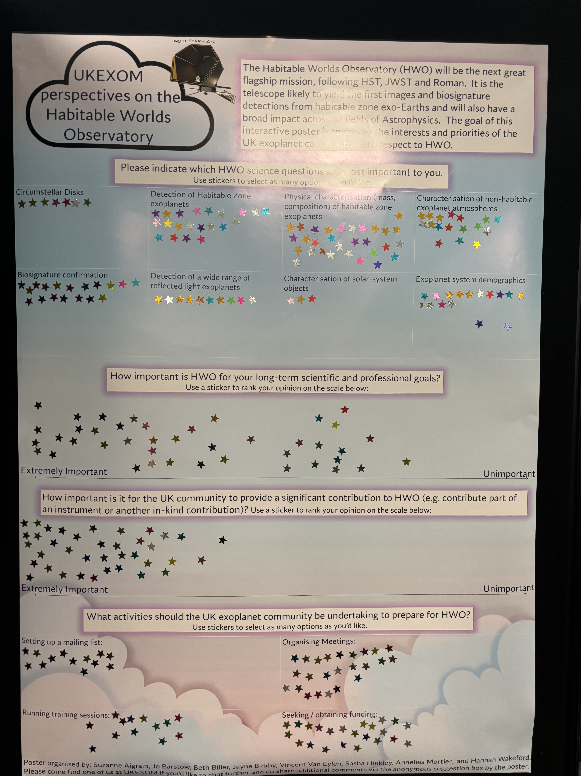
The goal of the UKEXOM interactive poster:
Survey the interests and priorities of the UK exoplanet community with respect to HWO
Areas of consensus across the community may identify scientific / technical areas where the UK could provide a substantial national contribution and thus serve as a basis for organisation of the community.

Slide 15
Opinions on HWO science questions
Physical
Characterisation
of HZ exoplanets
Detection of
HZ exoplanets
Characterisation
of non-habitable
exoplanet
atmospheres
Exoplanet System Demographics
Biosignature
Characterisation
Detection of a wide
range of reflected-light exoplanets
Circumstellar
Disks

Slide 16
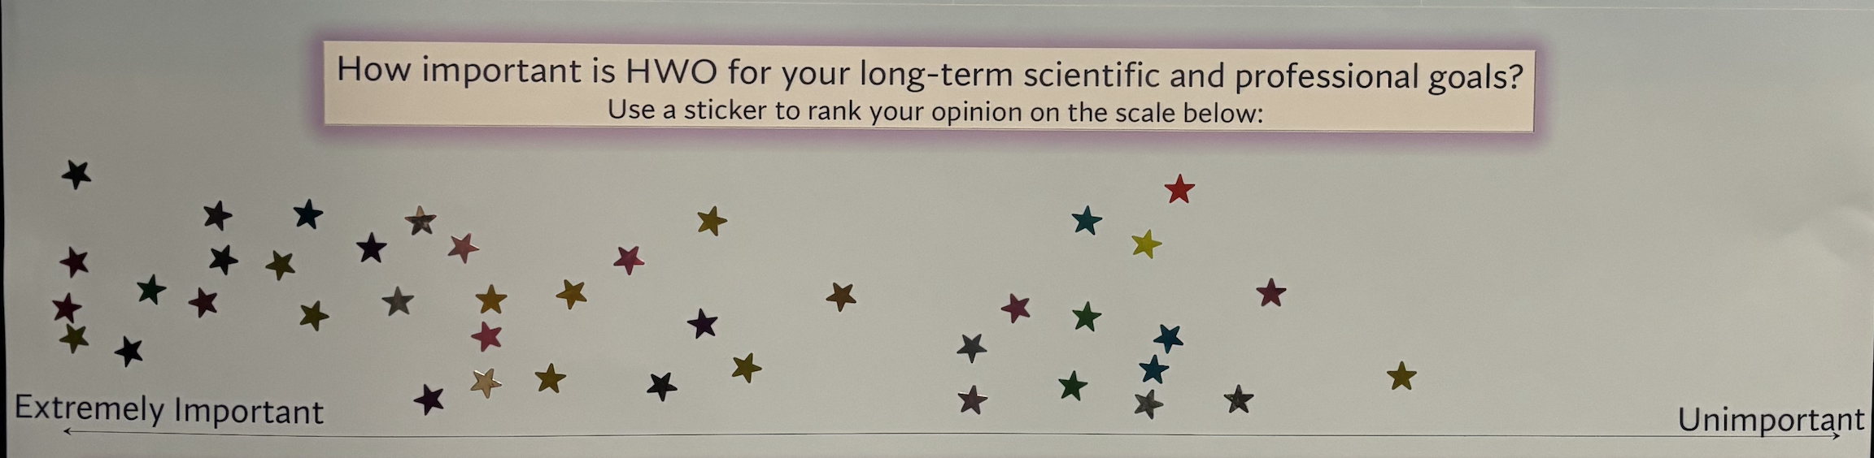

Slide 17
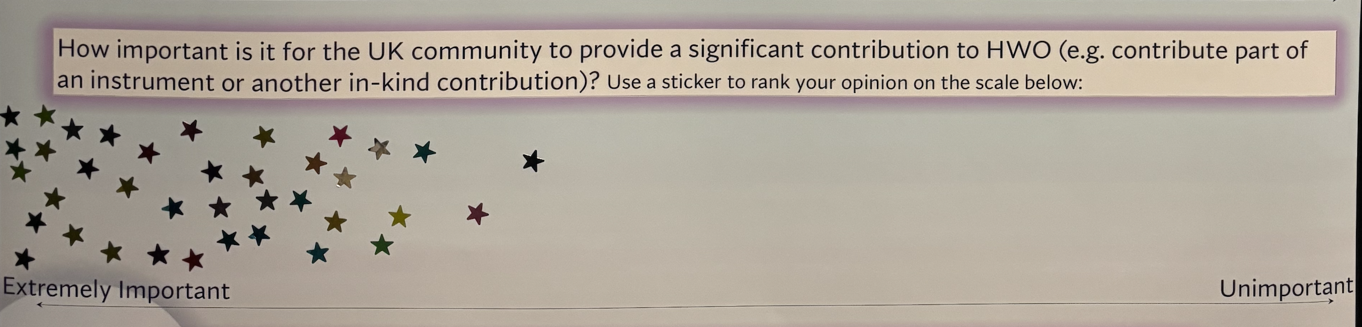

Slide 18
Opinions on actions to take:
Seeking / Obtaining Funding
Organising Meetings
Running Training Sessions
Setting up an email list

Slide 19
Additional comments from the suggestion box:
Much of the motivation for studying exozodiacal dust is to mitigate its effect on HWO searches for exo-Earths – we should talk! -- Tim
We have a strong terrestrial planet atmosphere modelling community in the UK – we should exploit that to prep/specs for HWO! (Catherine Walsh – Leeds)
We need to understand clouds! More UK labs!
Work together with stellar people → let’s characterize the targets! **
Planetary enriched white dwarfs!!

