Slide 1
EXO-DAO
Peer2Peer Swarm-Searching
Notes:
Structured and unstructured networks.
We will hae unstructured, as there should not be a central authority to the swarm.
This means we need to define the law of finding other nodes.

Slide 2
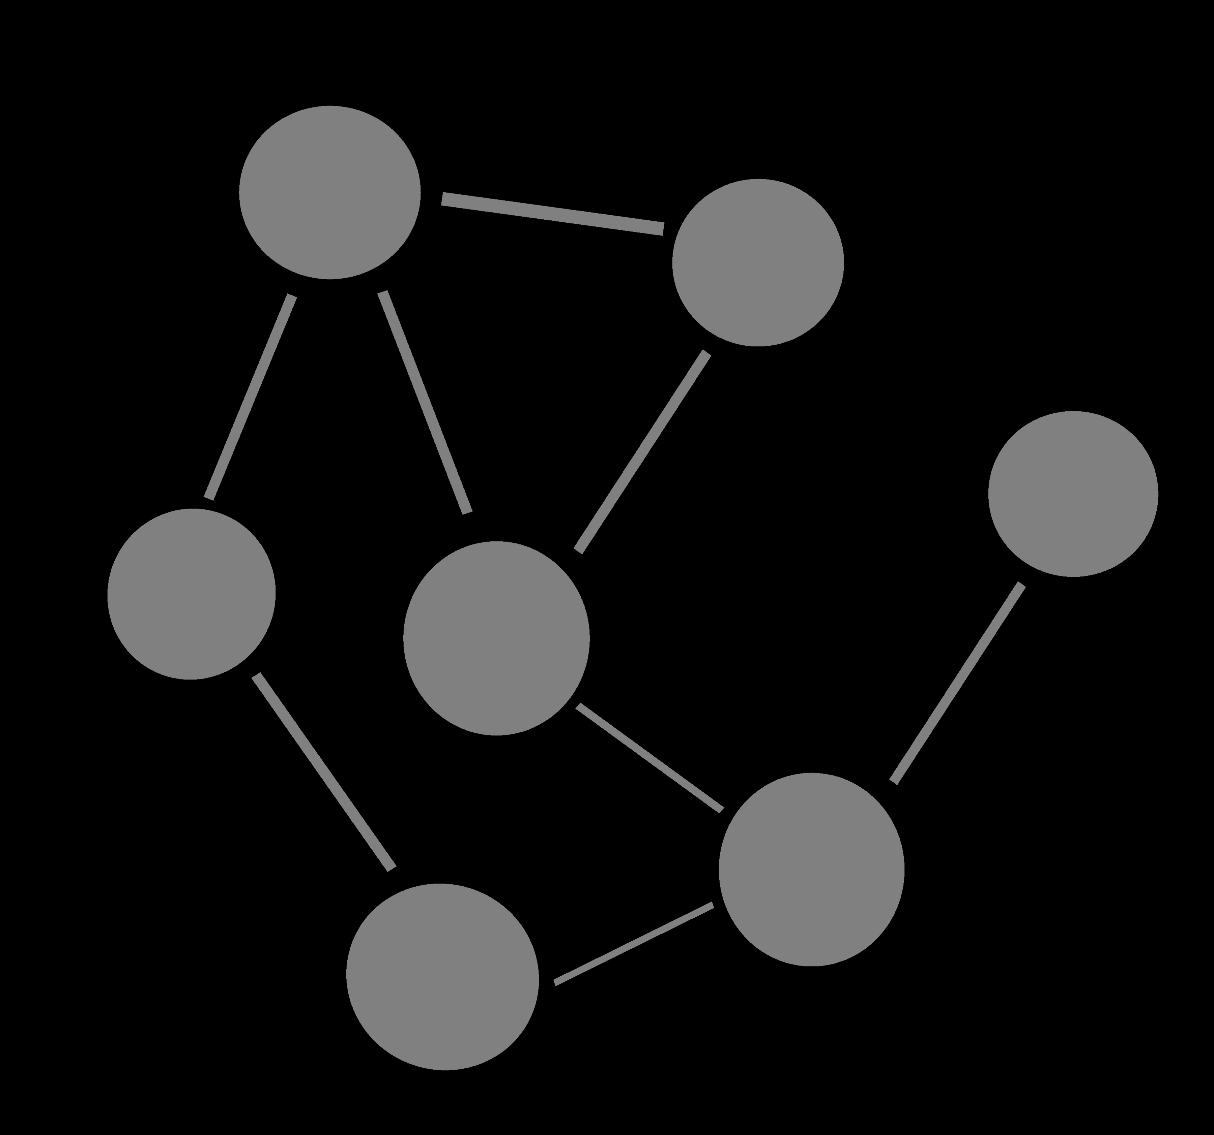
Peer 2 Peer:
A distributed application architecture that partitions tasks or workloads between peers.
Peers are equally privileged, equipotent participants in the network.
Notes:
Structured and unstructured networks
We use unstructured, as the swarm should not have an authority
So we need to define the rules for finding other nodes

Slide 3
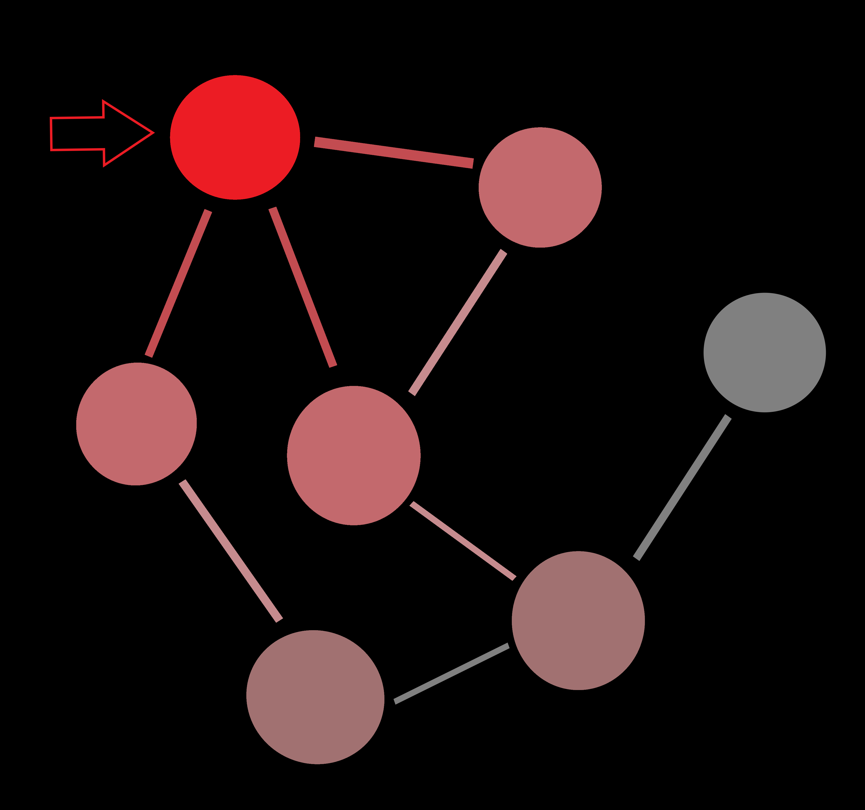
Peer 2 Peer:
A distributed application architecture that partitions tasks or workloads between peers.
Peers are equally privileged, equipotent participants in the network.
Notes:
Different ways, one is levelling the nodes up to super nodes once they have gathered „experience“ and making them hubs to their leaf nodes.
Another is a gossiping, where every node selects a number of random nodes in the network
thousands of different protocols, this we will have to experiment with, depending on network size.

Slide 4
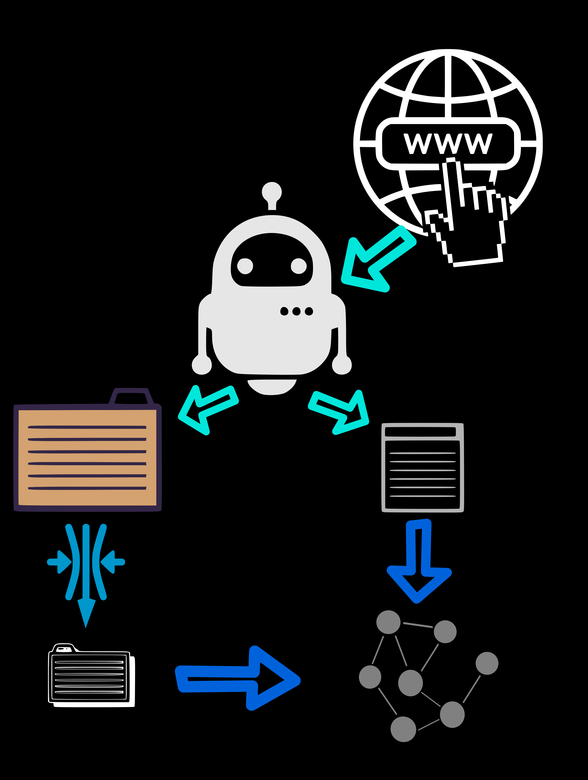
On the Node:
1) Crawling
2) Indexing
3) Searching
Crawler-Bot
Index
URL List
„Centroid“ of Index

Slide 5
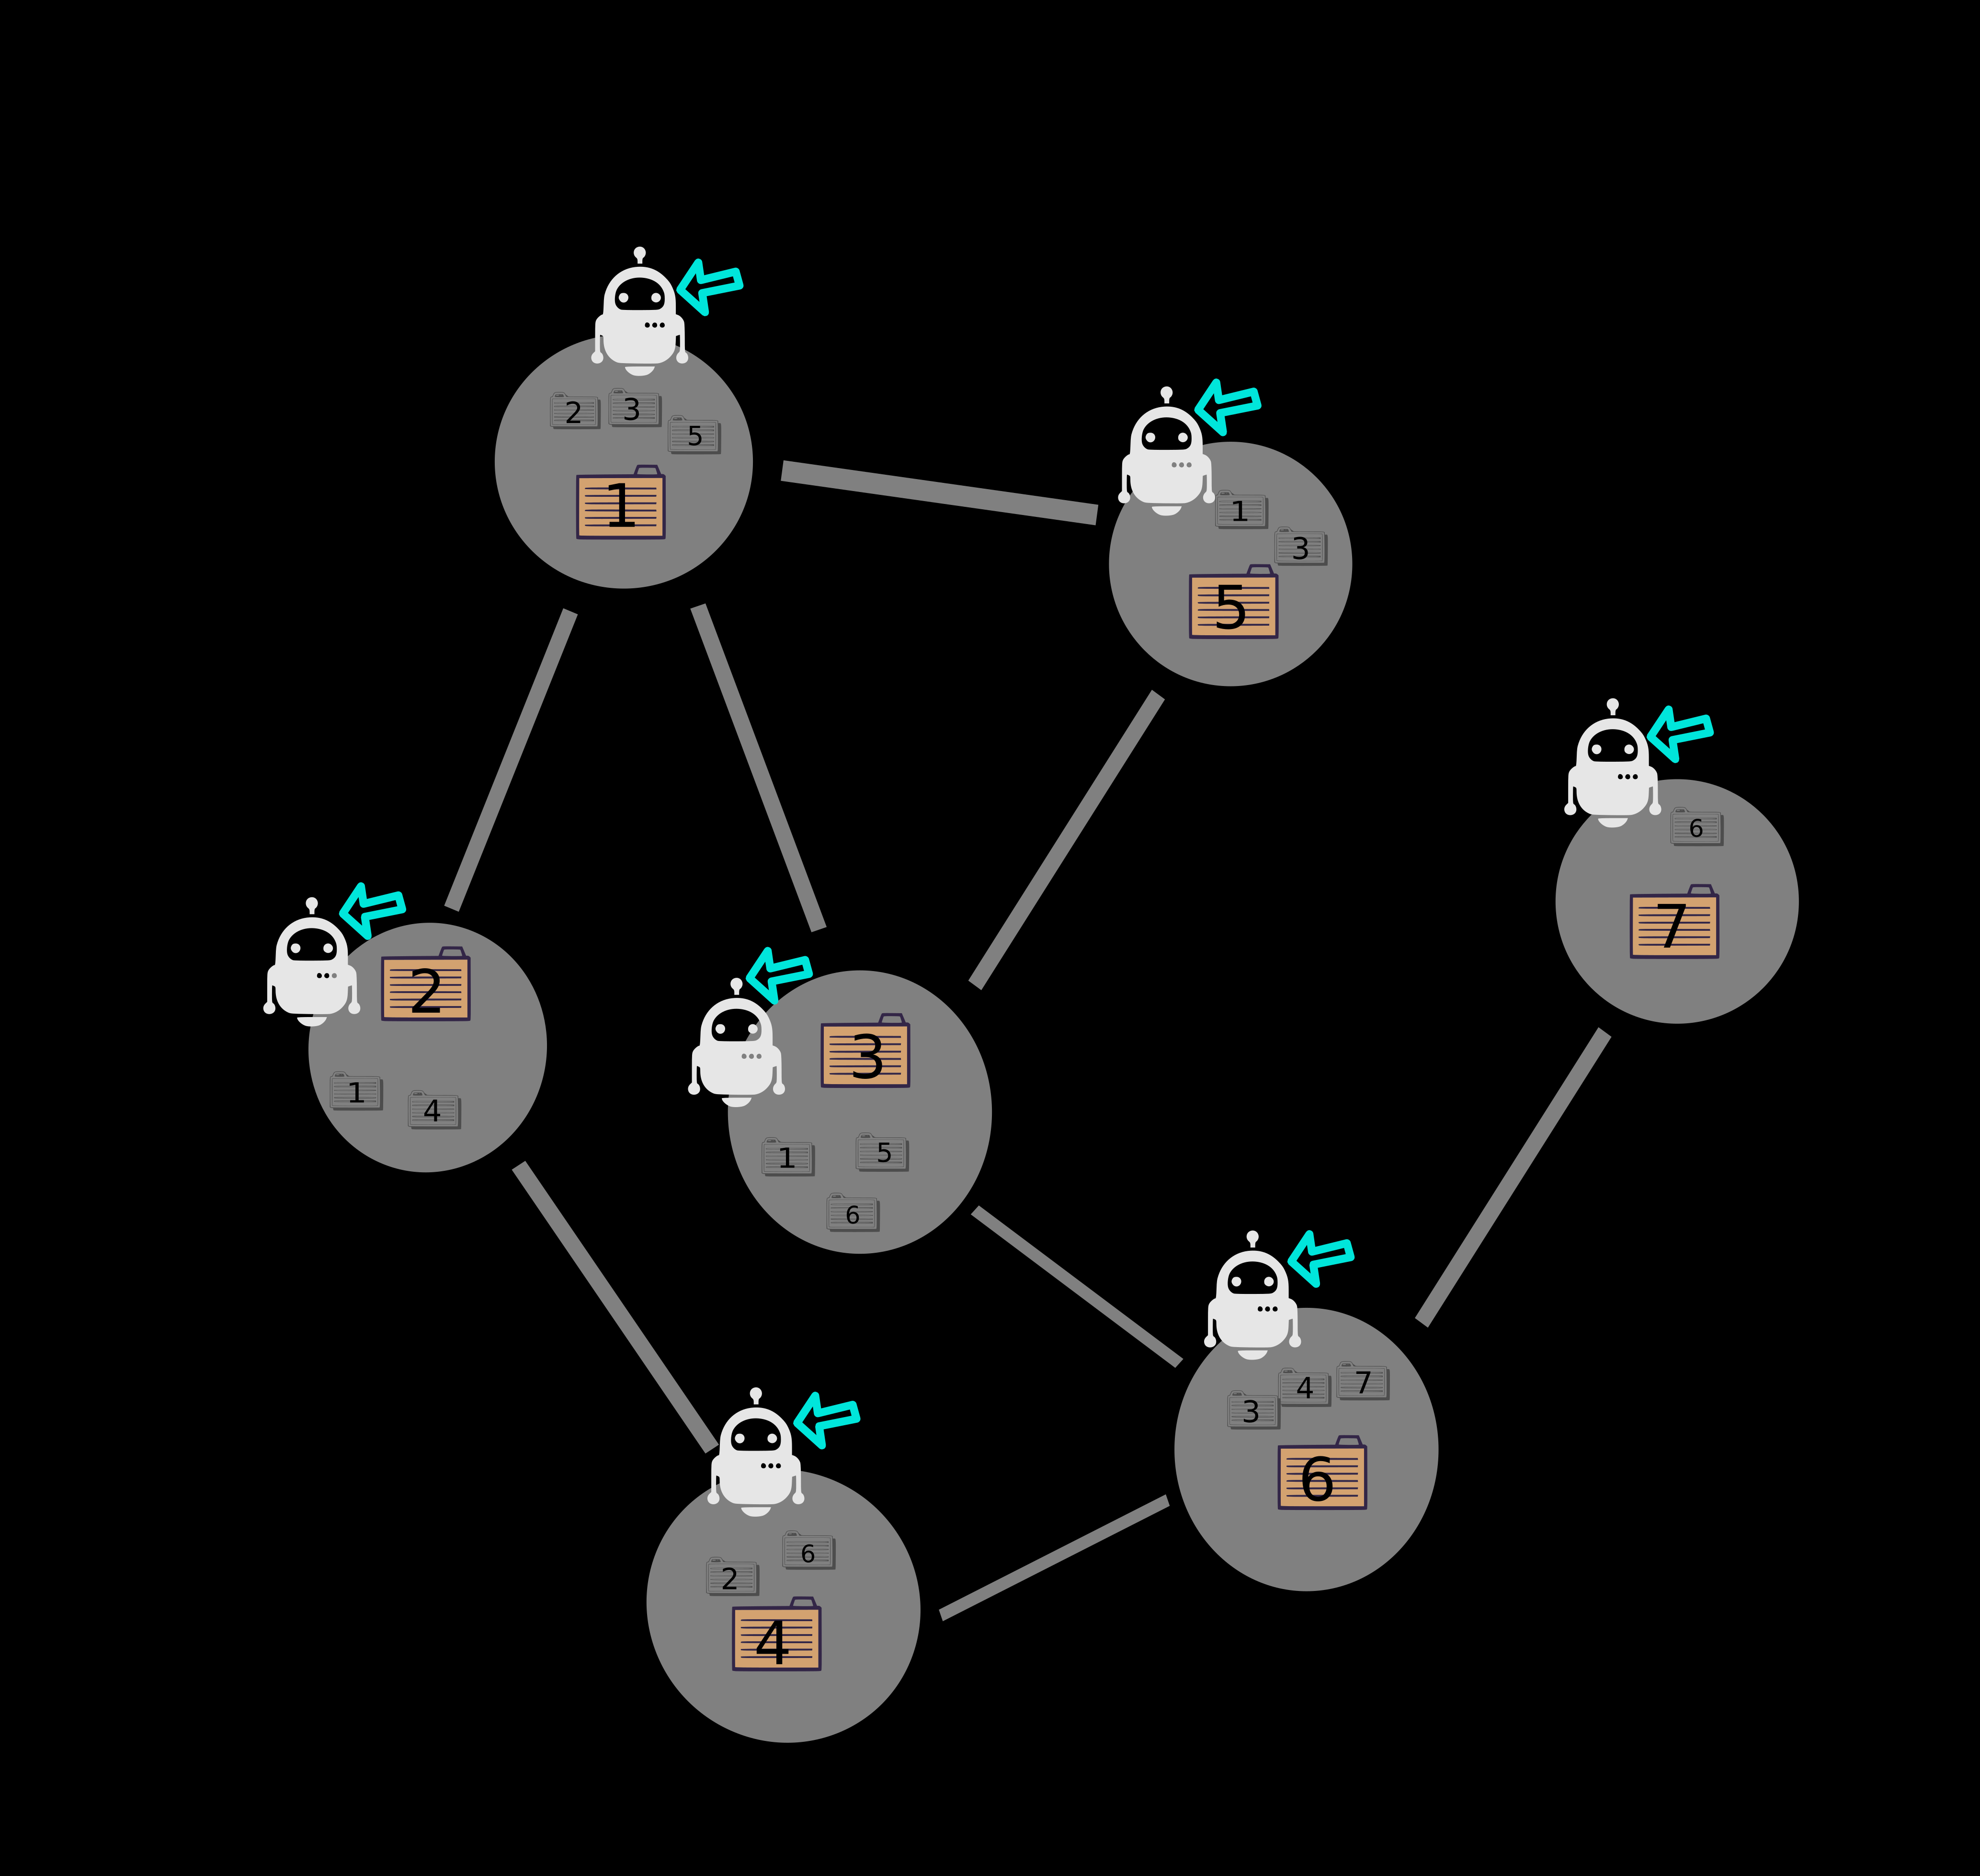
On the Network:
Crawling workloads split between peers
More pages added to combined Index by network

Slide 6
On the Node:
1) Crawling
2) Indexing
3) Searching

Slide 7
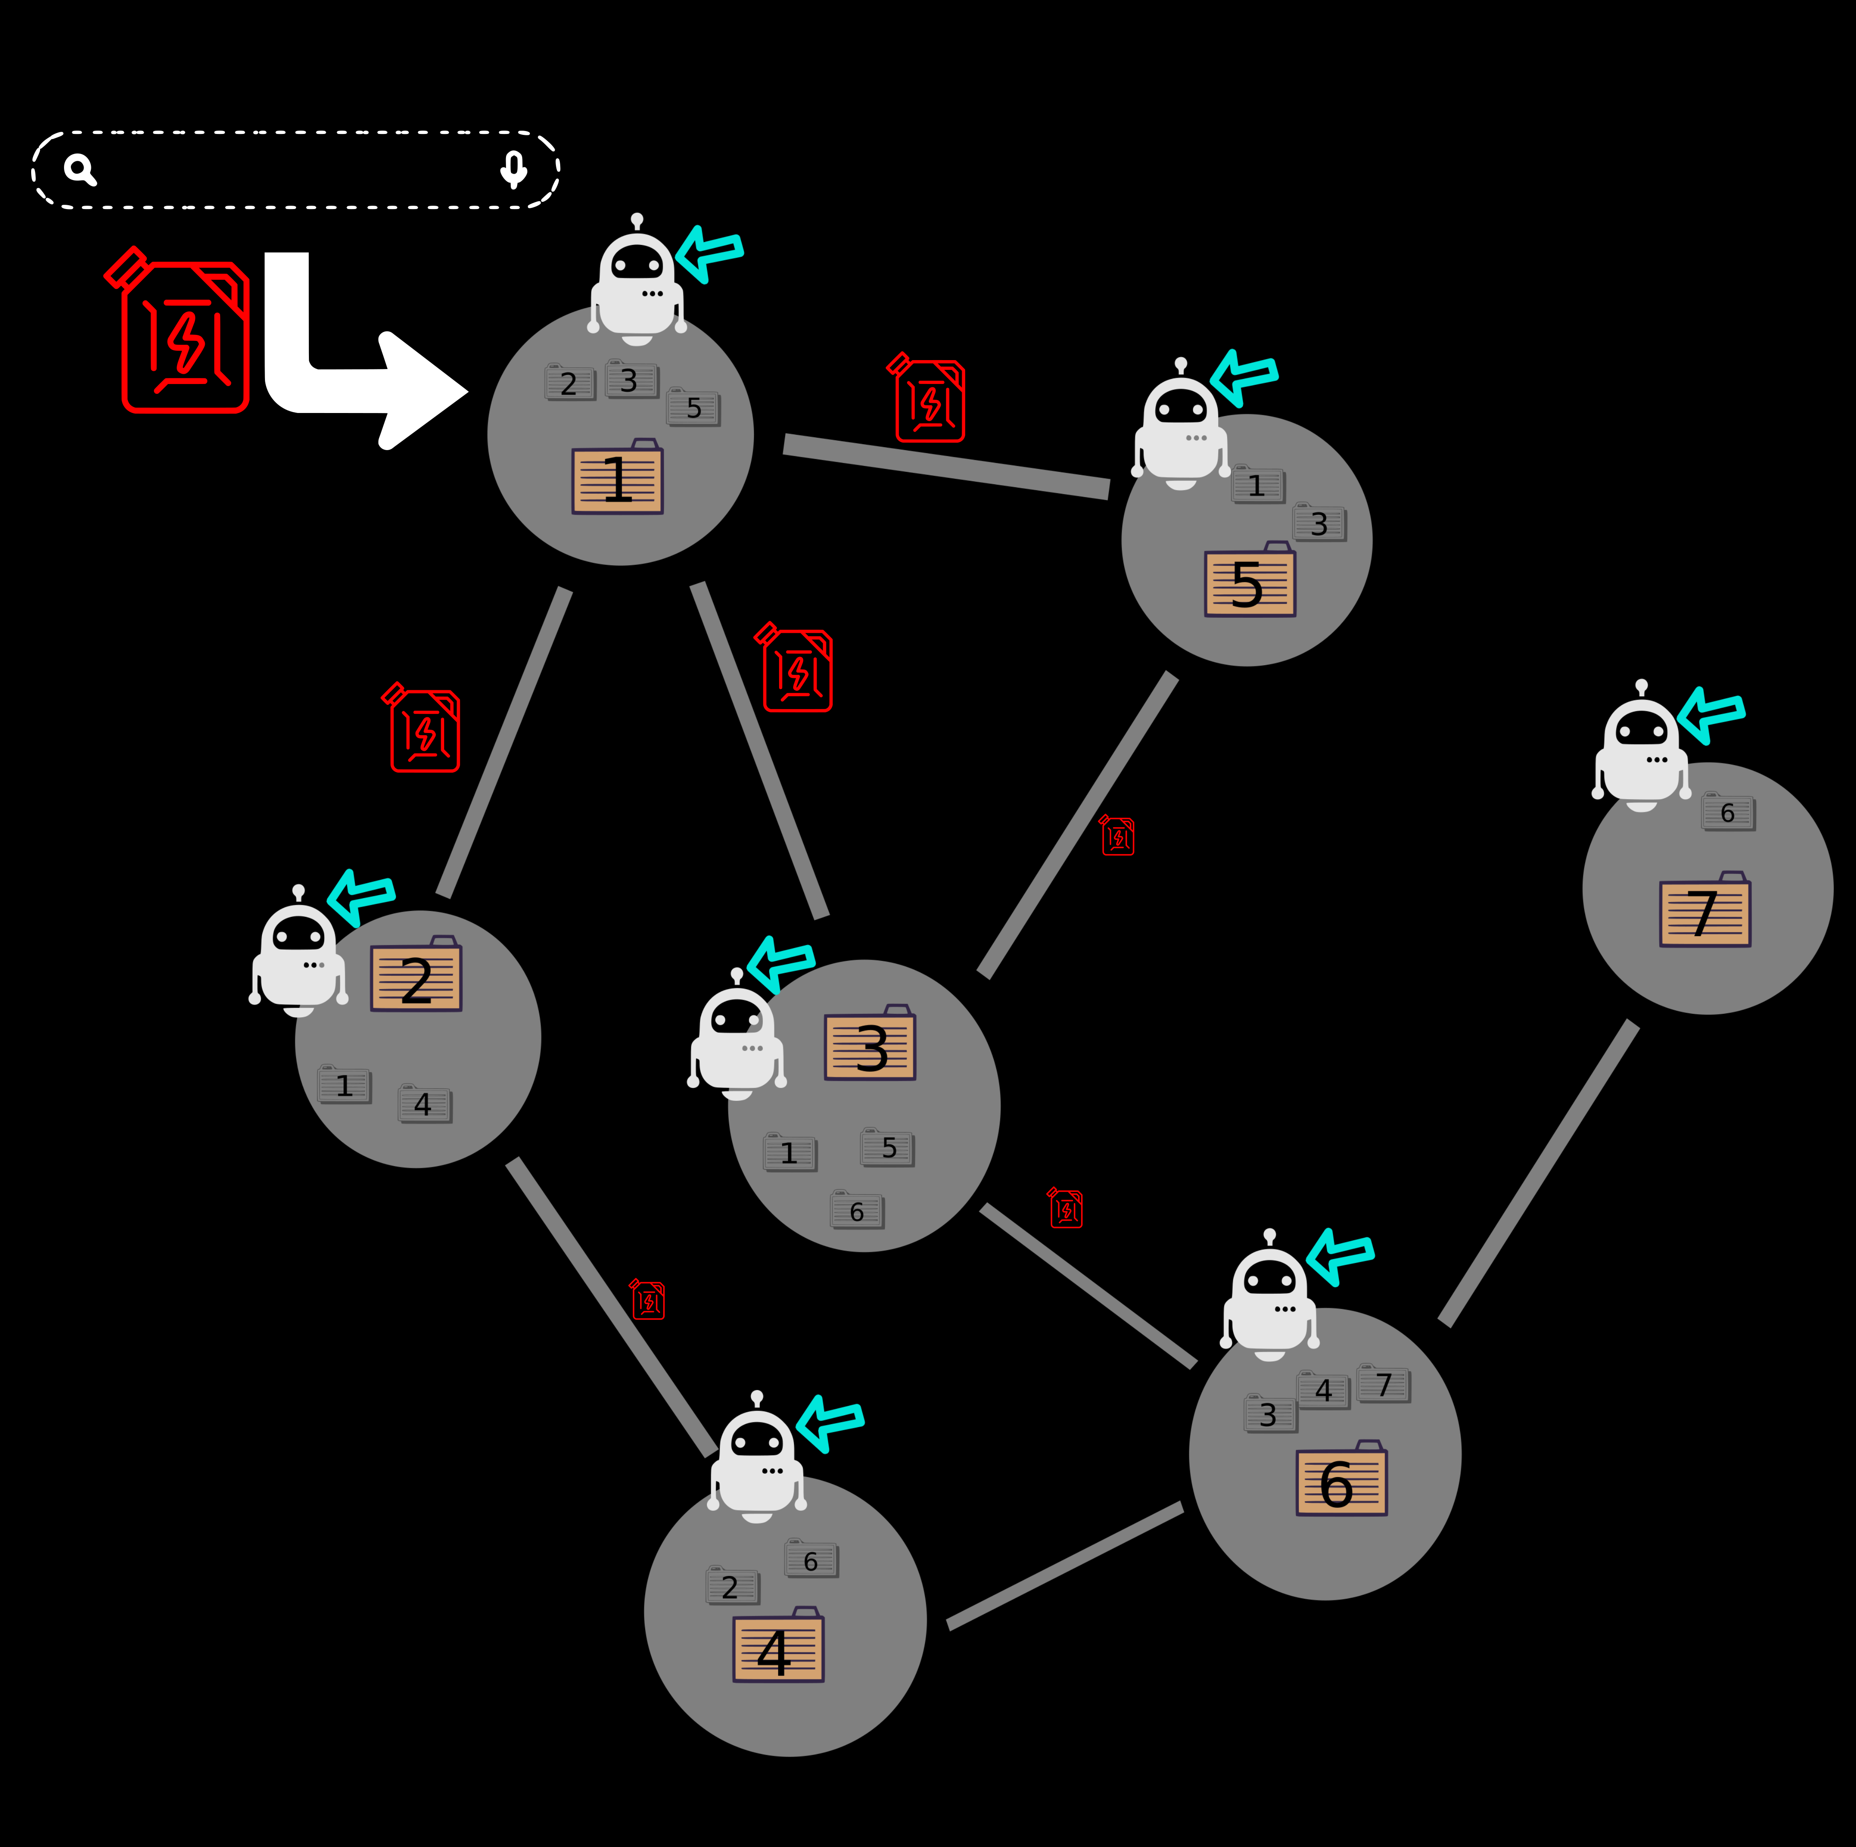
On the Network:
Query comes with a measure of desired search effort
Depending on the size of the Index, effort is „used“

Slide 8
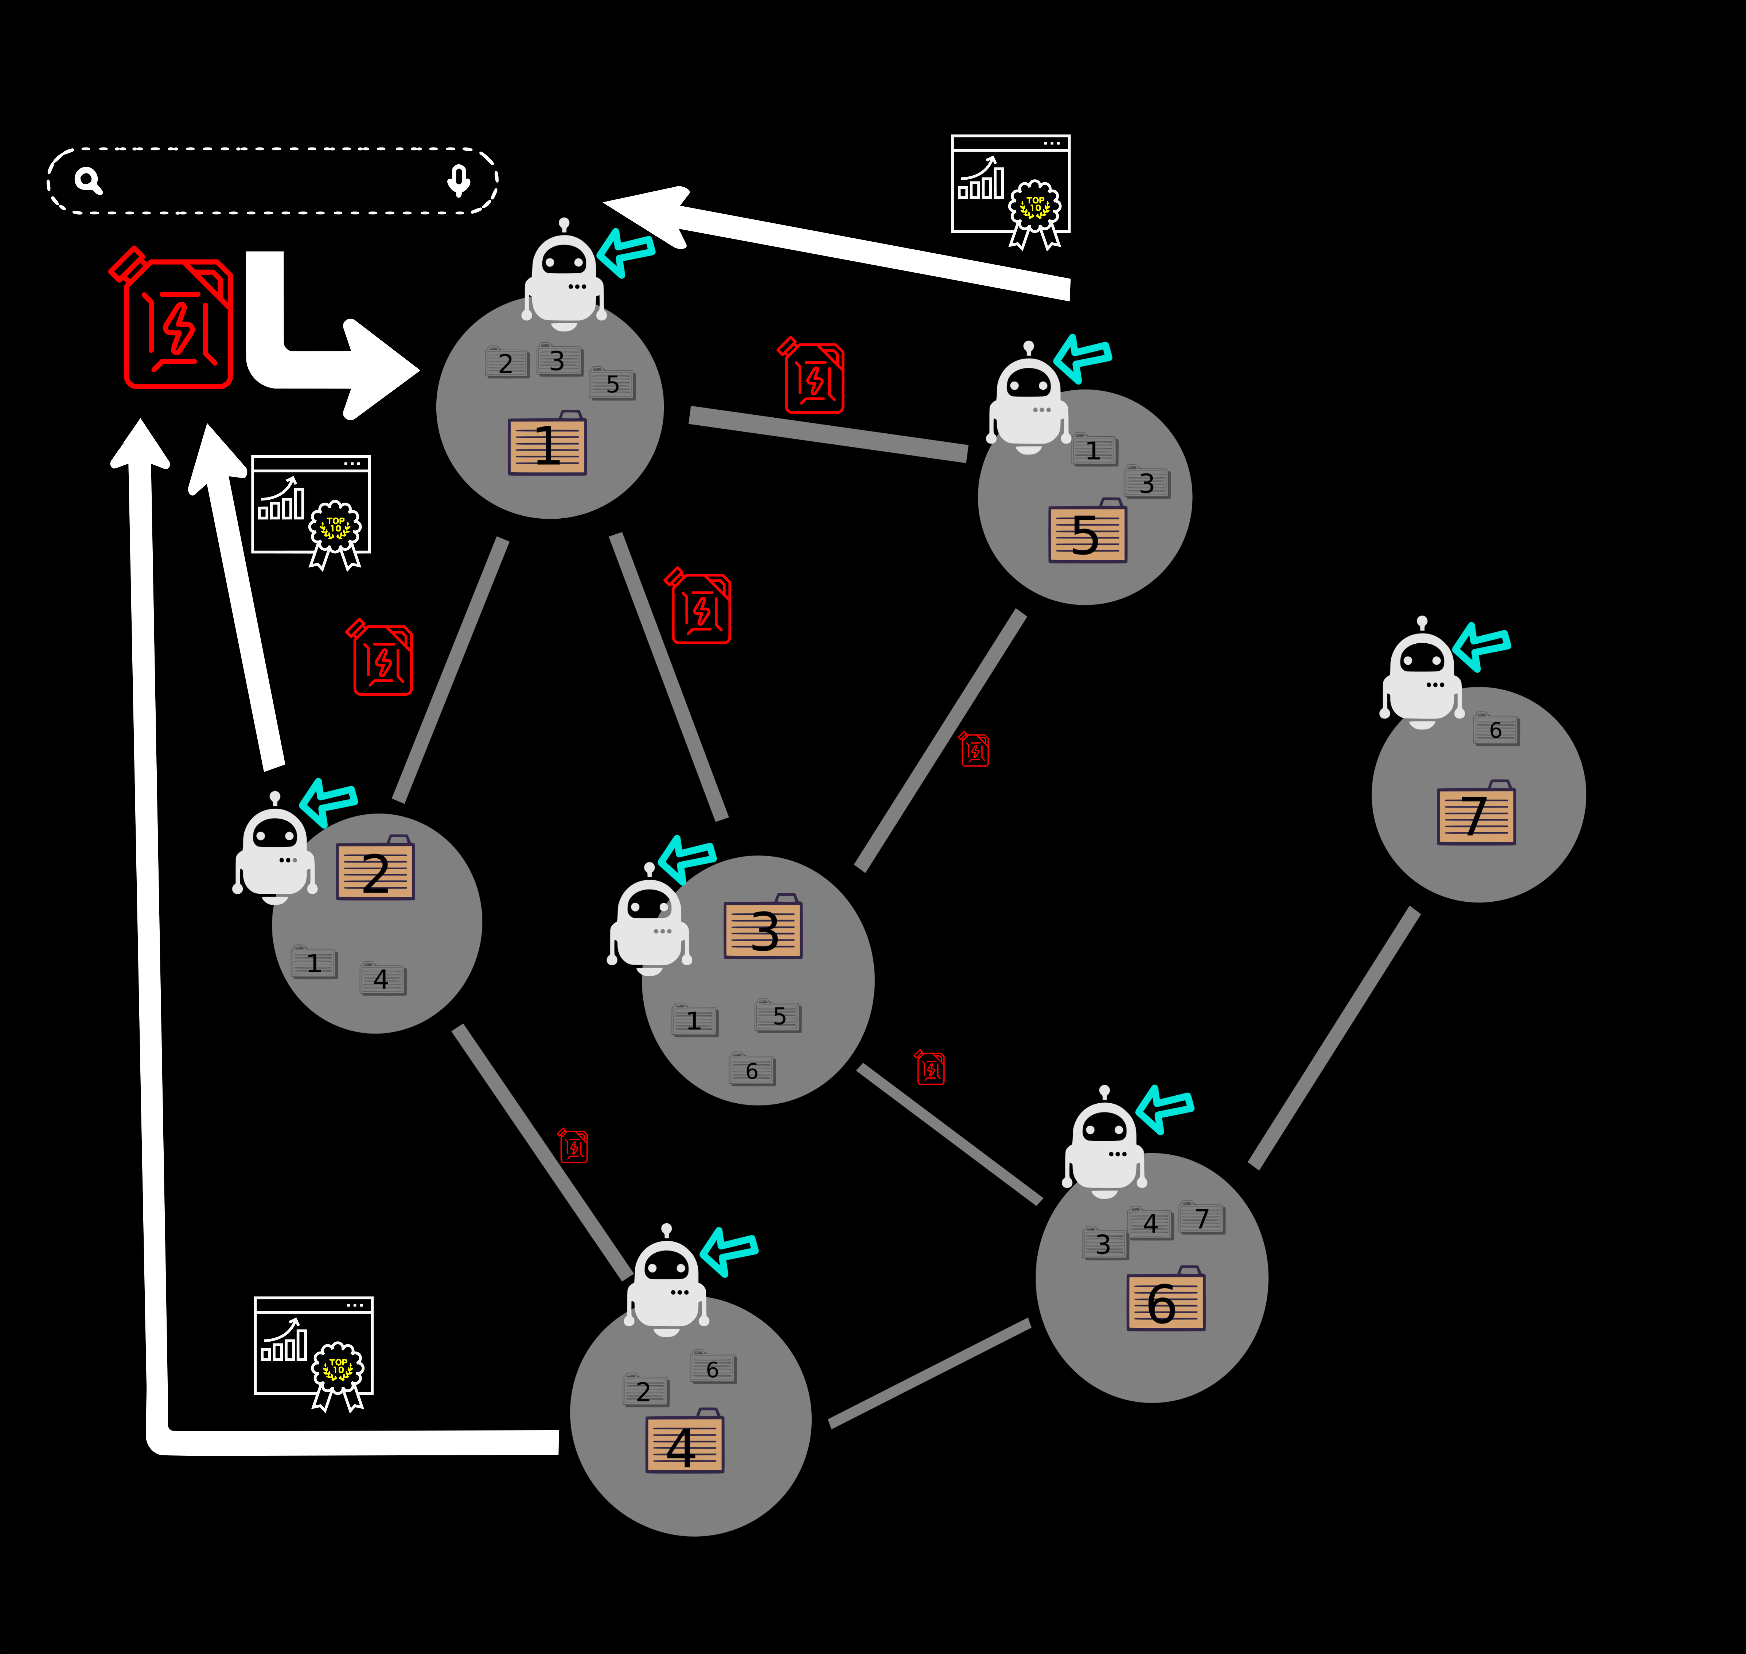
On the Network:
If the ranking is above threshold, send results back to gateway
Possibility for user to save indices
for later (faster) searches

