Slide 1

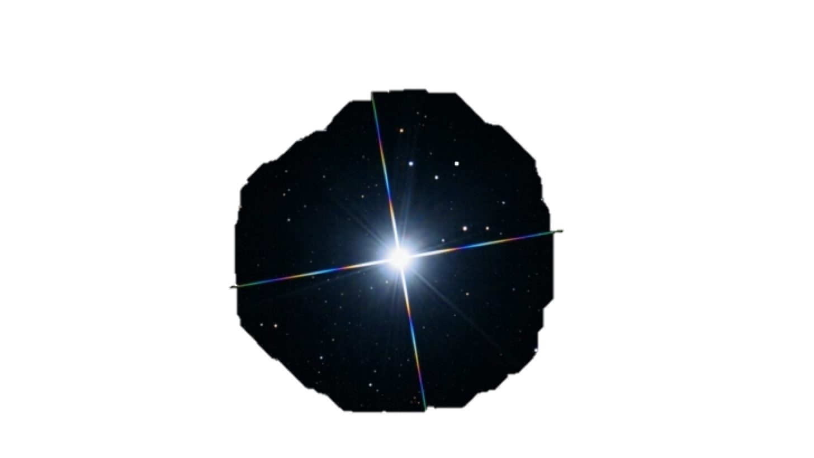

Photometric Software
HOlomon

Slide 2
Photometric Software
HOlomon

