Slide 1
CSE4110: Artificial Intelligence Laboratory
Attack on Defender
Grid Based Tactical Shooter Game
Presented By:
Nafiul Alam
Roll: 1807005
Partho Choudhury Shoumya
Roll: 1807021
Dept. of Computer Science and Engineering
Khulna University of Engineering and Technology

Slide 2




OUTLINES
1. Game Theory
3. Unity Demo
2. Gameplay
& Mechanics
4. Conclusion

Slide 3
1. Game Theory
This is a 5v5 game.
Both Human and Computer will have 5 agents to play with.
At first Human can choose either being attacker or defender.
Main objective of the attacker to win the game is either kill all the defenders or reach defender site.
Main objective of the defender to win the game is to kill all the attackers.
This is a turn based game. At each turn Human and Computer will able to do a single action to each agents. Also, each turn has a timer. Each party has to do some action to each agent before timer runs out.

Slide 4
1. Game Theory (Cont’d)
There are possible 3 kinds of Action each agent can make:
Move - Forward, Backward, Left, Right
Rotate – Clockwise, Counter-Clockwise
Shoot
Each Agent has a viewing cone. If an enemy agent comes in contact with the agent’s viewing cone then that agent can shoot the enemy agent.
Making the game more challenging, each agent has different probability of shooting enemy down.
Highest probability will be 0.5. Only one agent of each team will have this. Rest of the agents of each team will have lower probability.
Also, without direct contact each team will not able to see the other team’s agents positions.

Slide 5
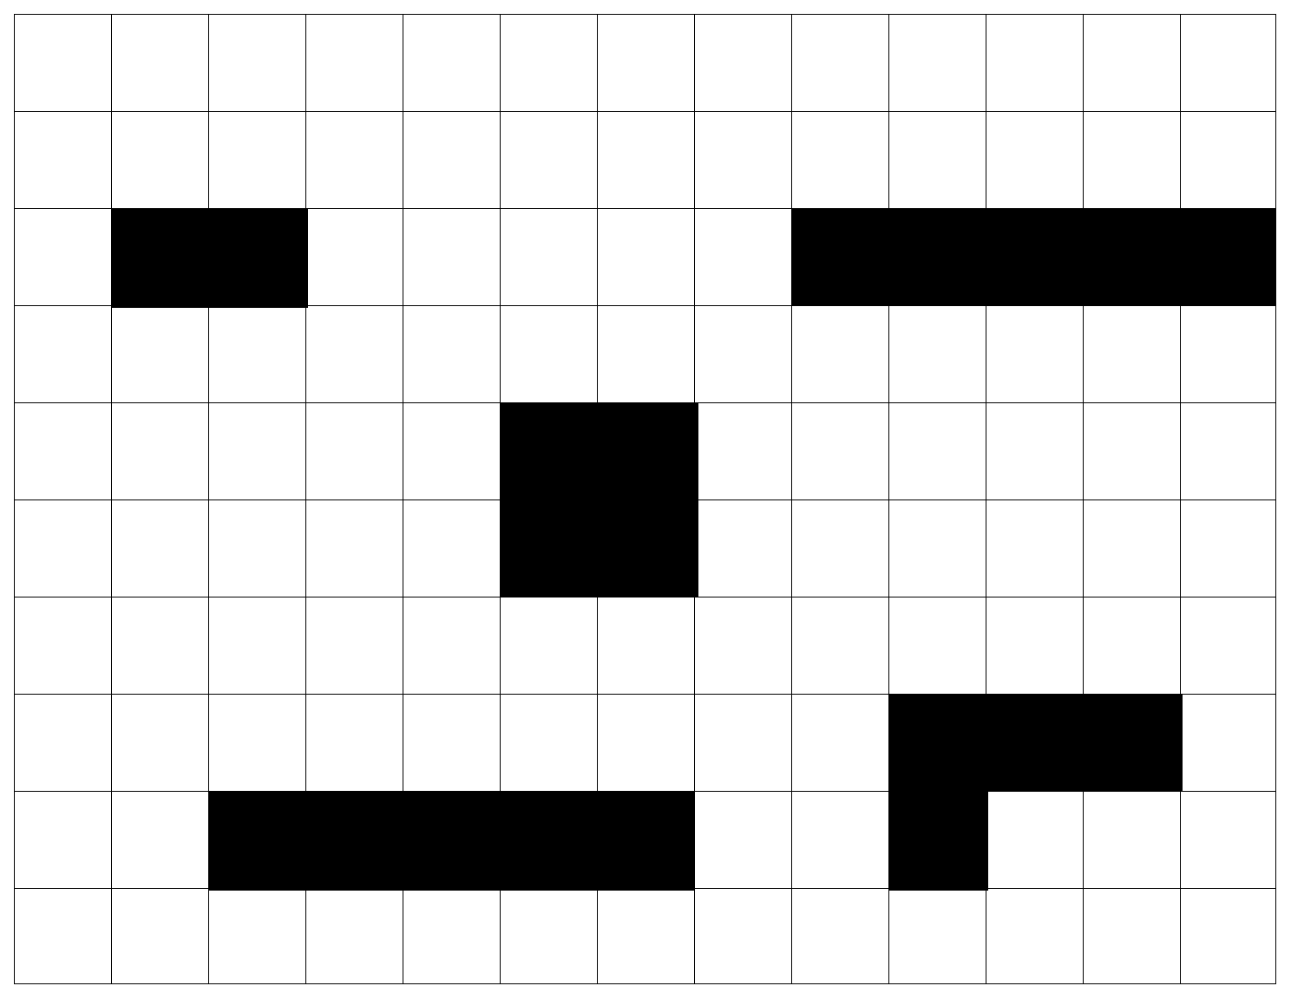
2. Gameplay & Mechanics
Defender Site
Attacker Site
MAP

Slide 6


2. Gameplay & Mechanics (Cont’d) Setup
Attacker View
Defender View

Slide 7
2. Gameplay & Mechanics (Cont’d) Gameplay
Move
Rotate
Shoot
Move
Rotate
Shoot
Attacker View
Defender View

Slide 8
2. Gameplay & Mechanics (Cont’d) Gameplay
Move
Rotate
Shoot
Move
Rotate
Shoot
Attacker View
Defender View

Slide 9
2. Gameplay & Mechanics (Cont’d) Gameplay
Move
Rotate
Shoot
Move
Rotate
Shoot
Attacker View
Defender View

Slide 10
2. Gameplay & Mechanics (Cont’d) Gameplay
Move
Rotate
Shoot
Move
Rotate
Shoot
Attacker View
Defender View

Slide 11
2. Gameplay & Mechanics (Cont’d) Gameplay
Move
Rotate
Shoot
Move
Rotate
Shoot
Attacker View
Defender View

Slide 12
2. Gameplay & Mechanics (Cont’d) Gameplay
Move
Rotate
Shoot
Move
Rotate
Shoot
Attacker View
Defender View

Slide 13
2. Gameplay & Mechanics (Cont’d) Gameplay
Move
Rotate
Shoot
Move
Rotate
Shoot
Attacker View
Defender View

Slide 14
2. Gameplay & Mechanics (Cont’d) Gameplay
Move
Rotate
Shoot
Move
Rotate
Shoot
Attacker View
Defender View

Slide 15
2. Gameplay & Mechanics (Cont’d) Gameplay
Move
Rotate
Shoot
Move
Rotate
Shoot
Attacker View
Defender View

Slide 16
2. Gameplay & Mechanics (Cont’d) Gameplay
Move
Rotate
Shoot
Move
Rotate
Shoot
Attacker View
Defender View

Slide 17
2. Gameplay & Mechanics (Cont’d) Gameplay
Move
Rotate
Shoot
Move
Rotate
Shoot
Attacker View
Defender View

Slide 18
2. Gameplay & Mechanics (Cont’d) Gameplay
Move
Rotate
Shoot
Move
Rotate
Shoot
Attacker View
Defender View

Slide 19
2. Gameplay & Mechanics (Cont’d) Gameplay
Move
Rotate
Shoot
Move
Rotate
Shoot
Attacker View
Defender View

Slide 20
2. Gameplay & Mechanics (Cont’d) Gameplay
Move
Rotate
Shoot
Move
Rotate
Shoot
Attacker View
Defender View

Slide 21
2. Gameplay & Mechanics (Cont’d) Gameplay
Move
Rotate
Shoot
Move
Rotate
Shoot
Attacker View
Defender View

Slide 22
2. Gameplay & Mechanics (Cont’d) Gameplay
Move
Rotate
Shoot
Move
Rotate
Shoot
Attacker View
Defender View

Slide 23
2. Gameplay & Mechanics (Cont’d) Gameplay
Move
Rotate
Shoot
Move
Rotate
Shoot
Attacker View
Defender View

Slide 24
2. Gameplay & Mechanics (Cont’d) Gameplay
Move
Rotate
Shoot
Move
Rotate
Shoot
Attacker View
Defender View

Slide 25
2. Gameplay & Mechanics (Cont’d) Gameplay
Move
Rotate
Shoot
Move
Rotate
Shoot
Attacker View
Defender View

Slide 26
2. Gameplay & Mechanics (Cont’d) Gameplay
Move
Rotate
Shoot
Move
Rotate
Shoot
Attacker View
Defender View

Slide 27
2. Gameplay & Mechanics (Cont’d) Gameplay
Move
Rotate
Shoot
Move
Rotate
Shoot
Attacker View
Defender View

Slide 28
2. Gameplay & Mechanics (Cont’d) Gameplay
Move
Rotate
Shoot
Move
Rotate
Shoot
Attacker View
Defender View

Slide 29
2. Gameplay & Mechanics (Cont’d) Gameplay
Move
Rotate
Shoot
Move
Rotate
Shoot
Attacker View
Defender View

Slide 30
2. Gameplay & Mechanics (Cont’d) Gameplay
Move
Rotate
Shoot
Move
Rotate
Shoot
Attacker View
Defender View

Slide 31
2. Gameplay & Mechanics (Cont’d) Gameplay
x
Move
Rotate
Shoot
Move
Rotate
Shoot
Attacker View
Defender View

Slide 32
2. Gameplay & Mechanics (Cont’d) Gameplay
x
x
Move
Rotate
Shoot
Move
Rotate
Shoot
Attacker View
Defender View

Slide 33
2. Gameplay & Mechanics (Cont’d) Gameplay
x
Move
Rotate
Shoot
Move
Rotate
Shoot
Attacker View
Defender View

Slide 34
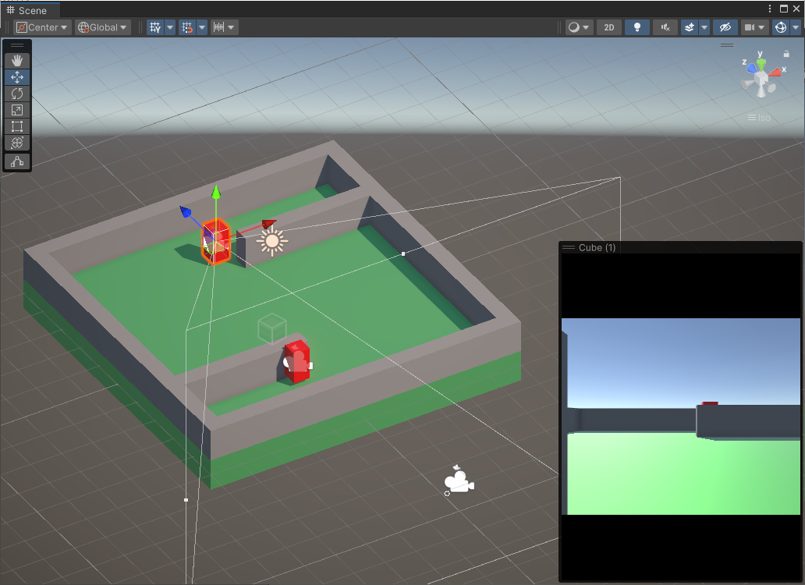
3. Unity Demo

Slide 35
4. Conclusion
Unity Engine and C# is being used for making this game.
This game will have custom heuristic function.
For defender objective will be cover as much as area possible.
For attacker objective will be hide behind walls, so that they can hide from defenders as much as possible.
Also, in future some powers can be added for making the game more interesting and challenging like
Smoke – to make addition cover
Flash – to getting out of cover
Sound – to hear if the enemy is nearby

Slide 36
THANK YOU

