Slide 1
XWUIFormMaster
This is a super component that handles both the form editing and the CRUD of a record or an entity or an object. Relies heavily on converting between JSON format and UI for:
FORM JSON
RECORDS JSON
RECORD JSON

Slide 2

EDITOR PAGE – FORM EDITOR - VIEW
form_state_editor_view
In this is the form editor page where you can drag and drop all input-related components that XWUI supports. In this sample, we're showing hard-coded components only.

Slide 3
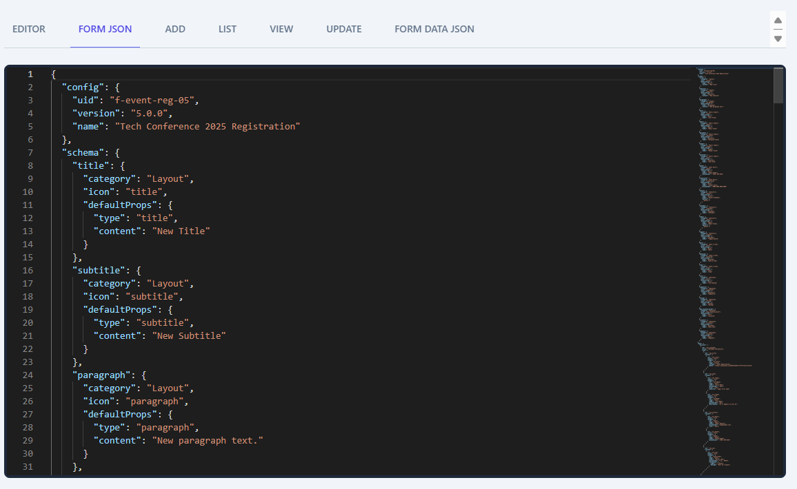
EDITOR PAGE – FORM EDITOR - JSON
In this is the form editor page where you can drag and drop all input-related components that XWUI supports. In this sample, we're showing hard-coded components only.
form_state_editor_json
form_state_editor_view

Slide 4


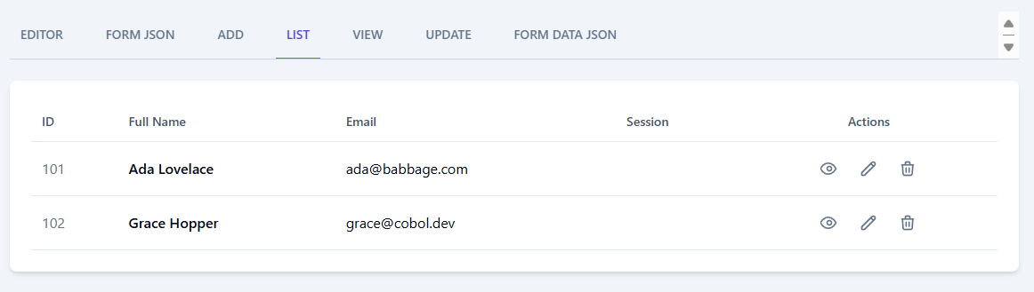
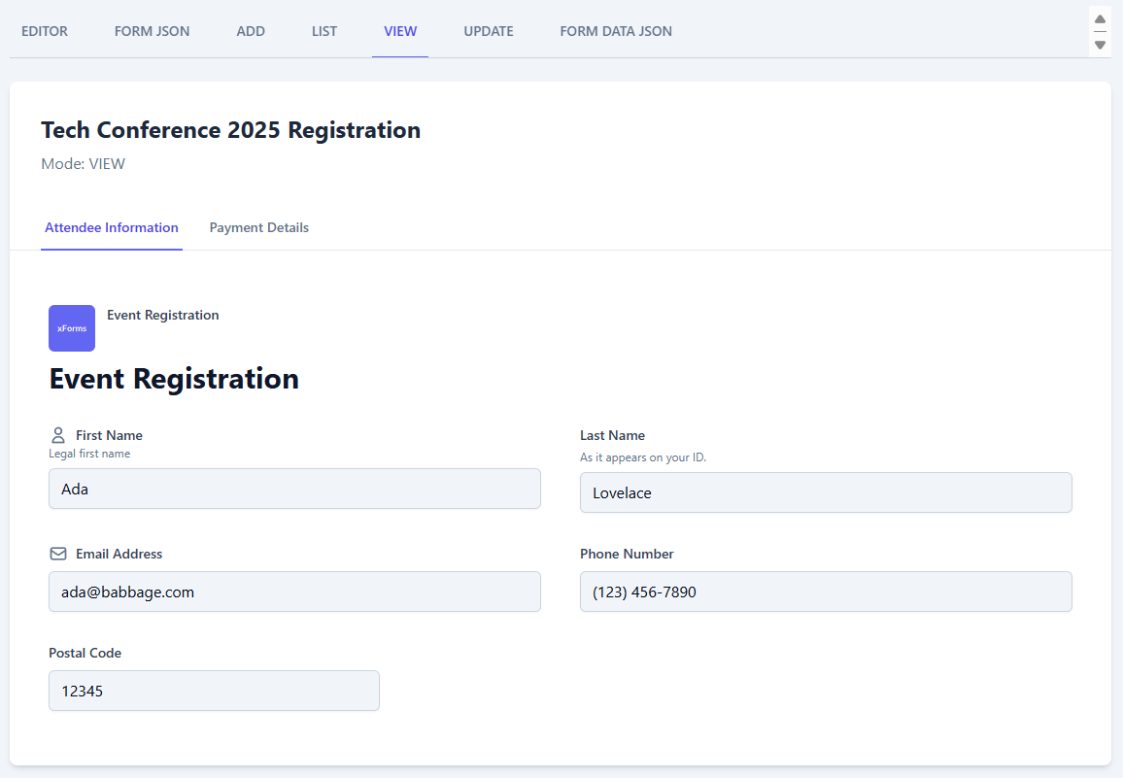
EDITOR PAGE – FORM JSON – to – RECORD CRUD
form_state_editor_json
In this is the form editor page where you can drag and drop all input-related components that XWUI supports. In this sample, we're showing hard-coded components only.
form_record_state_update
form_record_state_add
form_record_state_view

Slide 5
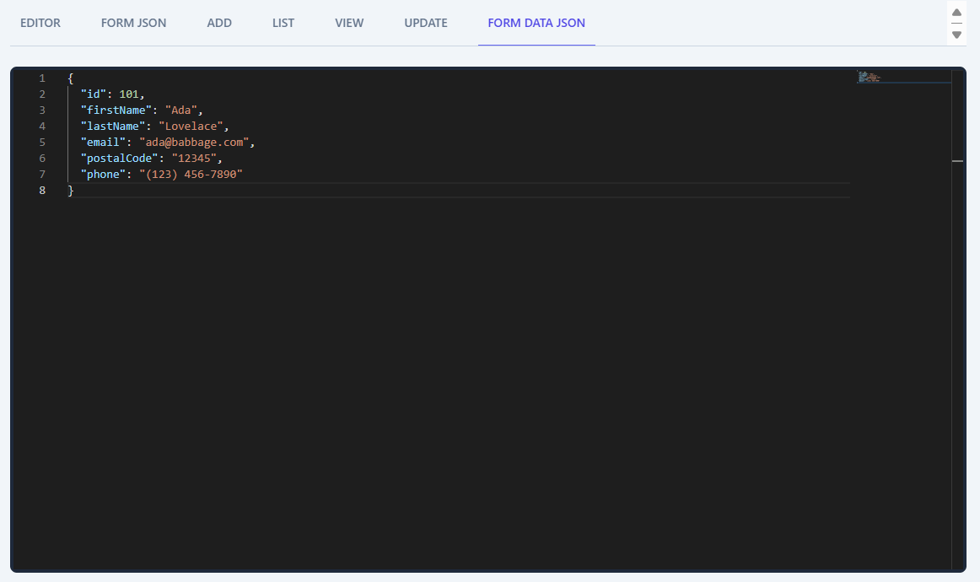
EDITOR PAGE – RECORD CRUD – to – RECORD JSON
form_state_editor_json
In this is the form editor page where you can drag and drop all input-related components that XWUI supports. In this sample, we're showing hard-coded components only.
form_record_state_add
form_record_state_update
form_record_state_view
form_record_state_json

