Slide 1
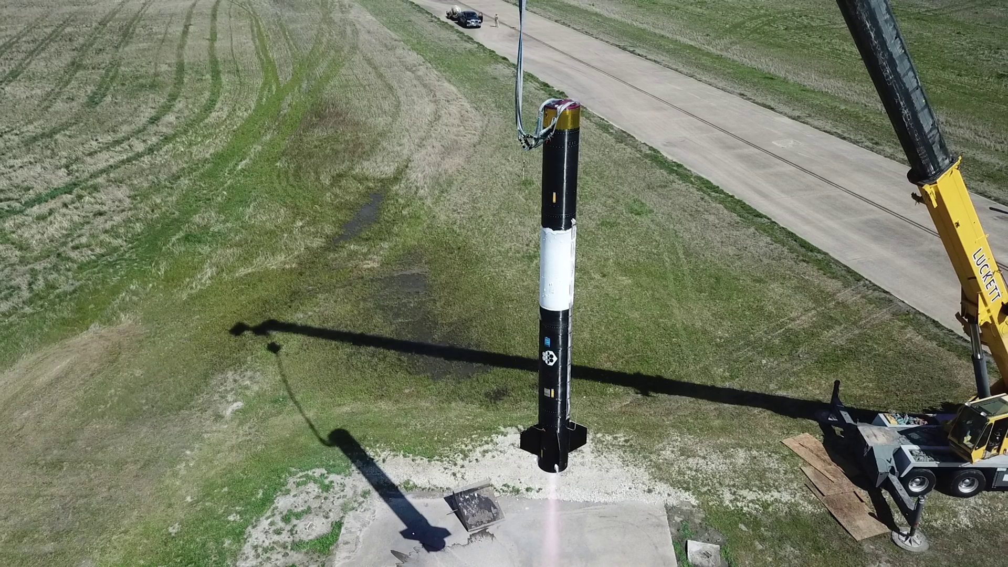
Exos Aerospace | Recoverable µg Cryo-Transfer Flight Demo
SBIR 2026.R6 | DAF26BX06-DV513 (D2P2)
Retiring the on-orbit refuel function: tank-to-tank cryogenic propellant transfer in microgravity on a reusable suborbital platform
Autonomous On-Orbit Logistics & Sustainment
Concept of Operations
Objective
• Demonstrate tank-to-tank cryogenic propellant transfer in microgravity (mass gauging, thermal, pressure, flow) and compare it against a characterized 1-g ground baseline.
• Deliver recovered flight hardware and a flight dataset that de-risks the refuel leg of DV513's resupply / refuel / repair / recover architecture.
Innovation
• Recoverable, repeatable space-environment test points for a fraction of the cost and schedule of an orbital campaign.
• Linerless composite Type-V cryo tankage (the class that flew as fuel and LOX tanks on IM-1 Odysseus and IM-2 Athena) is the leading tank candidate.
Team
• Exos (prime / integrator, BLK3 flight + Greenville transfer test set) · Princeton Cryogenics (transfer system, cryo-thermal) · Scorpius Space Launch Co. (Type-V tankage, subject to trade).
• Lockheed Martin (proposed): active Phase II teammate. Receiver-side / architecture requirements, data review, and the Phase III transition path.
1 Ground 1-g transfer baseline
(Greenville test set)
2 Integrate in BLK3 payload bay
3 µg coast: tank-to-tank
cryo transfer, instrumented
4 Recover · inspect · refly
BLK3 reusable VTVL vehicle, tethered hover test, Greenville TX
Refuel is the gating function of an on-orbit logistics enterprise. Exos flies the transfer hardware in microgravity, brings it back, and flies it again.
Ask of LM: Letter of Support + Phase II teaming on DV513.
Cost and Schedule ($K, 12-month D2P2)
Success & Transition
Element | $K
Exos labor: PM, systems eng., integration, test | 355
Princeton Cryogenics: transfer system & cryo-thermal | 185
Source/receiver tank set (Type-V candidate) | 130
Transfer hardware, QD, instrumentation | 95
Ground transfer campaign (Greenville) | 80
Flight integration + suborbital demo ops | 95
Travel, reserve, G&A | 45
Total (12 months) | 985
Success: an instrumented µg cryogenic transfer, recovered and inspected, with a flight-vs-1-g dataset and a transition package delivered.
1
D2P2 (DV513) — recoverable µg cryo-transfer flight demo, LM on the team
$985K / 12 mo
2
Phase III with LM — transfer + tankage scaled into LM on-orbit logistics / depot architectures
LM-integrated
3
USSF sustainment — refuel capability for LEO/MEO/GEO/cislunar assets; repeat flights qualify upgrades
SSC / SpaceWERX
Milestones: M1 SRR + cryogen/surrogate decision (Mo 2) · M2 PDR + tank down-select (Mo 4) · M3 CDR (Mo 7) · M4 ground 1-g transfer campaign (Mo 9) · M5 µg flight transfer + recovery (Mo 12) · final report + transition package
4
Commercial OTV — Type-V tank sets already baseline tankage for a commercial OTV program
dual-use pull
Proposal-stage estimate. TABA (if allowed) is additive. LM Phase II scope/share to be set jointly.
Distribution: non-proprietary summary; no export-controlled data (no LM NDA in place). Nothing is awarded. BLK3 received its FAA launch license Mar 2026 and is preparing for flight; Exos has flown commercial payloads since 2018 (SARGE). Type-V tanks are flight-proven as tankage; in-space cryo transfer on this architecture has not been demonstrated and is the objective of this effort.
1

Slide 2
Exos × Lockheed Martin | DAF26BX06-DV513
SBIR 2026.R6 | DAF26BX06-DV513 (D2P2)
Backup: why Exos, and what we are asking of Lockheed Martin
Why Exos
• One of only three FAA-licensed vertical-takeoff reusable rocket operators with demonstrated recovery/reflight (with SpaceX and Blue Origin).
• Commercial payloads flown since 2018 (SARGE). BLK3 is our latest FAA-licensed vehicle (Mar 2026).
• Minimal infrastructure: needs a pad plus power/comms. Fast, recoverable, repeatable test cadence.
• Greenville propellant-transfer ground test set for the 1-g baseline before any flight.
• Current USAF SBIR Phase II performer (FA9300-25-C-6022).
Tankage heritage
• Scorpius linerless composite Type-V cryo tanks flew as fuel and LOX tanks on IM-1 Odysseus and IM-2 Athena (TRL 9 as tankage).
• Exos holds an 18% stake in Scorpius; Type-V tanks are a leading candidate, subject to a fit/cost/schedule trade.
Proposed LM role (Phase II)
• Define receiver-side and interface requirements from LM on-orbit logistics / servicing architectures.
• Participate in design reviews (SRR / PDR / CDR) and flight data review.
• Co-own the Phase III transition plan into LM programs and USSF sustainment.
Ask
• Letter of Support for the DV513 D2P2 submission.
• Confirmation of LM Phase II teaming intent; Exos will report the government award outcome to LM.
• An NDA if LM wants technical detail beyond this non-proprietary summary.
Point of contact
• John Quinn, Cofounder & CEO · jquinn@exosaero.com · +1 (972) 740-8355 · www.exosaero.com
Distribution: non-proprietary summary; no export-controlled data (no LM NDA in place). Nothing is awarded. BLK3 received its FAA launch license Mar 2026 and is preparing for flight; Exos has flown commercial payloads since 2018 (SARGE). Type-V tanks are flight-proven as tankage; in-space cryo transfer on this architecture has not been demonstrated and is the objective of this effort.
2

