Slide 1
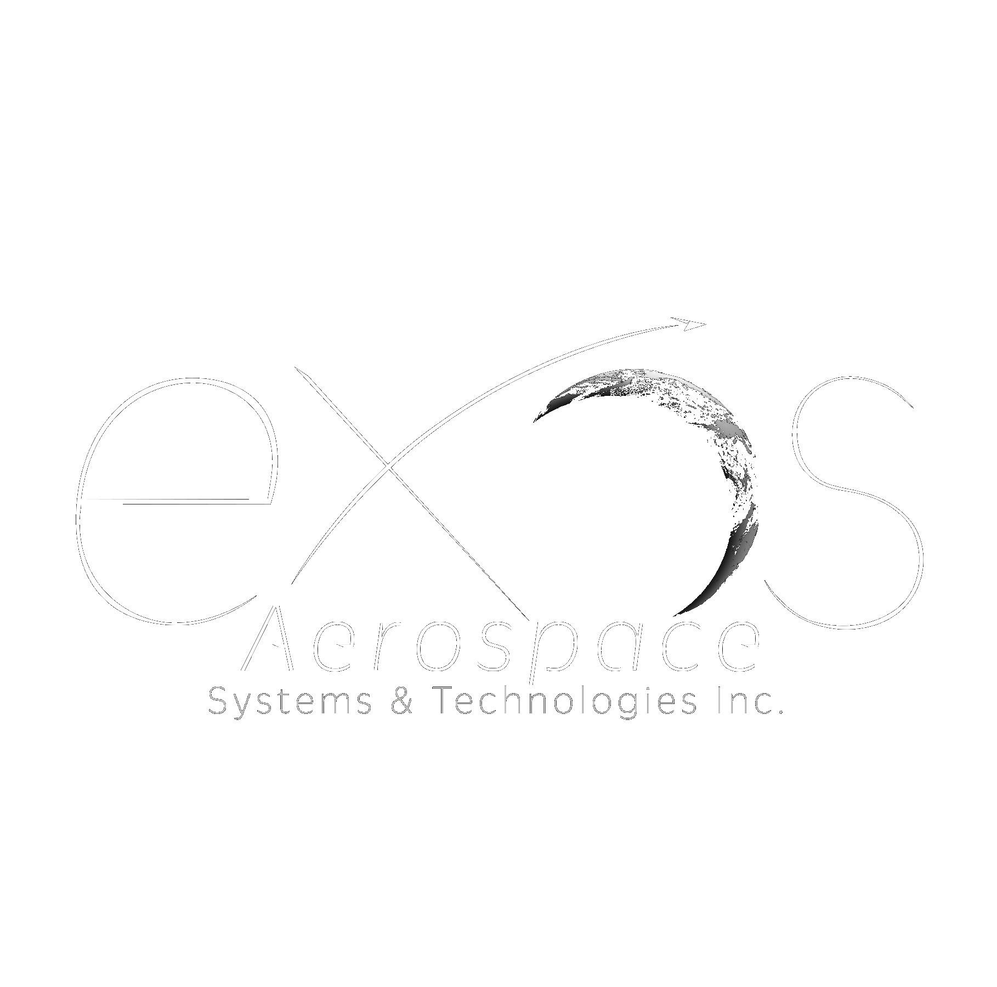
EXOS AEROSPACE
AI-Native Industrial Power for the Space & Defense Industrial Base
Reusable flight-test platform · TRL-9 lunar-proven composites · the consortium that re-industrializes space & defense
Profitable (2025) · Raising $10M first close (tranched to $25M) · August 2026
John Quinn, Cofounder & CEO · jquinn@exosaero.com · www.exosaero.com | PRIVATE & CONFIDENTIAL

Slide 2
WHY NOW
Three waves converge — and Exos sits at the intersection
THE $20T PHYSICAL WORLD
THE INDUSTRIAL-BASE IMPERATIVE
THE CAPITAL WAVE
AI conquered software; the physical world is next. Almost no one can apply AI to real flight hardware. Exos already does.
Congress and DoD are re-industrializing for surge to 2045. Capital is moving to dual-use hardware and dormant capacity — Exos's exact lane.
The SpaceX IPO and record defense spending are pulling institutional capital into space-defense hardware. The window to enter at this basis is now.
Exos is the rare asset that is all three at once: a profitable, licensed, reusable hardware operator, running AI-native, holding lunar-proven IP.
Exos Aerospace Systems & Technologies, Inc. — Private & Confidential. Financial figures are management-prepared estimates; supporting materials in the data room.

Slide 3
FOUR CORE ASSETS
Three technical assets, compounded by a fourth
1 · SCORPIUS TYPE-5 CRYO IP + ROFR
2 · REUSABLE SUBORBITAL PLATFORM
TRL-9 linerless composite cryogenic tanks, flight-proven on Intuitive Machines' IM-1 and IM-2. Exos holds 18% plus a right of first refusal at the 2021 basis — strategic valuation arbitrage.
BLK3 — one of only three FAA-licensed reusable rocket launch providers in the U.S. Recoverable, high-cadence, minimal fixed infrastructure.
3 · RDRE / ADVANCED PROPULSION
4 · AI-DEPLOYED OPERATING PLATFORM
Active USAF SBIR Phase II on a government-furnished RDRE, opening a sole-source Phase III path with no dollar ceiling. Reusable-RDRE roadmap.
Mission Control plus a governed agent fleet run BD, capture, compliance, and operations. A compounding, owned decision-and-audit-trail asset — capital-efficient and ITAR/CUI-safe.
Assets 1–3 are the hardware and IP; #4 is the operating system that compounds them — management-characterized, a moat, not a separate line item. Single valuation of record: $169.7M.
Exos Aerospace Systems & Technologies, Inc. — Private & Confidential. Financial figures are management-prepared estimates; supporting materials in the data room.

Slide 4




















2024- 2026
DoD HVRR Rotating Detonation Rocket Engine (RDRE) Test Vehicle Design and build USAF contracts
Today
2026+ Technology and Reputation Risk Reduction flights testing your hardware and software on our Reusable Rockets
Armadillo Aerospace Founded by John Carmack
Lunar Lander Challenge 1st Place
Rocket Racing League development program
Super Mod
(VTVL)
4 Launches and 3 recoveries on 1st SARGE vehicle
Aug 2018 – Oct 2019
Italy $6.4M grant LOI. 2022 -2025 Exos Aerospace Italia Srl work with Defense on Suborbital Air Launch development and work with Spaceland.it on microgravity research
2022 USAF Contract for Hypersonic Reusable Launch Vehicle
2000
2006
2008
2009
2010
2011
2015
2018
2020
2021
2021
2022
2023
2024
2025
2028
We don't build OTVs — we supply the enabling technology: Scorpius Type-5 cryo tank sets today (the baseline for IM's Nebula OTV), and a roadmap to provide RDRE propulsion for LEO→Moon→Earth orbital mobility.
Lunar lander Challenge2009 Armadillo prize $ winner- NASA Morpheus Sale
Exos Aerospace continues funding of Armadillo Team with new management and commercial objectives
X-Prize Competition w/Pixel and Texel Round 1 Winners
2010-2013 STIG Rocket flies to 95km
2021 Phase II Air Force Hypersonic Contract
Our Competitive Advantage is demonstrated by what our team has already done:
Working with companies like Vaya Space
and others Derisking Orbital access.

Slide 5
THE STORY
25 years of reusable rockets — to a profitable, lunar-proven inflection point
2000
Armadillo Aerospace — reusable VTVL rockets; 100+ engines built
2014
John Quinn buys out the program → Exos Aerospace
2018–19
SARGE: 4 flights in 14 months, guided-canopy recovery — capital-efficient reuse
2021
Carbon-composite pivot; Scorpius arbitrage struck (18% + ROFR at 2021 basis)
2024–25
Scorpius Type-5 cryo tanks fly to the Moon — IM-1 Odysseus & IM-2 Athena (TRL-9)
2025
First profitable year; 1 of 3 FAA-licensed reusable providers; AI-native ops live
2026 →
Series A: exercise the Scorpius ROFR + stand up the industrial-base consortium
Exos Aerospace Systems & Technologies, Inc. — Private & Confidential. Financial figures are management-prepared estimates; supporting materials in the data room.

Slide 6
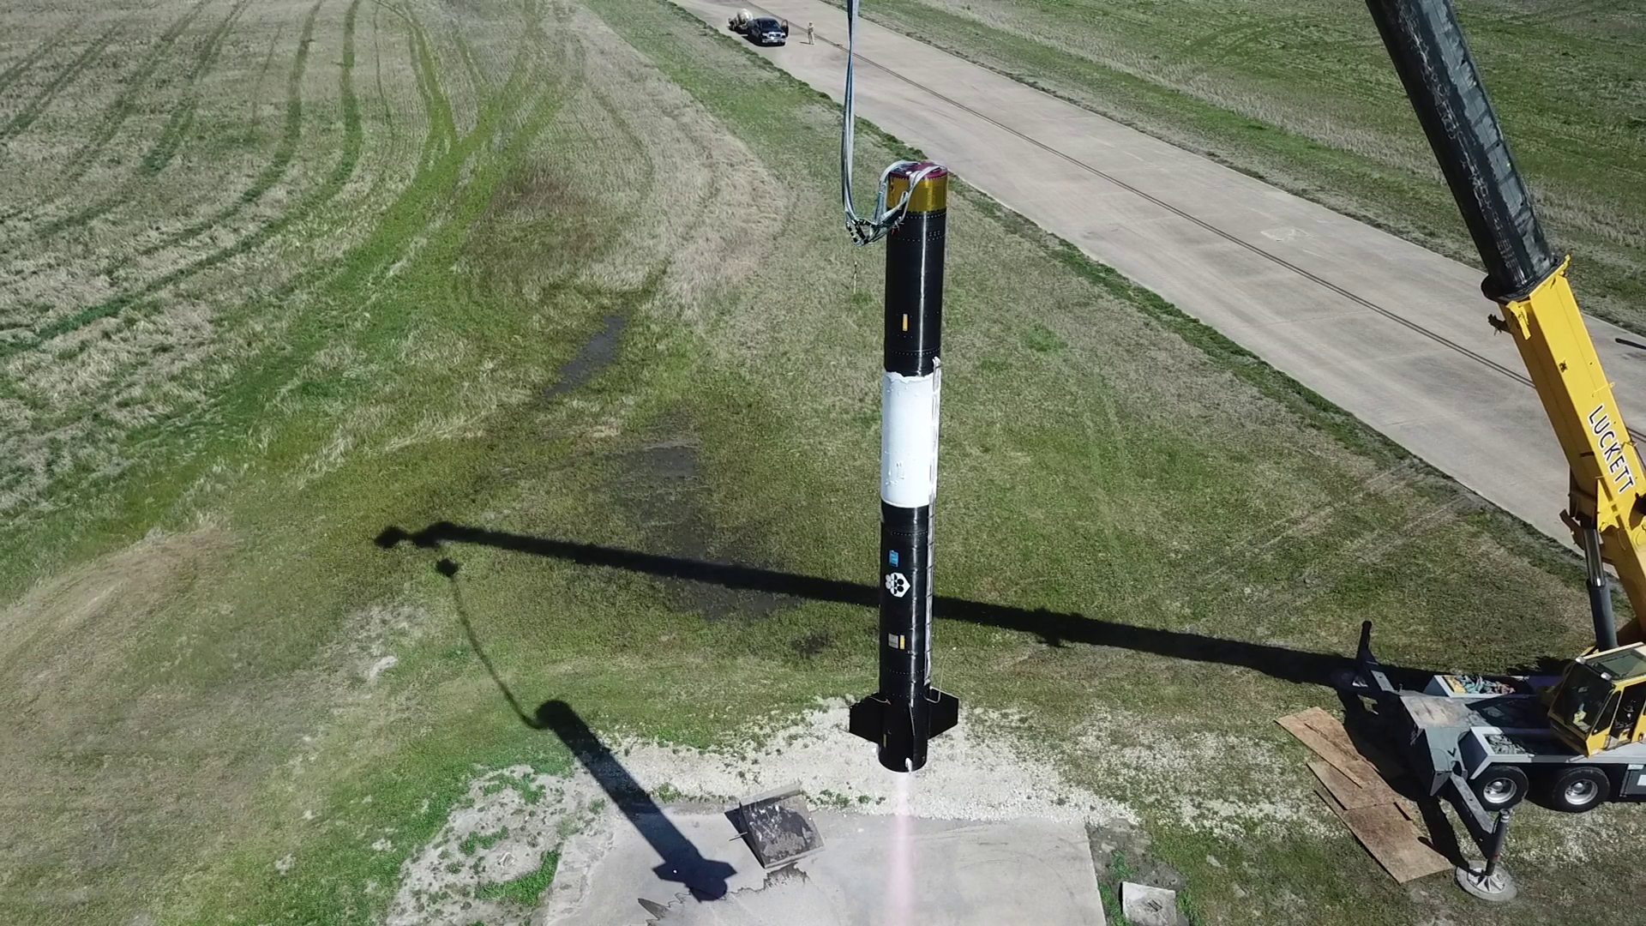
THE PLATFORM
BLK3 — a reusable de-risk engine for the whole orbital industry
▸ One of only three FAA-licensed reusable launch-and-recovery providers in the U.S. (Part 431 → Part 450).
▸ De-risk orbital programs on a proven ~$5M vehicle instead of losing $50–100M rockets on first flight — industry loses 4–7 to reach orbit; Exos can help cut that to 2–5.
▸ Customers place avionics, sensors, controls, and recovery in the BLK3 bay; hardware comes back, not just telemetry.
▸ $1M per flight (135 kg @ $7,500/kg); designed for rapid reuse (a 2-flight / 48-hour turnaround is proposed under Project KARMEN, not yet demonstrated).
▸ Licensed and hover-demonstrated; first commercial flight targeted early 2027.
BLK3 PSRLV — vertical for integrated test at Caddo Mills. Reusable, recoverable, licensed.
Exos Aerospace Systems & Technologies, Inc. — Private & Confidential. Financial figures are management-prepared estimates; supporting materials in the data room.

Slide 7
THE CROWN JEWEL
Scorpius ROFR — strategic arbitrage, not a generic acquisition
PAY $3.4M
OWN $20–40M
6–12×
2×
exercise price (frozen 2021 basis)
TRL-9 lunar-flown Type-5 IP
value vs. exercise price
flown to the Moon (IM-1 / IM-2)
▸ World's only TRL-9 linerless (Type-5) cryogenic composite tank technology, flown as fuel & LOX tanks on Intuitive Machines' Odysseus (2024) and Athena (2025).
▸ Now the baseline tank set for Intuitive Machines' Nebula Orbital Transfer Vehicle — SSLC holds the tank contracts in hand. The same Type-5 LOX/methane heritage is moving from lunar landers into the orbital-mobility market.
▸ ~50% mass reduction vs. metal; room-temperature-cure resin (no microcracking through 150 cycles); qualified to fuel on a Falcon 9 on the pad; export-approved variant.
▸ Exos holds 18% + a right of first refusal at the 2021 basis — the value gap is defined upside with a defined downside.
▸ Enables in-space refueling and long-duration cryo storage — the tankage a commercial space economy is built on.
Arbitrage figures are Exos's own valuation, independent of the $169.7M 409A equity value.
Exos Aerospace Systems & Technologies, Inc. — Private & Confidential. Financial figures are management-prepared estimates; supporting materials in the data room.

Slide 8
THE MULTIPLIER
AI-native operations — 5× output, and the way we commercialize dormant tech
▸ Mission Control — an in-house, AI-native operating system (ExO 3.0). Ran a 12-person team to ~5× output in 9 months.
▸ AI-driven DFARS/CFR compliance (caught same-day regulatory changes on a live contract); CMMC L1 → L2; DoD data walled off from commercial AI.
▸ This is how the consortium ships: the AI stack drops into acquired sub-50-person firms and makes them AI-native overnight — the commercialization engine dormant DoD tech never had.
▸ The physical-AI proof point institutional capital is looking for — AI applied where it is hardest, real flight hardware.
5×
$180M
96%
1,240
output, 12-person team, 9 mo
AI-built pipeline value
decisions cleared in-system
tasks orchestrated
Exos Aerospace Systems & Technologies, Inc. — Private & Confidential. Financial figures are management-prepared estimates; supporting materials in the data room.

Slide 9
THE THESIS
Activate America's dormant industrial capacity
THE PROBLEM & THE ENGINE
▸ Stranded capital is real: Virgin Orbit ($1B+ → Ch.11), Astra ($500M), ABL ($461M) — enormous capacity built, then idled.
▸ ~10 partner firms (CTD, GTL, Goodman, Firefly, Via Space) sit at 5–20% utilization, holding $1B+ of DoD-funded tech, <5% commercialized.
▸ Exos is the prime integrator that knits them into one skunk-works — surging Type-5 tanks, SRM cases, orbital-transfer tank sets, missile & Navy structures with no new CapEx.
▸ The same model transfers beyond space: advanced mfg, critical materials, energy, maritime, munitions.
SAME PLANT, UP TO 3× OUTPUT
▸ Idle winders & machines put to work at ~$150/hr — 10× manufacturing overnight.
▸ Humanoids + Mission Control fill 2nd/3rd shifts the labor market can't — fixed cost amortized across up to 3× output.
▸ Partner IP advances the Exos tech stack — continuous improvement, not one-off buys.
Exos Aerospace Systems & Technologies, Inc. — Private & Confidential. Financial figures are management-prepared estimates; supporting materials in the data room.

Slide 10
VALIDATION
The government has already validated the platform — and under-resourced it
PROJECT KARMEN — USSF SBIR SF254-D1002 (Direct-to-Phase-II)
A reusable suborbital platform to empirically qualify cargo, supplies & equipment under real spacelift conditions — a proposed 2-flight / 48-hour rapid-turnaround demonstration (not yet demonstrated). Competitively selected, then funded at ~1/10th of its validated $3M scope. A reissue at the proposed scope funds the next commercial launches and stands the pilot up in months.
▸ $10M unlocks ~$34M in government co-investment (TACFI + STRATFI) — a 3.4× capital multiplier. Non-dilutive upside, milestone-gated — not counted in the base case.
▸ $180M AI-built pipeline; Commission on the Future of the Navy toured Exos (Aug 2026) and is weighing the consortium/ITZ model for its report.
▸ Secure International Trade Zone (DHS-CRADA containers) bridges the foreign carbon fiber and cryo tankage the U.S. can't source — a national supply-chain-resilience tool.
Exos Aerospace Systems & Technologies, Inc. — Private & Confidential. Financial figures are management-prepared estimates; supporting materials in the data room.

Slide 11
THE MECHANISM
A pilot fund built on DoD's own playbook — where strategic capital plugs in
FOR TITLE III / OSC / STRATEGIC CAPITAL
▸ $50M pilot fund, deployed in 12–18 months — activation capital for dormant capacity, steered by insiders, run by pros.
▸ Mirrors mechanisms DoD already uses: DPA Title III (direct industrial-base investment), the Office of Strategic Capital (loans / loan guarantees), and OTA consortia (NSTXL / SpaceWERX).
▸ Cost-share where viable; the fund fills the gap where it isn't — a blanket 50% match kills small vendors.
▸ OTA + firm-fixed-price is the home for this: weeks-to-award, outcome-based, non-dilutive alongside the equity.
THE THREE WAYS TO PARTICIPATE
1 Institutional equity
Series A at a $169.7M 409A basis; TXSE listing path; SpaceX-IPO tailwind.
2 Strategic / Starfighters
JV / co-development on flight-test + reusable spacelift; shared cadence and range access.
3 Title III / OSC / OTA
Non-dilutive industrial-base capital into the consortium + KARMEN reissue.
Exos Aerospace Systems & Technologies, Inc. — Private & Confidential. Financial figures are management-prepared estimates; supporting materials in the data room.

Slide 12
THE NUMBERS
Profitable today, a government-backed path to ~$120M
$1.55M
102%
17%
~$5M
FY2025 revenue
4-yr revenue CAGR
2025 EBITDA margin (first profit)
combined pro-forma run-rate
▸ History: $0.19M (2022) → $0.31M → $0.63M → $1.55M (2025), first profitable year.
▸ Projection: ~$120M by Y5 on a contracted backbone (conservative Cash Flow case); TACFI/STRATFI/entX-expansion sit in a separate upside layer, not the base.
▸ Unit economics: BLK4 sale $6M (50%+ GM); wet-lease flight $3.75M (60%+); tanks $200K–$1M (45%+).
▸ Valuation: $169.7M independent 409A equity value (Eqvista 3/31/26; $8.66/share; DLOM 36.51%) — comps cross-check 4–6× 2028E revenue.
WHERE WE'VE BEEN → WHERE WE'RE GOING
2022
$0.19M
2023
$0.31M
2024
$0.63M
2025
$1.55M ✓ profit
Y5
~$120M
Exos Aerospace Systems & Technologies, Inc. — Private & Confidential. Financial figures are management-prepared estimates; supporting materials in the data room.

Slide 13
THE ASK
$10M first close — 100% deployed, unlocking a 3.4× government multiplier
▸ $10M first close (tranched to $25M):
▸ • Scorpius ROFR — $3.4M (the arbitrage)
▸ • RDRE / TACFI match — unlocks ~$30M STRATFI
▸ • BLK3/BLK4 vehicle build + working capital, Part 450, contingency
▸ $10M unlocks ~$34M in government co-investment — a 3.4× multiplier (non-dilutive upside).
▸ Listing path: Texas Stock Exchange (TXSE), dated/conditioned, ~18–24 months.
▸ All common stock; founders retain ~56% control; EAI investors' first liquidity window in the raise.
WHAT $10M ENABLES
▸ Exercise the Scorpius ROFR — lock the 6–12× arbitrage
▸ Stand up the industrial-base consortium
▸ Advance the RDRE flight-test program
▸ Put idle partner capacity to work — no new CapEx
▸ Bridge to the Title III / OSC non-dilutive layer
▸ Scale Scorpius into DoD orbital-mobility + SRM-case production — Title III non-dilutive
Exos Aerospace Systems & Technologies, Inc. — Private & Confidential. Financial figures are management-prepared estimates; supporting materials in the data room.

Slide 14
De-risk the impossible.
Deliver the mass that builds humanity's future in space.
John Quinn, Cofounder & CEO
jquinn@exosaero.com · +1-972-740-8355 · www.exosaero.com
PRIVATE & CONFIDENTIAL — not an offer to sell or a solicitation of securities. Financial figures are management-prepared estimates.

