Slide 1

EXOS AEROSPACE
Profitable (2025) · Raising $10M first close (tranched to $25M) · August 2026
PRIVATE & CONFIDENTIAL | NOT FOR DISTRIBUTION

Slide 2
FOUR CORE ASSETS
Three technical assets, compounded by a fourth
1: Scorpius Type-5 cryo IP + ROFR
TRL-9 linerless composite cryogenic tanks, flight-proven on Intuitive Machines' IM-1 and IM-2. Exos holds 18% plus a right of first refusal at the 2021 basis — strategic valuation arbitrage.
2: Reusable suborbital platform
BLK3 — one of only three FAA-licensed reusable rocket launch providers in the U.S. Recoverable, high-cadence, minimal fixed infrastructure.
3: RDRE / advanced propulsion
Active USAF SBIR Phase II on a government-furnished RDRE, opening a sole-source Phase III path with no dollar ceiling.
4: AI-deployed operating platform
Mission Control plus a governed agent fleet run BD, capture, compliance, and operations — a compounding, owned decision-and-audit-trail asset; capital-efficient and ITAR/CUI-safe.
Assets 1–3 are the hardware and IP; #4 is the operating system that compounds them — management-characterized, a moat, not a separate line item. Single valuation of record: $169.7M.

Slide 3
WHY NOW
• The $20 trillion physical world is re-industrializing — defense and aerospace are the two hottest sectors, and capital is moving to dual-use hardware.
• New U.S. National Space Transportation Policy targets 1,000+ launches AND reentries per year by 2030.
• SpaceX and Blue Origin have no spare launch capacity — leaving room for the reusable platform everyone else can use. One of only three FAA-licensed reusable rocket launch providers in the US.
PRIVATE & CONFIDENTIAL | NOT FOR DISTRIBUTION

Slide 4
THE CROWN JEWEL — SCORPIUS TYPE-5
• World's only TRL-9 linerless (Type-5) composite cryogenic tanks — flown as fuel and LOX tanks on Intuitive Machines' Odysseus and Athena lunar landers.
• ~50% mass reduction vs. metal; room-temperature-cure resin with potential for no microcracking through 150 cycles.
• Exos holds 18% plus a right of first refusal at the frozen 2021 basis — PAY $3.4M, OWN $20-40M (Exos's own valuation, independent of the $169.7M 409A).
PRIVATE & CONFIDENTIAL | NOT FOR DISTRIBUTION

Slide 5










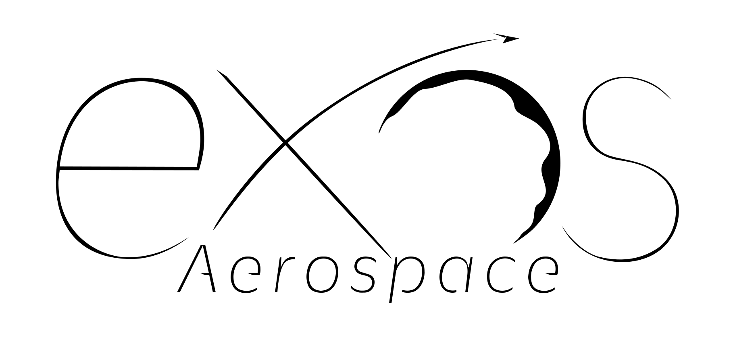










2024- 2026
DoD HVRR Rotating Detonation Rocket Engine (RDRE) Test Vehicle Design and build USAF contracts
Today
2026+ Technology and Reputation Risk Reduction flights testing your hardware and software on our Reusable Rockets
Armadillo Aerospace Founded by John Carmack
Lunar Lander Challenge 1st Place
Rocket Racing League development program
Super Mod
(VTVL)
4 Launches and 3 recoveries on 1st SARGE vehicle
Aug 2018 – Oct 2019
Italy $6.4M grant LOI. 2022 -2025 Exos Aerospace Italia Srl work with Defense on Suborbital Air Launch development and work with Spaceland.it on microgravity research
2022 USAF Contract for Hypersonic Reusable Launch Vehicle
2000
2006
2008
2009
2010
2011
2015
2018
2020
2021
2021
2022
2023
2024
2025
2028
Our OTV-enabled service offers LEO → Moon → Earth round-trip capability — a distinct transport solution powered by technology only we provide.”
Lunar lander Challenge2009 Armadillo prize $ winner- NASA Morpheus Sale
Exos Aerospace continues funding of Armadillo Team with new management and commercial objectives
X-Prize Competition w/Pixel and Texel Round 1 Winners
2010-2013 STIG Rocket flies to 95km
2021 Phase II Air Force Hypersonic Contract
Our Competitive Advantage is demonstrated by what our team has already done:
Working with companies like Vaya Space
and others Derisking Orbital access.

Slide 6
THE NUMBERS
• Profitable in FY2025 — first profitable year. Revenue $1.49M; EBITDA ~$296K (~20% margin); ~$6.2M NOL carryforward.
• Combined annual run-rate ~$2.6M (Exos $1.49M + Scorpius $1.1M, pending acquisition close).
• Government-backed path to ~$120M by Year 5 (conservative Cash Flow case) on a contracted backbone.
• Independent 409A equity value: $169.7M (Eqvista 3/31/26; $8.66/share).
PRIVATE & CONFIDENTIAL | NOT FOR DISTRIBUTION

Slide 7
THE ASK
• $10M first close — tranched to $25M. 100% deployed, zero idle capital.
• Scorpius ROFR $3.4M (the arbitrage); RDRE trade-study down-select (NASA MSFC license vs. GTL machined method) / TACFI match.
• $10M unlocks ~$34M in government co-investment (TACFI + STRATFI) — a 3.4x non-dilutive multiplier.
• All common stock; founders retain control; TXSE-primary listing path.
PRIVATE & CONFIDENTIAL | NOT FOR DISTRIBUTION

Slide 8
De-risk the impossible.

