Slide 1

Make Every Space Vehicle Reusable
Integrated Pressurized Structures built on moon-proven, TRL-9 Type-V tanks from our partner SSLC — the enabling base for reusable spaceflight.
Confidential Investor Presentation · October 2026 · Proprietary — Unclassified · Not an offer of securities

Slide 2
THE OPPORTUNITY
The space economy runs on tanks — and flight-grade supply is scarce.
Every launch vehicle, lunar lander, orbital-transfer vehicle, and commercial station needs flight-grade cryogenic tanks and pressure structures. The industry delivers them in ~2 years, single-sourced. Exos integrates moon-proven, TRL-9 Type-V tanks from partner SSLC (first lunar-lander tank set delivered in ~90 days), sells SSLC tank hardware as its channel, and is assembling the capacity under the rest of the defense industrial base: SRM cases, pressure structures, detonation engines.
$1T
cryogenic-tank TAM by 2030 (from ~$640B) — plus the $20T physical economy beneath it
We integrate the production layer.
Moon-proven tanks from our partner, then the capacity beneath everything the space economy and the DIB can't make fast enough — cheaper, lighter, on U.S. soil.
EXOS AEROSPACE · Confidential — Proprietary/Unclassified · Not an offer of securities
2

Slide 3
THE PROBLEM
America can't produce what it needs — fast enough, cheaply enough, or at home
1
Solid-rocket-motor cases
Single-source, ~2-year lead times, aging capacity — the munitions build-rate the Navy/DIB needs is out of reach today.
1,000
2
Cryogenic tanks & pressure structures
units / year
The moon economy and hypersonics demand flight-grade tanks in weeks, not years.
the surge production the Navy / DIB has signaled it needs — versus the fragmented capacity that exists today.
3
Detonation engines (RDRE)
Next-gen propulsion the DoD wants flown — with no scaled domestic producer.
EXOS AEROSPACE · Confidential — Proprietary/Unclassified · Not an offer of securities
3

Slide 4
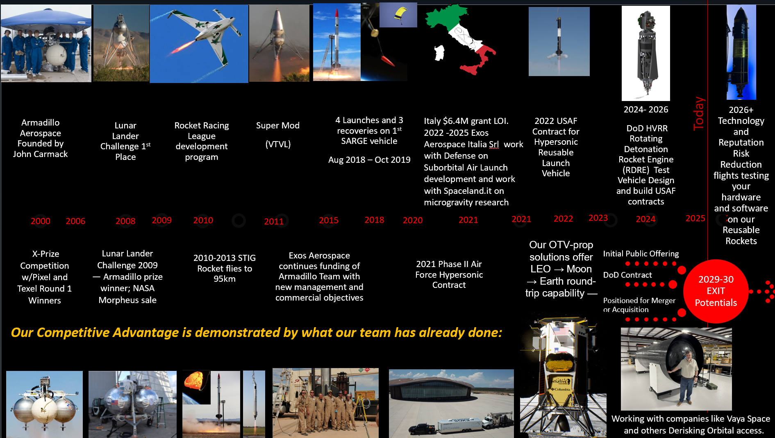
20+ YEARS OF DOING WHAT OTHERS ONLY PROMISE
A team that has flown, recovered, and re-flown — for two decades
From Armadillo Aerospace (John Carmack) → Lunar Lander Challenge → SARGE reusable flights → USAF/DoD contracts → SSLC tank partnership (moon-flown Type-V; 18% equity) → RDRE → a clear path to public markets and exit.
EXOS AEROSPACE · Confidential — Proprietary/Unclassified · Not an offer of securities
4

Slide 5
WHY EXOS
Proof, not promise
4 / 3
<20 · $5.7M
TRL-9
$2.6B
SARGE launches / recoveries (2018–19) — reflight demonstrated
the team & spend that did it — peers spent hundreds of millions
partner SSLC's Type-V cryo tanks flown on Intuitive Machines' lunar landers
prime on the AEDC Velocity Alliance test consortium
Half the cost. A fraction of the parts. BLK3 flies with <3,000 components vs. ~80,000 for peers; SSLC delivered the first moon-lander tank set in ~90 days vs. an industry two years; Exos sells SSLC tanks at a 15% commission.
EXOS AEROSPACE · Confidential — Proprietary/Unclassified · Not an offer of securities
5

Slide 6
THE MOAT
Moon-proven tank access, run by an AI-native operating system
Moon-proven, TRL-9 tank partner
The AI operating moat — Mission Control
SSLC (Scorpius) Type-5 linerless cryo tanks flew as fuel + LOX tanks on Intuitive Machines' Odysseus & Athena landers
SSLC tanks are the baseline tank set for IM's Nebula orbital-transfer vehicle — IM lander backlog ~$4.1B
Exos buys and integrates SSLC tanks into Integrated Pressurized Structures
Exos is SSLC's tank sales channel — 15% commission at SSLC's own price, no markup — and holds 18% passive equity
Of record, the 4th of Exos's four core assets — the AI-deployed operating platform
~125 governed automated agents across BD, finance, compliance; ~7,000 CRM contacts
Runs a public-grade cadence of programs and lights-out production without a public-company G&A stack
Governed autonomy with a full audit trail — operating leverage, not a black box
EXOS AEROSPACE · Confidential — Proprietary/Unclassified · Not an offer of securities
6

Slide 7
THE ENGINE
We don't build one product. We own the capacity under all of them.
1
2
3
4
Deploy robots
Run lights-out
Become the producer
Aggregate
into partners' idle, single-shift facilities
on ~$30M of equipment they already own
then their acquirer — Exos secures the IP
toward ~75% of U.S. winding capacity
A capability-gap ledger — acquire / build / license / partner. Manifest culled 137 companies → 7 finalists filling 9 mapped gaps, aggregating to the ~1,000-unit volume the DIB needs. Own the machines before the AI-materials breakthrough hits (casing 50→13 lb; materials $10→$0.10) and you own the base.
EXOS AEROSPACE · Confidential — Proprietary/Unclassified · Not an offer of securities
7

Slide 8
THE MARKET
A generational tailwind — and we sit under all of it
$1.7T
$1T
~$100B
$4.1B
proposed U.S. defense budget — re-industrialization is national priority
cryogenic-tank TAM by 2030 (from ~$640B)
asymmetric / missile production white space
Intuitive Machines lunar-lander backlog our tank partner SSLC supplies into
Defense-tech capital is at record highs and family offices are writing $25M+ checks into dual-use hard-tech. The scarce trade isn't another software play — it's the physical infrastructure almost no one can build.
EXOS AEROSPACE · Confidential — Proprietary/Unclassified · Not an offer of securities
8

Slide 9
BUSINESS MODEL
Profitable at the unit — and a consortium that compounds it
Unit economics that carry the story
The revenue bridge — stated honestly
~½ the cost, lighter, fewer parts (integrated pressurized structures)
~$12.5K/kg vs. Rocket Lab ~$25K/kg
SSLC tank channel: 15% commission on SSLC tanks Exos sells (no customer markup) + an effective 15% rebate on SSLC tanks Exos buys
Flight-test-as-a-service: orbital developers prove avionics/GNC/materials before risking a >$50M vehicle — recurring, high-margin
RDRE built ~$20K vs. a ~$300K market price
Base case (management-prepared): revenue $3.9M (FY27) → $103.6M (FY31)
EBITDA positive from FY29; $55.9M in FY31 — no SSLC acquisition or consolidated SSLC revenue assumed
Pipeline grew $500K → $150M identified in 9 months — capital converts it
SSLC commission economics (incl. rebate) $68.1K (FY27) → $375K (FY31) — a capital-light channel, not a revenue driver
The consortium adds capacity and revenue on top of the base case through JVs, licensing, supply and channel agreements, and selective acquisitions. FY = July–June; projections are management-prepared, not audited.
EXOS AEROSPACE · Confidential — Proprietary/Unclassified · Not an offer of securities
9

Slide 10
THE PATH
A public-market path already in motion — with control retained
Go public via reverse takeover into a clean, U.S. exchange-listed shell — with a verifiable track record and clean EDGAR provenance required before any mandate
Staged raise: ~$15M cash at close → +$25–50M on milestone news → $70–80M target
Founders retain voting control in writing; charter foreign-ownership cap ≤10% with a funded corrective buyback — no SSA/FOCI, CFIUS-clean, ITAR intact
Near-term, non-dilutive-leaning capital via an Office of Strategic Capital note (5–6%) + Title III
A legal news flywheel
Locked capacity →
Enabled orders →
Marquee customers →
The early-2027 BLK3 flight
Real, counsel-approved milestones on a monthly cadence — substance under the tape, not promotion.
EXOS AEROSPACE · Confidential — Proprietary/Unclassified · Not an offer of securities
10

Slide 11
THE ASK
Capitalize the build
~$75M
$1M now
15%
pipe → RTO onto NASDAQ (~$15M pre-merger pipe + ~$60M on-market)
prefunds BLK3 flight 2 — flight 1 is fully customer-funded
commission on SSLC tanks sold through Exos — plus an effective rebate on the tanks we buy
Use of proceeds — $15M pipe
FNEX 7% fee $1.05M · RDRE/TACFI match $4.1M · BLK3 to flight $3.4M · BLK4/HVRR $3.5M · WC / Part 450 / public-co costs $2.95M
First close $10M: RDRE/TACFI match $4.1M · BLK3 build/to flight $3.4M · BLK4/HVRR long-lead $1.0M · WC / Part 450 / contingency $1.5M
Build the SSLC international/Consortium tank channel and the BD muscle to convert the $150M pipeline into booked revenue
EXOS AEROSPACE · Confidential — Proprietary/Unclassified · Not an offer of securities
11

Slide 12
THE RETURN
Asymmetric upside, with a defined exit
Why the upside is asymmetric
The exit — 2029–30
Access to TRL-9 lunar-heritage Type-V tanks via partner SSLC — integrated by Exos
18% SSLC equity + a 15% commission channel on SSLC tank sales — capital-light tank exposure
The AI operating moat — public-grade output at private-company cost
A live public window on the space/defense wave
Uplist → DoD-contract flywheel → positioned for merger / acquisition
Live comps: Quantum Space (~$1.2B de-SPAC), Rocket Lab, Firefly, Hadrian ($1.37B round)
Defense-tech M&A consolidating fast — a scaled domestic producer is the prize
Multiple exit paths: strategic acquisition, secondary, or continued public compounding
EXOS AEROSPACE · Confidential — Proprietary/Unclassified · Not an offer of securities
12

Slide 13
THE TEAM
Operators who have actually flown — and re-flown
JQ
NM
PE
SS
John Quinn
Neil Milburn
Phil Eaton
SSLC (Scorpius)
Cofounder & CEO — capital, BD, strategy; drives the consortium and the public path
Co-Founder & COO — 50-yr aerospace operator; launch ops & manufacturing
Technical principal — direct John Carmack / Armadillo rocket lineage
Type-V tank supply & sales-channel partner; Exos holds 18% passive equity
EXOS AEROSPACE · Confidential — Proprietary/Unclassified · Not an offer of securities
13

Slide 14
Make every space vehicle reusable — the production layer beneath reusable spaceflight.
Moon-flown TRL-9 tanks via partner SSLC. An AI operating moat. A public path in motion. The scarce physical-AI trade — and a defined exit.
John Quinn Cofounder & CEO · jquinn@exosaero.com · +1-972-740-8355
Confidential — not an offer of securities. Any offering is made only through definitive documents, subject to due diligence and applicable securities, export-control, and CFIUS law.

