Slide 1
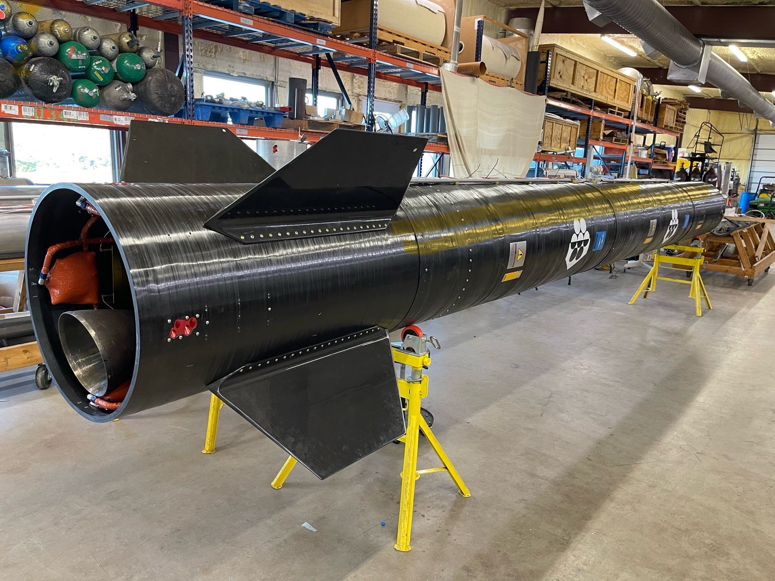
Exos Aerospace Systems & Technologies, Inc.
RDRE/BLK3 Integrated Flight Demonstration
PY26.2 AF TACFI | SBIR (FA9300-25-C-6022)
Integrate a flight weight ~5,800 lbf Rotating Detonation Rocket Engine (RDRE) onto the BLK3 reusable suborbital vehicle.
Fly 1 hover and 2 flights to 85km+ over 24 months to characterize RDRE performance across the full altitude envelope (spaceport level to near-vacuum).
Innovation
First altitude-swept FLIGHT characterization of an RDRE on a reusable VTVL platform.
Recoverable, iterative test cadence (2-day turnaround) — ground test cannot replicate altitude-dependent detonation dynamics prove space relight of RDRE
Operational Impact
ROI: flight-qualified detonation-propulsion data that de-risks RDRE for USAF boost propulsion & responsive launch, Orbital transfer proven by space relight attempts
Deliverable: 1 Hover +2 RDRE flight tests + flight-qualified performance dataset and final report.
End User: AFRL/RQRI Customer: AFRL/RQRI (Dr. M. Harvazinski)
De-risking detonation propulsion through reusable flight test.
Integrated Cost and Schedule ($M)
Critical Technology Area: Scaled Hypersonics (SHY) Focus Area: Autonomous Mass: Weapons Technology
 | Base Yr Execution | Yr Two Execution
Exp: Development
Exp: Prototype Delivered
Exp: Test Flights
SBIR or STTR | $2M
Gov Funding Org | $2M
Private (# of VCs) | $0
Total | $4M
PDR-1
CDR-1
CDR-2
Success & Transition: Phase II (FA9300-25-C-6022, AFRL/RQRI) matures the HVRR-RDRE — a Hybrid Vehicle Rocket Reusable testbed integrating an RDRE for hover/flight demonstration on BLK3 — advancing RDRE from ground test toward recoverable flight. Transition: if successful, sole-source Phase III under 15 U.S.C. 638(r) transitions flight-qualified RDRE propulsion to USAF boost/responsive-launch and Orbital transfer with RDRE proven; Exos scales to a recurring reusable flight-test cadence. Aligns with the signed Collaboration Agreement.
Prototype
Taxi Test(s)
Flight Test(s)

Slide 2


1. Summary of Phase II Technology Solution (Abstract)
Exos's Phase II (FA9300-25-C-6022, "Design, Fabrication, and Hover Test of Exos HVRR-RDRE," AFRL/RQRI) matures a Hybrid Vehicle Rocket Reusable (HVRR) testbed and integrates a Rotating Detonation Rocket Engine (RDRE) for hover/flight demonstration on a new BLK3 reusable suborbital platform. Development to date: BLK3 is one of only three FAA-licensed reusable suborbital VTVL vehicles in the U.S. (FAA launch license March 2026); Exos operates a 10K-lbf-capable test stand and owns its propellant-transfer/test set; the program is advancing RDRE from ground test toward recoverable flight characterization with a 2-day vehicle turnaround.

Slide 3
2. Summary of Proposed TACFI Technology Solution
Integrate a flightweight ~5,800 lbf RDRE (NASA printed design or GTL machined architecture) onto BLK3 and conduct a minimum of one hover and two recoverable flights over an 24-month period to characterize RDRE performance across the full suborbital altitude envelope (spaceport level to near-vacuum). Trials / acceptance criteria: measure detonation-wave stability vs. ambient backpressure (0.001-1 ATM), combustor wall heat flux and thermal gradient, thrust oscillation amplitude/frequency vs. altitude, and composite-airframe vibro-acoustic response; success = an altitude-swept RDRE flight dataset with engine recovery and reuse between flights. Key risks/mitigations: RDRE stability at altitude (incremental envelope expansion + GTL combustion models); thermal/heat-flux (instrumented checkouts, hot-fire qualification); recovery/refurbishment (proven BLK3 VTVL recovery) and in space RDRE relight capability testing enabling RDRE for Orbital Transfer Vehicle applications.
5

Slide 4

3. Transition Strategy
Post-TACFI, Exos transitions via sole-source Phase III under 15 U.S.C. 638(r) citing FA9300-25-C-6022 — no further competition required — delivering flight-qualified RDRE propulsion to USAF/USSF boost-propulsion and responsive-launch programs of record. Exos's reusable, low-cost, 2-day-turnaround flight-test cadence enables iterative qualification and recurring revenue (e.g., NASA Flight Opportunities on-ramp). Aligns with the signed Collaboration Agreement (Program-of-Record Transition Strategy): AFRL/RQRI End-User/Customer; AFTC/PZRB executing. If proving successful, next step is Phase III RDRE qualification flights and integration onto operational boost applications, OTV’s and evolution to a Black Brant replacement with a reusable rocket capable of low ost point to point operations.
6

Slide 5
4. Benefit to the Warfighter
DAF Gap/Need: low-cost, responsive, reusable launch and flight-qualified advanced propulsion effective from dispersed, contested, austere locations. Benefit: this TACFI de-risks RDRE — compact, high-performance detonation propulsion — through recoverable flight test, compressing the develop-test-fly cycle and accelerating fielding. Outcome: responsive reusable launch and point-to-point delivery of MASS that strengthens Speed and Reach of Disruption and Lethality and supports generating/projecting combat power from resilient, globally distributed positions (Mission Areas MA1/MA2/MA3).
7

