Slide 1
EXOS AEROSPACE
AI-Native Industrial Power
A reusable flight-test & composite industrial-base consortium
Commission on the Future of the Navy · Maritime Industrial Base
Greenville, Texas · August 11, 2026
John Quinn, Cofounder & CEO · jquinn@exosaero.com · www.exosaero.com

Slide 2
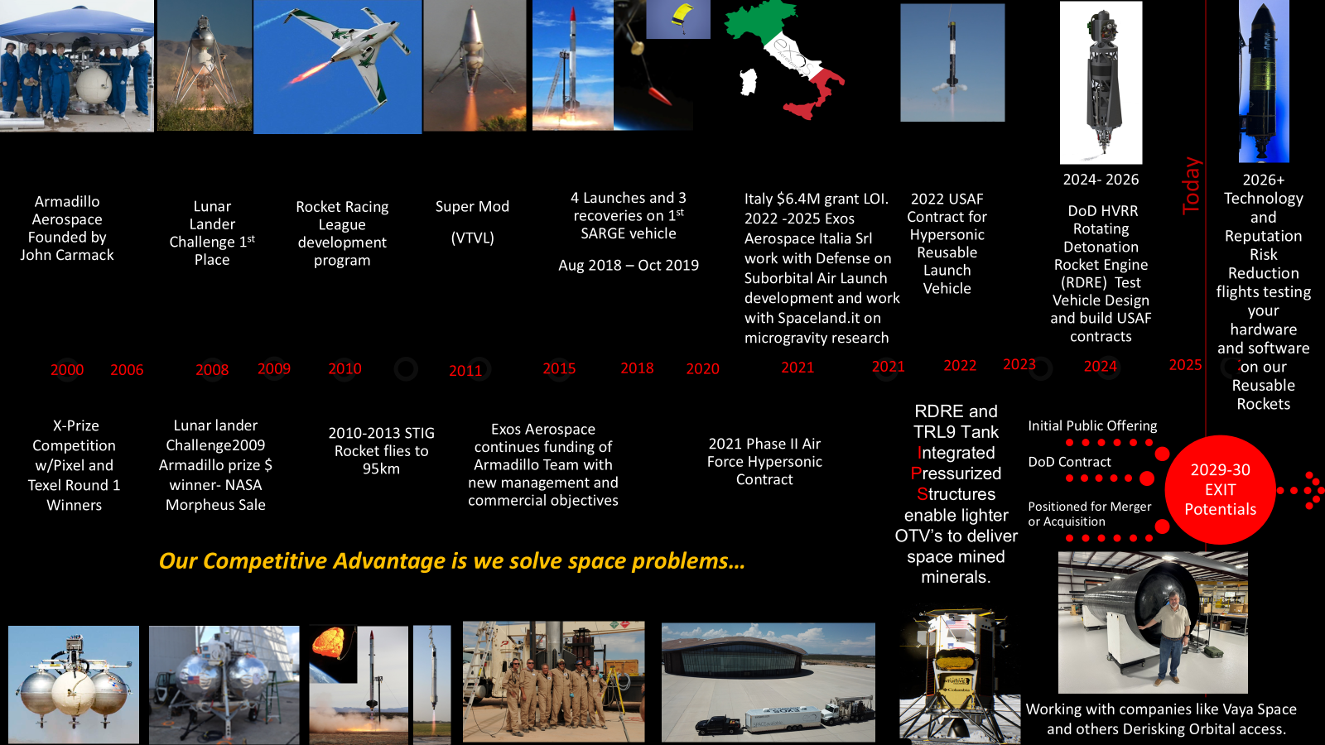

Slide 3
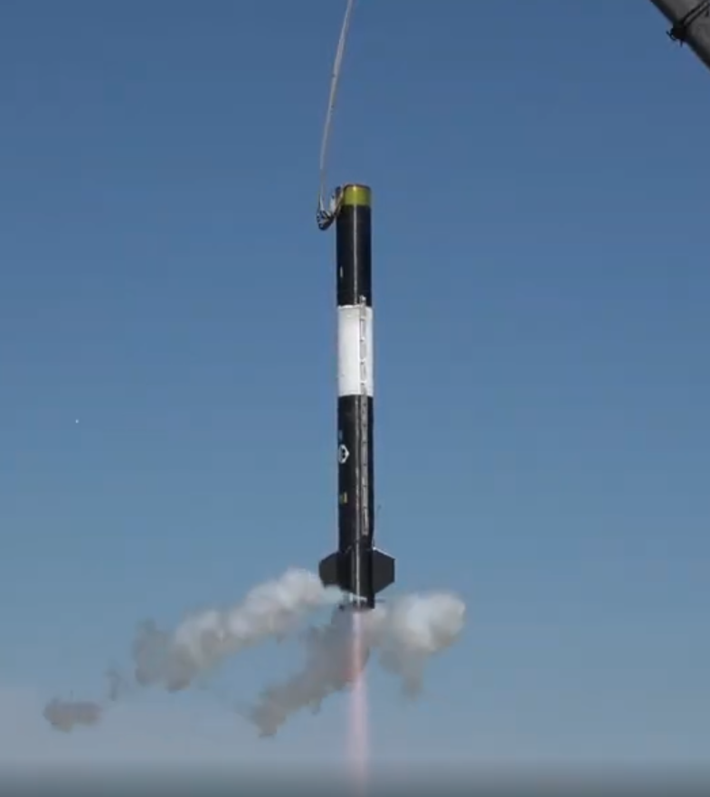
THE EXOS STORY
Two decades of reusable rockets. Lunar-proven tanks. A team that does more with less.
25+ yrs
4 / 14
reusable-rocket heritage
flights / months, 12-person team
Armadillo (2000) → Exos
SARGE — capital-efficient reuse
1 of 3
2× Moon
FAA-licensed reusable in the U.S.
Type-5 tanks — lunar-proven
~2-day turnaround — a design target
now cryo for commercial stations
ACTIVATING AMERICA'S DORMANT INDUSTRIAL CAPACITY
ACTIVATING AMERICA'S DORMANT INDUSTRIAL CAPACITY
Profitable in 2025 · 102% four-year revenue CAGR · management-prepared figures in the data room

Slide 4
Leadership — the team that built Exos
Navy discipline, propulsion & recovery, flight-ops, and capital markets — all built into Exos
John Quinn
Russel Blink
Neil Milburn
CEO & Co-Founder
CTO & Co-Founder
COO & Co-Founder
11 years building Exos — drove it to
Exos's technical bench — has built hundreds
Longtime Armadillo Aerospace veteran. FAA
profitability in 2025. Managed $1B+ FPL
of rocket engines and dozens of flying
liaison; drives operational excellence,
power-plant construction, adding $43M+ in
vehicles. Anchors propulsion and vehicle
program execution, and turnarounds.
revenue — major capital execution in a
engineering.
regulated utility. 14.5-year U.S. Navy
Submarine Service.
David Mitchell
Kyle Ballard
Phil Eaton
President & Co-Founder
Chief Financial Officer
Propulsion & Recovery Design Engineer
4th-generation energy entrepreneur; secured
With Exos for years — responsible first and
Exos's core engine — designs the propulsion
the private capital that built Exos's
foremost for Exos financial accuracy:
and recovery systems that make reusable
reusable rockets (prior family company sold
reporting, controls, diligence, and
flight and intact hardware recovery real.
to CBS). Leads financing & investor
public-listing (TXSE) prep.
relations.

Slide 5
ANSWERING THE COMMISSION'S QUESTIONS
On the terms of the Maritime Industrial Base Working Group — their concern, our answer.
THE COMMISSION'S CONCERN
EXOS'S ANSWER
Can the U.S. base build,
IF we learn how to enable commercialization and support expansion by
sustain, and SURGE?
leveraging business AI to multiply productivity and utilize the standing
production capacity to 85% then support targeted growth like OSC intended
Supplier-tier health:
.
Own the resin → tank → vehicle stack; domestic
composites & propulsion
propulsion options (GTL RDRE, Vaya hybrid motors)
Workforce scarcity
AI-native operations; standard robots now, humanoids for
the 2nd & 3rd shift
Speed — cut acquisition
OTA on-ramp, SBIR Phase III, firm-fixed-price — buy
friction
outcomes, not oversight
WE ARE THE PROFILE YOU'RE STUDYING
a small, non-traditional, agile supplier — and our answer runs through your own levers.

Slide 6
THE COMMISSION'S 8 QUESTIONS — DIRECT RESPONSES (1–4)
Every question: a prepared answer, linked to the hardware, process, and vision that backs it.
QUESTION
PREPARED RESPONSE
EVIDENCE & LINKAGE
1 · Overview of current
Reusable suborbital flight-test & de-risk platform — BLK3
Slides: Exos Story · Project
work, programs &
(FAA-licensed 3/13/26, ~2-day turnaround — a design target); active USAF HVRR
KARMEN · How the pieces play
vehicle build (RDRE propulsion GFE); Project KARMEN rapid
together. Tour: composites,
capabilities
reconstitution; 18% of Scorpius (lunar-flown Type-5 tanks).
integration, BLK3.
2 · 5-year workload in
Built from our 5-year financial model ($1.55M→$120M by program:
Slide: 5-Year Workload Projection.
man-hours (waterfall)
Scorpius, HVRR/TACFI-STRATFI, BLK4, payload). Man-hour equivalent
Basis: Exos financial model.
shown; final headcount plan to confirm. 5-yr capital: $25M equity (expanded) + ~$59.7M CapEx, $38M debt-financed
Small senior core with heavy AI-native leverage; scarce trades are
3 · Recruitment,
Slides: Automation Rollout
composites & propulsion techs; cross-training, apprenticeships &
retention & attrition
(quantified) · The automation gap
university pipelines. Standard bots + humanoids backfill the gap
· Mission Control.
(WC/BC)
(quantified). Attrition/hiring figures to follow.
4 · Critical
Scarce: composites layup/bonding/NDE, propulsion test,
Slides: The automation gap ·
skills/trades +
licensed-vehicle integration. Strategy: AI augmentation, standard
Output grows with shifts. Tour:
robots now + humanoids on 2nd/3rd shift, workforce training as a
composites/build.
shortfall strategy
line of business. Requires access to latest humanoid robots

Slide 7
THE COMMISSION'S 8 QUESTIONS — DIRECT RESPONSES (5–8)
Prepared answers, linked to supporting evidence in this deck and on the facilities tour.
QUESTION
PREPARED RESPONSE
EVIDENCE & LINKAGE
5 · Facilities capital +
Minimal fixed infrastructure (pad + power/comms; mobile command
Slides: What the anchor capital
planned improvements
module). Planned: BLK4 RDRE build-out, propulsion/test infrastructure,
buys · The pilot fund. Tour:
parallel payload integration. Capex figures to 5yr ~$59.7M total
Greenville facility.
6 · Supply-chain
Composite raw materials (carbon fiber) & specialty resins (lead time)
Slides: How the pieces play
challenges (booked &
— mitigated by owning the resin→tank→vehicle stack; propulsion long-lead;
together · What the anchor capital
commodity avionics. Bulk buys and Low unit count of reusables =less exposure.
buys.
anticipated)
Reuse = more tests per unit built (~2-day turnaround — a design target); KARMEN offered to
7 · Surge capacity of
Slides: Project KARMEN · Output
fly to space twice in 48 hrs for $3M. A reusable LIQUID platform burns
plant/equipment & supply
grows with shifts · Cost-share.
no SRM per flight – underutilized rocket winders can produce motor casings
and support weapons surge; build more by automating Industry 2nd/3rd shifts.
chain
Enable AI-native management ops & reusability as productivity multipliers.
8 · Productivity +
Slides: Mission Control · The OTA
Relief: right-size Part 450, predictable range/airspace, small-business
relief from
model is the home · The ask.
ITAR/EAR safe-harbors, fuller SBIR Phase III, move to OTA + FFP
law/reg/policy
(buy outcomes). Support International Trade Zone (DHS CRADA)
Facilities tour — composites/build → integration → test → hover/ops. The live hardware is the physical evidence behind Q1, Q4, Q5 & Q6.

Slide 8
5-YEAR WORKLOAD PROJECTION — FROM OUR FINANCIAL MODEL
Workload driven by the Exos 5-year revenue plan (model v9, Cash Flow conservative / building-financed case), by program. Fiscal years begin in July — spans 2027–2032; man-hours illustrative.
BLK4 launcher
Scorpius tanks
Propulsion (RDRE/TACFI/STRATFI)
SARGE / other
$121.6M
HUMANOIDS IN THE MODEL
Revenue scales ~13× (2027→2032); human headcount only ~5×.
Humanoids + Mission Control cover the 2nd & 3rd shift from 2029 —
the productivity lever that bends the man-hour curve down.
$61.6M
$37.5M
$21.1M
$9.1M
2027E
2028E
2029E
2030E
2031E
~57k hrs
~101k hrs
~129k hrs
~167k hrs
~272k hrs
~30 FTE
~53 FTE
~68 FTE
~88 FTE
~143 FTE
+ humanoids
+ humanoids
+ humanoids
Revenue = Exos 5-year financial model v9 — Cash Flow (conservative, building-financed) case; fiscal years, Jul start, spans 2027–2032. Standard bots + humanoids quantified next slide.
Man-hours illustrative: revenue ÷ revenue-per-FTE (rising as standard robots + humanoids and Mission Control cover added shifts) × ~1,900 hrs/FTE. Headcount plan to confirm.

Slide 9
AUTOMATION ROLLOUT — QUANTIFIED (STANDARD BOTS + HUMANOIDS)
First rollout: 20% of humanoids run as standard bots — delivery lag + required bot CLI/integration builds — ramping to ~92% humanoid-capable by 2031.
METRIC
2027E
2028E
2029E
2030E
2031E
Standard bots (cumulative units)
4
10
20
32
48
Humanoids ordered (cumulative units)
0
8
24
50
90
Humanoids productive (after 20% first-rollout + CLI
0
~2
~13
~40
~83
builds)
Bot capex, cumulative ($M)
0.6
3.1
7.8
14.8
25.2
FTE-equivalent labor offset (cumulative)
6
18
59
148
296
As a DIB supplier, early access to the latest standard and humanoid robots secures this capability against a challenging workforce-development environment.
~$25M in bots → ~296 FTE-equivalent of surge labor by 2031 — the productivity behind ~$122M revenue on ~145 human staff.
ACCELERANT — early, targeted capital (e.g. DPA Title III / an OTA program) front-loads this rollout:
a focused early investment pulls the FTE-equivalent surge — and the revenue it unlocks — forward by ~12–18 months.
Planning assumptions: standard bot ≈ $150K installed (~1.5 FTE offset); humanoid ≈ $200K all-in incl. CLI/integration build (~1.5 FTE at first rollout → ~2.7 FTE on 2nd/3rd shift at maturity).

Slide 10
5-YEAR CAPITAL NEEDS
The $10M base case unlocks the plan; the live raise expands to $25M. Total capital to execute the full plan ≈ $110M (Exos CapEx + consortium pilot fund).
EQUITY — BASE CASE (MODELED)
5-YEAR CAPEX — ~$59.7M
EQUITY — EXPANDED (LIVE RAISE)
$10M
$25M
~$21.7M
Equipment
enabler
Y1 $2.1M · Y2 $5.4M · Y3 $0.3M · Y4 $7.5M · Y5 $6.4M
accelerator
$38M
$3.4M
Facilities (Y4 $20M + Y5 $18M)
$3.4M
Scorpius ROFR
Scorpius ROFR
DEBT-FINANCED via commercial mortgage — not equity
$4.1M
Equipment funded by the raise + internally generated cash.
$8.0M
RDRE / TACFI match
RDRE development (GTL / MSFC)
$2.5M
$9.0M
BLK3 vehicle build
BLK4 build (next-gen PSRLV)
OPERATIONS SELF-FUND FROM YEAR 3
$4.6M
Working capital · Part 450 ·
Free cash flow
contingency
−$1.5M
−$0.9M
+$9.3M
+$8.0M
+$32.9M
Y1
Y2
Y3
Y4
Y5
Unlocks TACFI/STRATFI — without it the
Adds the hardware path above the base —
plan doesn't start.
RDRE down-select + next-gen BLK4.
The $10M covers the acquisition, the RDRE match, the BLK3 build,
and the Year 1–2 bridge.
≈ $110M
TOTAL 5-YEAR CAPITAL TO EXECUTE THE PLAN
~$59.7M Exos CapEx + $50M consortium pilot fund
Base $10M modeled in v9; $25M expanded is the current target. Revenue, CapEx & FCF per the model's Cash Flow (conservative) case; consortium pilot fund detailed on the pilot-fund slide.

Slide 11
STRANDED CAPITAL IS REAL
The competitive market already stranded enormous capacity — hundreds of millions, much of it just sitting idle.
CAPITAL RAISED → OUTCOME
Virgin Orbit
<15%
$1B+ → Chapter 11 (2023)
Astra
Virgin Orbit machine utilization
$500M → 2 of 7 to orbit, taken private
last year — an 85% idle gap.
ABL Space
$461M → RS1 failed, exited launch
WHAT EXOS CHANGES
Astra could have reached orbit
Vector
faster and far cheaper by
$100M → Chapter 11 (2019)
de-risking on Exos reuse +
recovery — it never did.
+ Relativity — Terran 1 retired after a single flight → pivot. Sector-wide: $300B+ into ~1,900 companies since 2009.
THE 85% IDLE GAP IS THE OPPORTUNITY.
The consortium turns stranded capacity into national throughput — for a fraction of building new.

Slide 12
WHY BURN-UP REENTRY DOESN'T SCALE
The disposable model — deorbit and burn up — is already changing the stratosphere. At constellation scale it breaks.
THE STRATOSPHERE IS ALREADY CHANGING
THE SCALE
10% → 50%
• Constellations scaling to tens of thousands of satellites
• ~5-year lifespans → tens of thousands of reentries per year
• Deorbit-to-burn-up is the default disposal plan
of stratospheric aerosol particles carry spacecraft-reentry
metals — today ~10%, rising toward 50%+ (NOAA, 2023)
•
20+ exotic elements (aluminum, lithium, niobium, hafnium) matched
to rocket & satellite alloys
•
THE ANSWER
Reentry metal influx now exceeds natural cosmic-dust influx for
some metals
• Recover and reuse hardware — Exos recovery systems
•
First stratospheric pollution unquestionably tied to reentering
• Service & refuel in space, don't deorbit — Scorpius cryo
space debris
•
High-altitude stratospheric sampling, NASA WB-57 (NOAA SABRE
• depots and commercial stations extend life on orbit
mission)
DISPOSABLE BURN-UP DOESN'T SCALE — RECOVER, REUSE, REFUEL.
reusability and in-space servicing aren't just cheaper — at constellation scale they're the only sustainable path

Slide 13
THE AUTOMATION GAP
The U.S. is behind on the standard robots that raise utilization — humanoids then fill what fixed automation can't.
ROBOT DENSITY — industrial robots per 10,000 manufacturing workers (2024)
South Korea
1,220
TIER 1 — STANDARD ROBOTS
arms · cobots · CNC / FMS cells
proven, deploy today —
Singapore
818
this closes the density gap
Germany
449
TIER 2 — HUMANOIDS
Japan
446
legacy lines not built for
fixed automation, and the
2nd & 3rd shift
307
United States
rank 8th
THE GAP IS STANDARD ROBOTS THE U.S. HASN'T INSTALLED.
Deploy standard automation now; humanoids fill the rest. China holds the world's largest installed base (~2M robots).

Slide 14
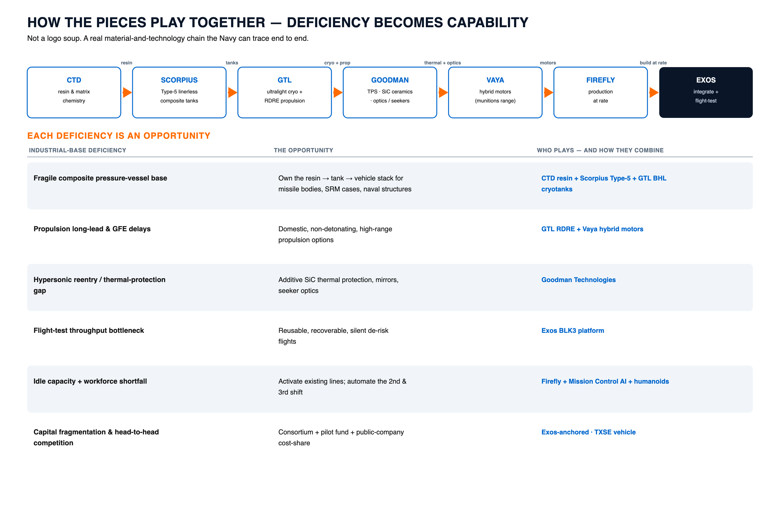

Slide 15
DECADES OF FEDERAL R&D — READY TO COMMERCIALIZE
Our partners aren't startups. They hold deep, government-funded technology — much of it never commercialized. Exos is the integrator that ships it.
Advanced materials & structures
Ceramics & space optics
58+ competitive SBIR awards since 2000 (DoD · DOE · NASA · NSF)
70+ SBIR awards; additive silicon-carbide mirrors
JWST + record UAS heritage; patented shape-memory
selected for NASA flagship telescopes; hypersonic thermal
deployables; fusion-magnet insulation
protection
government paid to develop it · Exos commercializes it
government paid to develop it · Exos commercializes it
Ultralight structures & propulsion
Lunar-proven tank technology
NASA- and DARPA-funded
TRL-9, flown to the Moon twice
record-light composite cryotanks + LH2 lines;
patented filament winding + trade-secret resin; ~50%
rotating-detonation propulsion
lighter than metal
government paid to develop it · Exos commercializes it
government paid to develop it · Exos commercializes it
130+ documented competitive federal R&D awards across the set — much of it still dormant. We turn it into product for the space & defense base.

Slide 16
WHAT THE ANCHOR CAPITAL BUYS
Strategic arbitrage, not a generic acquisition.
WHAT IT BUILDS
THE SCORPIUS ROFR
PAY $3.4M
Resin & matrix chemistry
↓
OWN $20–40M IP
Type-5 linerless composite tanks
↓
6–12× value · at a frozen 2021 basis
Reusable vehicle — flight-proven
Exercise the right of first refusal on TRL-9,
lunar-flown Type-5 composite tank technology.
One owned stack → a vertically integrated
Arbitrage figures are Exos's own valuation —
composite pressure-vessel base for missile
independent 409A + diligence in the data room.
bodies, SRM cases, and naval structures.

Slide 17
THE PILOT FUND — BUILT ON DoD'S OWN PLAYBOOK
$50M, fully deployed in 12–18 months. Not a new idea — the same capital mechanisms DoD already uses, run by pros and steered by insiders.
MECHANISMS IT MIRRORS
USE OF FUNDS
Anchor acquisitions (ROFR + materials)
1
DPA Title III
34%
direct industrial-base investment
Capacity activation (idle lines)
2
OTA consortia (NSTXL / SpaceWERX)
22%
rapid, cost-shared prototyping
Robotics / automation + Mission Control
3
In-Q-Tel
18%
strategic government-aligned capital
M&A execution overhead (pros, insider-steered)
4
SBIR / STRATFI
14%
non-dilutive matching
DIU
Working capital / contingency
5
12%
commercial on-ramp to DoD
M&A firm runs diligence & closings · Exos insiders decide what fits the stack

Slide 18
COST-SHARE THAT DOESN'T KILL SMALL VENDORS
A blanket 50% match on every project kills the small vendors. So: cost-share where it's viable — and the fund fills the gap where it isn't.
THE PROJECT PORTFOLIO
GOV 50%
COMMERCIAL 50%
GOVERNMENT-FUNDED
~HALF: cost-shared (commercially viable)
~HALF: mission-critical, no viable commercial match
THE PILOT FUND FILLS THE GAP
where a vendor can't front its 50% share, the fund bridges it — so the match requirement enables participation instead of blocking it
THE MATH, HONESTLY
≈ 1.3–1.5× federal reach across the portfolio · ~2× on the cost-shared projects · commercial capital via a public vehicle (Exos / TXSE)

Slide 19
OUTPUT GROWS WITH SHIFTS — SAME PLANT, NO NEW CAPEX
Humanoids and Mission Control fill the 2nd and 3rd shifts the labor market can't. Fixed cost amortizes across up to 3× the output.
up to ~2.6× output on the same fixed plant
265
185
100
1 SHIFT
2 SHIFTS
3 SHIFTS / LIGHTS-OUT
today · humans
+ humanoid backfill
24/7 · Mission Control

Slide 20
EXOS MISSION CONTROL
representative view
ACTIVE PURSUITS
PIPELINE VALUE
TASKS ORCHESTRATED
DECISIONS CLEARED
PARTNERS LOAD-BALANCED
37
$180M
1,240
96%
6
INTAKE
SCORING
ACTIVE
DELIVERED
SAM.gov RFP swept
Mission-fit + margin
Scorpius ROFR diligence
Quote sent
Partner idle-line ping
North-Star filter
BLK3 payload manifest
Decision → owner
New payload inquiry
Export screen
RDRE trade study
Contract booked
AI ORCHESTRATION — optimizing across billions of parameters: route work to idle capacity · allocate capital · track delivered value across every partner P&L

Slide 21
THE OTA MODEL IS THE HOME FOR THIS
Our program only moves at speed under Other Transaction Authority. OTA on-ramps and accelerates; FAR sustains what must ride it.
TRADITIONAL FAR / PROGRAM OF RECORD
18–36+ months to award · heavy PM overhead · slow to non-traditional vendors
CONSORTIUM OTA
weeks–months to award · cost-share native · non-traditional friendly
far faster
THE OTA UMBRELLA
Prototype OT
Follow-on Production OT
Cost-share + pilot fund
rapid build + test
scale without re-competing
inside the vehicle
Statutory basis: 10 U.S.C. 4021/4022 (OTA) · Middle Tier Acquisition · DPA Title III · SBIR Phase III

Slide 22
PROJECT KARMEN — RAPID-TURNAROUND SPACELIFT TEST PLATFORM
USSF SBIR SF254-D1002 (Direct-to-Phase-II): a reusable suborbital platform to empirically qualify cargo, supplies & equipment under real spacelift conditions.
$3M
$300K
~10× UNDERFUNDED
requested,
funded
a real requirement, under-resourced
THE MISSION
WHY EXOS CAN
Reusable, rapid-turnaround suborbital testbed (120+
BLK3 — FAA-licensed reusable suborbital vehicle with
•
•
km): launch, microgravity, reentry, recovery
a modular payload bay + high-precision recovery
Empirically qualify cargo — capture shock,
Flying reusable since 2018; ~2-day turnaround — a design target is
•
•
vibration, temperature, acceleration & structural
already the design point
data
48-hour recovery-to-relaunch for high-tempo
Directly fills USSF's cargo-qualification /
•
•
campaigns; minimal launch infrastructure
'Operational Energy for Space' gap
THE REQUIREMENT IS REAL — FUND THE OUTCOME.
$3M requested, funded at $300K. Full funding delivers cargo qualification the space-logistics enterprise lacks. USSF SBIR SF254-D1002 (D2P2).

Slide 23
THE ASK
What only the Commission can move.
1
Buy commercial outcomes
pay for delivered results, not process
2
Let us perform off the traditional base & DoD ranges
fractional cost, accelerated speed
3
Stop micromanaging the small steps
firm-fixed-price, milestone- and outcome-based
4
Make the OTA model the home
on-ramp non-traditional capacity without re-competing
5
Clear the friction
right-size Part 450 · predictable range/airspace · small-business ITAR/EAR safe-harbors ·
fuller SBIR Phase III

Slide 24
THE PATHWAY — PROVE IT IN SPACE & DEFENSE, THEN REPLICATE
Small vendors already see the opportunity across many industries. The same challenges show up everywhere — so the same model transfers.
SPACE & DEFENSE
Maritime & Shipbuilding
Munitions & Missiles
the proving ground — today
aging yards, fragmented sub-tiers, idle
surge demand on a fragile supplier base
THE CONSORTIUM ENGINE
berths
same challenge · same model
sector-agnostic — nothing here is space-specific
same challenge · same model
1
Find fragmented vendors + stranded capacity
Energy & Nuclear
2
REPLICATE
Semiconductors & Microelectronics
Anchor + pilot fund to activate it
long-lead fabrication, stranded shop
packaging/test bottlenecks, underused
capacity
3
Mission Control AI orchestration
small fabs
same challenge · same model
same challenge · same model
4
Humanoid automation backfills shifts
Advanced Manufacturing
5
Public-company cost-share capital
Critical Materials & Processing
machine shops at low utilization
small processors — no scale, no
nationwide
orchestration
same challenge · same model
same challenge · same model
Same challenges everywhere: fragmented small vendors · stranded capacity · workforce/automation gap · capital inefficiency

Slide 25
De-risk the impossible.
Deliver the mass that builds humanity's future in space.
John Quinn, Cofounder & CEO
jquinn@exosaero.com · www.exosaero.com

Slide 26
