Slide 1


EXOS OFFER TO
SCORPIUS SPACE LAUNCH COMPANY
Board Overview
John M. Quinn | Cofounder & CEO, Exos Aerospace
October 10, 2026
CONFIDENTIAL — DRAFT — NEGOTIATING TERMS
Notes:
This is a draft offer overview for the SSLC board. All figures are from the Option B Offer Summary (2026-10-07). The offer is subject to negotiation and board acceptance. Not a final or binding offer.

Slide 2
The Decision
The Board is asked to confirm §3 exclusivity under the May 2025 Asset Acquisition Agreement.
Exclusivity period: 90 days from board confirmation; extension not unreasonably withheld (§3)
Holdback: 5% escrow, released at 12-month anniversary (§7)
Agreement basis: May 2025 Asset Acquisition Agreement — §3 exclusivity trigger
DRAFT — NEGOTIATING TERMS
CONFIDENTIAL
Notes:
The sole action requested of the SSLC board at this meeting is confirmation of the §3 exclusivity provision in the existing May 2025 Asset Acquisition Agreement. Once exclusivity is confirmed, both parties have 90 days to negotiate and execute the definitive agreement and advance to financing close.

Slide 3
Where SSLC Stands Today
$198K
$713K
~$1.46M/qtr
Cash on hand
Last quarter revenue
Required to hit $5.1M
Current working capital
Most recent reported quarter
M1 milestone threshold
A $5.1M fiscal year requires approximately $1.46M per quarter — nearly double last quarter's pace of $713K — starting now. Exos's offer removes that funding risk and gives SSLC holders direct upside.
DRAFT — NEGOTIATING TERMS
CONFIDENTIAL
Notes:
These are SSLC's own numbers, presented factually and respectfully. The $198K cash figure is from the email draft. The $713K last quarter is from the offer summary. The $5.1M milestone (M1) requires nearly double that quarterly pace starting immediately — this is the context for why the Exos offer provides meaningful value through financing close and earn-out structure.

Slide 4
What SSLC Holders Receive
Cash at close
$2.51M
Issued at financing close
Restricted at issuance (Rule 504)
Part of RTO public float
Freely tradeable at listing
SSLC transaction costs
$60K
Exos stake credit (non-cash)
$790K
SSLC debts paid at face
~$500K
Working-capital bridge
$500K
① Cash & debt relief at close
$4.36M
+ Exos equity — EAI units at 409A (Rule 504, ~0.59%)
$1.0M
② Total at financing close
$5.36M
DRAFT — NEGOTIATING TERMS
CONFIDENTIAL
Notes:
All three scenarios (Low/Base/High) have identical at-close values: ① $4.36M, ② $5.36M with stock. The $4.36M breaks down as: $2.51M cash + $60K transaction costs + $790K stake credit (non-cash) + ~$500K SSLC debts at face + $500K WC bridge. The $1.0M EAI units are issued at financing close, not at board acceptance, and count toward the Rule 504 $10M rolling cap.

Slide 5
How Value Grows: Earn-Outs & Milestones
Earn-Out
Low
Base
High
Tank earn-out (5 yrs, IM revenue)
$750K
$1,250K
$1,500K
M1: FY2026-27 revenue ≥ $5.1M
$200K
$200K
$200K
M2: Nebula/OTV production contract signed
—
$200K
$200K
M3: SSLC annual revenue ≥ $10M
—
$250K
$250K
M4: SSLC annual revenue ≥ $20M
—
—
$250K
M5: BLK3 tank qualification complete
—
—
$200K
Stock earn-out at listing (additional equity)
$0
(0.0%)
$625K
(0.25%)
$1,500K
(0.50%)
"The up-front price reflects what the numbers support today; the earn-outs are how that value grows as goals are met." — John M. Quinn
DRAFT — NEGOTIATING TERMS
CONFIDENTIAL
Notes:
Tank earn-out: 5 years, 3%/5%/7% of IM revenue (Low/Base/High), $300K/yr cap. M1 pays FY28 Q1 if verified. M2 pays at contract execution any year FY27-30. M3 pays first year threshold hit (est. FY29 at base/high). M4 pays first year threshold hit (est. FY31 at high). M5 pays at Exos BLK3 tank certification (est. FY27-28). Stock earn-out: 0.0%/0.25%/0.50% additional FD equity at RTO, with the same lockup as Exos principals. Each milestone is independently verifiable; none pays unless the trigger is met.

Slide 6
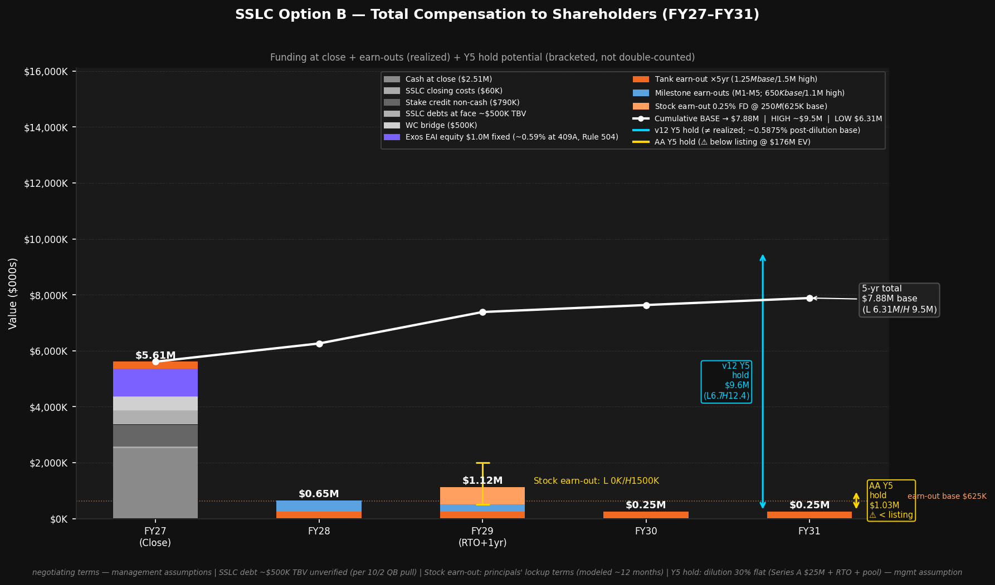
Total Offer Value
③ 5-Year Total (earn-outs realized)
④ If Exos Stock Held to 2031 (projection)
Low
Base
High
Low
Base
High
$6.3M
$7.9M
$9.5M
$12.0M
$15.8M
$19.4M
5-yr realized
5-yr realized
5-yr realized
if held to 2031
if held to 2031
if held to 2031
④ is a forward-looking projection, not a guarantee; an alternative to ③ — not added to it. RTO may not close.
DRAFT — NEGOTIATING TERMS
CONFIDENTIAL
Notes:
③ 5-yr total is ② ($5.36M) + earn-outs. Low = $6.31M / Base = $7.885M (shown as $7.9M) / High = $9.46M (shown as $9.5M). These are rounded for board presentation. ④ TOTAL IF STOCK HELD TO 2031: Low $12.0M / Base $15.8M / High $19.4M — this replaces and is not additive to ③. It assumes RTO completion, ~30% dilution, and management-projected valuations. Forward-looking statements subject to SEC Rule 10b-5. The chart shows the year-by-year compensation build from close through FY31.

Slide 7
The Exos Stock
Instrument
Offering
$1.0M EAI units at the current 409A valuation (~$169.7M); ~0.59% fully diluted at issuance.
Part of Exos's Rule 504 Regulation D offering. U.S. persons only. Counts toward the $10M rolling 12-month cap.
Restricted at issuance
Public float at RTO
Units carry a restrictive legend at issuance (Rule 504 Reg D). Not freely tradeable prior to the RTO listing.
Structured to be part of the public float at going public. No principals' lockup applies to these units; locked-up shares would not count as float.
Freely tradeable at listing
Timeline
Becomes freely tradeable at the RTO listing (no lockup on the up-front units). Covered by the RTO resale registration.
Units issued at financing close. Targeted RTO ~6 months post-financing. Not assured — RTO may not close.
DRAFT — NEGOTIATING TERMS
CONFIDENTIAL
Notes:
The $1.0M EAI units are issued at financing close (not at board acceptance). At the 409A valuation of ~$169.7M, this represents ~0.59% fully diluted. Earn-out stock (0.0%/0.25%/0.50% additional) issued post-RTO brings total equity to ~0.59%–1.09%. The Japan round EAI units are Reg S and must remain separate from the Rule 504 domestic offering. See model EAI Lockup & Liquidity sheet for full detail.

Slide 8
SSLC Employees
Employment Offer
Key-Employee Option Pool
Exos shall offer employment to SSLC employees — including management, support, engineering, and other technical and manufacturing employees — on terms no less favorable than their current terms with SSLC, including compensation and benefits.
Subject to each employee satisfying Exos's standard hiring policies and Exos's completion of confirmatory due diligence.
Exos will establish an option pool for key SSLC employees. The size and structure will be mutually agreed in the Definitive Agreement.
Designed to retain the talent that drives SSLC's mission continuity and milestones — including the programs that underpin the earn-out triggers.
DRAFT — NEGOTIATING TERMS
CONFIDENTIAL
Notes:
This language is verbatim from the offer email (Exos_SSLC_Offer_Briefing_Email_DRAFT_2026-10-09.docx) and the Key Terms section of the offer summary PDF. The exact terms — option pool size, vesting schedule — will be negotiated in the Definitive Agreement. IM program continuity: Exos-SSLC continues the Intuitive Machines contract with no delivery interruption.

Slide 9
Path to Close
1
Board Confirms Exclusivity
Today — action requested at this meeting
2
90-Day Exclusivity Window
Negotiation and diligence period begins
3
Definitive Agreement
Key terms, employee pool, earn-out detail finalized
4
Financing Close
Cash at close + EAI units issued; ① + stock = ②
5
Targeted RTO
~6 months post-financing; units tradeable at listing (not assured)
The Board is asked to confirm §3 exclusivity. Questions and open items welcome.
Notes:
The one action needed today is board confirmation of §3 exclusivity in the May 2025 Asset Acquisition Agreement. Once confirmed, the 90-day exclusivity period begins and both teams can proceed to diligence and the definitive agreement. The financing close triggers ② ($5.36M). The RTO is targeted ~6 months post-financing close but is not assured. All earn-out and milestone payments are independent and verifiable.

