Slide 1

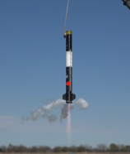
EXOS AEROSPACE
JAPAN
A partnership & investment opportunity
Reusable launch capability • Lunar-proven cryogenic tank technology
• Japan expansion
Exos Aerospace Japan (K.K.)
October 2026 | Toshi Kumazawa, Japan BD • John Quinn, Co-founder & CEO

Slide 2
01 | THE PLATFORM
A profitable U.S. space company with real flight heritage
A focused combination of reusable launch capability and advanced cryogenic tank technology.
25+
FAA
$1.49M
TRL-9
years of reusable-vehicle heritage
licensed for reusable launch operations
2025 revenue · EBITDA $254K (17%)
Type-5 linerless composite cryogenic tanks
FY2025, accrual basis, unaudited
Heritage matters.
The technology stack
Exos brings more than two decades of hands-on
reusable-vehicle experience,
rooted in the Armadillo Aerospace heritage.
• BLK3: out-of-autoclave carbon composite, low parts count, recovered and reflown.
• SSLC / Scorpius: linerless Type-5 composite cryogenic tanks designed for demanding applications.
• Type-5 tanks have flown in lunar missions.
EXOS AEROSPACE JAPAN • INVESTOR BRIEF
02

Slide 3
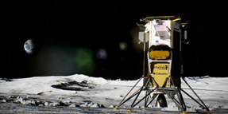
02 | PROOF
Technology that has already left Earth
The strongest investor story is not a promise of future technology—it is demonstrated hardware and mission heritage.
SSLC Type-5 tanks flew as fuel & LOX tanks
on Intuitive Machines' Odysseus (2024),
and Athena lunar landers.
Why this matters for Japan
• A reusable flight-test platform for Japanese industry and universities.
• Cryogenic tank technology applicable to launch and in-space propellant management.
• A technology base for long-term Japanese manufacturing and technical partnerships.
Lunar mission heritage
EXOS AEROSPACE JAPAN • INVESTOR BRIEF
03

Slide 4
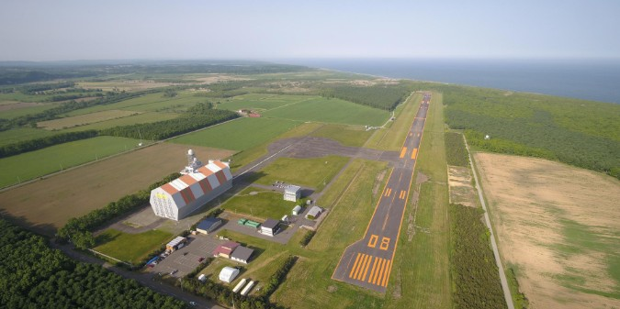
03 | WHY JAPAN
A local platform connecting Exos technology to Japanese demand
Exos Aerospace Japan is designed as an operating company—not simply a sales office.
Japan operating model
• Establish Exos Aerospace Japan (K.K.), with local office and team in 2026.
• Deploy BLK3 as a verification / flight-test platform for Japanese customers.
• Offer reusable rocket engines and SSLC Type-5 cryogenic tanks.
• Build consulting and long-term technical collaboration in Japan.
Hokkaido Spaceport (HOSPO)
A potential operating base for BLK3 wet-lease reusable
suborbital flight services, with Exos as licensed operator.
EXOS AEROSPACE JAPAN • INVESTOR BRIEF
04

Slide 5
04 | INVESTMENT
A structured raise into the Japan entity
Capital goes into the Japan operating entity (K.K.). The U.S. parent retains majority and control — clean for both Japan FDI (FEFTA) and U.S. (CFIUS).
SEED ROUND — INTO THE K.K.
STRUCTURED FOR REALISTIC EQUITY FINANCING
¥790M
Seed now into the K.K. → growth round as Japan revenue scales → alignment with an Exos US liquidity event.
Round sized to Japan build-out milestones; priced off the Exos US Series A.
≈ US$5.0M target
USE OF FUNDS
at ~¥157 / US$ (27 Sep 2026)
01
02
03
04
Japan entity
Flight capability
Local presence
Growth
Stand up the local operating company
Secure a BLK3 wet-lease for HOSPO
Open the Japan office in 2026
Customers, partners & licensed tank production
OWNERSHIP / CONTROL
The U.S. parent retains majority and control; the Japan entity runs Japan operations. The structure is modeled on the established Exos Aerospace Italia subsidiary.
Not an offer of securities of Exos Aerospace Systems & Technologies, Inc. Any offering by Exos Aerospace Japan K.K. will be made only through definitive documents to eligible investors.
EXOS AEROSPACE JAPAN • INVESTOR BRIEF
05

Slide 6
05 | RETURNS
Path to profit growth and exit
How investors realize a return — recurring revenue growth, then a defined exit. Non-dilutive layers can complement the equity round.
SEED (NOW)
SCALE
EXIT
Fund Japan stand-up + first wet-lease flights at HOSPO.
→
Recurring revenue — wet-lease flights · Type-5 tank & engine sales · verification & consulting.
→
Liquidity paths: acquisition of the K.K. stake by Exos U.S. or a strategic buyer, or a K.K.-level listing. Horizon ~3+ years.
ALSO ON THE TABLE — NON-DILUTIVE LAYERS (per Innovation Dojo)
Payload pre-sales
Crowdfunding
Reserve BLK3 flight capacity ahead of service — cash in without giving up equity.
Community & supporter participation to broaden the base and build the Japan brand.
Not an offer of securities of Exos Aerospace Systems & Technologies, Inc. Any offering by Exos Aerospace Japan K.K. will be made only through definitive documents to eligible investors.
EXOS AEROSPACE JAPAN • INVESTOR BRIEF
06

Slide 7
06 | TRACTION
The Japan opportunity is already moving
Current signals point to customer demand, infrastructure collaboration, and an expanding local partner network.
CUSTOMER SIGNAL
LOI received for a fuel-tank order from a Japanese space-development
company; engine-specification inquiry also received.
INFRASTRUCTURE
Collaboration discussions underway with Hokkaido Spaceport (HOSPO /
Space Cotan).
PARTNER BUILD
Seeking Japanese technical partners for licensed production of TRL-9 Type-5 tanks in Japan. BLK3-for-Japan production commences upon international approvals (incl. U.S. export), with potential reallocation of U.S. BLK3 assets to match the speed of those approvals.
October 2026: CEO visit to Japan
HOSPO • LOI client • space-development companies • prospective investors
EXOS AEROSPACE JAPAN • INVESTOR BRIEF
07

Slide 8
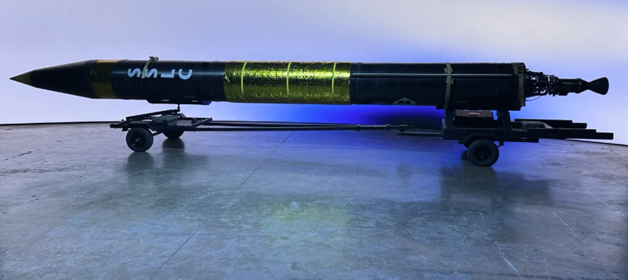
07 | THE INVITATION
Build Exos Aerospace Japan with us
The objective: turn proven U.S. technology into a durable Japan operating platform.
What partners can help build
• A local reusable-flight capability at HOSPO.
• A Japanese customer and university flight-test platform.
• Local technical partnerships for Type-5 cryogenic tanks.
• A long-term Exos presence in Japan.
Exos Aerospace Japan (K.K.)
Toshi Kumazawa • toshihisa@exosaero.com
Built in Japan, together with Japan.
John Quinn • Co-founder & CEO
EXOS AEROSPACE JAPAN • INVESTOR BRIEF
08

