Slide 1

EXOS AEROSPACE
AI-Native Industrial Power for the Space & Defense Industrial Base
Reusable flight-test platform · TRL-9 lunar-proven composites · the consortium that re-industrializes space & defense
Profitable (2025) · Raising a $10M Series A · October 2026
John Quinn, Cofounder & CEO · jquinn@exosaero.com · www.exosaero.com | PRIVATE & CONFIDENTIAL

Slide 2
WHY NOW
Three waves converge — and Exos sits at the intersection
THE $20T PHYSICAL WORLD
THE INDUSTRIAL-BASE IMPERATIVE
THE CAPITAL WAVE
AI conquered software; the physical world is next. Almost no one can apply AI to real flight hardware. Exos already does.
Congress and DoD are re-industrializing for surge to 2045. Capital is moving to dual-use hardware and dormant capacity — Exos's exact lane.
The SpaceX IPO and record defense spending are pulling institutional capital into space-defense hardware. The window to enter at this basis is now.
Exos is the rare asset that is all three at once: a profitable reusable hardware operator under an FAA Part 431 launch license (transitioning to Part 450), running AI-native, holding lunar-proven IP.
Exos Aerospace Systems & Technologies, Inc. — Private & Confidential. Historical figures per QuickBooks (accrual, unaudited); projections are management-prepared estimates; supporting materials in the data room.

Slide 3
FOUR CORE ASSETS
Three technical assets, compounded by a fourth
1 · SCORPIUS TYPE-5 CRYO TANK IP
2 · REUSABLE SUBORBITAL PLATFORM
TRL-9 linerless composite cryogenic tanks, flight-proven on Intuitive Machines' IM-1 and IM-2. Exos owns 18% today; the Series A completes our acquisition and brings the technology fully in-house.
Exos — one of only three FAA-licensed reusable rocket launch providers in the U.S. (Part 431, transitioning to Part 450). BLK3: Recoverable, high-cadence, minimal fixed infrastructure.
3 · RDRE / ADVANCED PROPULSION
4 · AI-DEPLOYED OPERATING PLATFORM
Active USAF SBIR Phase II on a government-furnished RDRE, opening a sole-source Phase III path with no dollar ceiling. Next-gen propulsion via a structured trade study (Exos is the flight-test integrator, not a propulsion provider).
Mission Control plus a governed agent fleet run BD, capture, compliance, and operations. A compounding, owned decision-and-audit-trail asset — capital-efficient and ITAR/CUI-safe.
Assets 1–3 are the hardware and IP; #4 is the operating system that compounds them — management-characterized, a moat, not a separate line item. Single valuation of record: $169.7M.
Exos Aerospace Systems & Technologies, Inc. — Private & Confidential. Historical figures per QuickBooks (accrual, unaudited); projections are management-prepared estimates; supporting materials in the data room.

Slide 4



















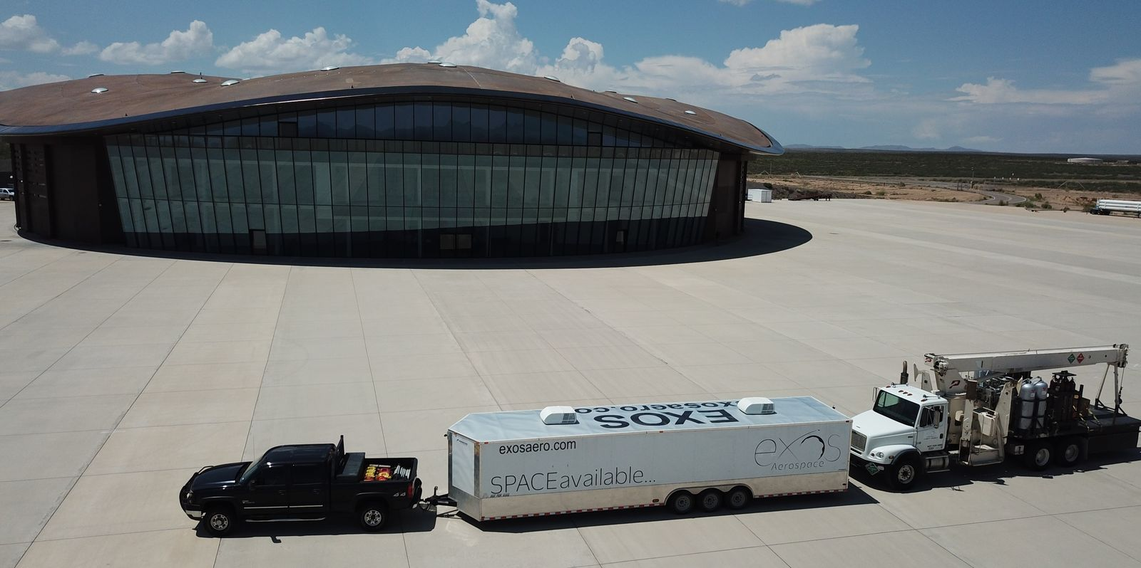

2024- 2026
DoD HVRR Rotating Detonation Rocket Engine (RDRE) Test Vehicle Design and build USAF contracts
Today
2026+ Technology and Reputation Risk Reduction flights testing your hardware and software on our Reusable Rockets
Armadillo Aerospace Founded by John Carmack
Lunar Lander Challenge 1st Place
Rocket Racing League development program
Super Mod
(VTVL)
4 Launches and 3 recoveries on 1st SARGE vehicle
Aug 2018 – Oct 2019
Italy $6.4M grant LOI. 2022 -2025 Exos Aerospace Italia Srl work with Defense on Suborbital Air Launch development and work with Spaceland.it on microgravity research
2022 USAF Contract for Hypersonic Reusable Launch Vehicle
2000
2006
2008
2009
2010
2011
2015
2018
2020
2021
2021
2022
2023
2024
2025
2028
Lunar Lander Challenge 2009 — Armadillo prize winner; NASA Morpheus sale
Our OTV-prop solutions offer LEO → Moon → Earth round-trip capability —
2029-30 EXIT Potentials
Initial Public Offering
DoD Contract
Positioned for Merger or Acquisition
X-Prize Competition w/Pixel and Texel Round 1 Winners
2010-2013 STIG Rocket flies to 95km
Exos Aerospace continues funding of Armadillo Team with new management and commercial objectives
2021 Phase II Air Force Hypersonic Contract
Our Competitive Advantage is demonstrated by what our team has already done:
Working with companies like Vaya Space
and others Derisking Orbital access.

Slide 5
THE STORY
25 years of reusable rockets — to a profitable, lunar-proven inflection point
2000
Armadillo Aerospace — reusable VTVL rockets; 100+ engines built
2014
John Quinn buys out the program → Exos Aerospace
2018–19
SARGE: 4 flights in 14 months, guided-canopy recovery — capital-efficient reuse
2021
Carbon-composite pivot; Exos takes an 18% stake in Scorpius
2024–25
Scorpius Type-5 cryo tanks fly to the Moon — IM-1 Odysseus & IM-2 Athena (TRL-9)
2025
First profitable year; 1 of 3 FAA-licensed reusable providers; AI-native ops live
2026 →
Series A: complete our acquisition of Scorpius + finish and fly BLK3
Exos Aerospace Systems & Technologies, Inc. — Private & Confidential. Historical figures per QuickBooks (accrual, unaudited); projections are management-prepared estimates; supporting materials in the data room.

Slide 6
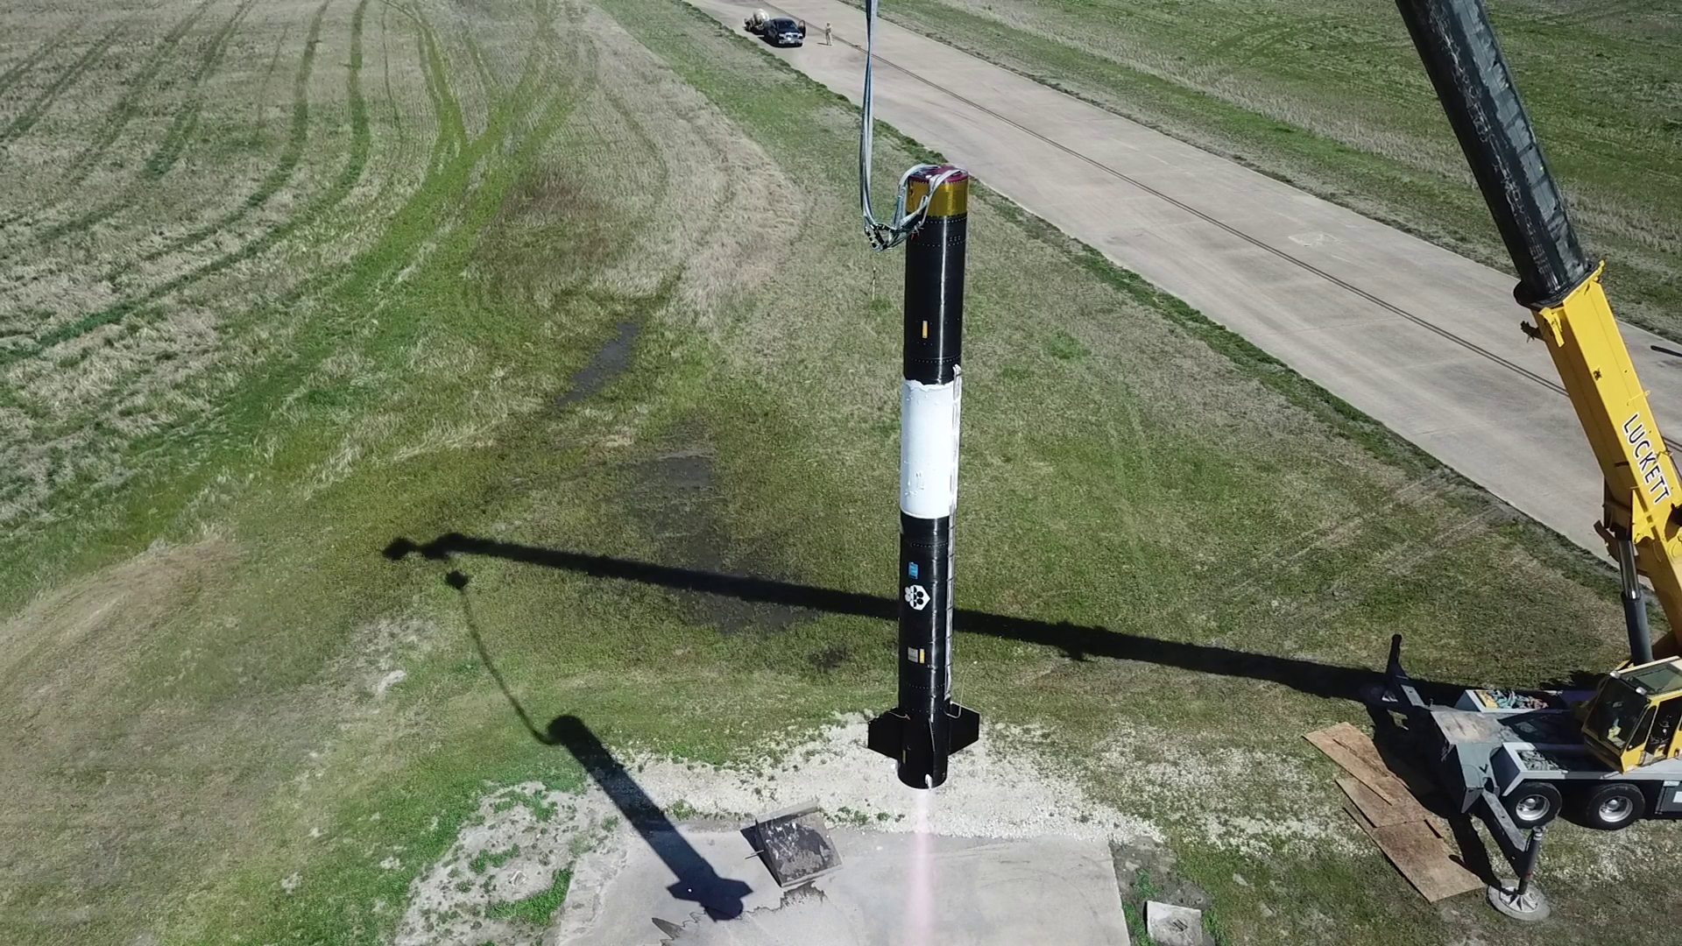
THE PLATFORM
BLK3 — a reusable de-risk engine for the whole orbital industry
▸ One of only three FAA-licensed reusable launch-and-recovery providers in the U.S. (Part 431 → Part 450).
▸ De-risk orbital programs on a proven ~$5M vehicle instead of losing $50–100M rockets on first flight — industry loses 4–7 to reach orbit; Exos can help cut that to 2–5.
▸ Customers place avionics, sensors, controls, and recovery in the BLK3 bay; hardware comes back, not just telemetry.
▸ $1M per flight (135 kg @ $7,500/kg); designed for rapid reuse (a 2-flight / 48-hour turnaround is proposed under Project KARMEN, not yet demonstrated).
▸ Hover test campaign completed; first commercial flight targeted early 2027.
BLK3 PSRLV — vertical for integrated test at Caddo Mills. Reusable and recoverable.
Exos Aerospace Systems & Technologies, Inc. — Private & Confidential. Historical figures per QuickBooks (accrual, unaudited); projections are management-prepared estimates; supporting materials in the data room.

Slide 7
THE CROWN JEWEL
Scorpius — completing our acquisition of Moon-proven tank technology
OWN 18%
IP $20–40M
1st
2×
of Scorpius today
TRL-9 lunar-flown Type-5 IP
tank sale for an orbital transfer vehicle
flown to the Moon (IM-1 / IM-2)
▸ TRL-9 linerless (Type-5) cryogenic composite tank technology, flown as fuel & LOX tanks on Intuitive Machines' Odysseus (2024) and Athena (2025).
▸ Scorpius's tank technology has made its first tank sale for an orbital transfer vehicle. The same Type-5 LOX/methane heritage is moving from lunar landers into the orbital-mobility market.
▸ ~50% mass reduction vs. metal; room-temperature-cure resin (no microcracking through 150 cycles); qualified to fuel on a Falcon 9 on the pad; export-approved variant.
▸ Exos owns 18% of Scorpius today; the Series A completes our acquisition and brings this composite cryogenic tank technology fully in-house.
▸ Enables in-space refueling and long-duration cryo storage — the tankage a commercial space economy is built on.
The IP value figure is Exos's own valuation, independent of the $169.7M 409A equity value.
Exos Aerospace Systems & Technologies, Inc. — Private & Confidential. Historical figures per QuickBooks (accrual, unaudited); projections are management-prepared estimates; supporting materials in the data room.

Slide 8
THE MULTIPLIER
AI-native operations — 5× output, and the way we commercialize dormant tech
▸ Mission Control — an in-house, AI-native operating system (ExO 3.0). Ran a 12-person team to ~5× output in 9 months.
▸ AI-driven DFARS/CFR compliance (caught same-day regulatory changes on a live contract); CMMC L1 → L2; DoD data walled off from commercial AI.
▸ This is how the consortium ships: the AI stack drops into acquired sub-50-person firms and makes them AI-native overnight — the commercialization engine dormant DoD tech never had.
▸ The physical-AI proof point institutional capital is looking for — AI applied where it is hardest, real flight hardware.
5×
$180M
96%
1,240
output, 12-person team, 9 mo
AI-built pipeline value
decisions cleared in-system
tasks orchestrated
Exos Aerospace Systems & Technologies, Inc. — Private & Confidential. Historical figures per QuickBooks (accrual, unaudited); projections are management-prepared estimates; supporting materials in the data room.

Slide 9
THE THESIS
Activate America's dormant industrial capacity
THE PROBLEM & THE ENGINE
▸ Stranded capital is real: Virgin Orbit ($1B+ → Ch.11), Astra ($500M), ABL ($461M) — enormous capacity built, then idled.
▸ ~10 partner firms (CTD, GTL, Goodman, Firefly, Via Space) sit at 5–20% utilization, holding $1B+ of DoD-funded tech, <5% commercialized.
▸ Exos is the prime integrator that knits them into one skunk-works — surging Type-5 tanks, SRM cases, orbital-transfer tank sets, missile & Navy structures with no new CapEx.
▸ The same model transfers beyond space: advanced mfg, critical materials, energy, maritime, munitions.
SAME PLANT, UP TO 3× OUTPUT
▸ Idle winders & machines put to work at ~$150/hr — 10× manufacturing overnight.
▸ Humanoids + Mission Control fill 2nd/3rd shifts the labor market can't — fixed cost amortized across up to 3× output.
▸ Partner IP advances the Exos tech stack — continuous improvement, not one-off buys.
Exos Aerospace Systems & Technologies, Inc. — Private & Confidential. Historical figures per QuickBooks (accrual, unaudited); projections are management-prepared estimates; supporting materials in the data room.

Slide 10
VALIDATION
The government has already validated the platform — and under-resourced it
PROJECT KARMEN — USSF SBIR SF254-D1002 (Direct-to-Phase-II)
A reusable suborbital platform to empirically qualify cargo, supplies & equipment under real spacelift conditions — a proposed 2-flight / 48-hour rapid-turnaround demonstration (not yet demonstrated). Competitively selected, then funded at ~1/10th of its validated $3M scope. A reissue at the proposed scope funds the next commercial launches and stands the pilot up in months.
▸ Proposed path forward: a $34M STRATFI. Other public funding (DPA Title III, OSC) could deliver the same strategy. Non-dilutive, milestone-gated, not counted in the base case.
▸ $180M AI-built pipeline; Commission on the Future of the Navy toured Exos (Aug 2026) and is weighing the consortium/ITZ model for its report.
▸ Secure International Trade Zone (DHS-CRADA containers) bridges the foreign carbon fiber and cryo tankage the U.S. can't source — a national supply-chain-resilience tool.
Exos Aerospace Systems & Technologies, Inc. — Private & Confidential. Historical figures per QuickBooks (accrual, unaudited); projections are management-prepared estimates; supporting materials in the data room.

Slide 11
THE MECHANISM
A pilot fund built on DoD's own playbook — where strategic capital plugs in
FOR TITLE III / OSC / STRATEGIC CAPITAL
▸ $50M pilot fund, deployed in 12–18 months — activation capital for dormant capacity, steered by insiders, run by pros.
▸ Mirrors mechanisms DoD already uses: DPA Title III (direct industrial-base investment), the Office of Strategic Capital (loans / loan guarantees), and OTA consortia (NSTXL / SpaceWERX).
▸ Cost-share where viable; the fund fills the gap where it isn't — a blanket 50% match kills small vendors.
▸ OTA + firm-fixed-price is the home for this: weeks-to-award, outcome-based, non-dilutive alongside the equity.
THE THREE WAYS TO PARTICIPATE
1 Institutional equity
Series A at a $169.7M 409A basis; public-markets path in progress (TXSE listing as backup); SpaceX-IPO tailwind.
2 Strategic / Starfighters
JV / co-development on flight-test + reusable spacelift; shared cadence and range access.
3 Title III / OSC / OTA
Non-dilutive industrial-base capital into the consortium + KARMEN reissue.
Exos Aerospace Systems & Technologies, Inc. — Private & Confidential. Historical figures per QuickBooks (accrual, unaudited); projections are management-prepared estimates; supporting materials in the data room.

Slide 12
THE NUMBERS
Profitable today, a government-backed path to ~$120M
$1.58M
$278K
$1.49M
~$5M
2026 YTD revenue (Jan–Sep) · +168% YoY
2026 YTD EBITDA (Jan–Sep) · 18% margin
FY2025 revenue (first profitable year)
combined pro-forma run-rate
▸ History: $0.19M (2022) → $0.31M → $0.62M → $1.49M (2025), first profitable year; $1.58M in 2026 through September.
▸ Projection: ~$120M by Y5 on a contracted backbone (conservative Cash Flow case); TACFI/STRATFI/entX-expansion sit in a separate upside layer, not the base.
▸ Unit economics: future BLK4 sale (gated orbital path) $6M (50%+ GM); wet-lease flight $3.75M (60%+); tanks $200K–$1M (45%+).
▸ Valuation: $169.7M independent 409A equity value (Eqvista 3/31/26; $8.66/share; DLOM 36.51%) — comps cross-check 4–6× 2028E revenue.
WHERE WE'VE BEEN → WHERE WE'RE GOING
2022
$0.19M
2023
$0.31M
2024
$0.62M
2025
$1.49M ✓ profit
Y5
~$120M
Exos Aerospace Systems & Technologies, Inc. — Private & Confidential. Historical and 2026 YTD (Jan–Sep) figures per QuickBooks (accrual, unaudited); EBITDA = operating income + net interest; 2026 depreciation is booked at year-end, so YTD net income is before depreciation (EBITDA is unaffected); projections are management-prepared estimates; supporting materials in the data room.

Slide 13
THE ASK
A $10M Series A — 100% deployed on three things
▸ $10M Series A — use of funds:
▸ • Complete our acquisition of Scorpius — bring its composite cryogenic tank technology fully in-house
▸ • Finish and fly BLK3 — first commercial flight targeted early 2027
▸ • Advance next-generation propulsion through a structured trade study
▸ Public-markets path: in progress; a Texas Stock Exchange (TXSE) listing is the backup route.
▸ All common stock; founders retain ~56% control; EAI investors' first liquidity window in the raise.
WHAT $10M ENABLES
▸ Complete our acquisition of Scorpius — tank technology fully in-house
▸ Finish and fly BLK3 — flight evidence for orbital developers
▸ Advance next-gen propulsion via a structured trade study
▸ Put idle partner capacity to work — no new CapEx
▸ Bridge to the Title III / OSC non-dilutive layer
▸ Scale Scorpius into DoD orbital-mobility + SRM-case production — Title III non-dilutive
Exos Aerospace Systems & Technologies, Inc. — Private & Confidential. Historical figures per QuickBooks (accrual, unaudited); projections are management-prepared estimates; supporting materials in the data room.

Slide 14
De-risk the impossible.
Deliver the mass that builds humanity's future in space.
John Quinn, Cofounder & CEO
jquinn@exosaero.com · +1-972-740-8355 · www.exosaero.com
PRIVATE & CONFIDENTIAL — not an offer to sell or a solicitation of securities. Historical figures per QuickBooks (accrual, unaudited); projections are management-prepared estimates.

