Slide 1


EXOS AEROSPACE
AI-Native Industrial Power · Reusable Flight-Test for the Space & Defense Industrial Base
Licensed Reusable Launch | Lunar-Proven Technology | Profitable
Primary objective: DPA Title III domestic advanced-manufacturing capacity · Raising: $10M Tranche 1 — of a $25M raise
July 2026
PRIVATE & CONFIDENTIAL | NOT FOR DISTRIBUTION

Slide 2
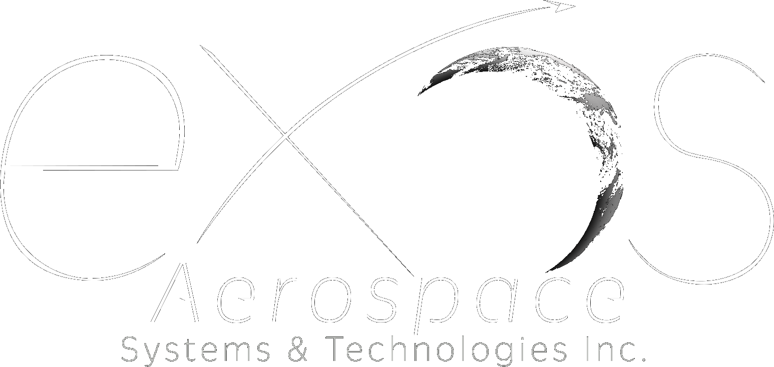
Strategic Objective — Domestic Advanced-Manufacturing Platform
Primary objective: non-dilutive DPA Title III funding for a domestic, defense-critical advanced-manufacturing platform.
▪ Own the stack: Scorpius Type-5 resin + tanks, CTD (acquisition), Gloyer-Taylor Labs (composite cryo tanks + transfer lines), Goodman (CMC/TPS) — resin to flight.
▪ Defense-critical manufacturing: room-temperature-cure, all-composite Type-5 tank = build/repair without an autoclave. Lead use case: B-2 / stealth aircraft fuel-tank depot & field repair.
▪ Domestic resilience: the reusable, recoverable U.S. alternative to foreign, single-source, expendable sounding rockets (Black Brant / Magellan).
▪ Broad dual-use demand: hypersonics, SRM cases/COPVs, magnet insulation, on-orbit refueling; commercial hydrogen, aviation, fusion, semiconductor.

Slide 3
The Capital Pathway — Title III Primary
Stack non-dilutive federal capacity funding first; use equity last and least.
▪ DPA Title III (PRIMARY): non-dilutive grants / purchase commitments for domestic manufacturing capacity — equipment, facilities, workforce. Executed via NSTXL / the Defense Industrial Base Consortium (DIBC).
▪ OSC (via Stifel): loans / equity for the cryo-tank manufacturing line ($10–150M; FY27 $20.2B authority), sitting under the note.
▪ $50M note: equity / convertible for the corporate acquisitions (Scorpius ROFR, CTD) and partnerships (GTL, Goodman, Princeton).
▪ Non-dilutive on top: SBIR Phase II→III, TACFI, NASA Flight Opportunities / Tipping Point.
▪ Result: federal capacity dollars build the industrial base; investor capital captures the frozen-basis acquisitions.
Title III and OSC are complementary, not either/or. Securities matters route through counsel (Keyes).

Slide 4
THE $20 TRILLION BLIND SPOT
AI conquered software. The physical world is next — and almost nobody can build for it.
The last decade of AI value went to BITS.
Code, chat, SaaS, automation. That trade is crowded and commoditized.
The next decade goes to ATOMS.
Aerospace, propulsion, manufacturing, energy, defense hardware — the $20 TRILLION physical economy.
"Almost nobody is building" it — because it is brutally hard.
Real engineering, licensed flight hardware, manufacturing, regulatory clearance. Moats that take years and cannot be cloned like an app.
That difficulty is the opportunity. Exos is already on the other side of it.
PRIVATE & CONFIDENTIAL | NOT FOR DISTRIBUTION

Slide 5
WHY EXOS IS THE PHYSICAL-AI PLAY
Four pillars no software company — and almost no hardware company — can assemble.
1. PHYSICAL AI, ALREADY IN PRODUCTION
AI applied where it is hardest: real flight hardware. Generative turbomachinery design (AxSTREAM), autonomous flight ops, AI-driven test & integration. Operating today — not on a roadmap.
2. SCARCE PHYSICAL INFRASTRUCTURE
One of only 3 U.S. FAA-licensed reusable launch companies. The only active commercial suborbital rocket test operator, that we are aware of. TRL-9, lunar-proven Scorpius cryo-tank IP. Years-deep moats.
3. RE-INDUSTRIALIZATION & AI-ERA WORKFORCE
Rebuilding domestic aerospace manufacturing in rural Texas & Montana — and pioneering the manufacturing-to-AI workforce transition. The labor & supply-chain side of the thesis.
4. DE-RISKING THE PHYSICAL FRONTIER
Exos’s reusable suborbital platform is the flight-truth layer the entire physical-space economy needs before committing capital — de-risking orbital, propulsion, in-space architecture.
THE PLAY: own the whole lunar‑proven chain — resin to flight — and consolidate the Scorpius stack at a frozen 2021 basis, before the market reprices it as a completed package.
PRIVATE & CONFIDENTIAL | NOT FOR DISTRIBUTION

Slide 6
THE FLIGHT TEST BOTTLENECK
Every orbital program needs flight truth before it commits. There is no substitute.
Wind tunnels are saturated
18-24 month wait times at major facilities nationwide
Computational modeling has limits
Models diverge from reality at hypersonic and reentry regimes
Custom test vehicle costs $50M+
And takes 2-3 years before first flight
Failed orbital launch destroys hardware
No intact hardware = no post-flight analysis
The gap: Between simulation and orbital commitment, there is no affordable, rapid, repeatable flight test option.
PRIVATE & CONFIDENTIAL | NOT FOR DISTRIBUTION

Slide 7
EXOS: THE DE-RISKING PLATFORM
One of only three U.S.-licensed reusable suborbital rocket companies — and the only one currently booking commercial test campaigns, that we are aware of
FLIGHT TEST AT A FRACTION OF THE COST
Customers place avionics, flight controls, and subsystems in our BLK3 payload bay. BLK3 flies to space, executes reentry profiles, then recovers. Customers validate hardware survives — before risking an orbital vehicle.
SILENT OPERATIONS
All test operations conducted confidentially until the customer is ready to disclose. Failed tests never become public. Critical for companies with public investors, government stakeholders, or competitive exposure.
INTACT HARDWARE RECOVERY
SpaceX and Blue Origin both recover customer hardware intact — but neither currently sells suborbital test services. Exos is the only licensed rocket operator offering commercial suborbital flight-test with full payload recovery, that we are aware of.
PRIVATE & CONFIDENTIAL | NOT FOR DISTRIBUTION

Slide 8
THE BLK3 PLATFORM
CUSTOMER PROGRAM PROGRESSION
Precision Suborbital Reusable Launch Vehicle
Phase 1
Test avionics, GNC, flight controls via BLK3 suborbital flights
• Suborbital flight profile reaching 100+ km altitude
• LOX/ethanol propulsion system
• Multiple flight test articles per mission
• Vertical launch, parachute recovery, fully reusable
• Integrated telemetry, tracking, and real-time data return
• FAA-licensed (3-13-2026) operations from Spaceport America, NM
• Modular payload bay for diverse customer hardware
Phase 2
Iterate — fly repeatedly until all systems validated
Phase 3
Suborbital proof flight of customer's actual orbital-class vehicle using Exos-developed recovery systems — validating full reentry before orbital commitment
The endgame: Customers graduate from testing subsystems to flying their own orbital vehicle suborbitally — recovering it intact — before committing to full orbital flight.
PRIVATE & CONFIDENTIAL | NOT FOR DISTRIBUTION

Slide 9
STRATEGIC ACQUISITION: SCORPIUS TYPE 5 TANKS
Own the stack — resin to flight: Scorpius's evolved resin (trade secret) and patented winding method for TRL‑9 Type‑5 tanks, integrated into Exos's FAA‑licensed reusable vehicle
TANK ADVANTAGES
• ~50% mass reduction vs. metal tanks
• All-composite, corrosion-resistant, export-approved
• Room-temperature cure — no autoclaves required
• Enables LOX-methane and advanced propellants
• Proprietary trade secret manufacturing process
Metric | Value
Acquisition price | $3.4M (Right of First Refusal)
Conservative IP valuation | $20–40M conservative
Arbitrage multiple | 6–12x
Key customer | Intuitive Machines ($3.2B mkt cap)
Additional targets | SpaceX, NGC, NASA Artemis
Terms | $2.4M close + $1M Exos debt repayment at funding (if not converted by Note holders)
Current ownership | Exos is existing 18% owner
Scorpius Type 5 composite-overwrapped cryogenic tanks served as fuel and LOX tanks on Intuitive Machines' Odysseus (IM-1) and Athena (IM-2) lunar missions — launched aboard SpaceX Falcon 9, funded by NASA CLPS.
PRIVATE & CONFIDENTIAL | NOT FOR DISTRIBUTION

Slide 10
MARKET SIZE & TRACTION
Market Segment | Size by 2030 | Source
Suborbital Flight Test Services | $1.5–2.5B | NSR, FAA AST, Bryce Tech
Cryogenic Tank Production (Space) | $2–4B | In-space refueling + lunar demand
Advanced Propulsion Systems | $1–2B | RDRE/detonation programs DoD/NASA
Total Serviceable Market | $4.5–8.5B
CURRENT TRACTION
GOVERNMENT PIPELINE
• Exos FY2025 Revenue: $1.49M (102% CAGR over 4 years)
• Exos contract revenue Sept 2025 – July 2026: $1.9M
• Scorpius revenue (pro forma): $3.1M for Sept 2025 – Sept 2026
• Combined pro forma annual run-rate: ~$5M
Exos FY2025 EBITDA: ~$296K (~20% margin) — first profitable year; ~$6.2M NOL carryforward
• USAF SBIR Phase II — HVRR-RDRE (FA9300-25-C-6022)
• TACFI ($4M) — RDRE development ($2M DoD + $2M match)
• STRATFI ($30M) — follow-on, RDRE operational engine
• Active NASA relationships via Scorpius heritage
Scorpius revenue shown pro forma pending acquisition close. Not yet consolidated Exos revenue.
PRIVATE & CONFIDENTIAL | NOT FOR DISTRIBUTION

Slide 11
REVENUE SCALING — PROJECTED
Government backbone + commercial fleet scaling — ~140% CAGR
Year | BLK4 Commercial | Scorpius | TACFI/STRATFI | Other Gov/Svc | Combined | YoY
2025A | — | — | — | $1.55M | $1.55M | 146%
2026E | — | $2.65M | $0.7M | $1.1M | $4.4M | 184%
2027E | — | $3.5M | $2.7M | — | $6.2M | 41%
2028E | $9.8M | $7.0M | $8.2M | — | $25M | 303%
2029E | $31M | $14M | $10M | — | $55M | 120%
2030E | $82M | $28M | $10M | — | $120M | 118%
UNIT ECONOMICS
• BLK4 vehicle sale: $6M/unit, 50%+ gross margin
• BLK4 wet-lease flight: $3.75M/flight, 60%+ margin
• Tank manufacturing: $200K–$1M/unit, 45%+ margin
• TACFI/STRATFI: 30% margin (70% COGS for gov't dev)
Forward-looking projections from March 2026. Actuals through February 2026. See disclaimers on final slide.
PRIVATE & CONFIDENTIAL | NOT FOR DISTRIBUTION

Slide 12
USE OF FUNDS & FINANCIAL PERFORMANCE
$10M Tranche 1 — 100% deployed, zero idle capital (Tranche 1 of a $25M, 5-year raise)
Allocation | Amount | Purpose
Scorpius Acquisition | $3.4M | 6–12x value on $20–40M IP. ROFR at $3.4M.
RDRE Development (TACFI match) | $2M | Match for $4M TACFI. Unlocks $30M STRATFI.
BLK3 Vehicle Build | $2.5M | 2nd vehicle. Dual-site ops. Doubles capacity.
Listing + Working Capital | $2.1M | Public listing costs + operational buffer.
CAPITAL AMPLIFICATION
$10M private capital unlocks $34M in government co-investment (TACFI + STRATFI) — a 3.4x multiplier on investor capital.
Metric | CY2026 | CY2027 | CY2028 | CY2029 | CY2030
Revenue | $4.4M | $6.2M | $25M | $55M | $120M
Gross Margin | 42% | 40% | 50% | 55% | 57%
EBITDA | $0.3M | $0.4M | $4M | $14M | $38M
EBITDA Margin | 7% | 6% | 16% | 25% | 32%
Net Income | $0 | $0 | $2M | $9M | $28M
PRIVATE & CONFIDENTIAL | NOT FOR DISTRIBUTION

Slide 13
MANAGEMENT TEAM
JOHN QUINN — CEO & Co-Founder
14.5-year U.S. Navy Submarine Service career
$43M ROI in Six Sigma projects at FPL
Company IP sale to Emerson Power
Drives strategy, capital markets, government relations
DAVID MITCHELL — President & Co-Founder
4th-generation energy entrepreneur and investor
Secured private funding enabling Exos to build commercial-grade reusable rockets
Company sale to CITS
Drives financing, corporate development, investor relations
RUSSEL BLINK — CTO & Co-Founder
BS EE, Michigan Technological University
TI Defense → Long Range Systems (VP/Co-founder) → Armadillo Aerospace (VP Eng)
Hundreds of engines, dozens of flying vehicles incl. NASA Lunar Landers
NEIL MILBURN — COO & Co-Founder
Chemical Engineering; co-founded Armadillo Aerospace (2000)
Revolutionized CNG refueling at NASA launch facilities
FAA liaison; company turnarounds and operational excellence
KYLE BALLARD — CFO
Financial operations, reporting, due diligence
Leading SSLC financial analysis and public listing preparation
PRIVATE & CONFIDENTIAL | NOT FOR DISTRIBUTION

Slide 14
OWNERSHIP & GOVERNANCE
Shareholder | Stake | Role
David Mitchell | 37% | President, Co-founder
John Quinn | 21% | CEO, Co-founder
EAI (Exos Aerospace Investors) | 37% | Common stock — directed by Quinn/Mitchell
Incentive Stock Option Pool | 5% | Key employee retention
Shareholder | Post-Listing | Status
David Mitchell | ~33% | Active management
John Quinn | ~19% | Active management
EAI (Exos Aerospace Investors) | ~33% | Public float — directed by Quinn/Mitchell
ESOP | ~4.5% | Vesting
Series A investors | TBD | Terms under negotiation
KEY GOVERNANCE
• All shares are common stock — no preferred classes
• Mitchell + Quinn retain 56% effective control
• EAI (Exos Aerospace Investors) — directed by John Quinn and David Mitchell
• EAI investors get first liquidity event in 10 years
• Public float sourced from existing EAI shares
• Exos Aerospace Systems & Technologies, Inc. — Texas corporation
PRIVATE & CONFIDENTIAL | NOT FOR DISTRIBUTION

Slide 15
CORPORATE STRUCTURE & LISTING PATH
EXOS AEROSPACE SYSTEMS & TECHNOLOGIES, INC. (Texas)
Parent entity — all operations, IP, contracts, and public listing vehicle
FAA-LICENSED OPERATIONS
Reusable suborbital launch | ITAR-controlled technology | Government contracts | Spaceport America
SCORPIUS SPACE LAUNCH COMPANY INC
Cryo tank IP, manufacturing, lunar heritage
PUBLIC-MARKET PATH — PRIMARY: TEXAS STOCK EXCHANGE (TXSE)
TIMELINE FROM INVESTMENT CLOSE
Texas Stock Exchange (TXSE) — primary public path; target ~18–24 months, contingent on Series A close + TACFI/STRATFI engagement
(Prior Euronext Dublin / EU listing route discontinued)
Currently a private growth Series A; TXSE-primary is the single, dated destination — no interim OTC / Reg A+ route is being marketed.
• Aug–Oct 2026: Capital deployed + Scorpius close
• 2027: Listing prep + regulatory filings
• Q1–Q2 2028: Admission to trading
PRIVATE & CONFIDENTIAL | NOT FOR DISTRIBUTION

Slide 16
COMPARABLE VALUATIONS
Company | Exchange | Market Cap | Revenue | Multiple | Notes
Rocket Lab (RKLB) | NASDAQ | $12B | $436M | 27x | Orbital, M&A-driven
Intuitive Machines (LUNR) | NASDAQ | $3.2B | $227M | 14x | Uses Scorpius tanks
Spire Global (SPIR) | NYSE | $600M | $110M | 5x | Space data/analytics
Mynaric (MYNA) | NASDAQ | $180M | $40M | 4.5x | Laser comms
Virgin Galactic (SPCE) | NYSE | $320M | $2M | — | Suborbital tourism
EXOS VALUATION: $169.7M INDEPENDENT 409A EQUITY VALUE
Independent 409A (Eqvista, 3/31/26): $169.7M equity; $8.66/share common; DLOM 36.51%
Comps cross-check: 4–6x 2028E combined revenue ($25M) ≈ $100–150M EV — in line with peers adjusted for growth
CY2028 = first year of full commercial operations
WHY EXOS IS NOT VIRGIN GALACTIC
• Sells to gov't/defense (contracted, recurring)
• Already profitable — SPCE never has been
• Owns irreplaceable IP (Scorpius + RDRE)
• $34M gov't funding pipeline = revenue floor
PRIVATE & CONFIDENTIAL | NOT FOR DISTRIBUTION

Slide 17
WHY NOW? MARKET TIMING
SPACEX IPO (2026–2027)
The largest space sector event in history. Creates massive retail and institutional interest in anything space-adjacent. A publicly listed Exos captures investor allocation from those seeking diversified space exposure beyond SpaceX.
DEFENSE SPENDING SURGE
NATO nations committed to 2%+ GDP on defense. U.S. and allied governments actively seeking domestic defense/space capabilities. Exos provides flight test infrastructure that supports national security objectives.
IN-SPACE REFUELING MARKET
SpaceX Starship depot, NASA Artemis architecture, commercial space stations — all require cryogenic storage solutions. Scorpius is the only TRL 9 technology of its kind available commercially that we are aware of. Market timing is ideal for this acquisition.
PRIVATE & CONFIDENTIAL | NOT FOR DISTRIBUTION

Slide 18
POLICY TAILWIND — THE 'GOLDEN AGE OF SPACE TRANSPORTATION'
New U.S. National Space Transportation Policy (Aug 2026) targets 1,000+ launches AND reentries per year by 2030 — a ~10x market expansion; reentry is the underserved half.
Reusable + recoverable: every Exos flight is a launch and a reentry — native to the policy's hardest goal, where few operators compete.
48-hour responsive launch: demonstrated by Exos Project Karmen (USAF-funded, 2 flights in 48 hours).
Spaceport & reentry-site build-out + streamlined Part 450 portfolio licensing favor Exos's minimal-infrastructure, multi-site model (West Texas).
Commercial Moon/Mars push + export emphasis align with Scorpius Type-5 tanks (lunar heritage) and international wet-lease.
Net: federal demand-pull that reinforces the Title III / OSC capital pathway and the market-timing thesis.

Slide 19










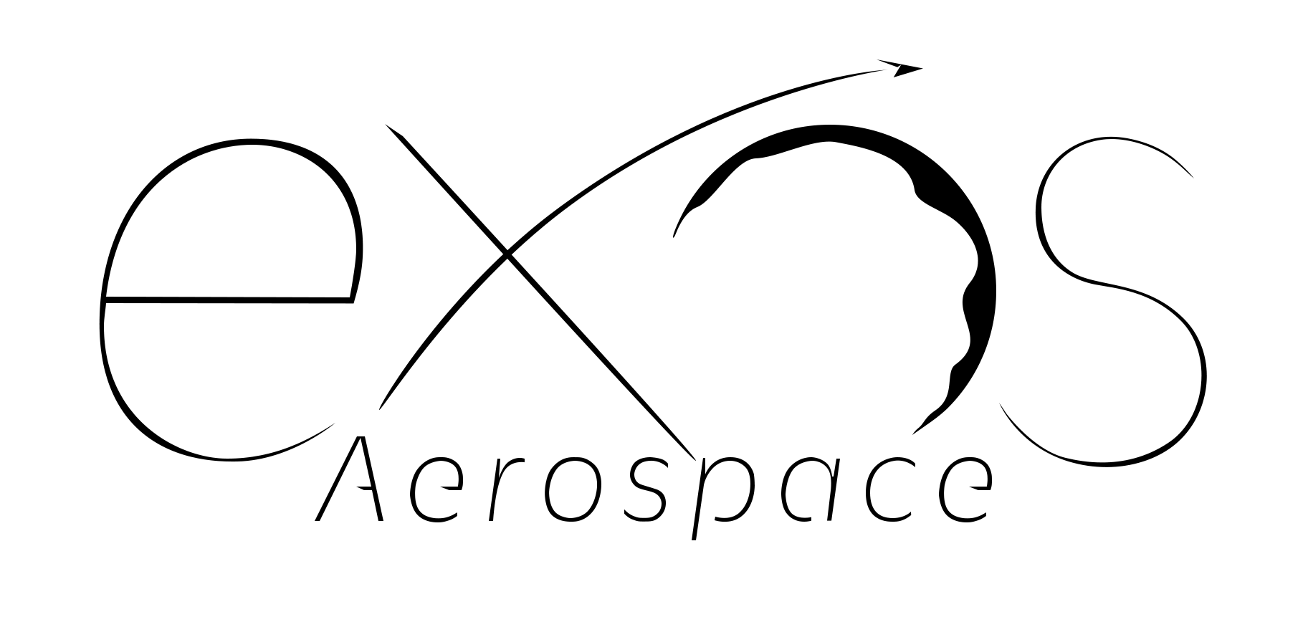










2024- 2026
DoD HVRR Rotating Detonation Rocket Engine (RDRE) Test Vehicle Design and build USAF contracts
Today
2026+ Technology and Reputation Risk Reduction flights testing your hardware and software on our Reusable Rockets
Armadillo Aerospace Founded by John Carmack
Lunar Lander Challenge 1st Place
Rocket Racing League development program
Super Mod
(VTVL)
4 Launches and 3 recoveries on 1st SARGE vehicle
Aug 2018 – Oct 2019
Italy $6.4M grant LOI. 2022 -2025 Exos Aerospace Italia Srl work with Defense on Suborbital Air Launch development and work with Spaceland.it on microgravity research
2022 USAF Contract for Hypersonic Reusable Launch Vehicle
2000
2006
2008
2009
2010
2011
2015
2018
2020
2021
2021
2022
2023
2024
2025
2028
Our OTV-enabled service offers LEO → Moon → Earth round-trip capability — a distinct transport solution powered by technology only we provide.”
Lunar Lander Challenge 2009 — Armadillo prize winner; NASA Morpheus sale
Exos Aerospace continues funding of Armadillo Team with new management and commercial objectives
2029-30 EXIT Potentials
Initial Public Offering
DoD Contract
Positioned for Merger or Acquisition
X-Prize Competition w/Pixel and Texel Round 1 Winners
2010-2013 STIG Rocket flies to 95km
2021 Phase II Air Force Hypersonic Contract
Our Competitive Advantage is demonstrated by what our team has already done:
Working with companies like Vaya Space
and others Derisking Orbital access.

Slide 20
RISK FACTORS & MITIGATION
Risk | Mitigation
Regulatory (ITAR, FAA) | 15+ year compliance track record; ITAR counsel; clean domestic (Texas) corporate structure
Scorpius integration | Exos is existing 18% owner; team/operations already familiar
Technology (RDRE) | SBIR Phase II funded; failure doesn't affect core business
Market liquidity post-listing | Market maker appointed; EAI sell-down provides volume
Single customer dependency | Diversified: DoD, NASA, 3 defense primes, commercial, university
Key person risk | D&O insurance; COO operational; 50+ years combined exec experience
BLK4 timeline | 18–24 mo. development in projections; CY2026–2027 revenue not BLK4 dependent
PRIVATE & CONFIDENTIAL | NOT FOR DISTRIBUTION

Slide 21
THE ASK — TITLE III PRIMARY
EXOS AEROSPACE — Licensed Reusable Launch | Lunar-Proven Technology | Profitable
Raising | $10M Tranche 1 (of $25M over 5 years)
Revenue Trajectory | $4.4M (2026) → $6.2M → $25M → $55M → $120M (2030)
Reusable Launch License | One of only three U.S. companies
TRL-9 Technology | Scorpius fuel tanks operating on the Moon
Gov't Co-Investment | $34M TACFI/STRATFI pipeline — 3.4x multiplier
Profitability | EBITDA-positive since 2025 — 17% margin
$10M ENABLES:
NEXT STEPS:
• Scorpius acquisition ($3.4M — Right of First Refusal)
• TACFI match → unlocks $30M STRATFI
• BLK4 commercial fleet development
• Public listing — Texas Stock Exchange (TXSE), ~18–24 mo
1. Review this materials package and financial model
2. Sign NDA for data room access
3. Management presentation (in person or virtual)
4. Confirm investment structure and timeline
John Quinn, CEO | jquinn@exosaero.com | Mobile 972-740-8355
Exos Aerospace Systems & Technologies, Inc.
PRIVATE & CONFIDENTIAL | NOT FOR DISTRIBUTION

Slide 22
IMPORTANT DISCLAIMERS
PRIVATE & CONFIDENTIAL
This presentation is provided for informational purposes only to selected potential investors and does not constitute an offer to sell or a solicitation of an offer to buy any securities of Exos Aerospace Systems & Technologies, Inc. or any affiliated entity.
FORWARD-LOOKING STATEMENTS
This presentation contains forward-looking statements within the meaning of applicable securities laws. These statements involve known and unknown risks, uncertainties, and other factors that may cause actual results to differ materially. Forward-looking statements include projections of revenue, earnings, capital expenditures, market size, product development timelines, and business strategy. Risk factors include: delays in vehicle development; failure to close the Scorpius acquisition; loss of government contracts; regulatory changes; competition; inability to raise additional capital; technology risks; and general economic conditions.
NO ASSURANCE
There can be no assurance that any projections or forward-looking statements will be realized. Past performance is not indicative of future results. Investors should conduct their own due diligence.
EXPORT CONTROL NOTICE
Exos Aerospace maintains full compliance with ITAR and EAR. All controlled technical data and government contract work are performed exclusively by U.S. persons within U.S. facilities. This presentation does not contain controlled technical data. Any international structure maintains full compliance with appropriate isolation.
CONFIDENTIALITY
This presentation and its contents are strictly confidential. Recipients may not reproduce, distribute, or disclose without prior written consent. All financial figures are management estimates unless otherwise noted. Audited statements will be prepared in connection with the listing process.
Exos Aerospace Systems & Technologies, Inc. | Greenville, TX | July 2026
PRIVATE & CONFIDENTIAL | NOT FOR DISTRIBUTION

