Slide 1
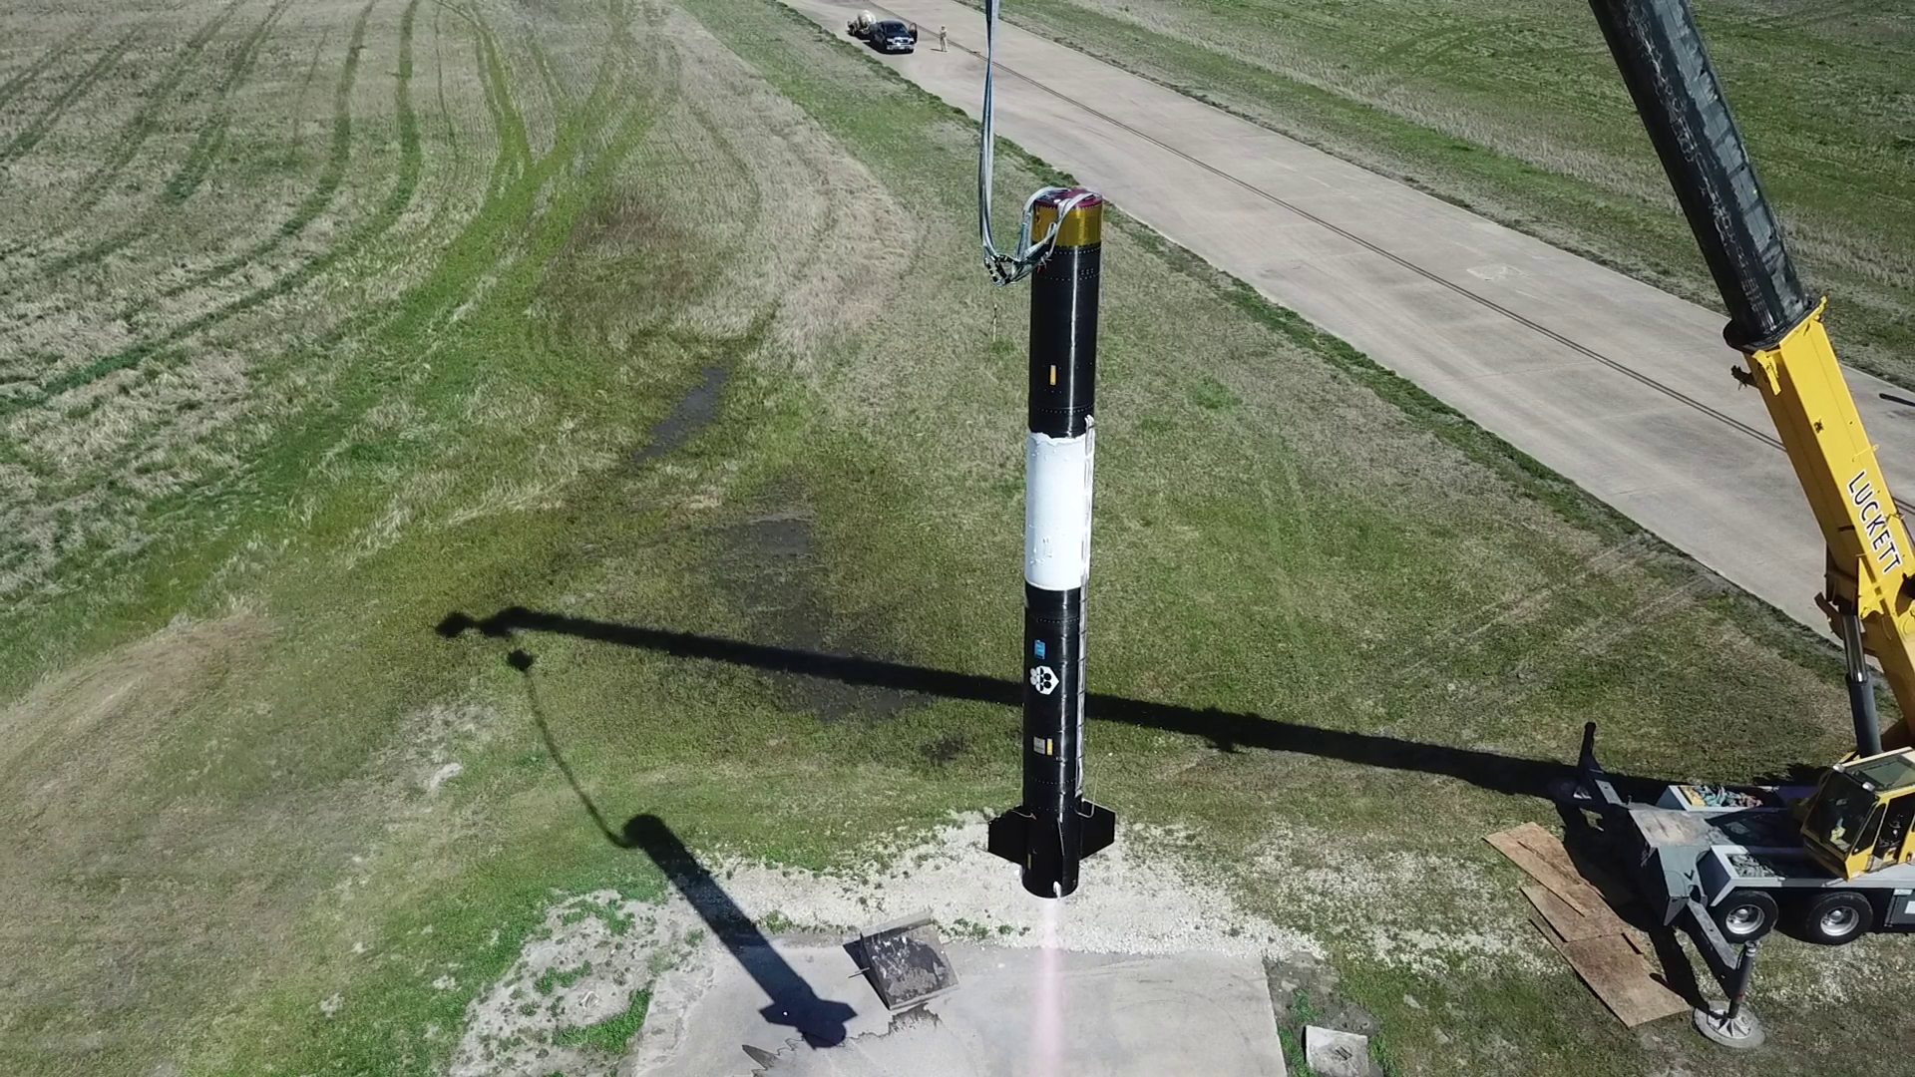
Exos Aerospace Systems & Technologies, Inc. | Project GUNGNIR
AF TACFI | SBIR Phase II FA9300-25-C-6022
Refuel · Relight · Reuse: In-Space Refueling + Storable-Propellant RDRE Flight Demo for Fast Transfer Vehicles (FTV/OTV)
Focus: Space Mobility & Logistics / in-space propulsion
Concept of Operations
Objective
• Fly a non-cryogenic (storable) RDRE on the reusable BLK3 vehicle: hover → flights to 100 km+ → in-space ignition, restart and pulsing.
• Same campaign: tank-to-tank storable-propellant transfer in microgravity, the refueling function FTVs and depots need.
Innovation
• Recoverable in-space test of refueling + detonation propulsion: vacuum ignition/restart and µg feed/transfer can't be done on a ground stand.
• Beyond HVRR/Hermes (atmospheric VTVL hops): GUNGNIR takes the RDRE to vacuum, coupled to µg refueling. Reusable = repeated in-space test points.
Operational Impact
• Refuelable FTVs = maneuver without regret for USSF mobility & logistics; refuel and service on orbit instead of reentry disposal; stations as refueling depots.
Deliverables
• 1 hover + 2 flights to 100 km+ (in-space RDRE firings + µg transfer); flight dataset (thrust, Isp, restart, transfer) + final report.
1 Hover
2 Flight to 100 km+
3 In-space: RDRE fire + restart
& µg propellant transfer
4 Land · recover · refly
BLK3 reusable VTVL vehicle — tethered hover test, Greenville TX
Space logistics needs FTVs that can be refueled and re-maneuvered on orbit. Exos flies the refueling and propulsion hardware in space, recovers it, and flies it again.
End User: AFRL/RJPE (Edwards) · Customer: AFRL — Dr. M. Harvazinski; J. Burr (RDRE lead)
Engine: government-furnished / candidate storable RDRE (GTL-built), selected by program trade study. Tanks: Type V composite heritage (Scorpius, flew on IM Odysseus & Athena).
Integrated Cost and Schedule ($M)
Success & Transition (DoD)
$M | Year 1 | Year 2 | Total
Dev: integration, storable feed + transfer module | 1.4 | 0.3 | 1.7
Prototype: hover test | 0.6 | — | 0.6
Test flights: in-space fire/restart + µg transfer | — | 1.7 | 1.7
TACFI (SBIR/federal) | 1.0 | 1.0 | 2.0
Match: Texas Space Commission (SEARF)* | 1.0 | 1.0 | 2.0
Total | 2.0 | 2.0 | 4.0
Success: storable-RDRE ignition and restart in space, plus a µg propellant transfer, both recovered and reflown, with the flight dataset delivered to AFRL. No NASA dollars required; the path is DoD-only.
1
Now: SSC SML In-Domain Orbital Logistics Challenge — concept paper on propellant management, tank refuelability and FTV integration (Q4 CY26)
share of $20M
2
TACFI on FA9300-25-C-6022 — resumes when guidance issues; sponsor AFRL/RQ Rocket Propulsion
$2M + $2M TSC
3
Sole-source SBIR Phase III (15 USC 638(r)) — AFRL/RQ + RV, bridged by the SPRINT BAA
$2–10M
Milestones: M1 PDR (Q1) · M2 CDR (Q2) · M3 Hover (Q4) · M4 Flight 1: in-space RDRE fire (Q5) · M5 µg transfer demo (Q6) · M6 Flight 2: restart/pulse + final report (Q8)
4
STRATFI Government-Only ($1 SBIR : $2 DoD) — or Strategic Breakthrough (≥20% DoW); SML as match signatory
$9–45M
*TSC board meets 11 Dec 2026; match subject to board approval and TACFI selection. Year splits are planning estimates.
5
SpEC OTA prototype → program of record — SAML PE 1203955SF, RG-XX refuel suppliers, 'high-thrust reusable OTV' (2030–35)
$10–60M
Distribution: non-proprietary summary. TACFI is subject to selection; nothing is awarded. Exos provides the reusable flight-test platform, integration and propellant-transfer hardware; RDRE hardware is government-furnished or selected by trade study.
1

Slide 2
GUNGNIR — DoD Transition Path
AF TACFI | SBIR Phase II FA9300-25-C-6022
DoD-only ladder, no NASA share required. Refueling/logistics leads; storable RDRE is the FTV propulsion enabler.
Why refueling leads
• USSF Objective Force plan (Apr 2026): demonstrate refueling + augmented-maneuver tugs 2025–30; make refueling operational + high-thrust reusable OTVs 2030–35; on-orbit logistics architecture 2035–40.
• USSPACECOM Dynamic Space Operations / maneuver without regret needs on-orbit resupply. RG-XX is the first NSS program with a refueling requirement ($355M FY27; >$2.7B over the FYDP).
• Commercial stations as refueling depots: a second revenue line that helps make LEO stations sustainable. SSC's 'orbital warehousing' topic is the closest DoD demand signal today.
Sustainment / environment
• NOAA WB-57 sampling found spacecraft-reentry metals (Al, Cu, Li, niobium, hafnium) in ~10% of stratospheric aerosol particles (Murphy et al., PNAS 2023).
• Models project mega-constellation reentries could exceed 360 t/yr of alumina, with open questions on ozone and upper-atmosphere effects (GRL 2024; JGR 2025).
• Refuel, service and reuse on orbit lower the number of vehicles disposed of by reentry, which fits debris rules and the atmospheric concern alike.
Exos role
• Reusable VTVL flight testbed to 100 km+ (in-space firing + µg transfer, recovered and reflown), integration, and Type V tank / zero-loss transfer systems.
• Engine: storable RDRE, government-furnished or candidate GTL build, selected by trade study. Interfaces designed to mate with SERB-approved refueling ports (RAFTI / PRM).
1 · Now: SSC SML In-Domain Orbital Logistics Challenge ($20M)
• SpaceWERX + SSC Servicing, Mobility & Logistics. Topics: propellant management, tank refuelability, transfer metering, FTV/OTV. Also: SSC Front Door intake + SpEC (NSTXL) membership.
2 · TACFI on FA9300-25-C-6022
• On hold pending AFWERX/SpaceWERX guidance. Submit within the next window. Sponsor: AFRL/RQ Rocket Propulsion (GS-15 branch/division lead). Match: TX Space Commission SEARF $2M (board 11 Dec 2026).
3 · Sole-source SBIR Phase III
• 15 USC 638(r) off the Phase II; no competition required. Non-SBIR funds from AFRL/RQ (PE 0602203F / USSF PE 1206601SF, Rocket Propulsion Technology) and AFRL/RV for the in-space mission. SPRINT BAA white paper as the S&T bridge.
4 · STRATFI, DoD-only
• Government-Only Matching Option: $1 SBIR : $2 non-SBIR federal (e.g., $3M + $6M), no private or NASA share. Alternative: Strategic Breakthrough (up to $30M, ≥20% DoW program funds). Match signatory: SSC SML.
5 · OTA prototype → program of record
• SpEC OTA prototype ($10–60M), then SAML PE 1203955SF, supplier to RG-XX refueling vendors, and the Objective Force high-thrust reusable OTV line (2030–35).
Ask of the GS-15
• (1) Sponsor TACFI when guidance posts. (2) Name the Phase III funding office. (3) Introduce us to SSC SML for the Orbital Logistics Challenge and the STRATFI match.
Sources: USSF Objective Force (Breaking Defense, Apr 2026); SSC SML / SpaceWERX Orbital Logistics Challenge (SSC, May 2026); AFWERX PY26.1 STRATFI Matching Funds Guidance; Murphy et al., PNAS 2023. TACFI is subject to selection; nothing is awarded. Program names and $ ranges are planning estimates.
2

