Slide 1
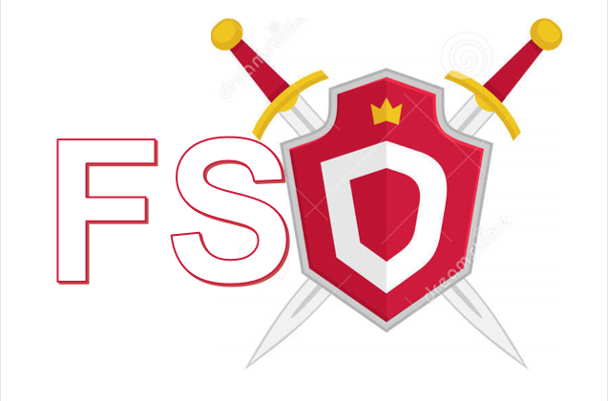




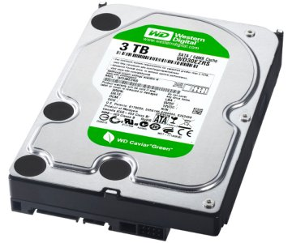

FSD – File System Defender
As part of project in ransomware, Spring 2018
Alexander Gurevich and Denys Svyshchov
Assaf Rosenbaum
FSD protects your PC against ransomware and guaranties zero file loss even in case of successful Ransomware attack. FSD uses kernel module to filter filesystem activities and uses heuristics to detect Ransomware like behavior.
We protect your private files and backup them to Azure Cloud Storage.
Configure FSD using FSD Manager
Set folder you want to protect
FSD Manager backup your private files to Azure
FSD Driver Module filters relevant IRPs (I/O request packet)
FSD Manager receives IRPs information from Driver Module and analyzes them
When FSD Manager detect a threat, it signals Kernel Module to kill malicious process and gives user a notification, that thread was detected, and instructions to backup saved files
No files are lost during the attack thanks to backup
Detection techniques:
Measurement of writes entropy (Shannon`s entropy)
Comparison of file modifications (“distance” between initial and final file)
File type changes
Statistics of file access types
Multiple indicators provide low false positive results and high accuracy
FSD Manager Service
User private files
I/O Operations
User Mode
Kernel Mode
FSD Minifilter Driver
Legacy Device Driver

