Slide 1
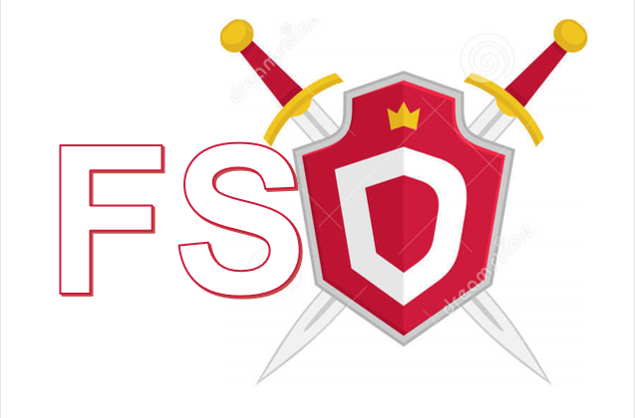



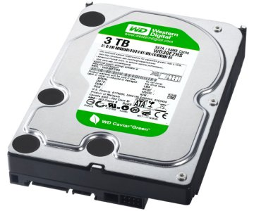


FSD – File System Defender
As part of project in ransomware, Spring 2018
Alexander Gurevich and Denys Svyshchov
Prof. Eli Biham, Assaf Rosenbaum, Dr. Nir Levy
FSD protects your PC against ransomware and guaranties zero file loss even in case of successful Ransomware attack. We protect your private files and backup them to Azure Cloud Storage.
FSD uses kernel module to filter filesystem activities and uses heuristics to detect Ransomware like behavior.
FSD Manager Service
Word
Chrome
Ransomware
I/O Operations
User private files backup
User private files are protected
IPR (I/O Request Packet)
User Mode
Detection techniques:
Measurement of writes entropy (Shannon`s entropy)
Ransomware used to write encrypted data => high entropy writes
Comparison of file modification
After ransomware finishes encryption of file, the data changes significantly
Bulk modifications of user data should considered suspicious
File type changes
Ransomware usually changes file types when it does the encryption
Statistics of file access types
Multiple deletion of user files may indicate malicious activity
Only triggering of multiple indicators will be considered malicious activity.
FSD Manager:
Does periodic backup to Azure
Analyzes Operation Descriptions and decides when process considered suspicious
Sends command to FSD Driver to kill malicious process
Kernel Mode
FSD Minifilter Driver
FSD Driver:
Filters incoming IRPs (I/O Request Packets)
Makes quick processing of operations
Sends Operation Description and details to FSD Manager
Kills malicious processes upon Manager`s request
Legacy Device Driver

