Slide 2


FSD Team
Alexander Gurevich
Denys Svyshchov

Slide 3
What is FSD?
Standalone Anti-Ransomware Solution
Protection & Backup All-in-One
Your private files are always secure
FSD detects Ransomware attack and neutralizes the threat
Detection is done by monitoring of system activity
Complex analysis detects new (unknown) Ransomware
After successful defense FSD repairs corrupted user files

Slide 4
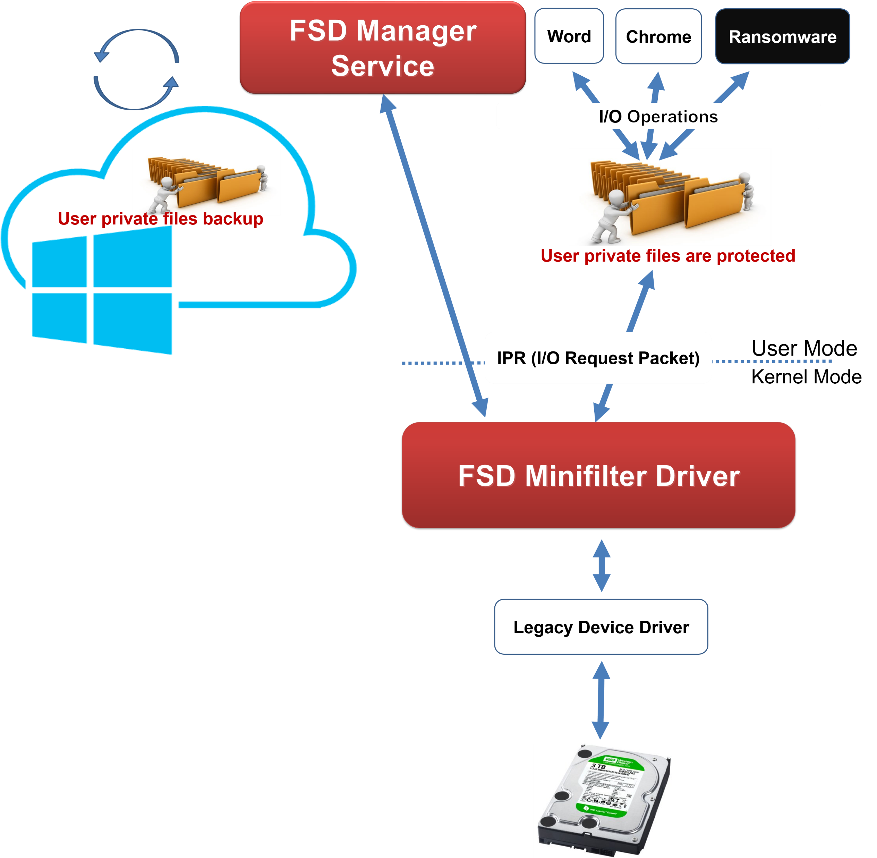
How it works – In general
2 modules Kernel + User:
Kernel Module works as a sniffer of current system activity:
Receives all IRPs (I/O Request packets) from OS and filters the “interesting” ones
Sends stored packets to User Module upon request
User Module does processing and monitoring, backups files and kills detected threats
Stores file system state and information about running processes
Receives packets from Kernel Module
Analyzes activity of processes
Makes decisions when to kill malicious process
Repairs corrupted files

Slide 5
How it works – Kernel Module
Using Windows Minifilter Driver Model
Driver registers callbacks for IRPs:
IRP_MJ_CREATE (Create file / Open file)
IRP_MJ_CLOSE & IRP_MJ_CLEANUP (Close file)
IRP_MJ_READ (Read file)
IRP_MJ_WRITE (Write file)
IRP_MJ_SET_INFORMATION (Rename file / Delete file)
Filters only relevant operations, that are related to our files
For each filtered IRP Driver creates Operation Description Item
Saves filename, operation type, entropy of read and write operations
Stores only relevant operation
IRP - I/O request packet

Slide 6
How it works – User Module
Running as high privilege process
Does a handshake with Driver Module on Initialization, scans & backups User folder
Queries Driver for new ready IRPs to process in loop
Gets Operation Description Items (ODIs) in bulks using dynamic size buffer
Parses ODIs and updates internal data structures
HashMap of Processes
(Each process has statistics counters and sets holding read/write file extensions)
HashMap of Accessed and Protected Files
(Each file has statistics counters and holds current file state)
Saving statistics about Process operations
After each processed ODI we check if process is malicious
When process marked as malicious User Module terminates process and return corrupted files back

Slide 7
How it works – Detection
Using technique of multiple triggers (every protected file plays role of smart “HoneyPot”)
We check 9 triggers every ODI:
Entropy trigger (Shannon`s entropy)
File Distance trigger (LZJDistance algorithm)
File Extensions trigger
Deletion trigger
Rename trigger
Access type trigger
Move in trigger
Extensions change trigger
High entropy replaces trigger
Only triggering of multiple indicators will be considered malicious activity
Result: Low False Positive and High Detection rate

Slide 8
How it works – Backup
Using cloud storage (Azure) to backup User Private files
Makes recovering after virus attack faster
Guarantee of zero file loss even in case of successful attack
Provide User reliable All-In-One solution: Cloud backup + Ransomware detection
Simplify life to User: backup is done automatically when system is safe and protected
Note: this part is not implemented yet

Slide 9
Performance
Kernel Module is fully independent from User Module
No operations are waiting for User Module reaction
Processing in Kernel is insignificant
Lightweight sniffing of only relevant operations
All processing is done in User mode
Power and efficiency of standard libraries (STL)
Measured rate of 10K ODIs per second and it not the limit
Using C++ in both Kernel and User Modules
No locks used in both Kernel and User Modules
Efficient atomic interlocked queue with multipop in Kernel
Single thread processing in User Mode

Slide 10
About Project
Implementation was done from scratch
GitHub: /Randomize163/FSDefender
Tested on: WannaCry, Cerber, TeslaCrypt and JigSaw, Windows zip archiver and AxCrypt (file encryption program)
Things to improve
Add files backup to Cloud
Add multiple safe folders option
Add mode that asks user to decide what to do about the threat

Slide 11
References
ShieldFS (A Self-healing, Ransomware-aware Filesystem http://shieldfs.necst.it/)
CryptoLock article (link)
LZJD algorithm
Article (link)
Implementation (GitHub - EdwardRaff/LZJD: C++ implementation of LZJD algorithm)
Shannon`s entropy (wiki)

Slide 12
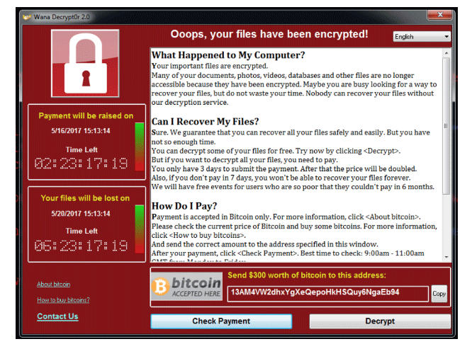
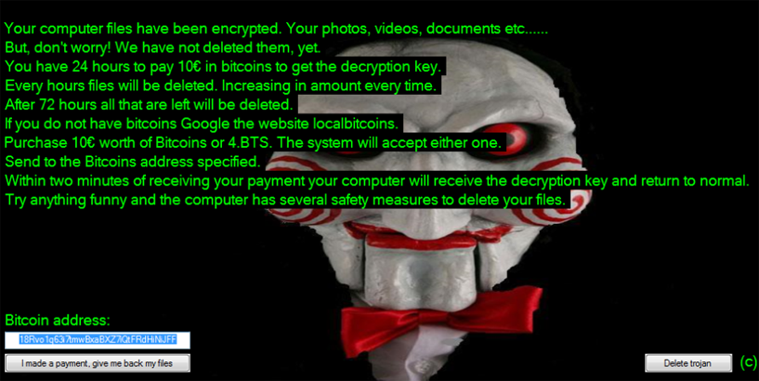


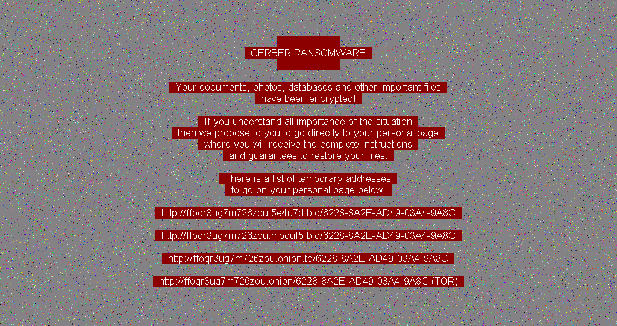
Demo time

Slide 13

WINS
Questions?

