Slide 1
naGuard End-Point Ransomware Protection
Naftaly Avadiaev, Aviad Yifrah

Slide 2
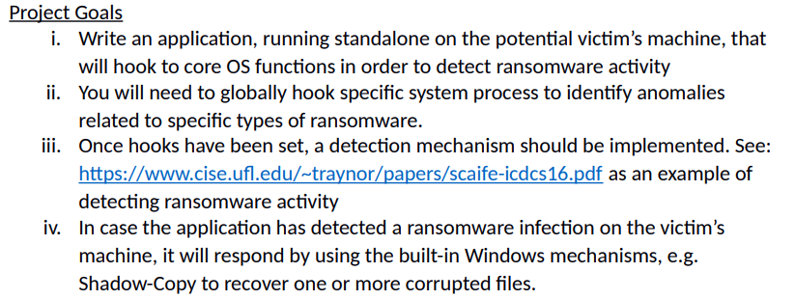
Project definition

Slide 3
Assumptions
Windows 10
1
Malware run in user mode (admin available)
2
Malware main interest is in user important data files: doc, docx, xls, xlsx, ppt, pptx, pdf, txt.
3
Malware probably will not be sign OR at least not by MS.
4

Slide 4
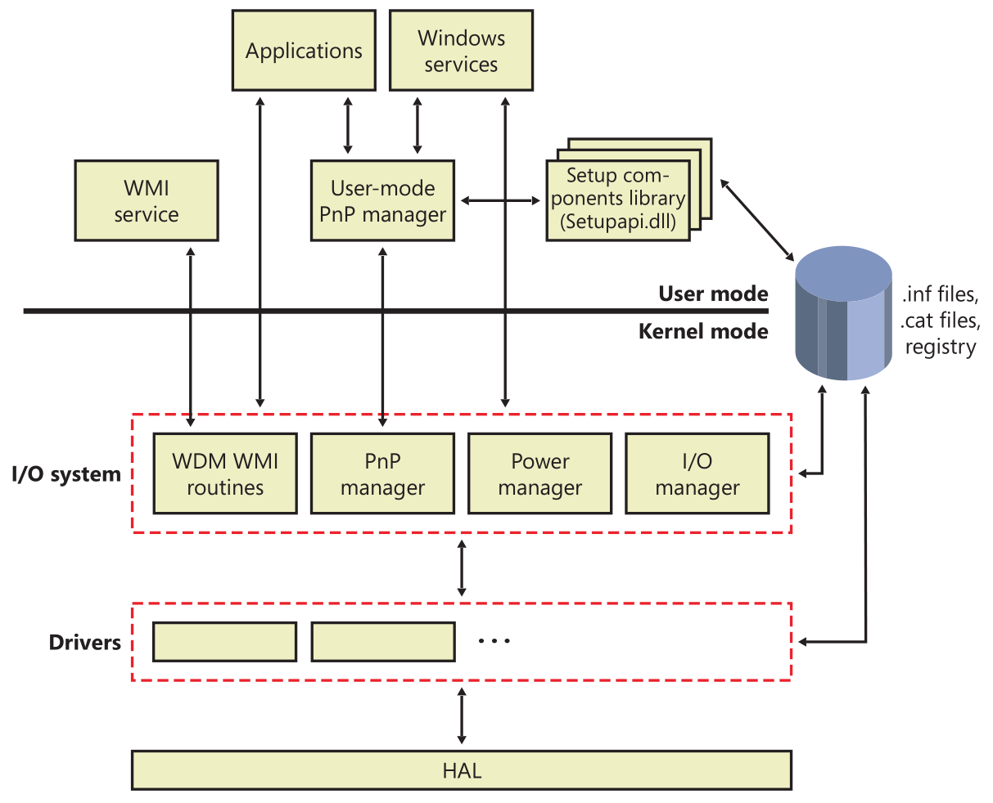
Introduction to Windows I/O System

Slide 5
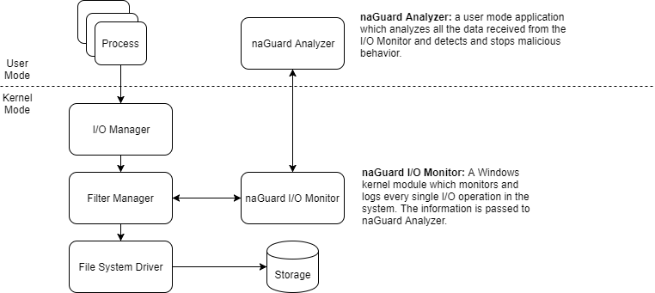
Architecture

Slide 6
naGuard I\O monitor
mini-filter-driver
monitor all I/O operations in the system
filter the relevant ones
measures entropy
send message to naGuard Analyzer
Handle callbacks implemented: IRP_MJ_CREATE, IRP_MJ_WRITE, IRP_MJ_SET_INFORMATION.

Slide 7
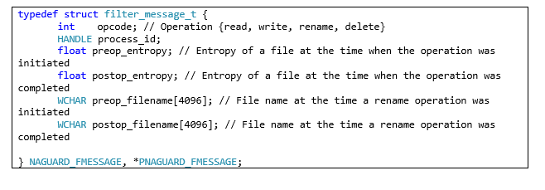
Kernel – User protocol

Slide 8
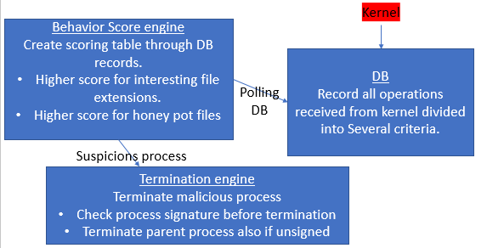
naGuard Analyzer
Multithreaded scoring table which grant higher scoring to malicious behavior processes.

Slide 9
naGuard Analyzer DB
unordered_map <HANDLE, ThreadInfo>
ThreadInfo:
M_score - current malicious score.
honeyPotsCounter – counter of honey pots touched by process in the last X seconds (X=3).
Write_end_entropy – sum of absolute entropy in rewrite operations.
Write_delta_entropy – sum of delta entropy in rewrite operations.
New_write_entropy – sum of entropy in new write operations.
notExtInListWrite – number of all write operations (include all extensions) in the last X seconds (X=3) if absolute entropy higher then 3.5.
honey_pots_touched – number of honey pots files touched (all OPS)
m_total_ops[OPS_NUM] – number of all operations (interesting extensions only) in the last X seconds (X=3).
m_ops[OPS_NUM] – number of all operations (interesting extensions only) in the process life.
Criteria:
I/O operations: Read, write(new file), rewrite, rename.
short (3 sec) aggregation and long (process life) time aggregation
Absolute and relative entropy.

Slide 10
Malware behavior analysis
Ransomware can behave in one of 3 ways:
Read file -> encrypt -> write content to file in same path with different extensions -> delete original file.
Read file -> encrypt -> write content to same file-> rename original file.
Read file -> encrypt -> write content to same.

Slide 11
Score engine
The algorithm based on malware behavior analysis which was presented earlier.
Increase score for suspicions behavior and decrease score for innocent behavior through time
Higher score for “interesting” file extensions and higher for honey pots.
The algorithm was tuned experimentally.
If total score of process is higher than 100 and the process is not signed it would be terminated.

Slide 12
Tests and Results
Detection accuracy - Detect 5 known real ransomware
WannaCry
Jigsaw
Satana
Vipassana
Cerber
False positive checks
Windows update – no FP.
Applications installation – no FP.
7z (zip and unzip) – no FP.
Overhead [performance hit].
Various checks for System stability
Various checks for System stability

Slide 13

Future Work
Analyzer based on machine learning.
Check for bin file signer.
Check for ADS.
Protect boot sector.
Recover encrypted files.
Smarter honey pots (randomly generated)

Slide 14
Conclution
The project include 3 distinct parts of research
Windows internals.
kernel development and debugging.
Ransomware research & behavior analysis.
Despite the complexity we decided to carry out the project because we believed this is the right way to implement such mission.
Bonus points implemented
Kernel based (driver) solution.
Honey pots.
Sign check

