Slide 1
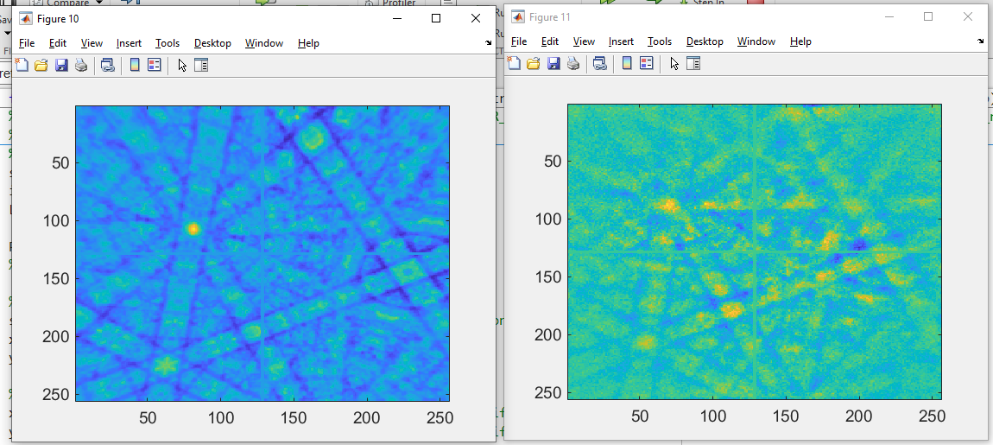
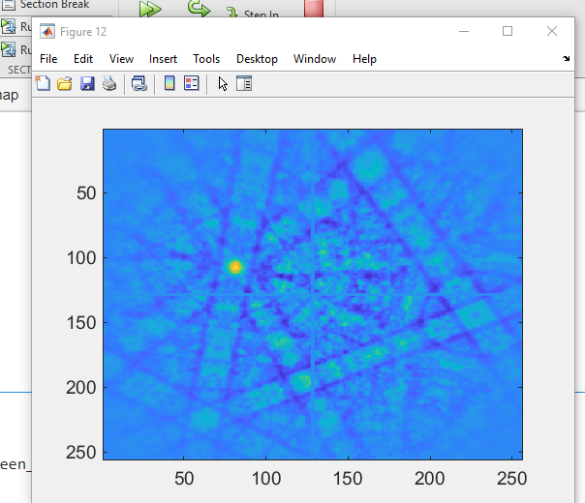
Before Refinement, Pat_iter und EBSP_ref(right, experimental)

Slide 2
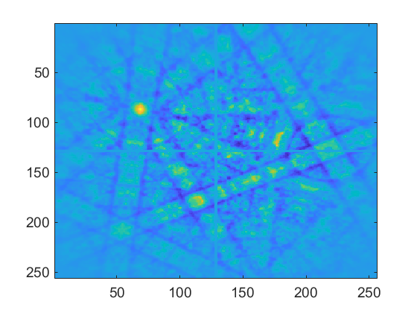
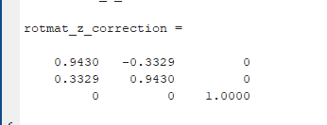
In first loop: ebsp_halfcorr
Why so much ????
This fixed it for now….

