Slide 1
Suricata

Slide 2
What is Suricata
Suricata is a high performance Network IDS, IPS and Network Security Monitoring engine.

Slide 3
How to install
Ubuntu/Debian
apt-get install libpcre3 libpcre3-dbg libpcre3-dev build-essential libpcap-dev \ libnet1-dev libyaml-0-2 libyaml-dev pkg-config zlib1g zlib1g-dev \ libcap-ng-dev libcap-ng0 make libmagic-dev libjansson-dev \ libnss3-dev libgeoip-dev liblua5.1-dev libhiredis-dev libevent-dev \ python-yaml rustc cargo
CentOS
yum install epel-release
yum install suricata

Slide 4
Data Flow
Packet Stream
Online
Suricata
Offline
Sniffing
Packet Decoder
Data Flow
Preprocessor
(Plug-ins)
Detection Engine
(Plug-ins)
Output Stage
(Plug-ins)
Alerts/Logs

Slide 5
Rule
A rule/signature consists of the following:
The action, that determines what happens when the signature matches
The header, defining the protocol, IP addresses, ports and direction of the rule.
The rule options, defining the specifics of the rule.
An example of a rule is as follows:
alert http any any -> any any (msg:"Cerberus Banker Check";flow:to_server, established;content:"POST";http_method;content:"/gate.php";http_uri;content:"action=";http_client_body;depth:7;content:"&data=";distance:0;classtype:trojan-activity;sid:20191217; rev:1)
Notes:
http
ftp
tls (this includes ssl)
smb
dns
dcerpc
ssh
smtp
imap
modbus (disabled by default)
dnp3 (disabled by default)
enip (disabled by default)
nfs (depends on rust availability)
ikev2 (depends on rust availability)
krb5 (depends on rust availability)
ntp (depends on rust availability)
dhcp (depends on rust availability)

Slide 6
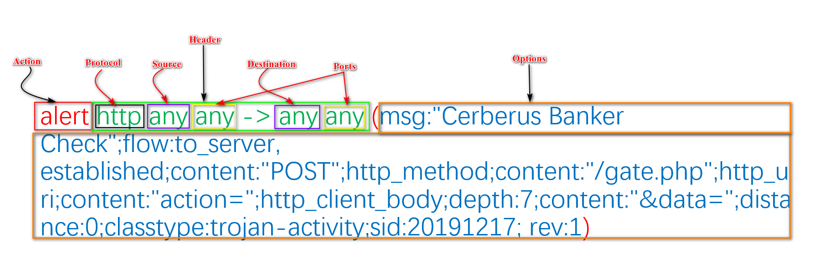
In this example:
red is the action
green is the header
blue are the options.

Slide 7
Action
Pass
If a signature matches and contains pass, Suricata stops scanning the packet and skips to the end of all rules (only for the current packet).
Drop
This only concerns the IPS/inline mode. If the program finds a signature that matches, containing drop, it stops immediately. The packet will not be sent any further. Drawback: The receiver does not receive a message of what is going on, resulting in a time-out (certainly with TCP). Suricata generates an alert for this packet.
Reject
This is an active rejection of the packet. Both receiver and sender receive a reject packet. There are two types of reject packets that will be automatically selected. If the offending packet concerns TCP, it will be a Reset-packet. For all other protocols it will be an ICMP-error packet. Suricata also generates an alert. When in Inline/IPS mode, the offending packet will also be dropped like with the ‘drop’ action.
Alert
If a signature matches and contains alert, the packet will be treated like any other non-threatening packet, except for this one an alert will be generated by Suricata. Only the system administrator can notice this alert.

Slide 8
Header
Protocol
http
ftp
tls (this includes ssl)
smb
dns
dcerpc
ssh
smtp
imap
modbus (disabled by default)
dnp3 (disabled by default)
enip (disabled by default)
nfs (depends on rust availability)
ikev2 (depends on rust availability)
krb5 (depends on rust availability)
ntp (depends on rust availability)
dhcp (depends on rust availability)
Source and destination
Direction
Operator | Description
../.. | IP ranges (CIDR notation)
! | exception/negation
[.., ..] | grouping
source -> destination
source <> destination (both directions)
Example | Meaning
! 1.1.1.1 | Every IP address but 1.1.1.1
![1.1.1.1, 1.1.1.2] | Every IP address but 1.1.1.1 and 1.1.1.2
$HOME_NET | Your setting of HOME_NET in yaml
[$EXTERNAL_NET, !$HOME_NET] | EXTERNAL_NET and not HOME_NET
[10.0.0.0/24, !10.0.0.5] | 10.0.0.0/24 except for 10.0.0.5
Ports
Operator | Description
: | port ranges
! | exception/negation
[.., ..] | grouping
Example | Meaning
[80, 81, 82] | port 80, 81 and 82
[80: 82] | Range from 80 till 82
[1024: ] | From 1024 till the highest port-number
!80 | Every port but 80
[80:100,!99] | Range from 80 till 100 but 99 excluded
[1:80,![2,4]] | Range from 1-80, except ports 2 and 4

Slide 9
Rule options
1. Meta Keywords
msg (message)
The keyword msg gives textual information about the signature and the possible alert.
sid (signature ID)
The keyword sid gives every signature its own id. This id is stated with a number
rev (revision)
The sid keyword is almost every time accompanied by rev. Rev represents the version of the signature. If a signature is modified, the number of rev will be incremented by the signature writers.
classtype
The classtype keyword gives information about the classification of rules and alerts. It consists of a short name, a long name and a priority. It can tell for example whether a rule is just informational or is about a hack etcetera. For each classtype, the classification.config has a priority which will be used in the rule.
reference
The reference keywords direct to places where information about the signature and about the problem the signature tries to address, can be found. The reference keyword can appear multiple times in a signature. This keyword is meant for signature-writers and analysts who investigate why a signature has matched

Slide 10
HTTP
content
The content keyword is very important in signatures. Between the quotation marks you can write on what you would like the signature to match. The most simple format of content is:
content: "............";
nocase
If you do not want to make a distinction between uppercase and lowercase characters, you can use nocase.
depth
The depth keyword is a absolute content modifier. It comes after the content.
distance
The keyword distance is a relative content modifier. This means it indicates a relation between this content keyword and the content preceding it. Distance has its influence after the preceding match. The keyword distance comes with a mandatory numeric value. The value you give distance, determines the byte in the payload from which will be checked for a match relative to the previous match. Distance only determines where Suricata will start looking for a pattern. So, distance:5; means the pattern can be anywhere after the previous match + 5 bytes. For limiting how far after the last match Suricata needs to look, use ‘within’.

Slide 11
Request
Response
Keyword | Sticky or Modifier | Direction
http_uri | Modifier | Request
http_raw_uri | Modifier | Request
http_method | Modifier | Request
http_request_line | Sticky Buffer | Request
http_client_body | Modifier | Request
http_header | Modifier | Both
http_raw_header | Modifier | Both
http_cookie | Modifier | Both
http_user_agent | Modifier | Request
http_host | Modifier | Request
http_raw_host | Modifier | Request
http_accept | Sticky Buffer | Request
http_accept_lang | Sticky Buffer | Request
http_accept_enc | Sticky Buffer | Request
http_referer | Sticky Buffer | Request
http_connection | Sticky Buffer | Request
http_content_type | Sticky Buffer | Both
http_content_len | Sticky Buffer | Both
http_start | Sticky Buffer | Both
http_protocol | Sticky Buffer | Both
http_header_names | Sticky Buffer | Both
Keyword | Sticky or Modifier | Direction
http_stat_msg | Modifier | Response
http_stat_code | Modifier | Response
http_response_line | Sticky Buffer | Response
http_header | Modifier | Both
http_raw_header | Modifier | Both
http_cookie | Modifier | Both
http_server_body | Modifier | Response
http.server | Modifier | Response
http.location | Modifier | Response
file_data | Sticky Buffer | Response
http_content_type | Sticky Buffer | Both
http_content_len | Sticky Buffer | Both
http_start | Sticky Buffer | Both
http_protocol | Sticky Buffer | Both
http_header_names | Sticky Buffer | Both

Slide 12

Rule Test
1. mkdir your rule in /etc/suricata/rules/your.rules
Such as: /etc/suricata/rules/Joker.rules
2. Add your rule to /etc/suricata/suricata.yaml
such as:
3. Run command: suricata -c /etc/suricata/suricata.yaml –r your.pcap -l ./
Such as: suricata -c /etc/suricata/suricata.yaml -r /home/deep/Desktop/Joker.pcap -l ./
4. Check log
Run: cat fast.log

Slide 13
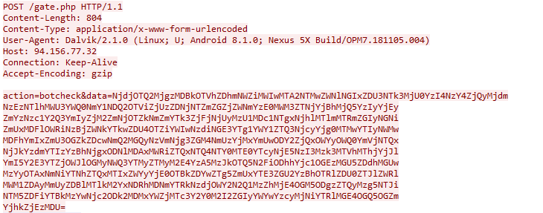
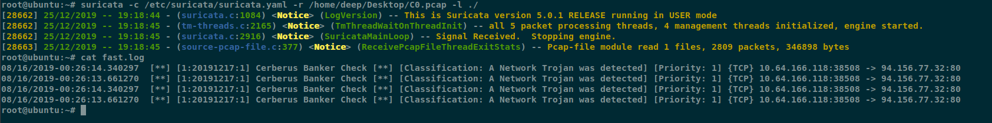
Cerberus Rule Demo
alert http any any -> any any (msg:"Cerberus Banker Check";flow:to_server, established;content:"POST";http_method;content:"/gate.php";http_uri;content:"action=";http_client_body;depth:7;content:"&data=";distance:0;classtype:trojan-activity;sid:20191217; rev:1)

Slide 14
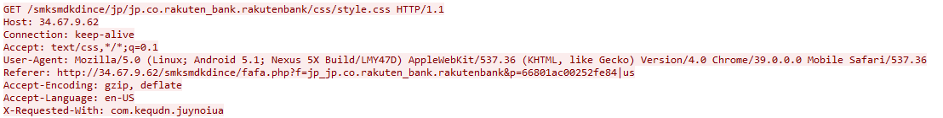
Anubis Rule Demo
alert http any any -> any any (msg:"Anubis Banker Check";flow:to_server,established;content:"GET";http_method;pcre:"/\/jp\/jp\.co\.rakuten_bank\.rakutenbank.*/s"; classtype:trojan-activity;sid:20191230; rev:1;)

Slide 15
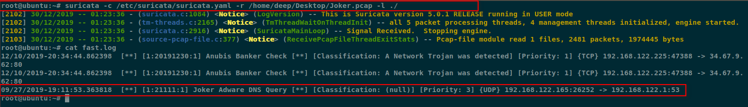
Joker Rule Demo
alert dns any any -> any any (msg:"Joker Adware DNS Query";dns.query;content:"aliyuncs.com";sid:21111;rev:1;)

