Slide 1

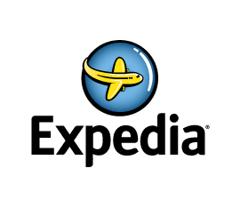

26.04.2017

Slide 2

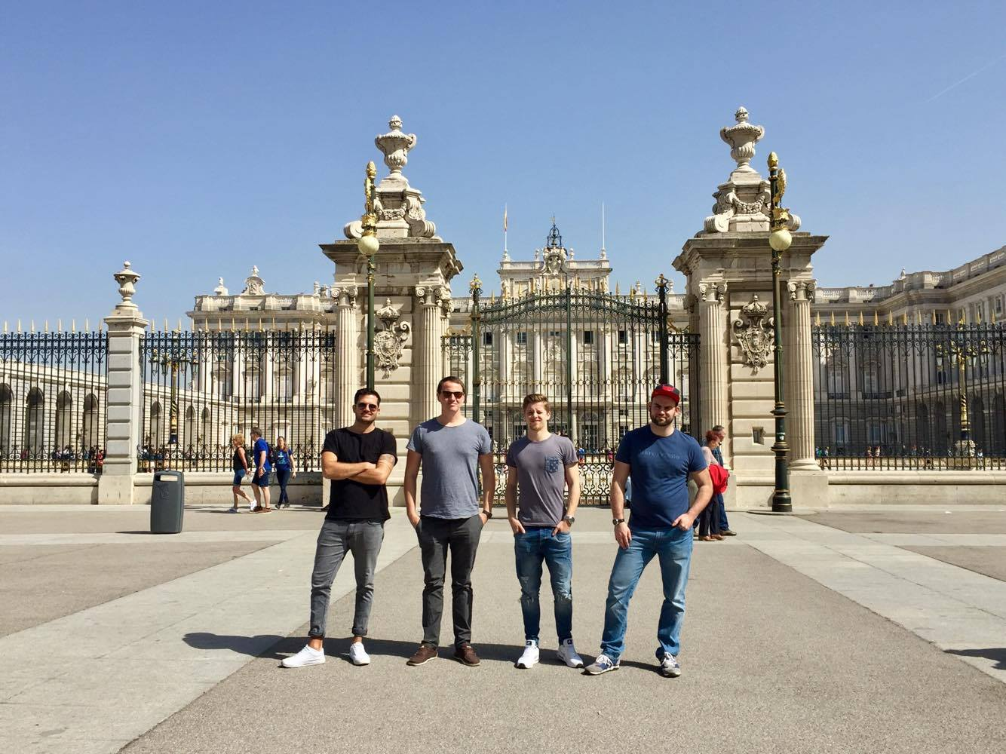
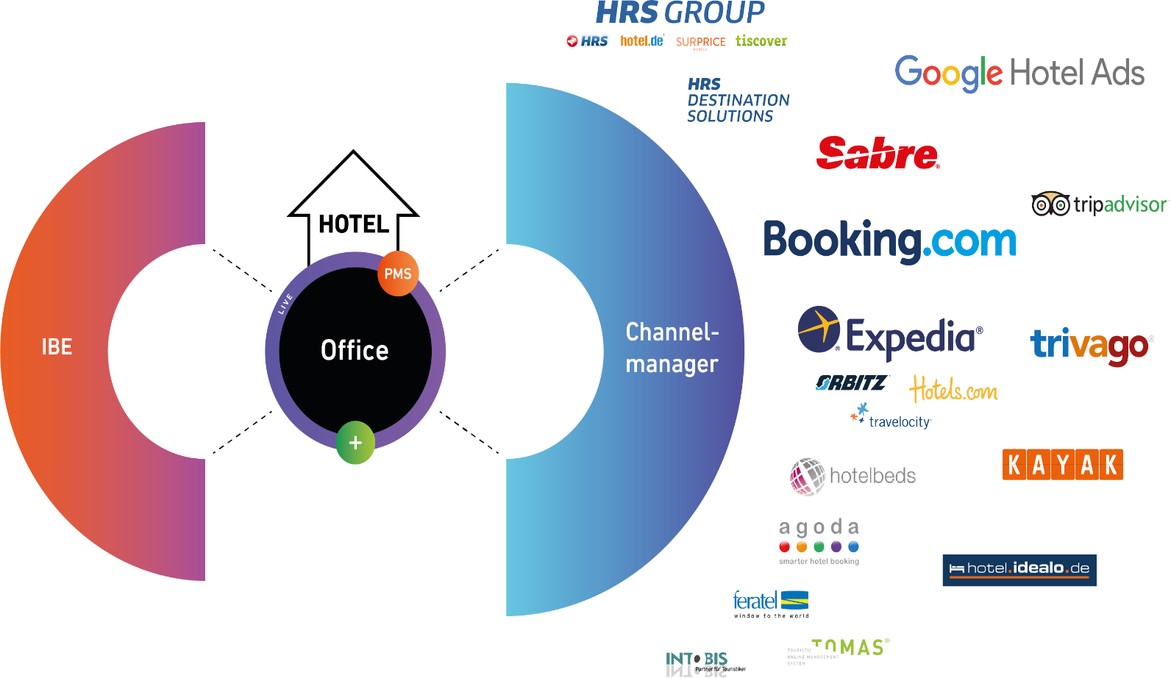
Who are we?
Team:
Adrian, Patrick, Alex, Anthony
Company:
DIRS21 by TourOnline AG, Germany
Notes:
Team vorstellen
Founded 1996, located germany near stuttgart
Focus on ibe and channelswitch, but also other stuff like meta, hompegae, voucher shop
5000 customer, 3500 channelswitch 1/3 expedia
Market leader in germany regarding to customer

Slide 3
What is our idea?
Background:
Meeting with Expedia Lodging Content Team
Solving current business issues
Goal
To build a tool to discover and curate content for the hotel
Realization:
Use the mediatagging and google places to complement the customers content in order to accelerate publication of the hotel on the Expedia platform.
Notes:
Background is visit to the lodging team in munich → 1 week to acitvate customer. Always had to call the hotel, the channelmanager, maybe the reseller and so on
And honestly i was a little bit egoistic as 2nd level support. There is often the issue that the hotel calls. I am still not available on expedia and the first level support doent not solve it and than i check the databank, the request and than i just go into the epc it it says to me. Please contact the market manager. Than he tells me. Yes the hotel still have some open points in the set up and that expedia is waitung for content stuff…than i give the response to support , they to the hotel and the hotel says oops…costs in total 1 hour
Atrracted by the api and the experimental api and the workshop we want to help our friends of expedia in munich to have an easier life in setting up the new customers or the cutomer can edit his current account

Slide 4
What is the result?
UI Link
Notes:
Scenario
1. Contract with provider for the interface to expedia
The provider sends a login. Hotel just have to look for hisself on google and confirms itsself
Automatically a contract could be filled out with the information so that just the signature is missing. Hotel signs the contract, may be a signature tool
2. After confirmation of the contract we have the 2nd point based of the picture from goolge and hp. Can choese what he wants to use and add it to the hotel descriptions and roomdescription and with the tagging all the features and the description are filled out automatically. And also can edit
Expedia is already doing it for the hotel description with automatic configuration of the description of the hotel based on the equeipemt features. Now plus the automateclly tagged and also for the room
Revievs and content score
3. What is than used but we just made here as default and did not focus it the input by the provid of a rate including price, availabilites and restirction, policies,included services. Evenutall based on some existing rates in the provider account for other ota, ibe and he just hast to confirm that the rates are exported for the rooms
4. The hotel can make a range around his location and than the pictures pop up of poi, events, restaurants and more. He can choose what he wants
Pictures from the pool of expedia. Also highligt in the whole area. And also can edit
5. Based on rooms, rates and the information about poi, events, restaurant it creates automatically arrangements, hot deals with pictures and descriptions and also can edit
Confirms
Translator for all languages
Reviews
6. Finish and afterwars improve of the content by the content score and push notifactions to the customer

Slide 5
Summary
Value Prop
Use Google Places to retrieve hotel information and pictures
Use Mediatagging to discover automatically the general information and amenities
Use Google translate to have the content directly in other languages
Expedia APIs Used:
Mediatagging Service API
(Property API)
(Product API)
Business Potential
Reduce set up time by providing automatically the content
Less effort from the hoteliers
Crossselling by Packages, Activities etc.
Increase of the attractivness of the hotel

