Slide 1



TRAVELCLICK SOLUTIONS
in conjunction with
EXPEDIA Inc. APIs Present:
Brand Position Analysis Dashboard
(B-PAD)
#ExpediaHackathon
April 26, 2017

Slide 2

Use Case:
Hoteliers have so much information available revenue optimization decisions can be difficult
MULTIPLE DATA SOURCES Between their Reservations Solutions Product, Rate Intelligence, and Expedia partners, the data can be overwhelming!
BRAND POSITION MISALIGNMENT
Hotels may think they are a luxury brand with less price elasticity, but BPAD categorization can either validate or modify brand position
TC Solution: Validate Binary Brand Position Categorization Expectations and Provide Revenue Recommendations

Slide 3
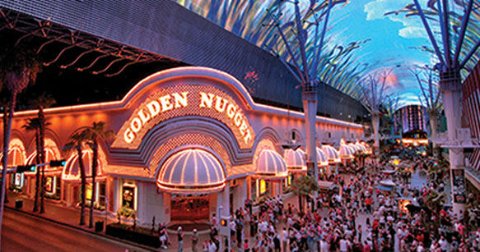

Output: Brand Position and Revenue Recommendations
Brand Position: Defining Luxury vs. Value Brands Luxury brands focus on service with higher RevPAR; Value brands focus on Visibility and competitive ADR. Also, B-PAD compares Luxury Brands vs. Value Brands in the same Comp Set
Revenue Recommendation
Luxury brands can increase or Value brands can decrease their ADR

Slide 4
APIs utilized in the Brand Position Analysis Dashboard (B-PAD)
Integrating TravelClick data with Expedia APIs creates a unique and complete view of the brand
If Luxury Brand, LSR >10
If Value Brand, LSR <10
Expedia
Lodging Sort Rank
If Luxury Brand, Property contained “service” score >.9
If Value Brand, Property contained “value” score >.9
Expedia
Hotel Review Analyzer
TC ADR vs. Comp Set (if higher: Luxury, lower: Value)
TC REVPAR vs. Comp Set (if higher: Luxury, Lower: Value)
TC Occupancy: (if lower: Luxury, if higher: Value
TravelClick HT360 (Rate360, Demand360, Agency360)
Note: this is a scalable model that can continue to expand with additional Expedia APIs

Slide 5


B-PAD
DEMO

Slide 6

Value Proposition:
Creating a Decision Making Tool
B-PAD combines TravelClick and Expedia data to give hotels actionable revenue optimization insights based on a computed Brand Position
TC Solution: Evolve to Sliding Scale of Hotel Categorization Expectations and Enhance Revenue Recommendations

Slide 7

THANK YOU!

