Slide 1

Country rating by
Adam Szałucha, Mateusz Cieśla, Tomasz Fitulski

Slide 2
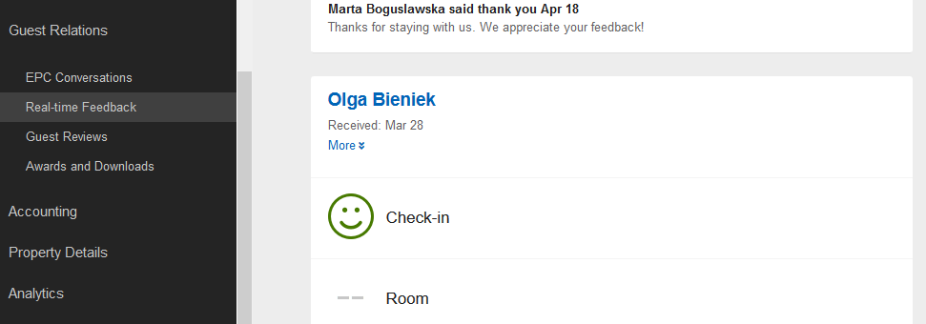
Problem Statement
In the project we want to get the most valuable information provided by Expedia about Guest Relations and show satisfaction of Clients in the more atractive way:
Real-Time Feedback
Review Feedback

Slide 3
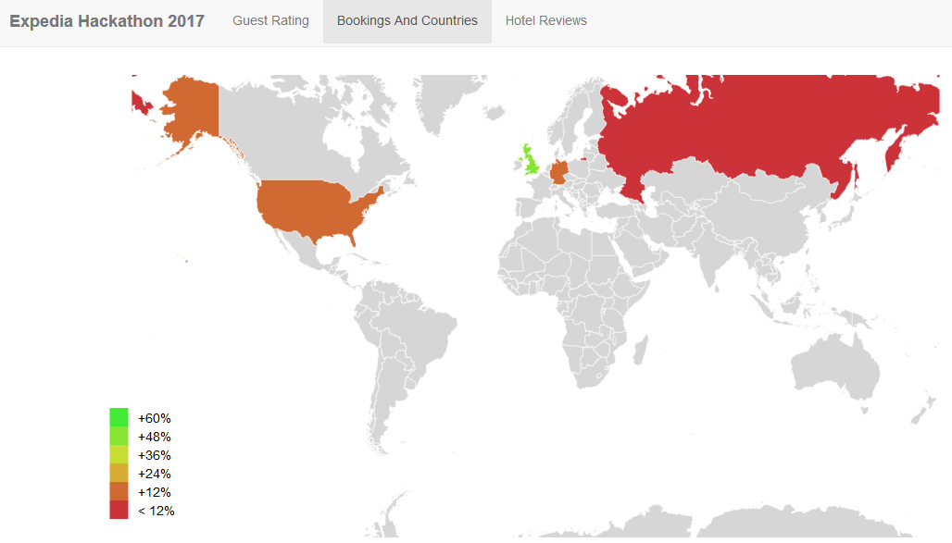
Demo
<demo and tell your story>

Slide 4
Summary
Value Prop
Better understanding of guest needs – especially from country where rating is bad – possibility to be more oriented on culture, meals, promotion materials in foreign language
Possibility to focus on regions where number of search hits is high, but number of resevation is still low.
Expedia APIs Used
Business Potential
Focusing on regions to increase number of guest and client’s satisfaction
Be more active on markets where number of guest is increasing (promotion, advertising)
According to those information we can increase revenue and be more popular on Expedia portal
Product API - Booking trends - Countries
Marketplace Feed - Real-Time Feedback and Hotel Review

Slide 5

Questions ?

