Slide 1

Booking Forecast by Availpro
Horia Toma
Sergii Salata

Slide 2
Problem Statement
Revenue and number of bookings are uncertain
By applying different types of actions, hotels can get an overview of their impact on the occupancy rate and revenue

Slide 3
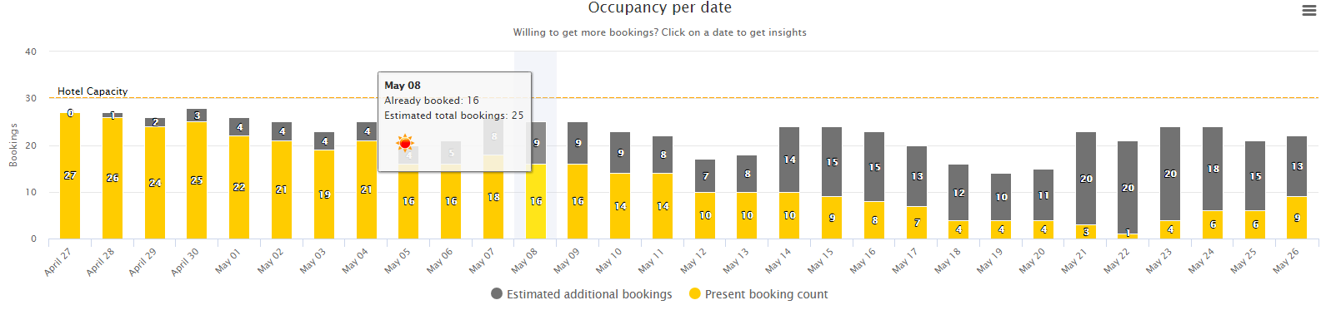
Current bookings vs predicted

Slide 4
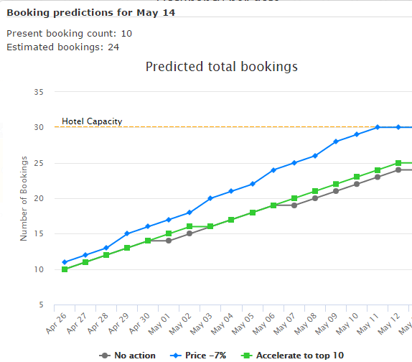
Predicted bookings when taking action

Slide 5
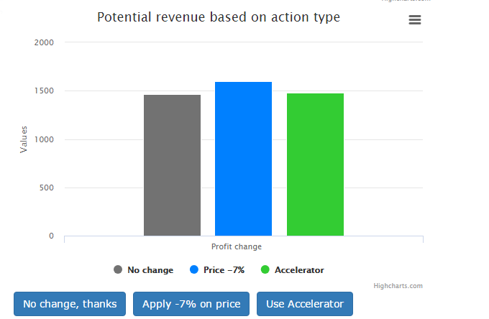
Estimated profit by action

Slide 6
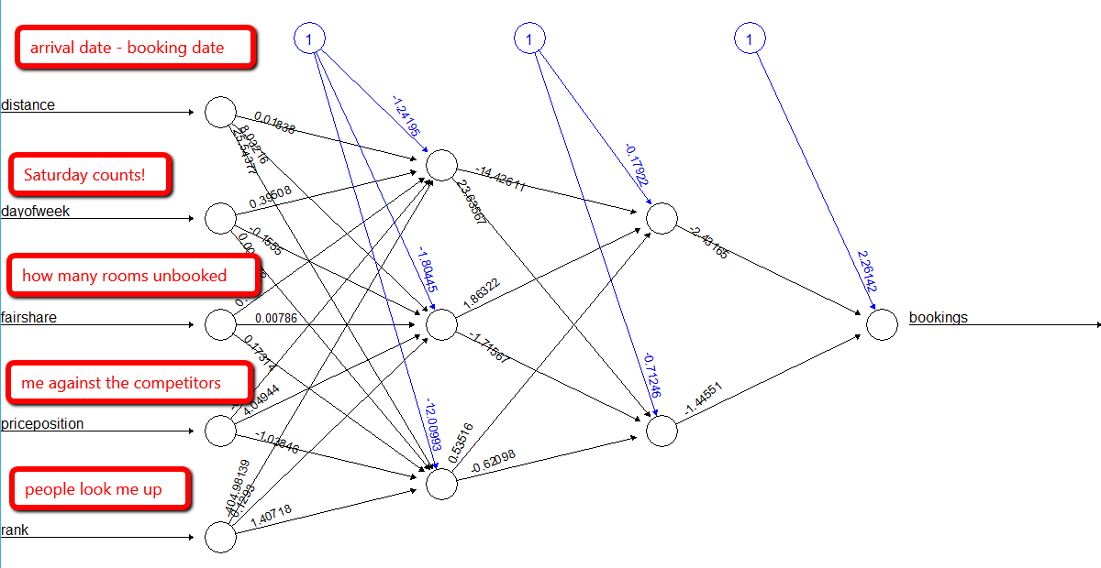

Slide 7
Summary
Value Prop
We’re using an Artificial Neural Network (ANN) that observes booking trends, makes recommendations on when to boost your sort and learns over time to achieve better and better results
Removes manual, laborious task of analyzing bookings and determining how to boost
Expedia APIs Used
Insights (Fair Share & Price Distribution)
Production
EQC Booking
Lodging Sort Rank
Accelerator
Business Potential
The Neural Network can be extended to add more data inputs including weather, events
Additional actions could be added to maximize bookings including other promotions or rate changes

Slide 8

Questions ?

