Slide 1
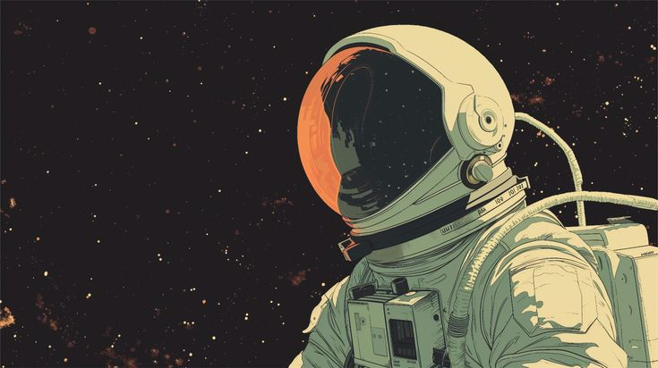
SENTINELS OF SAFETY

Slide 2
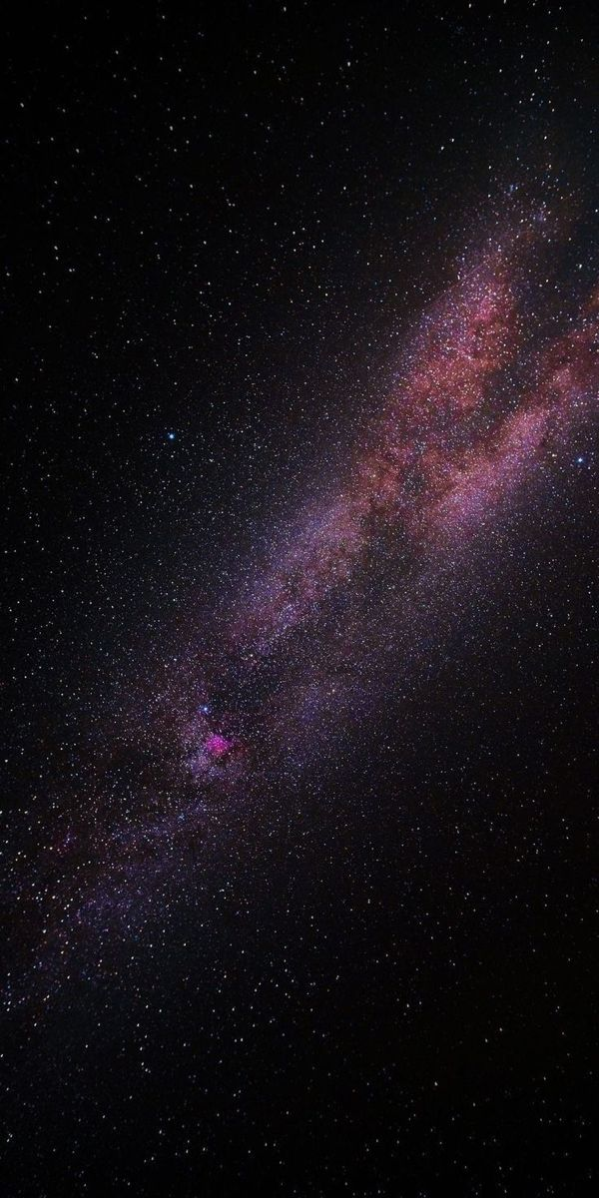
PROBLEM STATEMENT:
Space missions rely on flawless identification of critical safety equipment, but gathering real-world training data in space is difficult and restricted. Leveraging Falcon’s digital twin environment, high-fidelity synthetic data enables safe, scalable, and realistic training for AI-driven detection.
OBJECTIVES:
Train a robust YOLO model to detect 7 key pieces of space-station safety equipment.
Evaluate performance under varied lighting, object angles, and occlusions.
Optimize the model for accuracy, reliability, and generalization.
Demonstrate a real-world deployment use case powered by the detection pipeline.
~Spotting danger before it becomes a problem.
Ensuring Safety in Space Stations Using Falcon and YOLO~

Slide 3

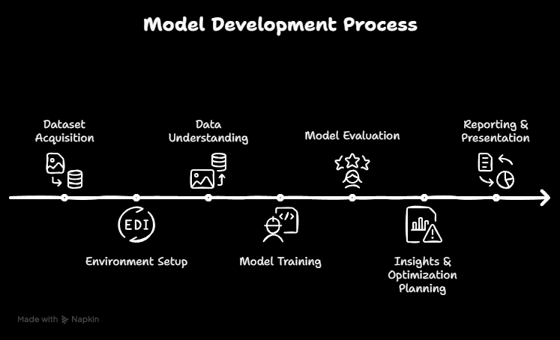
MODEL DEVELOPMENT PROCESS

Slide 4
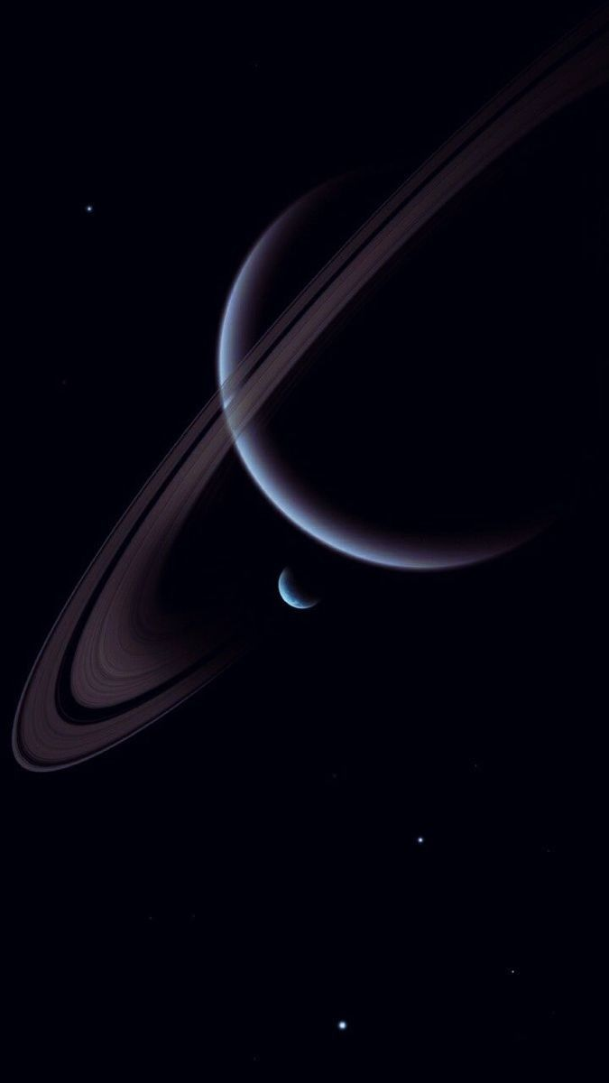
KEY FINDINGS & INSIGHTS
1. ROBUSTNESS TO VARIATION:
The model maintained high precision/recall under varied lighting and camera angles, showing that synthetic data effectively captured real-world variance.
2. CONFUSION PATTERNS:
Some misclassifications emerged — e.g., Fire Alarm vs Safety Panel under occlusion — suggesting overlapping visual features or insufficient training diversity.
3. FALIURE ANALYSIS:
In rare edge cases (deep shadow, extreme occlusion), the model struggled, highlighting boundary conditions not well represented in the synthetic set.
4. TRAINING BEHAVIOUR:
The loss curves stabilized early, indicating relatively stable convergence and no major overfitting on the synthetic training set.

Slide 5
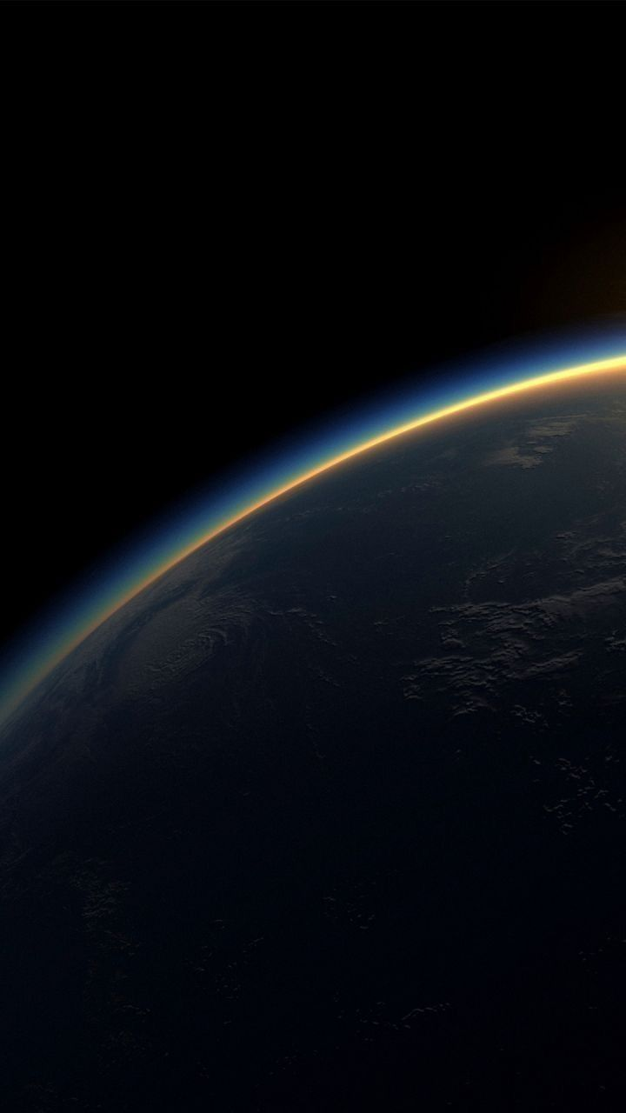
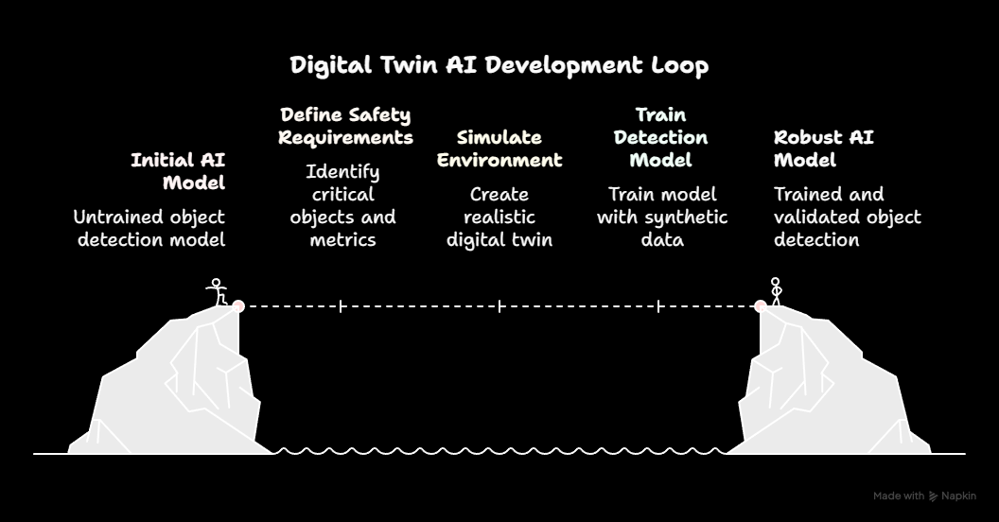

Slide 6

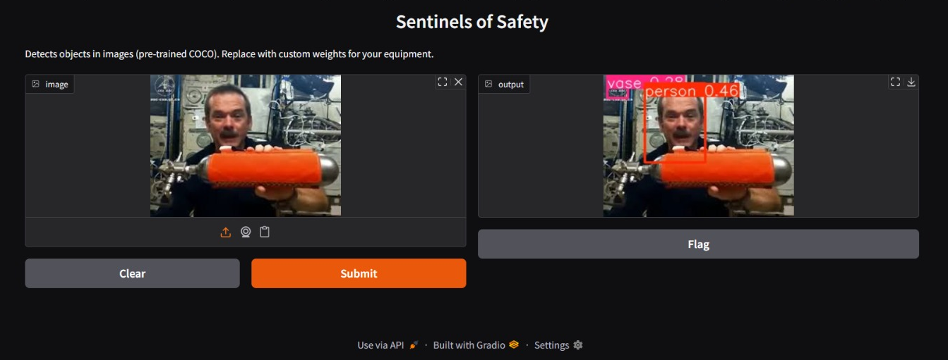
CHALLENGES
Difficulty converting the trained model into a functional application.
Challenges in setting up and configuring the Anaconda environment.
Complexity in designing a usable interface for model interaction.
Inaccurate measurement of equipment dimensions due to model limitations.

Slide 7

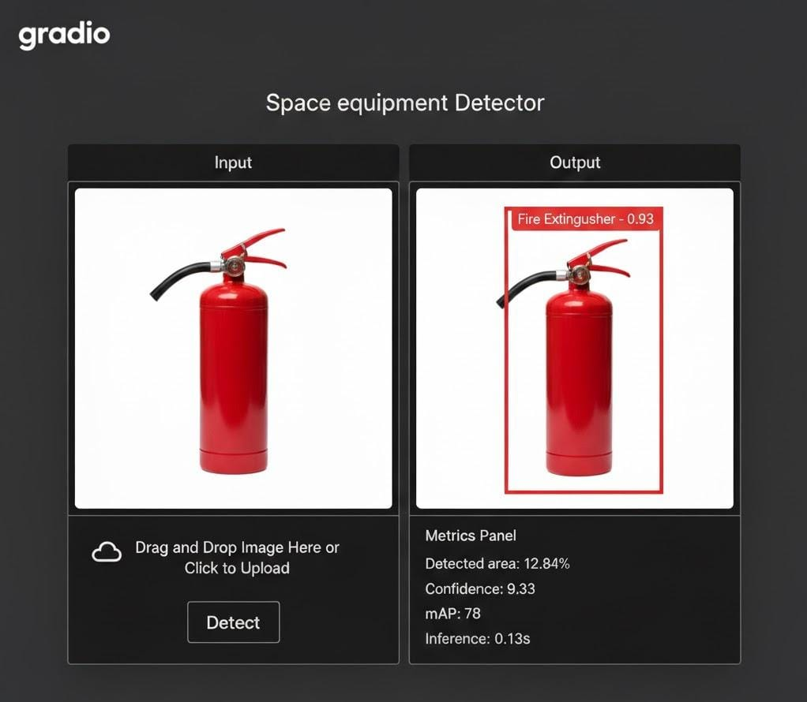
BONUS POINT?
YES IT WORKS!
How It Works?
User uploads or captures an image.
The model performs instant inference.
Bounding boxes + class labels appear on-screen.
Demo not based on data which has been provided
Works on YOLOv8 (Deep Learning) and uses Gradio
[can be done for other equipments too mAP (here in%)]

Slide 8

CONCLUSION
Using Falcon’s synthetic data, our YOLO-based pipeline reliably detects critical space-station safety equipment even under challenging visual conditions, and when an image is passed through YOLOv8, it automatically generates bounding boxes to identify and classify each piece of equipment
FUTURE DIRECTIONS
Fine-tune the model on a small real-world or simulated real-like dataset to bridge the domain gap.
Expand the synthetic dataset to include more extreme lighting/occlusion cases.
Explore multi-view detection (multiple camera angles) or use 360° simulations.
Develop a demo “safety-monitoring assistant” that flags unmonitored or misclassified safety equipment in real time.

Slide 9
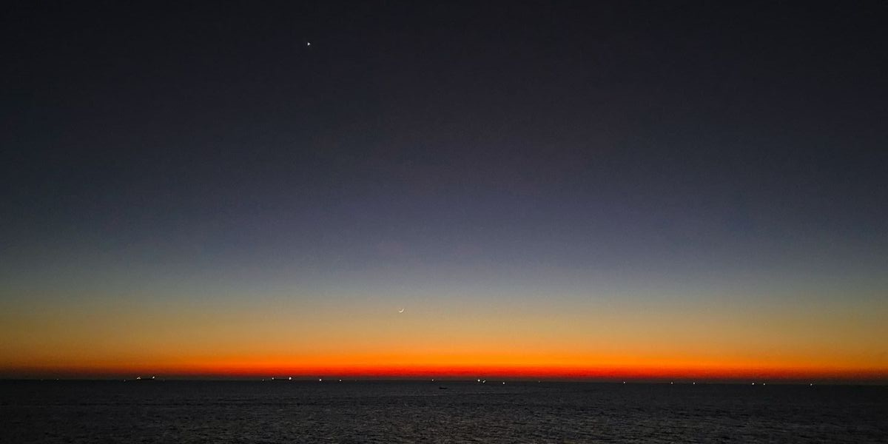
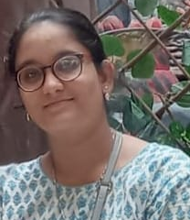

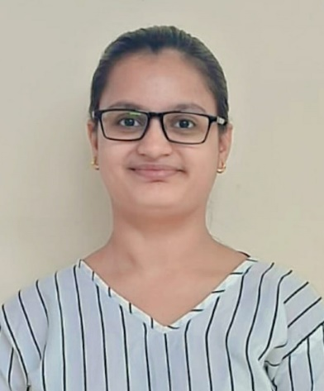
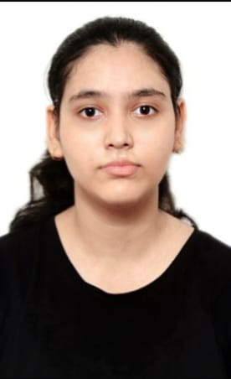
MEET THE TEAM:
PROMPT PIRATES
TANVI SHARMA
B. Tech ECE @ GTB4CEC
Lead Coordinator
KUNAL KAPUR
B. Tech ECE @ GTB4CEC
Presentation Curator
SAANCHI DANDRIYAL
B. Tech ECE @ GTB4CEC
Insight Developer
SNEHA SINGHAL
B. Tech ECE @ GTB4CEC
Insight Developer
~Navigating Space safety with a sharp vision~

Slide 10
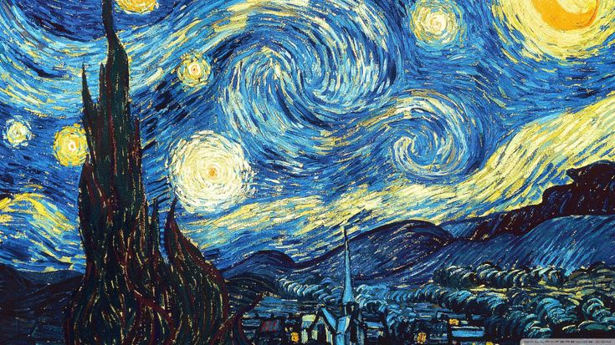
THANK YOU

