Slide 1


DATA - ANALYSIS FOR CUSTOMER ACTIVATION & RETENTION
Submitted by:
RAJASEKAR S

Slide 2
ACKNOWLEDGMENT
This project includes the professional reference of much external research analysis done by various organisations and individuals. Such references are mentioned below:
1. Consumer's perceptions of website's utilitarian and hedonic attributes and online purchase intentions: A cognitive–affective attitude approach
https://www.sciencedirect.com/science/article/pii/S2444969516300191.
2. The Impact of Utilitarian and HedonicValue on Online Shopping Behavior.
http://www.asmaindia.in/pdf/press/29-The-Impact-of-Utilitarian-and-Hedonic-Value-on-
Online-Shopping-Behavior.pdf

Slide 3
3. THE INFLUENCE OF UTILITARIAN VALUE, HEDONIC VALUE, SOCIAL VALUE, AND PERCEIVED RISK ON CUSTOMER SATISFACTION:SURVEY OF E- COMMERCE CUSTOMERS IN INDONESIA
https://journals.vgtu.lt/index.php/BTP/article/view/12143
4. Hedonic and Utilitarian Aspects of Consumer Behavior: an Attitudinal
https://www.acrwebsite.org/volumes/6348/volumes/v12/NA-

Slide 4
5. Hedonic and Utilitarian Values Behind Engagement of Online Consumers.
https://www.igi-global.com/gateway/article/257192#pnlRecommendationForm
6. https://www.geeksforgeeks.org
7. https://en.wikipedia.org/wiki/Wiki

Slide 5
TABLE OF CONTENTS
Introduction
1. What is Customer Retention?
2. Customer retention benefits.
3. E-Commerce websites and Customer Retention.
4. Review of Literature.

Slide 6
Analytics of Customer Retention
1. What is Analytical problem framing?
2. Hardware Requirements.
3. Software Requirements.
4. Tools, Libraries and Packages used.
5. Data Pre-Processing.
6. Exploratory Data-Analysis.

Slide 7
Conclusion

Slide 8
INTRODUCTION
1. What is Customer Retention?
Customer retention refers to a company’s ability to turn customers into repeat buyers and prevent them from switching to a competitor. It indicates whether your product and the quality of your service please your existing customers. It’s also the lifeblood of most subscription-based companies and service providers.
Customer retention strategies are the processes and initiatives businesses put in place to build customer loyalty and improve customer lifetime value.

Slide 9
2. Why is customer retention important?
Keeping your current customers happy is generally more cost-effective than acquiring first-time customers. According to the Harvard Business Review, acquiring a new customer can be 5 to 25 times more expensive than holding on to an existing one.
You don’t need to spend big on marketing, advertising, or sales outreach. It is easier to turn existing customers into repeating ones, since they already trust your brand from previous purchases. New customers, however, often require more convincing when it comes to that initial sale.
Customer loyalty won’t just give you repeat business.
Loyal customers are more likely to give free recommendations to their colleagues, friends, and family. Creating that cycle of retained customers and buzz marketing is one way your company can cultivate customer loyalty for long-term success

Slide 10
3. Customer retention benefits :
Cost savings: Customer retention is generally more cost- effective than acquiring first-time customers.
Positive word of mouth marketing: Loyal customers are more likely to tell their friends and family about your brand.
A better bottom line: Increasing retention rates by just 5 percent can increase revenue by 25 percent to 95 percent.

Slide 11
4. E-Commerce websites and Customer Retention :
For an e-commerce store, the customer retention rate is directly related to how much your customers trust you and how much they relish the experience of spending time on your website/app.
Trust is built by being honest and upfront about the product and service. Questions like how you guarantee quality, what your process of customer service is, what the options for customer grievance redressal are and the like need to be answered upfront and put into practice. This builds trust and subsequently word of mouth.

Slide 12
Coming to the experience that you create for your customers, aesthetics, ease of use and clarity are the three most important parameters.
Aesthetics - A good looking vibrant user interface that functions smoothly without bugs is an absolute must. Do make sure it functions equally on all kinds of interfaces like laptop, tablet, mobile etc.
Ease of use - Customers like to come back to e-commerce sites where they could view the product, compare options, read reviews and complete their transaction with minimum fuss and in the minimum time.

Slide 13
Clarity - People love clarity when buying online.
Clarity interms of - how is my product going to be packed? How many days would it take for delivery? Is there a tracking mechanism? I may know there is a return policy if am not satisfied with it, but how does the return actually work? All these and more questions provide clarity to the buyer and enhance his experience manifold. Other than these, there can also be loyalty programs, tie-ups with other complimentary e-commerce providers and co- branded events with physical stores that will boost customer acquisition and retention. Tying up with a more known brand rubs off some of the reliability and trust onto us. That leads to further customer retention over a period of time.

Slide 14
5. Review of Literature :
Customer satisfaction has emerged as one of the most important factors that guarantee the success of online store; it has been posited as a key stimulant of purchase, repurchase intentions and customer loyalty. A comprehensive review of the literature, theories and models have been carried out to propose the models for customer activation and customer retention.
Five major factors that contributed to the success of an e- commerce store have been identified as: service quality, system quality, information quality, trust and net benefit. The research furthermore investigated the factors that influence the online customers repeat purchase intention.

Slide 15
The combination of both utilitarian value and hedonistic values are needed to affect the repeat purchase intention (loyalty) positively. The data is collected from the Indian online shoppers.

Slide 16
ANALYTICS OF THE BUSINESS PROBLEM
1. What is Analytical problem framing?
Analytic problem framing involves translating the business problem into terms that can be addressed analytically via data and modeling. It’s at this stage that you work backwards From the results / outputs you want to the data/inputs you’re going to need, where you identify potential drivers and hypotheses to test, and where you nail down your assumptions. Analytic problem framing is the antithesis of merely working with the ready-to-hand data and seeing what comes of it, hoping for something insightful. Typically, the process moves on from here to data collection, cleansing and transformation, Methodology selection and model building, never to return. But if you’re willing to borrow and use a concept from complex adaptive systems – maps and models – you can make repeat use of this stage to improve your overall outcome.

Slide 17
2. Hardware Requirements
A mid level computer that runs on Intel i3/i5/i7 or A10/A11/M1 or ryzen 3/5 or any other equivalent chipset and a suitable processor.
3. Software Requirements
Windows / Linux /Mac OS

Slide 18
4. Tools, Libraries and Packages used
Tool: 1.Anaconda Navigator.
2. Jupyter Notebook.
Libraries and Packages:
1. Numpy
2. Pandas
3. Matplotlib
4. Seaborn

Slide 19
5. Data Pre- Processing
For understanding the factors influencing the customer retention, we should consider 4 important variables.
These 4 variables manipulate the 'customer satisfaction', which in turn makes the customer to stay.
These variables are:
Hedonic Value.
Utilitarian Value.
Precieved Risk.
Customer Experience.
By Analysing on the basis of these variables, we can find the basic factors influencing the 'customer satisfaction’. Thus, by achieving the 'customer satisfaction' we can make the customer to stay and make them buy more products.

Slide 20
So we will do the following Analysis in 5 parts. We will use different parts of the given data-set to help us find the customer retention factors.
By following these processes we can achieve a more efficient data-set. We will use Python through Jupyter notebook for data processing . Also we will use Libraries such as Pandas, Numpy for Analysis and Matplotlib , seaborn for visualization.

Slide 21
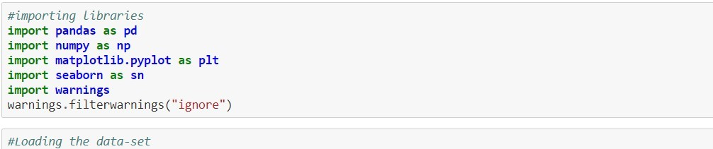
6. Exploratory Data-Analysis

Slide 22
1. Checking the null values, data type and title of the columns :
Title : 1Gender of respondent Col dtype : object
NaN val: 0
Title : 2 How old are you? Col dtype : object NaN val: 0
Title : 3 Which city do you shop online from? Col dtype : object
NaN val: 0
Title : 4 What is the Pin Code of where you shop online from? Col dtype : int64
NaN val: 0
Title : 5 Since How Long You are Shopping Online ? Col dtype : object
NaN val: 0
Title : 6 How many times you have made an online purchase in the past 1 year? Col dtype : object
NaN val: 0
Title : 7 How do you access the internet while shopping on-line? Col dtype : object
NaN val: 0
Title : 8 Which device do you use to access the online shopping? Col dtype : object
NaN val: 0
Title : 9 What is the screen size of your mobile device? Col dtype : object NaN val: 0

Slide 23
Title : 10 What is the operating system (OS) of your device? Col dtype : object
NaN val: 0
Title : 11 What browser do you run on your device to access the website? Col dtype : object
NaN val: 0
Title : 12 Which channel did you follow to arrive at your favorite online store for the first time?
Col dtype : object NaN val: 0
Title : 13 After first visit, how do you reach the online retail store? Col dtype : object
NaN val: 0
Title : 14 How much time do you explore the e- retail store before making a purchase decision?
Col dtype : object NaN val: 0
Title : 15 What is your preferred payment Option? Col dtype : object
NaN val: 0
Title : 16 How frequently do you abandon (selecting an items and leaving without making payment) your shopping cart?
Col dtype : object NaN val: 0
Title : 17 Why did you abandon the “Bag”, “Shopping Cart”? Col dtype : object
NaN val: 0
Title : 18 The content on the website must be easy to read and understand Col dtype : object
NaN val: 0
Title : 19 Information on similar product to the one highlighted is important for product comparison
Col dtype : object NaN val: 0
Title : 20 Complete information on listed seller and product being offered is important for purchase decision.
Col dtype : object NaN val: 0
Title : 21 All relevant information on listed products must be stated clearly Col dtype : object
NaN val: 0
Title : 22 Ease of navigation in website Col dtype : object
NaN val: 0
Title : 23 Loading and processing speed Col dtype : object
NaN val: 0 Title : 24 User friendly Interface of the website Col dtype : object

Slide 24
NaN val: 0
Title : 25 Convenient Payment methods Col dtype : object
NaN val: 0
Title : 26 Trust that the online retail store will fulfill its part of the transaction at the stipulated time
Col dtype : object NaN val: 0
Title : 27 Empathy (readiness to assist with queries) towards the customers Col dtype : object
NaN val: 0
Title : 28 Being able to guarantee the privacy of the customer Col dtype : object
NaN val: 0
Title : 29 Responsiveness, availability of several communication channels (email, online rep, twitter, phone etc.)
Col dtype : object NaN val: 0
Title : 30 Online shopping gives monetary benefit and discounts Col dtype : object
NaN val: 0
Title : 31 Enjoyment is derived from shopping online Col dtype : object
NaN val: 0
Title : 32 Shopping online is convenient and flexible Col dtype : object
NaN val: 0
Title : 33 Return and replacement policy of the e-tailer is important for purchase decision
Col dtype : object NaN val: 0
Title : 34 Gaining access to loyalty programs is a benefit of shopping online Col dtype : object
NaN val: 0
Title : 35 Displaying quality Information on the website improves satisfaction of customers
Col dtype : object NaN val: 0
Title : 36 User derive satisfaction while shopping on a good quality website or application
Col dtype : object NaN val: 0
Title : 37 Net Benefit derived from shopping online can lead to users satisfaction Col dtype : object
NaN val: 0
Title : 38 User satisfaction cannot exist without trust Col dtype : object
NaN val: 0
Title : 39 Offering a wide variety of listed product in several category

Slide 25
Col dtype : object NaN val: 0
Title : 40 Provision of complete and relevant product information Col dtype : object
NaN val: 0
Title : 41 Monetary savings Col dtype : object
NaN val: 0
Title : 42 The Convenience of patronizing the online retailer Col dtype : object
NaN val: 0
Title : 43 Shopping on the website gives you the sense of adventure Col dtype : object
NaN val: 0
Title : 44 Shopping on your preferred e-tailer enhances your social status Col dtype : object
NaN val: 0
Title : 45 You feel gratification shopping on your favorite e-tailer Col dtype : object
NaN val: 0
Title : 46 Shopping on the website helps you fulfill certain roles Col dtype : object
NaN val: 0
Title : 47 Getting value for money spent Col dtype : object
NaN val: 0
Title : From the following, tick any (or all) of the online retailers you have shopped from;
Col dtype : object NaN val: 0
Title : Easy to use website or application Col dtype : object
NaN val: 0
Title : Visual appealing web-page layout Col dtype : object
NaN val: 0
Title : Wild variety of product on offer Col dtype : object
NaN val: 0
Title : Complete, relevant description information of products Col dtype : object
NaN val: 0
Title : Fast loading website speed of website and application Col dtype : object
NaN val: 0
Title : Reliability of the website or application Col dtype : object
NaN val: 0
Title : Quickness to complete purchase

Slide 26
Col dtype : object NaN val: 0
Title : Availability of several payment options Col dtype : object
NaN val: 0
Title : Speedy order delivery Col dtype : object
NaN val: 0
Title : Privacy of customers’ information Col dtype : object
NaN val: 0
Title : Security of customer financial information Col dtype : object
NaN val: 0
Title : Perceived Trustworthiness Col dtype : object
NaN val: 0
Title : Presence of online assistance through multi-channel Col dtype : object
NaN val: 0
Title : Longer time to get logged in (promotion, sales period) Col dtype : object
NaN val: 0
Title : Longer time in displaying graphics and photos (promotion, sales period) Col dtype : object
NaN val: 0
Title : Late declaration of price (promotion, sales period) Col dtype : object
NaN val: 0
Title : Longer page loading time (promotion, sales period) Col dtype : object
NaN val: 0
Title : Limited mode of payment on most products (promotion, sales period) Col dtype : object
NaN val: 0
Title : Longer delivery period Col dtype : object
NaN val: 0
Title : Change in website/Application design Col dtype : object
NaN val: 0
Title : Frequent disruption when moving from one page to another Col dtype : object
NaN val: 0
Title : Website is as efficient as before Col dtype : object
NaN val: 0
Title : Which of the Indian online retailer would you recommend to a friend? Col dtype : object
NaN val: 0

Slide 27

2. Visualising the null values using Heat-Map:

Slide 28
3. Observation about the Data-set:
The Data-set seems to have 271 rows and 71 columns.
The Data-set does not have any Null values.
All the data’s present in the Data-set seems to be Object type.
4. We will divide the given data-set into 5 parts for the EDA:
Part-1 will be informaiton about the cutomer.
Part-2 will be Utilitarian Value.
Part-3 will be Hedonic Value.
Part-4 will be Precieved Risk.
Part-5 will be Customer Experience.
For this we will divide the given Data-set into 5 parts.

Slide 29
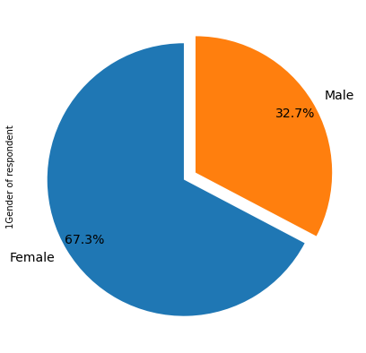
PART-1 CUSTOMER INFORMATION
1. Visualising the Gender of respondent
Female 181
Male 88
Name: 1Gender of respondent

Slide 30
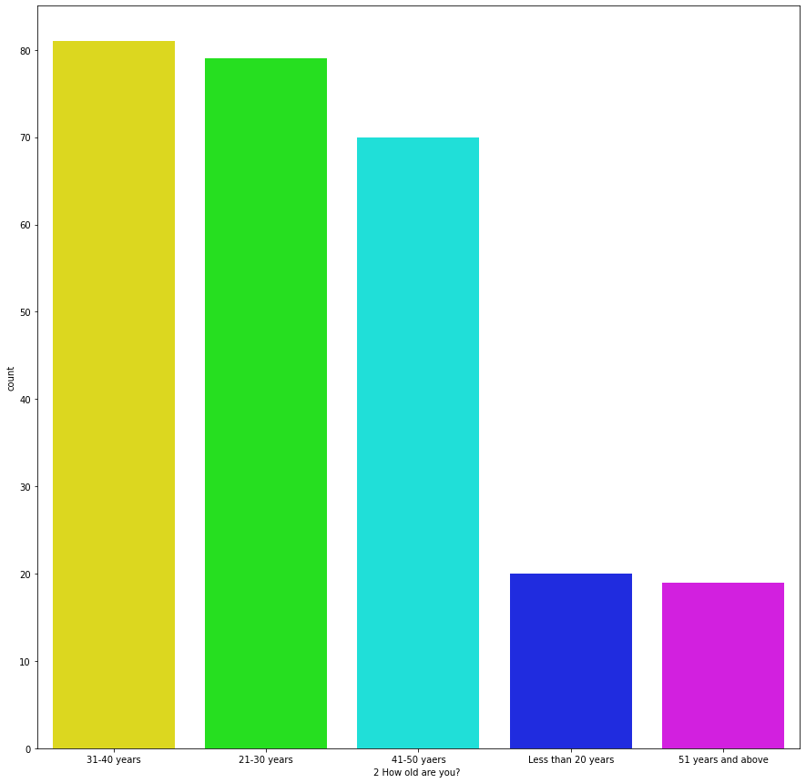
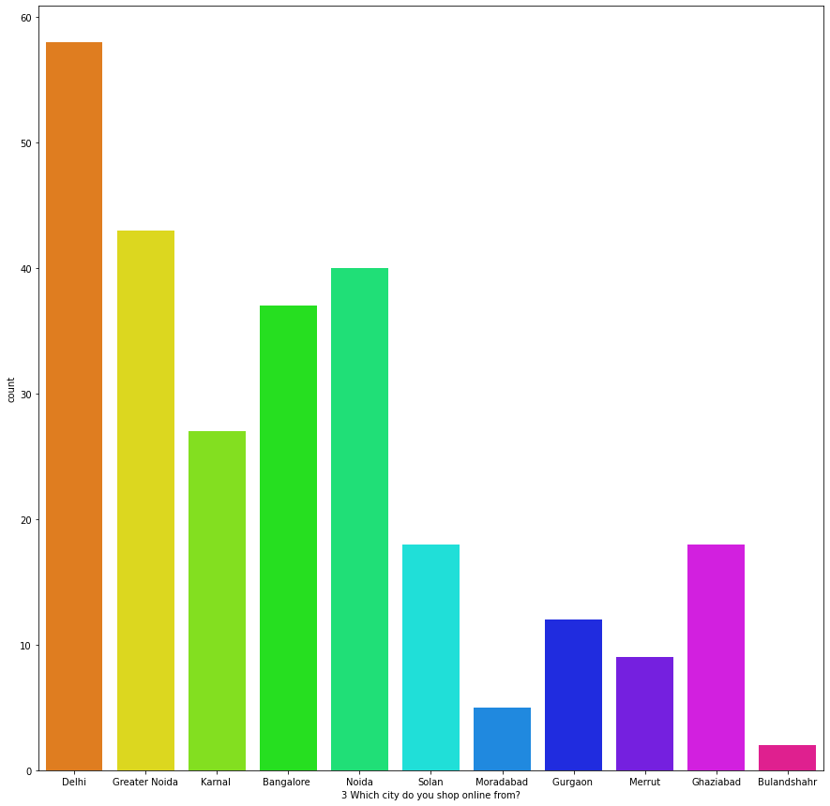

Slide 31
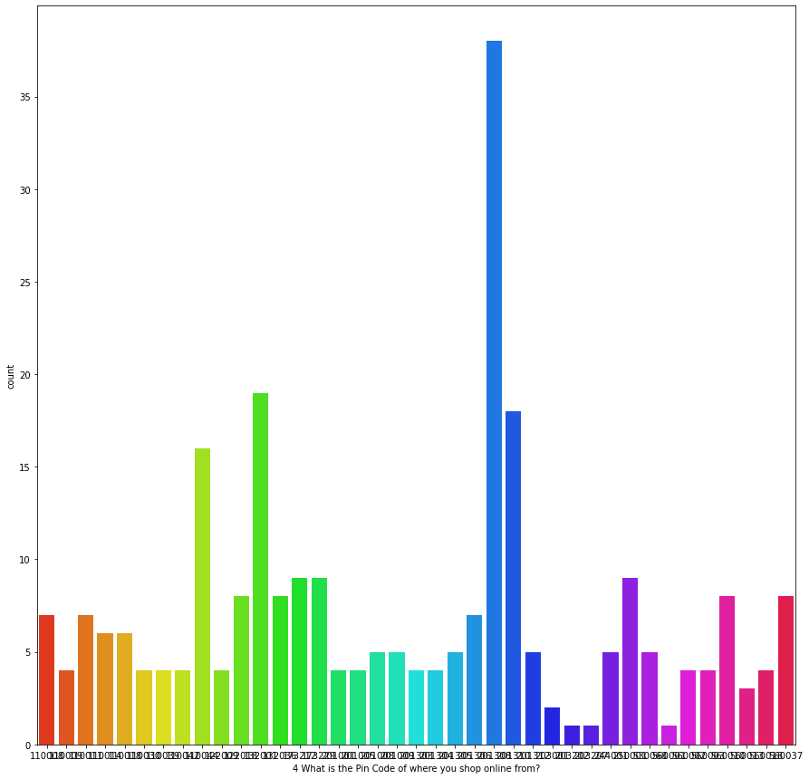

Slide 32
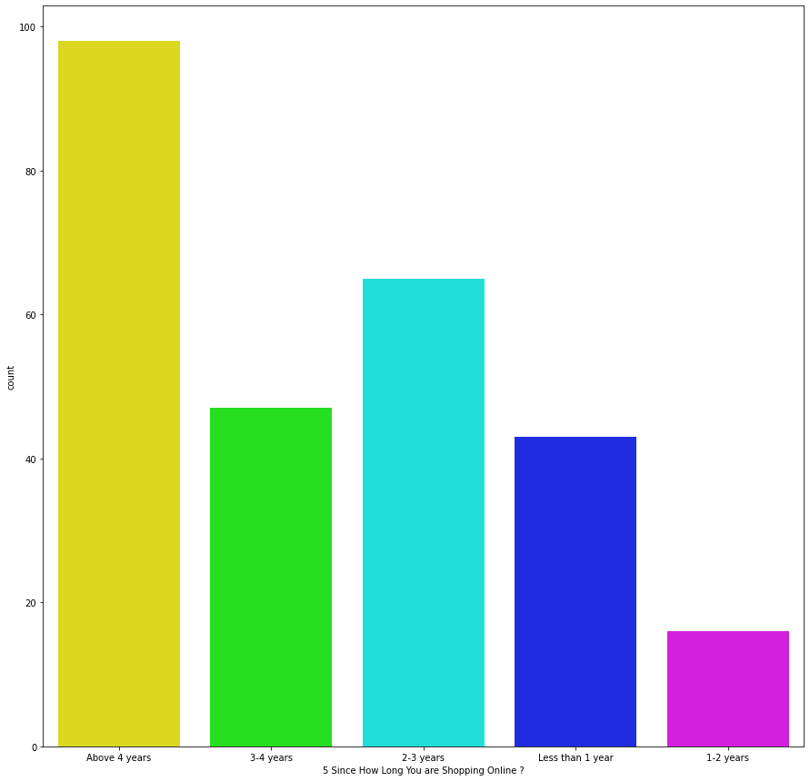

Slide 33
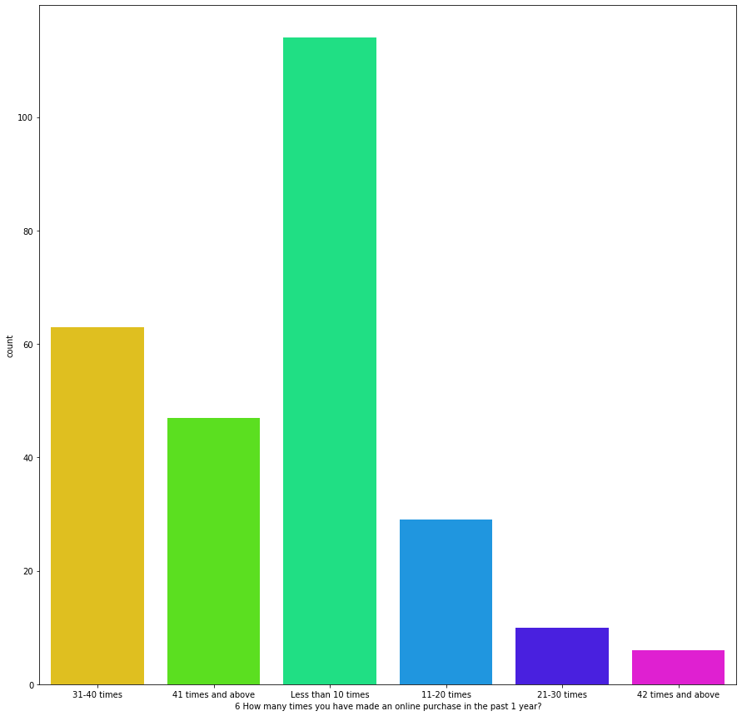

Slide 34
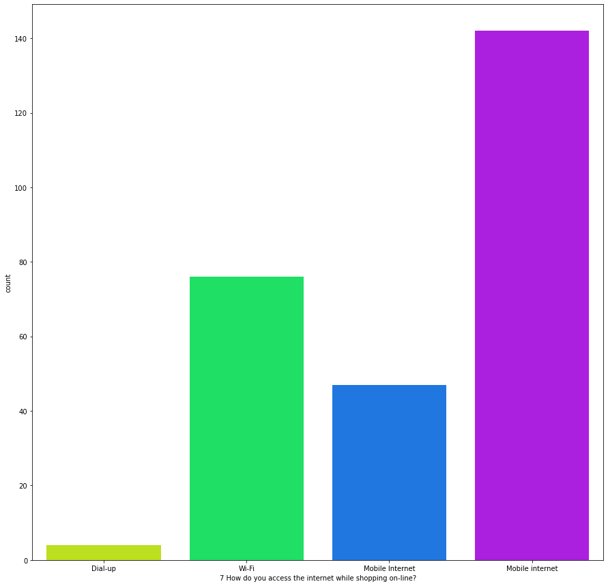

Slide 35
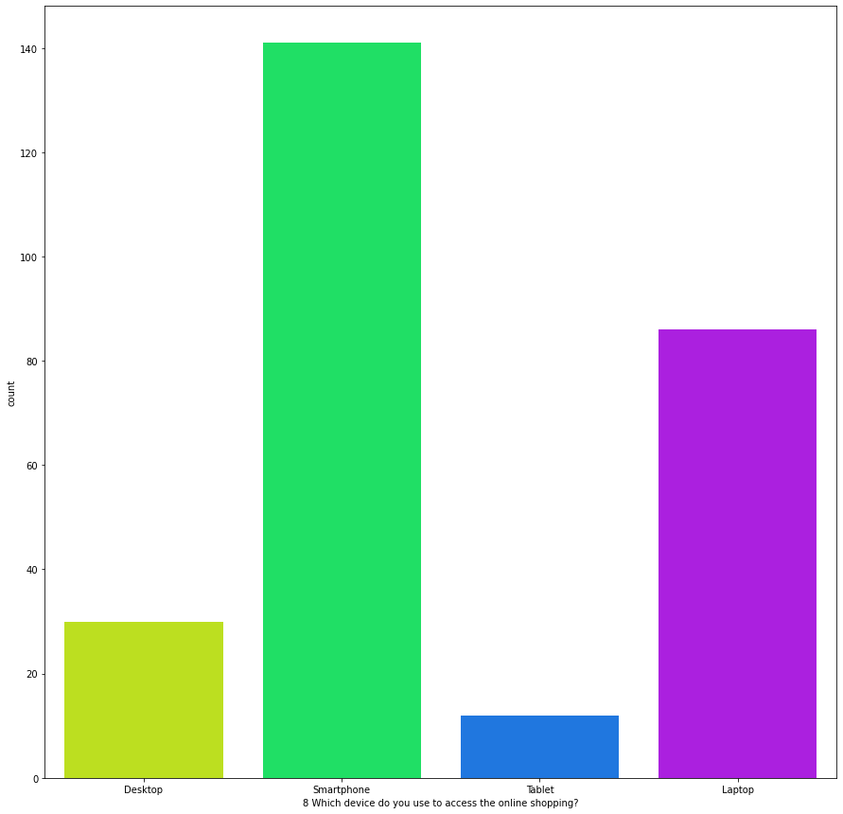

Slide 36
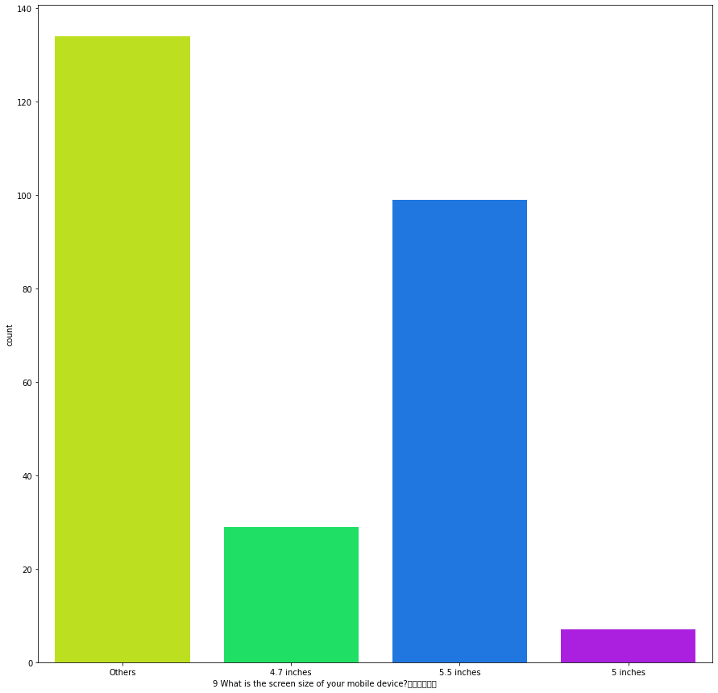

Slide 37
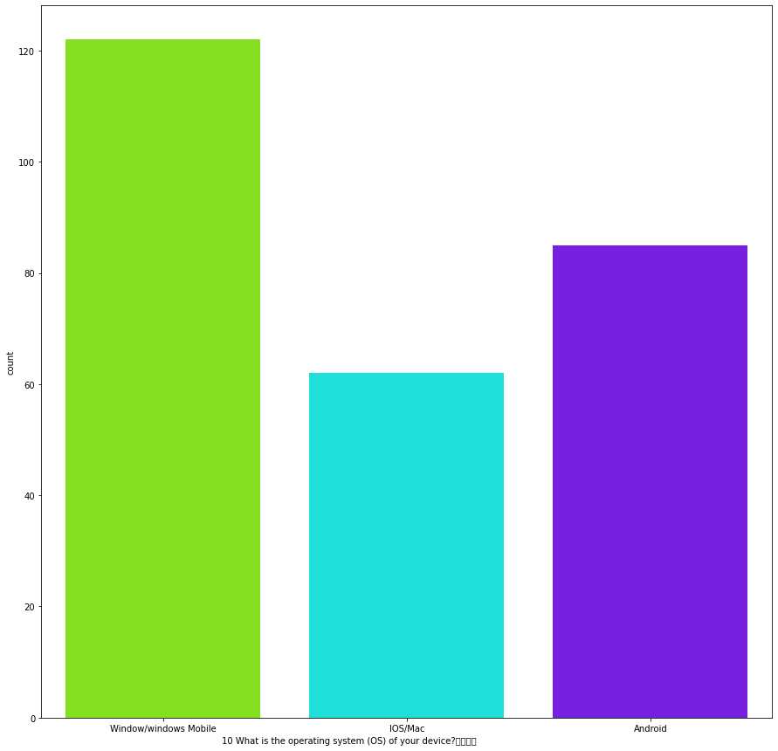

Slide 38
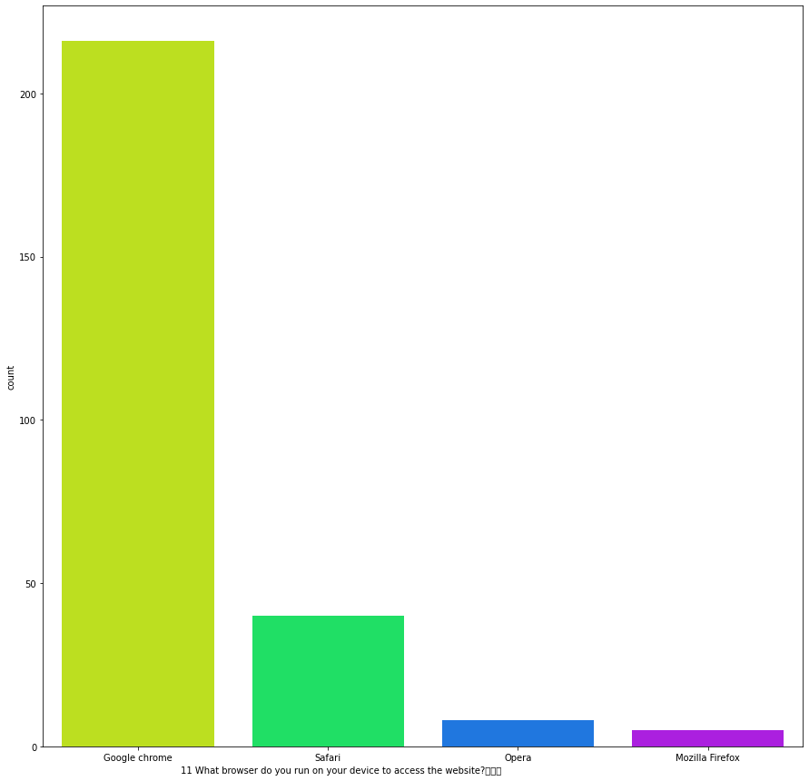

Slide 39
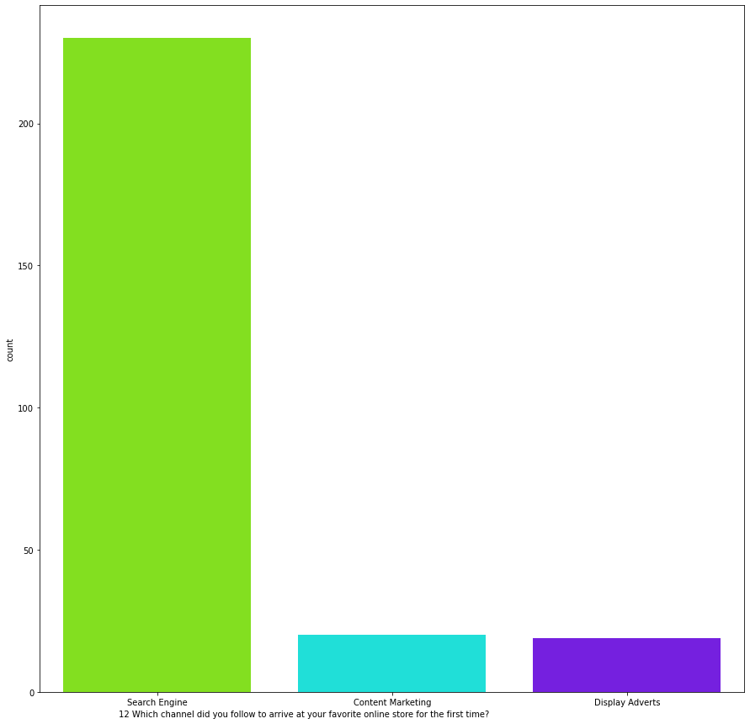

Slide 40
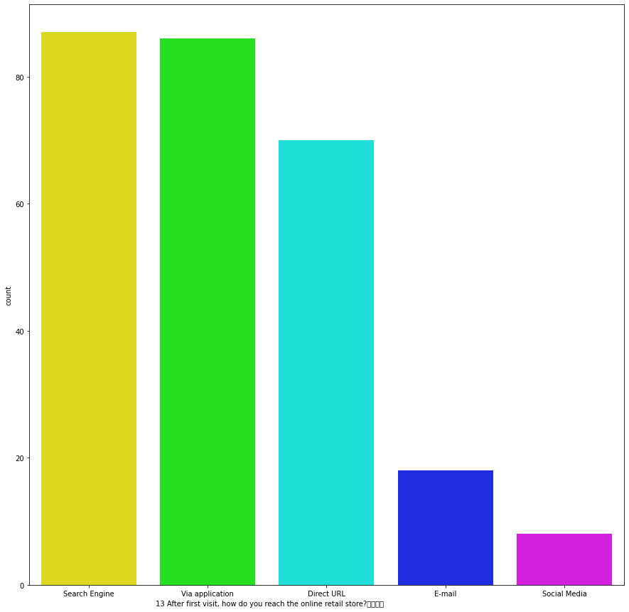

Slide 41
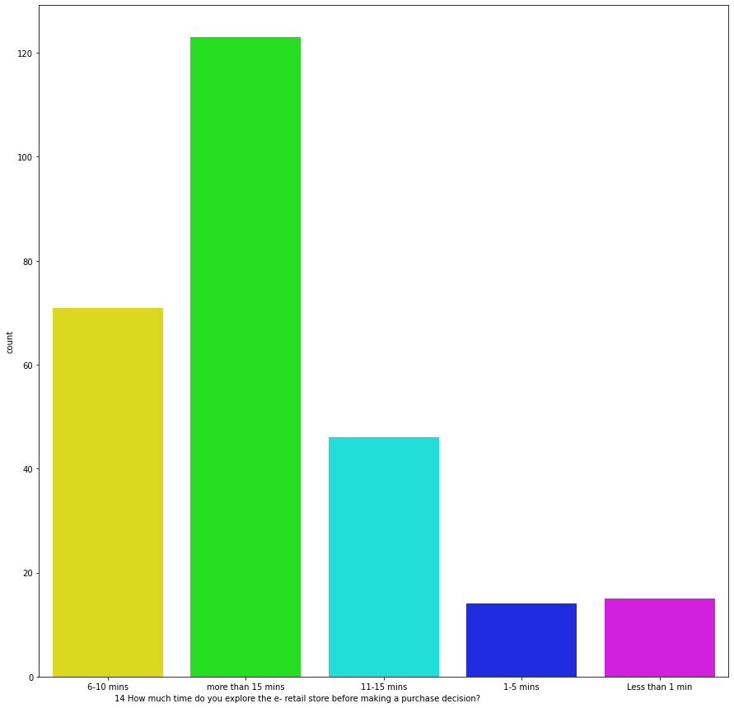

Slide 42
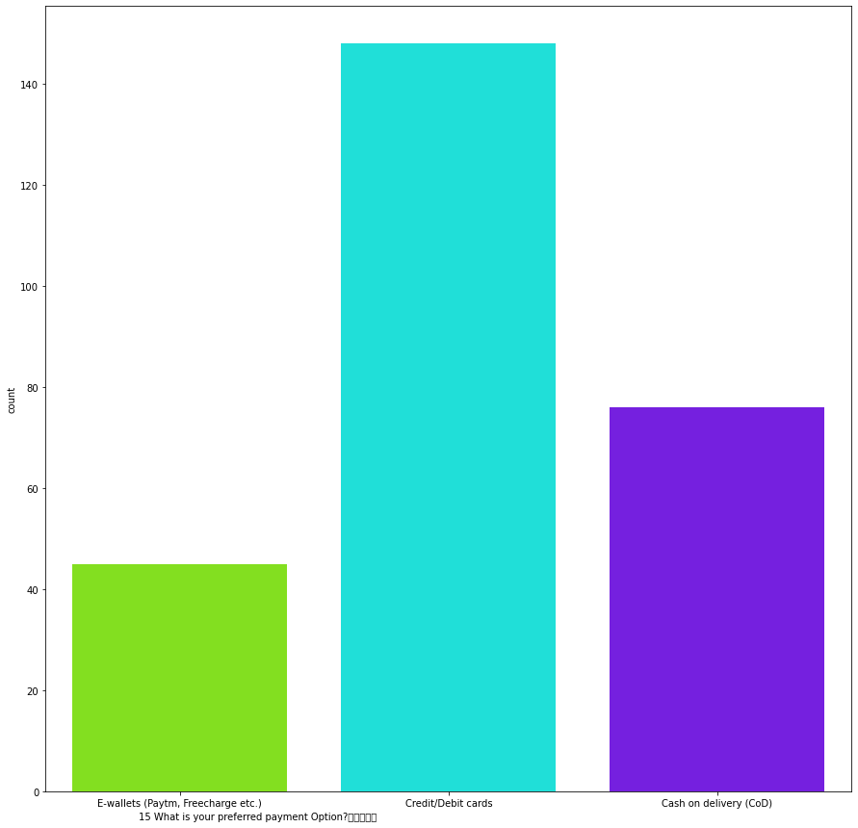

Slide 43
OBSERVATION ON CUSTOMER INFO:
1. Most of the people fall between the age of 21 to 50 years and it occupies 85.50% percentage in overall dataset.Only 7.5% of the people are below 20 years and above 51 years.
2. Delhi tops with the list of 21.5% and followed by "GR.Noida" and "Noida" with 16% and "Bangalore" with nearly 14 percent of the customer form the given dataset.
3. 36.4% of the people are shopping online for more than 4 years.
4. 42% of people are shopped online for less than 10 times in an year and 17.5% of people are shopped for more than 41 times in an year.
5. 52.78% of people used mobile internet while shopping online.
6. 52.6% of people used Smartphone while shopping online.

Slide 44
7. 80% of people used Google Chrome website for
shopping.
8. . 85.5% of people used Search Engine to accessed the favourite store for the first time and after the first visit Search Engine percentage drops to 32% and increase in apllication upto 32%.
9. More than 45% of people spend over 15 minutes to make a purchase decision in E-Retail Store.
10. 55% of people used credit/debit cards for the payments and only 28.25% of people are paying through Cash on Delivery mode.

Slide 45
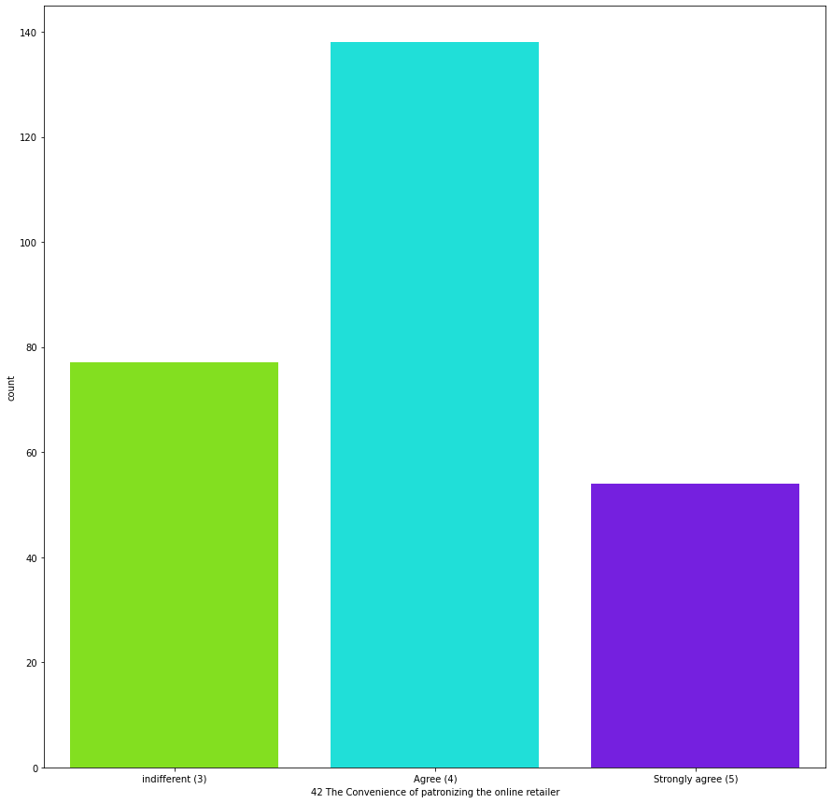
PART-2: UTILITARIAN VALUE

Slide 46
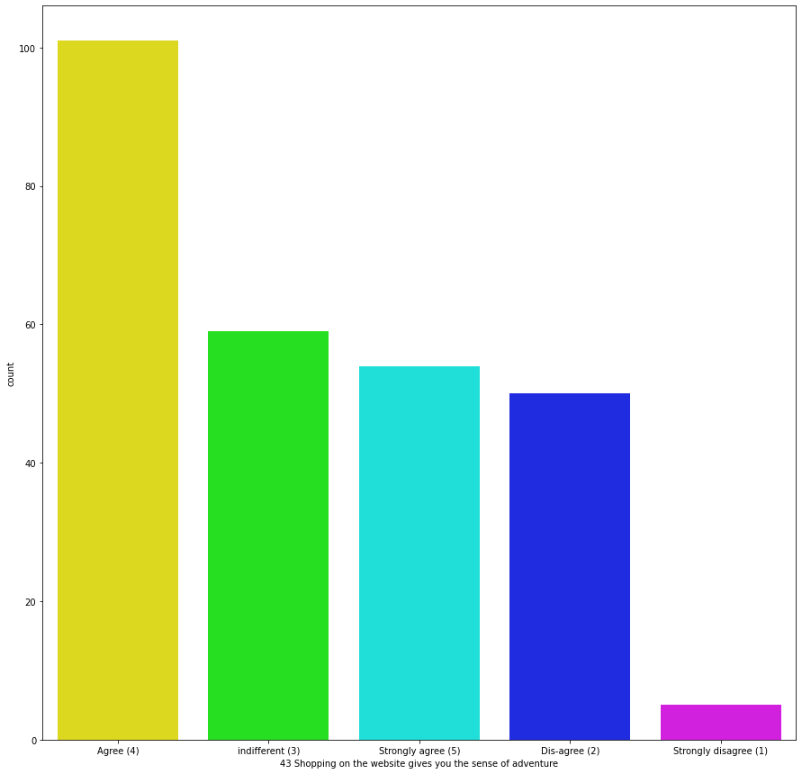

Slide 47
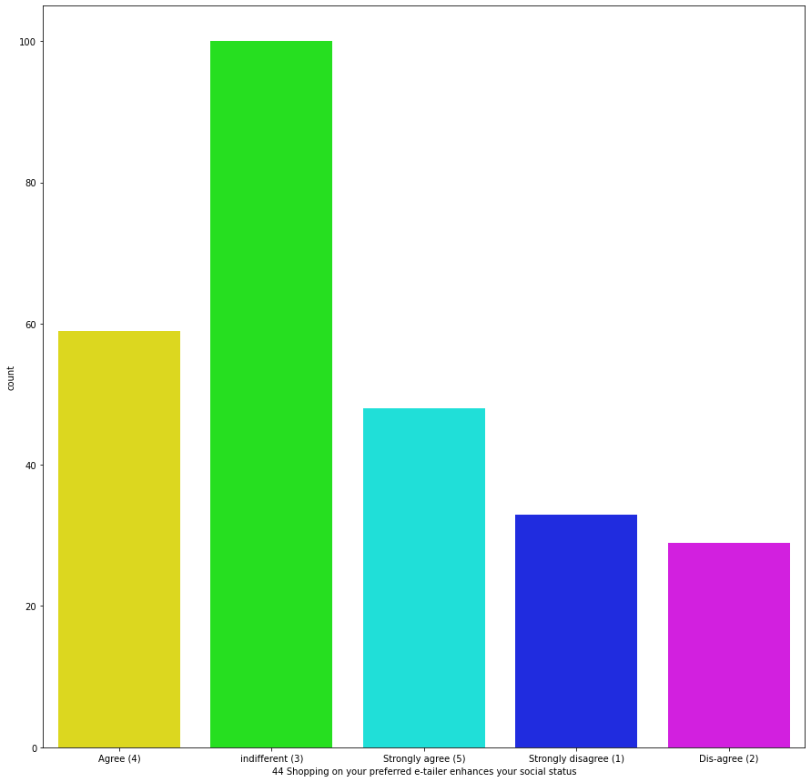

Slide 48
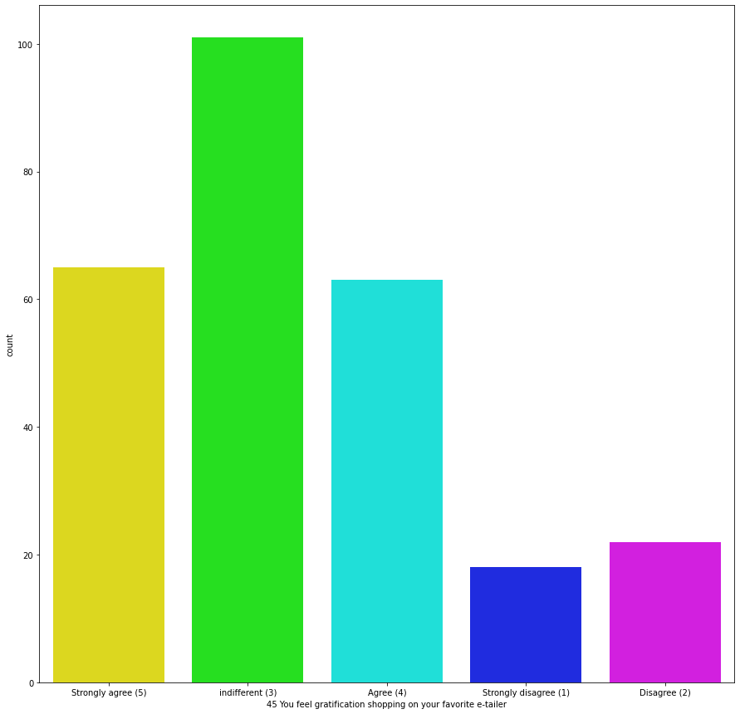

Slide 49
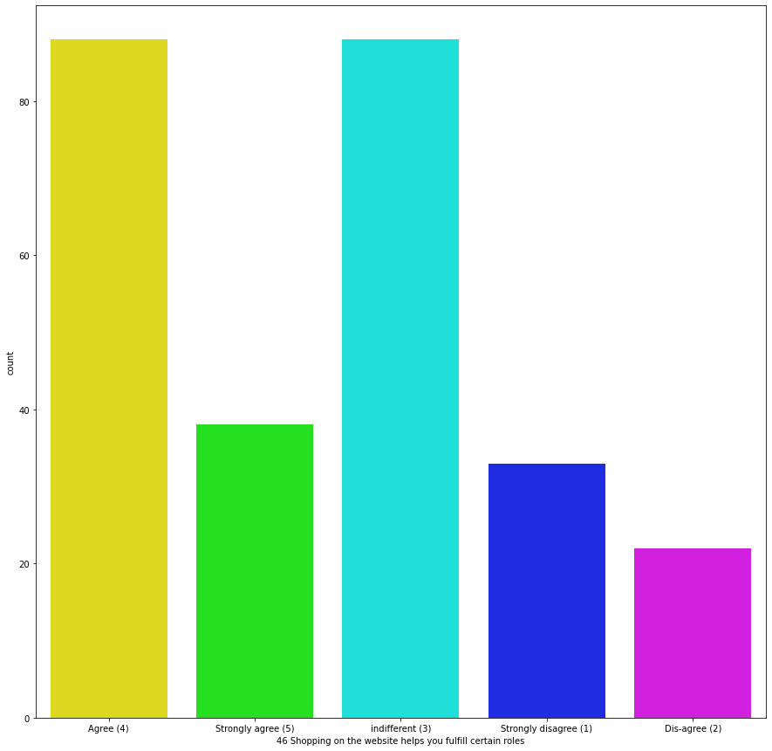

Slide 50
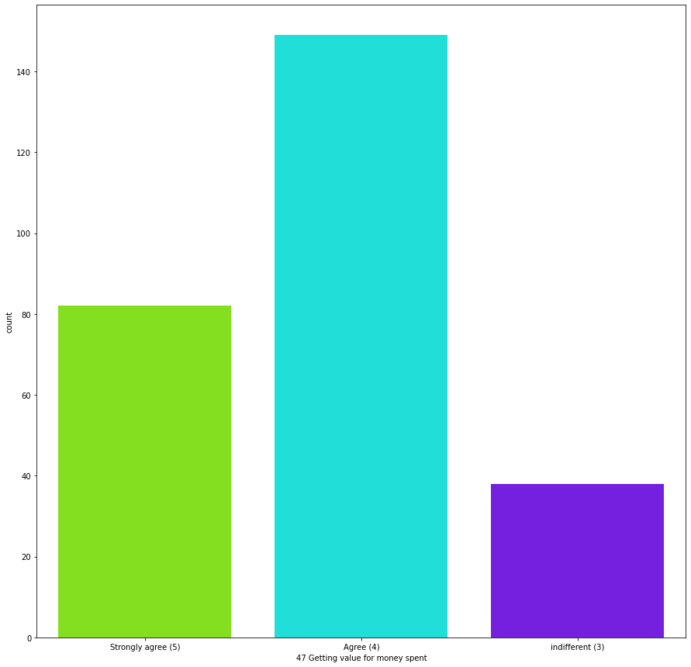

Slide 51
OBSERVATION ON UTILITARIAN VALUES:
1. 61% of the participants Strongly Agrees with that the content on the website is easy to read and understand.
2. 43% of the participant "Strongly Agrees" that information about similar product to the one highlighted is important for product comparison.
3. 37% and 32% participants are "Agrees" and "Strongly Agrees" about the Complete information about the listed seller and product being offered is important for purchase decision.
4. 53% of the participants "Strongly Agrees" that the Website should be Easy to Navigate.
5. 43% of the participants "Strongly Agrees" about the Loading and Processing Speed.

Slide 52
6. 70% of the participants "Strongly Agrees" about the User Friendly Interface of the website.
7. 59% of the participants "Strongly Agrees" about the Convenient Payment methods.
8. 53% of the participantss "Strongly Agrees" about the Trust that the online retail store will fulfill its part of the transaction at the stipulated time.
9. 72% of the participants "Strongly Agrees" about the Empathy (readiness to assist with queries) towards the customers.
10. Nearly 40% of the participants "Strongly Agrees" about the Online shopping gives monetary benefit and discounts.

Slide 53
11. 54% of the participants "Strongly Agrees" about the Shopping online is convenient and flexible.
12. 73% of the participants "Strongly Agrees" about the Return and replacement policy of the e-tailer is important for purchase decision.
13. Nearly 50% of the participants "Strongly Agrees" about Displaying quality Information on the website improves satisfaction of customers.
14. 61% of the participants "Strongly Agrees" about Net Benefit derived from shopping online can lead to users satisfaction.
15. 55% of the people "Strongly Agrees" about the Monetary savings.

Slide 54
PART-3 : HEDONIC VALUE

Slide 60
Observations on Hedonic Values
1. 51% and 20% of participants are "Agrees" and "Strongly Agrees" with the Convenience of Patronizing the online retailer.

Slide 61
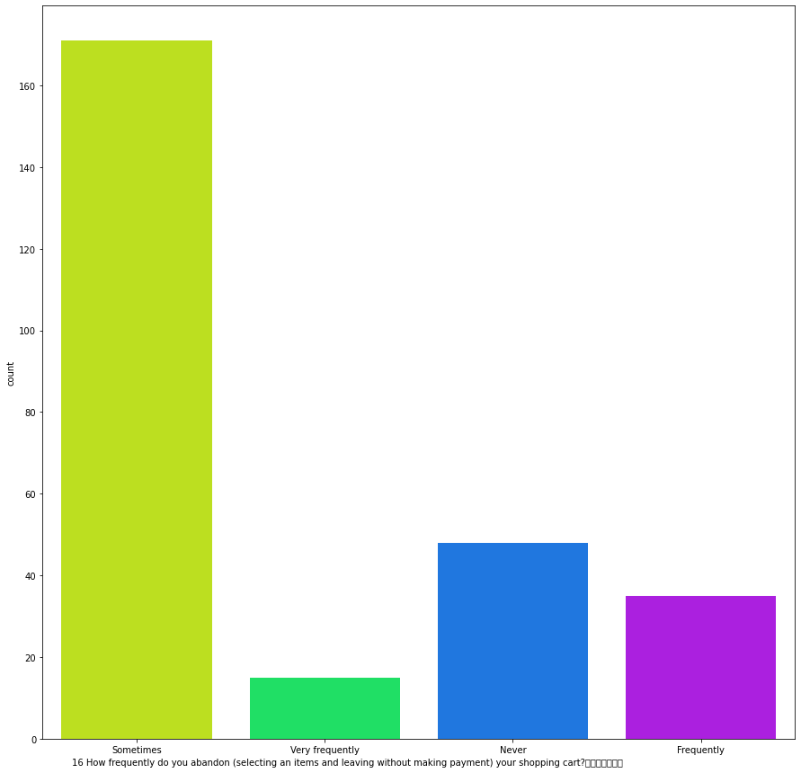
Part - 4 : Perceived Risk

Slide 62
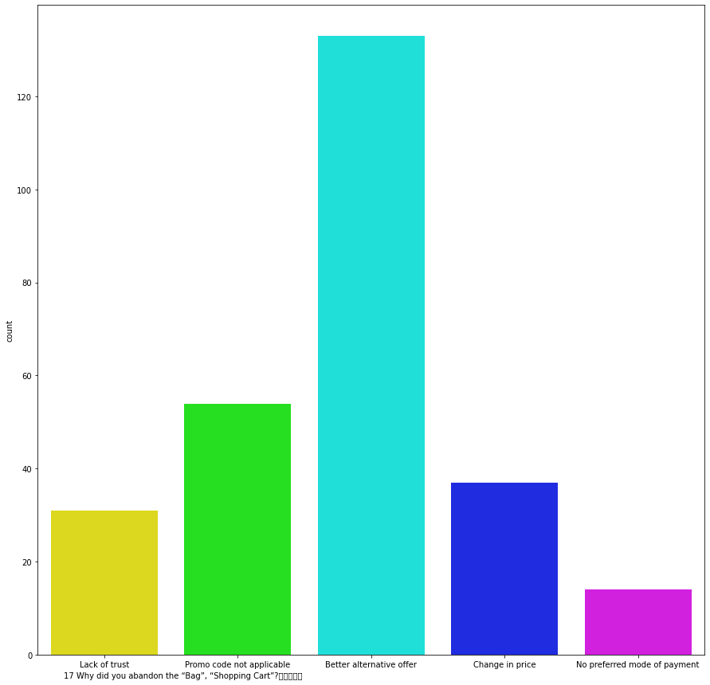

Slide 63
Observations on Perceived Risk
1. Nearly 64% of people ocassionally abandoned the shopping cart without payment and nearly 18% of people never abandon the shopping cart and 13% of people oftenly abandon the shopping cart.
2. Reason for abandoning the shopping cart is "Better Alternative Offer" for about 50% and interestingly lack of trust and change in price for about 11% and 14% of people answered and also "No Preferred mode of payment is very less percentage of about only 5%.

Slide 64
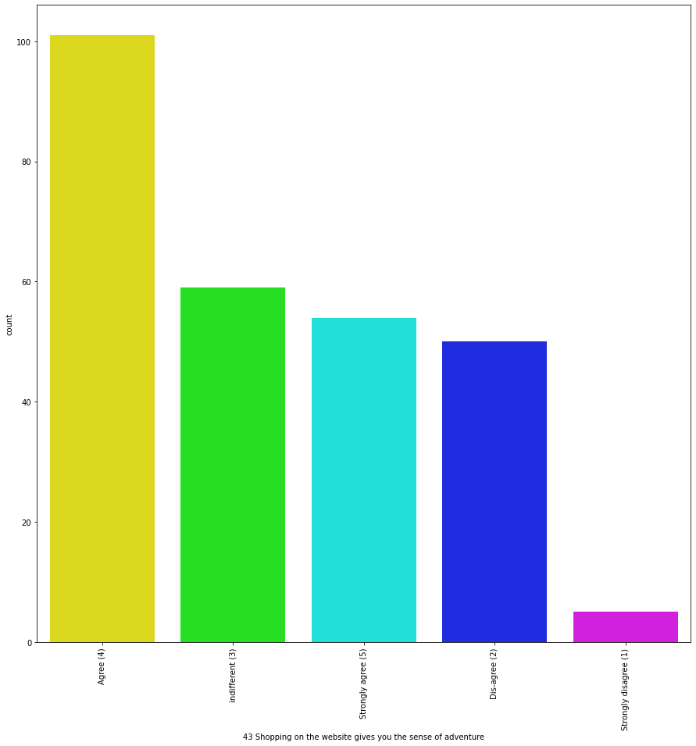
Part – 5 : Customer Experience

Slide 65
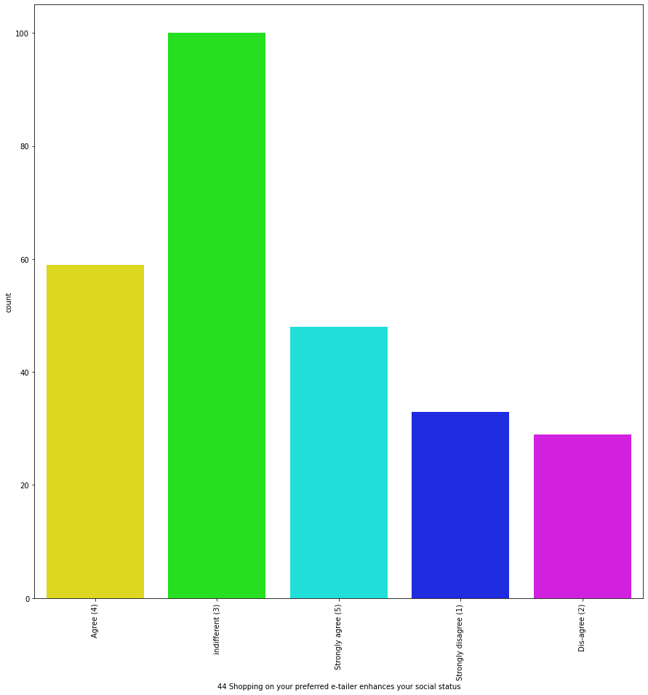

Slide 66
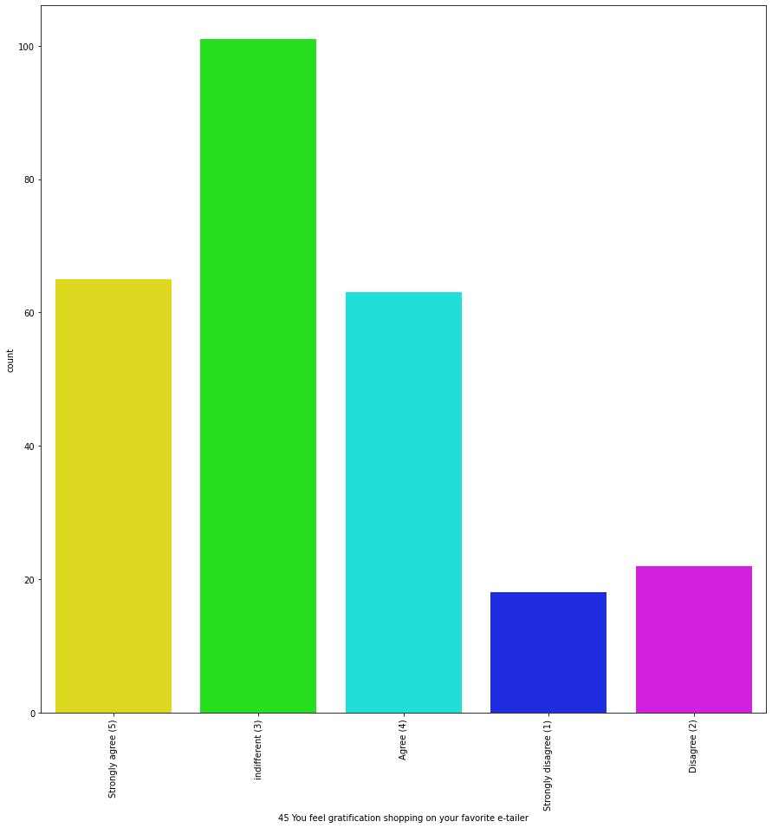

Slide 67
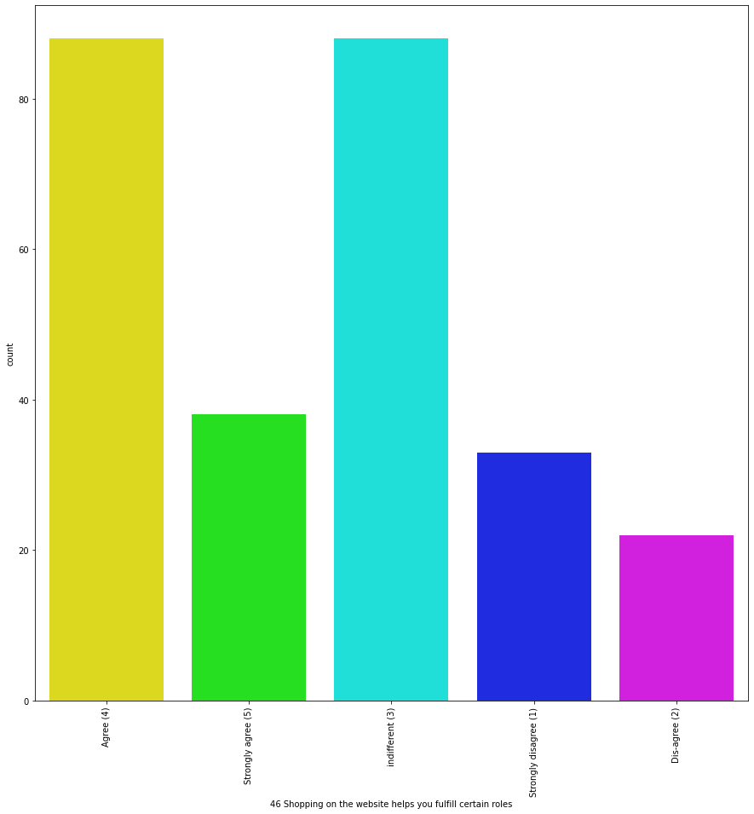

Slide 68
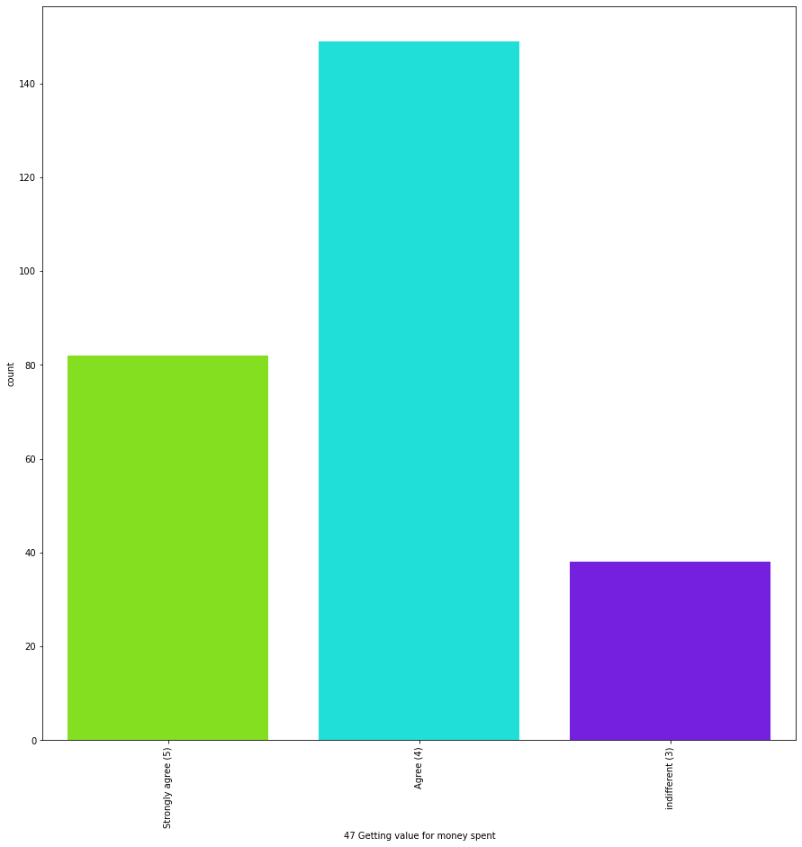

Slide 69
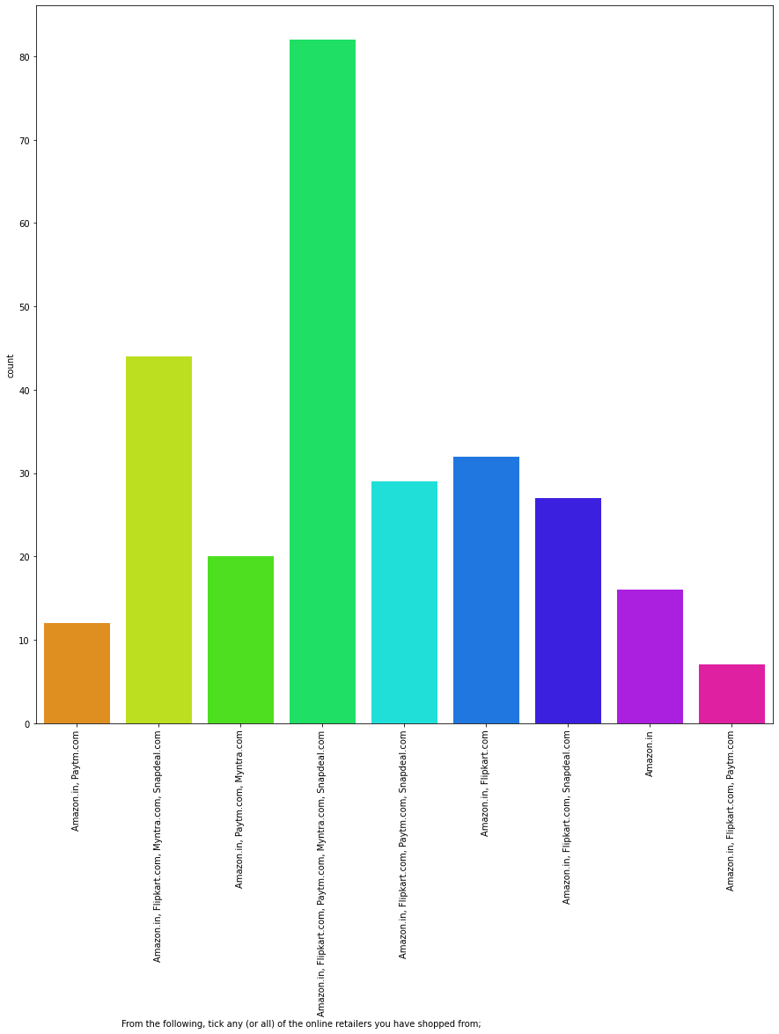

Slide 70
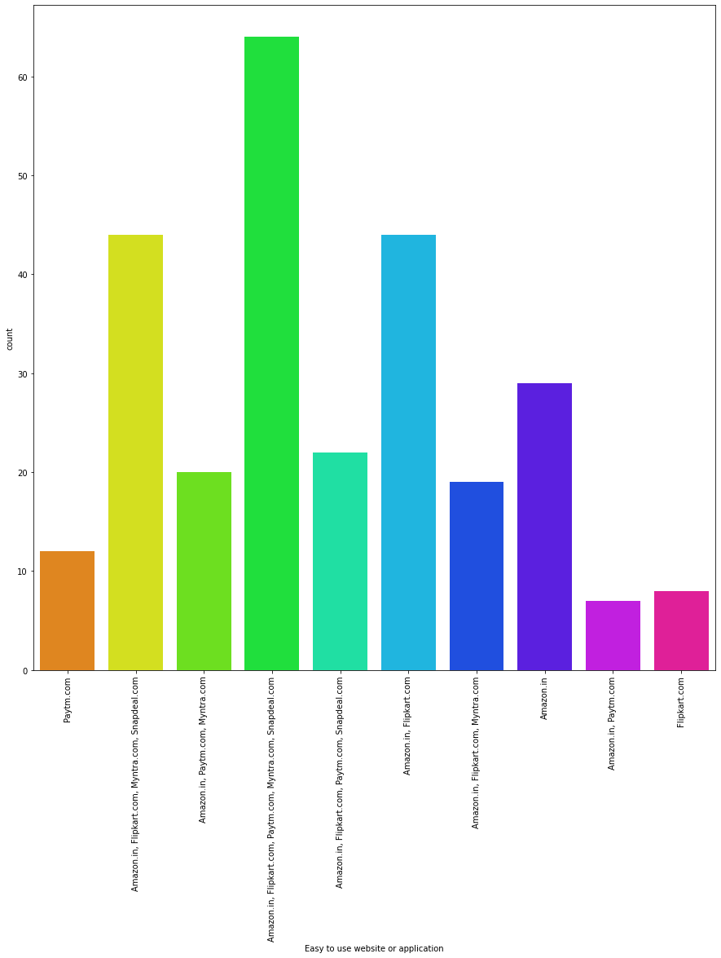

Slide 71
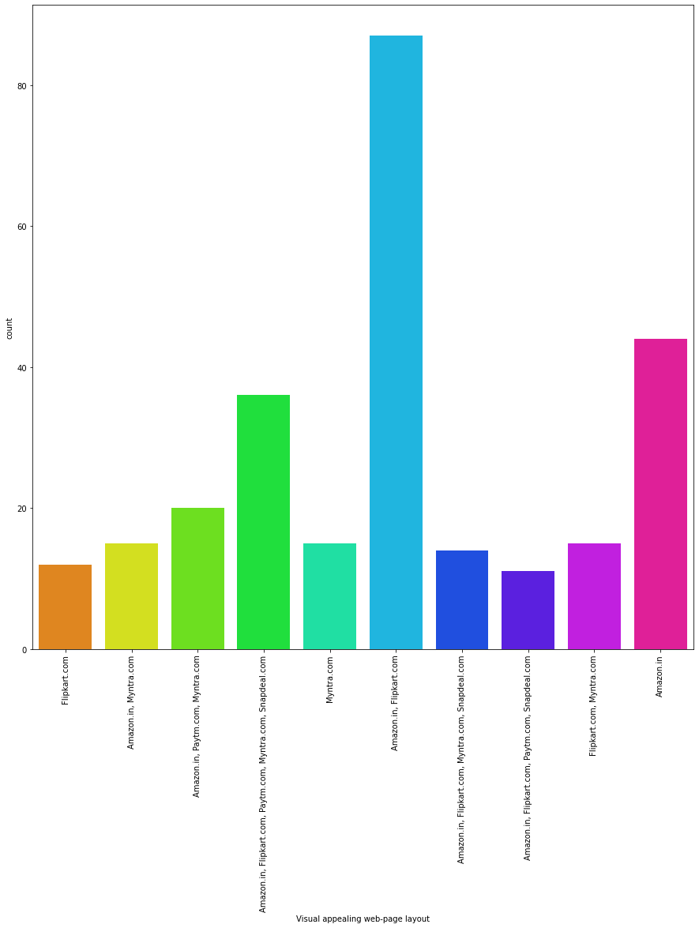

Slide 72
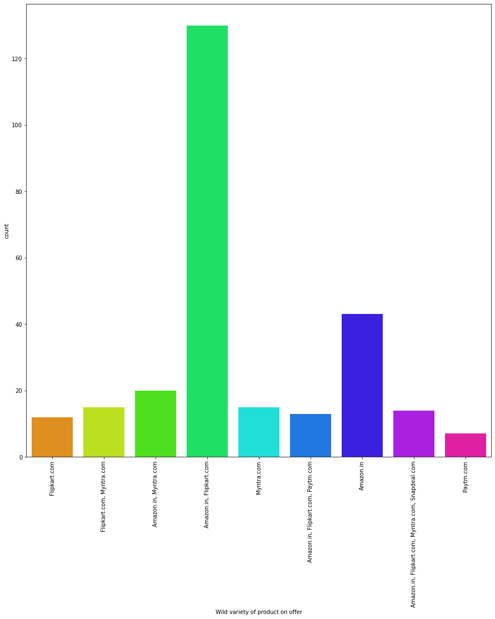

Slide 73
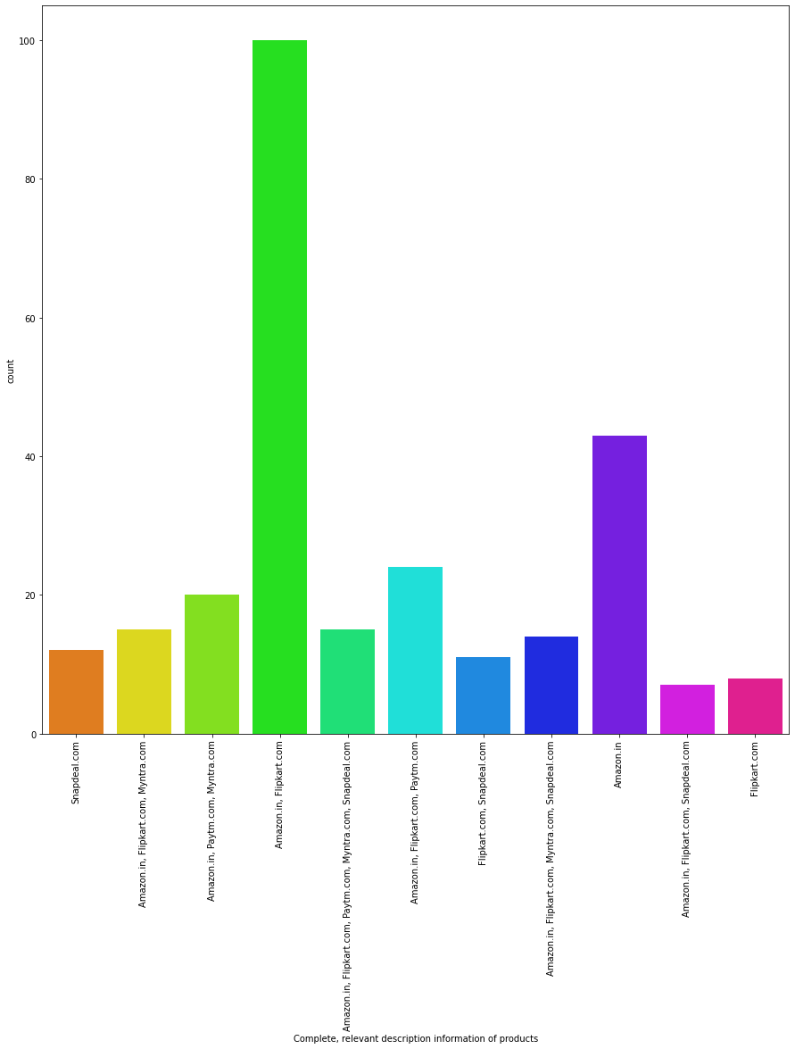

Slide 74
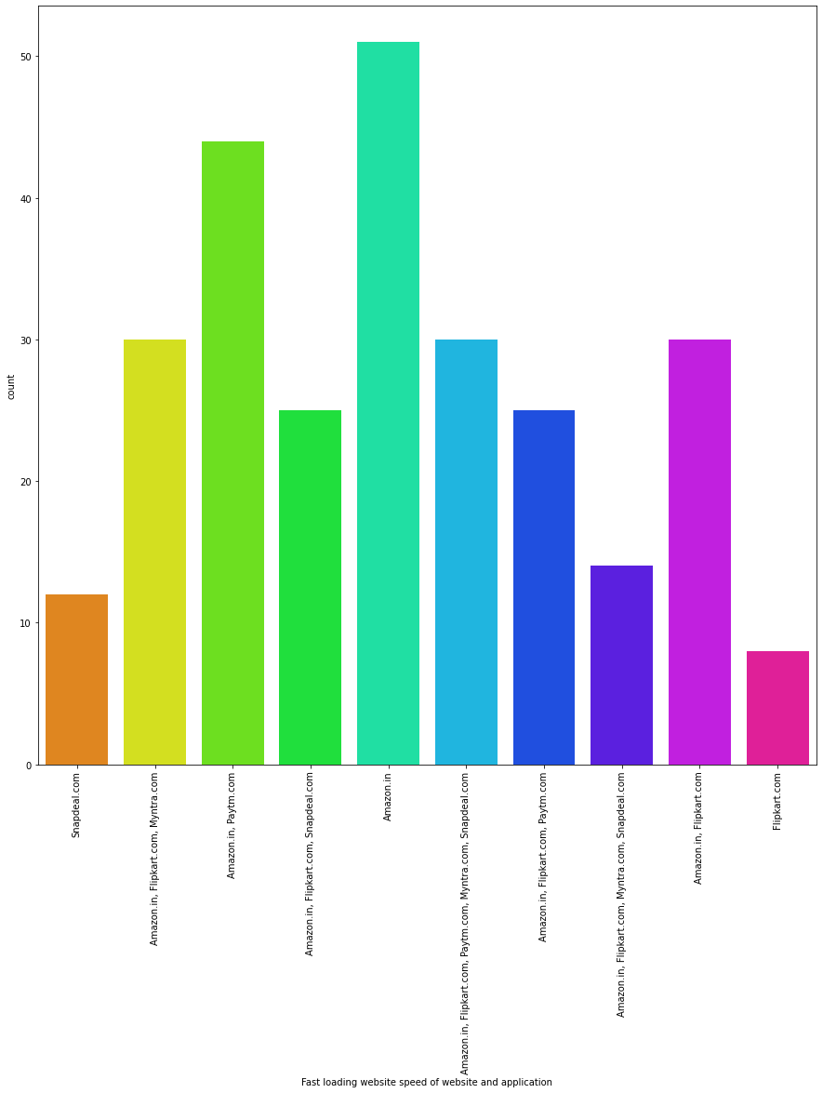

Slide 75
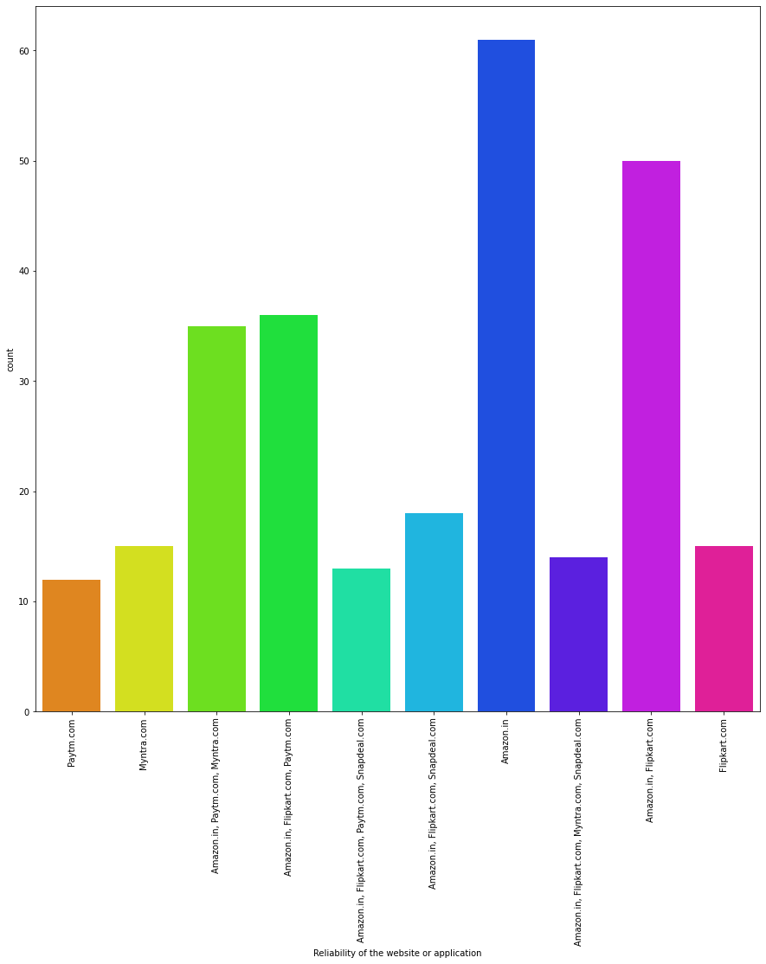

Slide 76
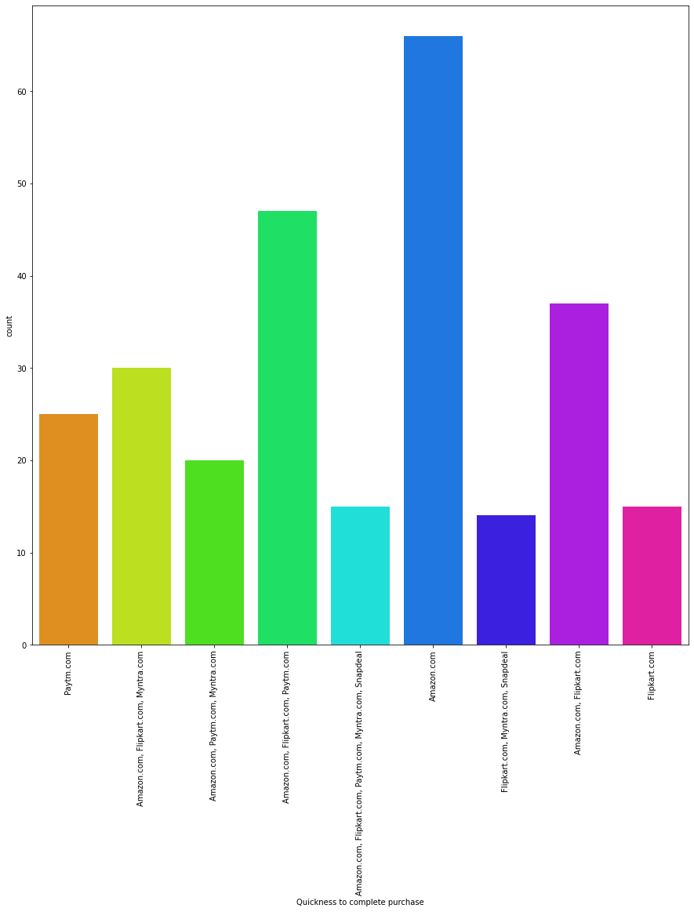

Slide 77
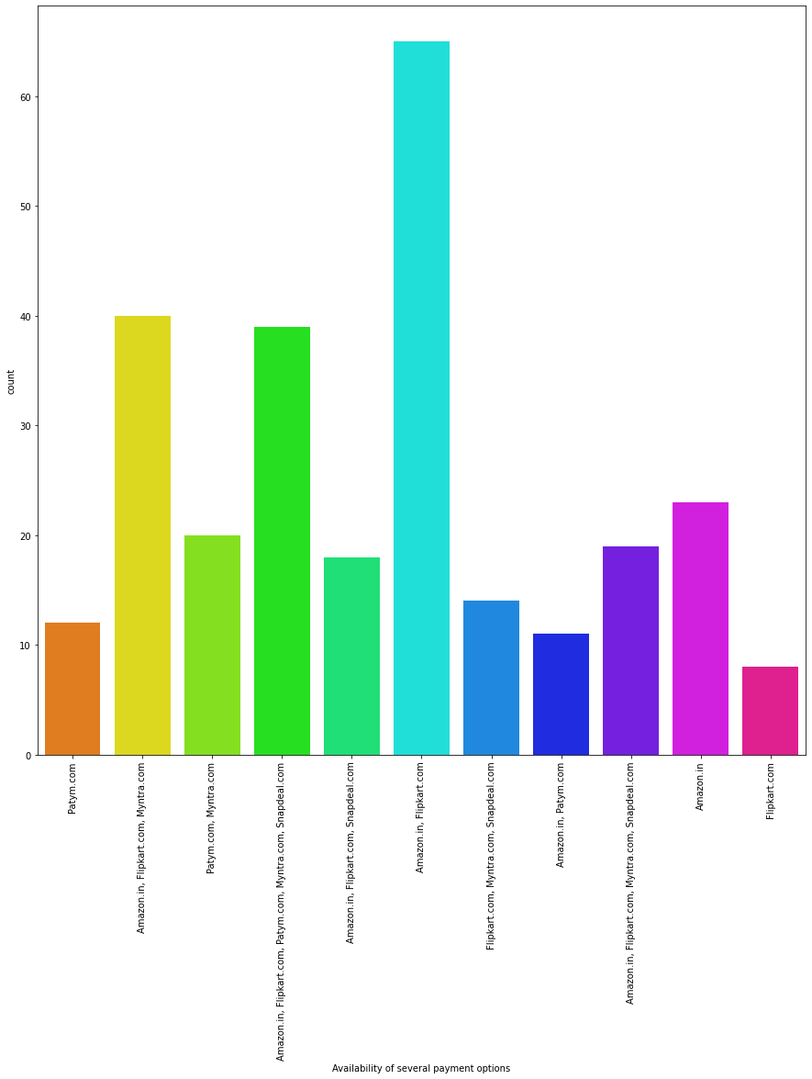

Slide 78
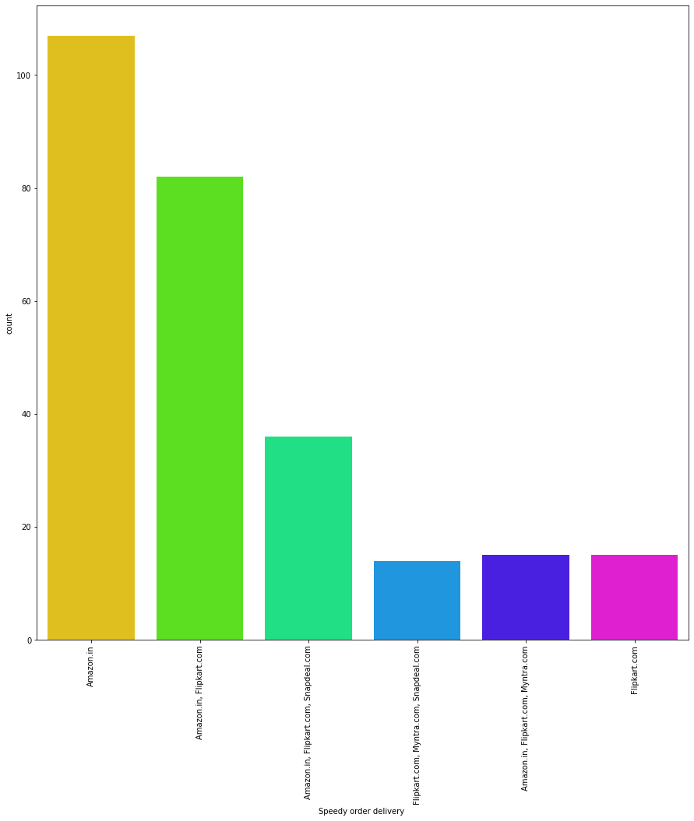

Slide 79
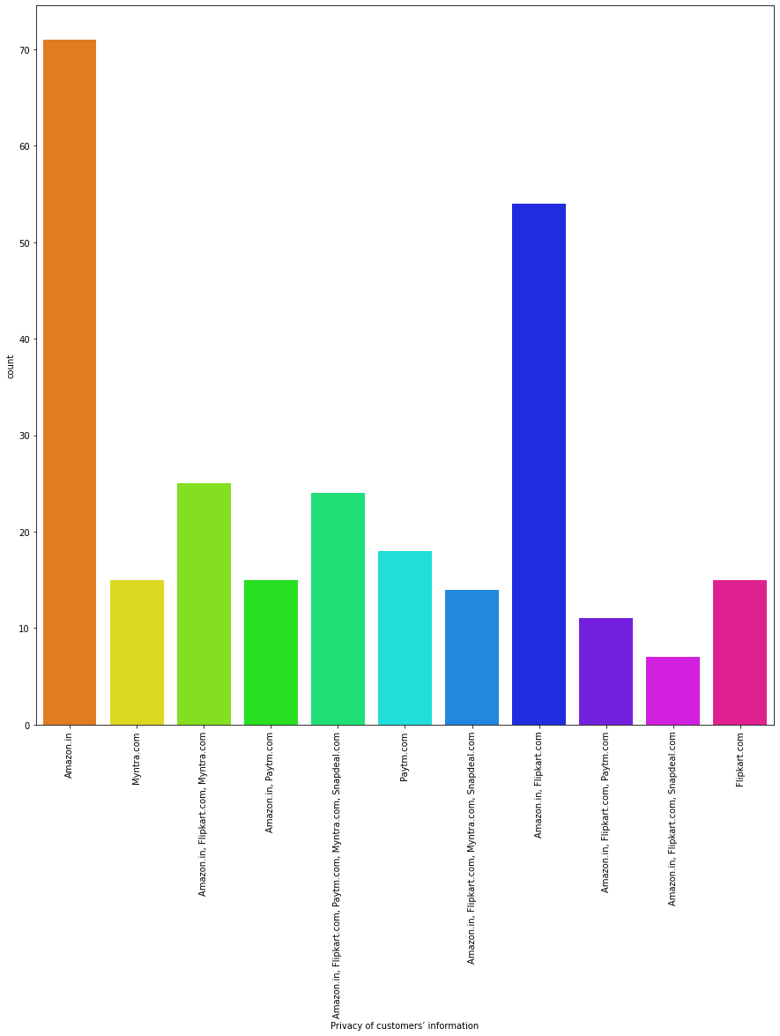

Slide 80
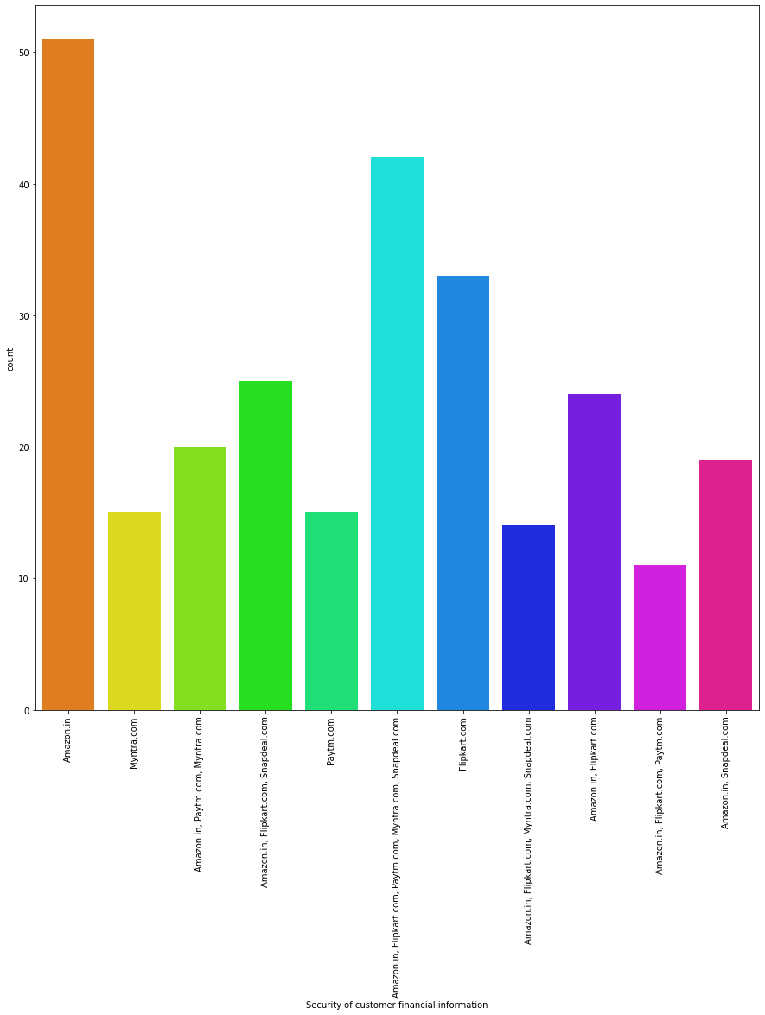

Slide 81
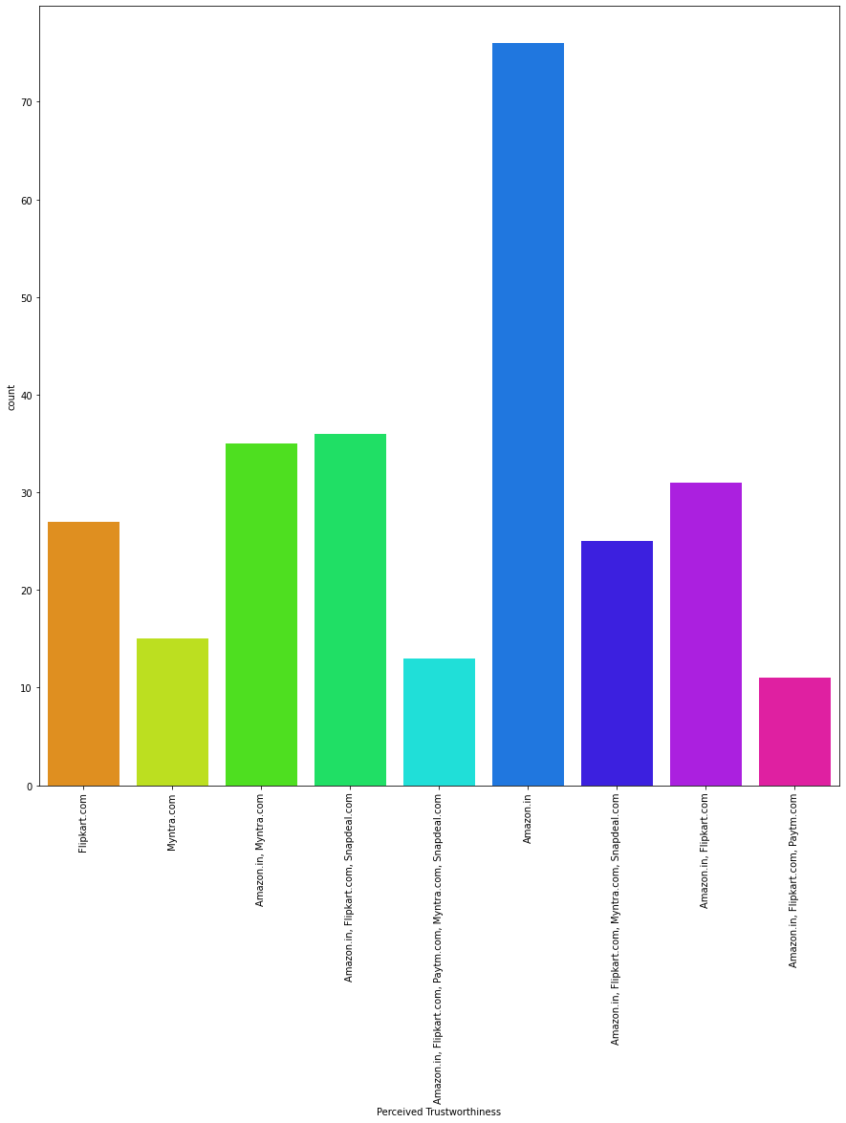

Slide 82
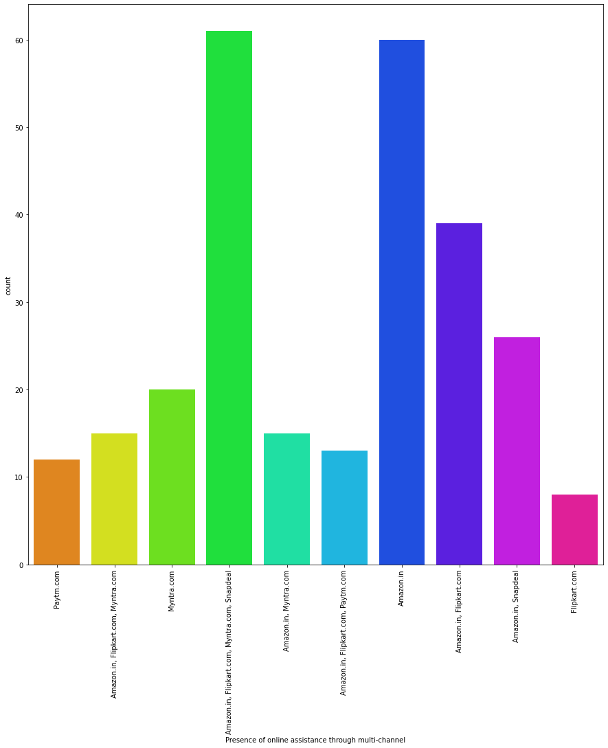

Slide 83
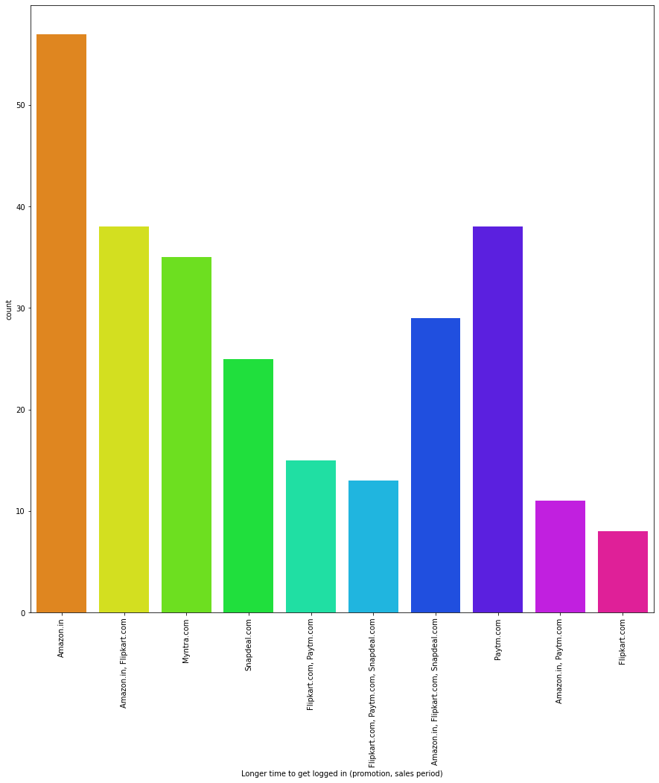

Slide 84
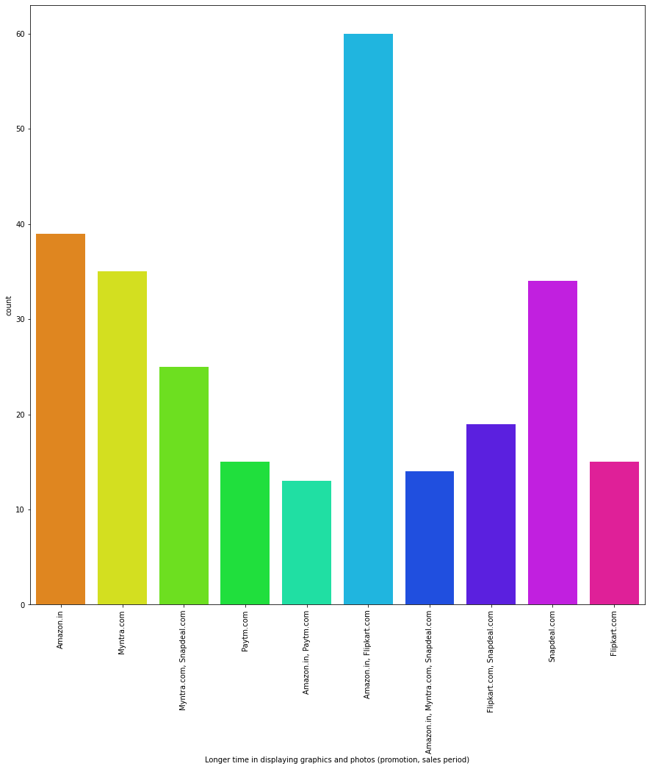

Slide 85
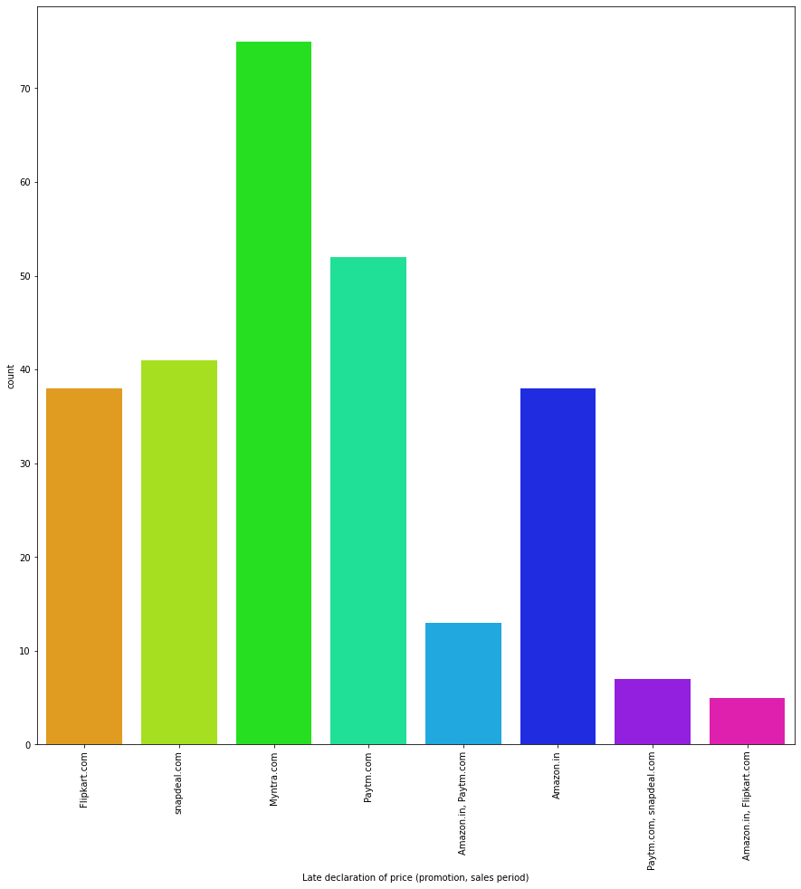

Slide 86
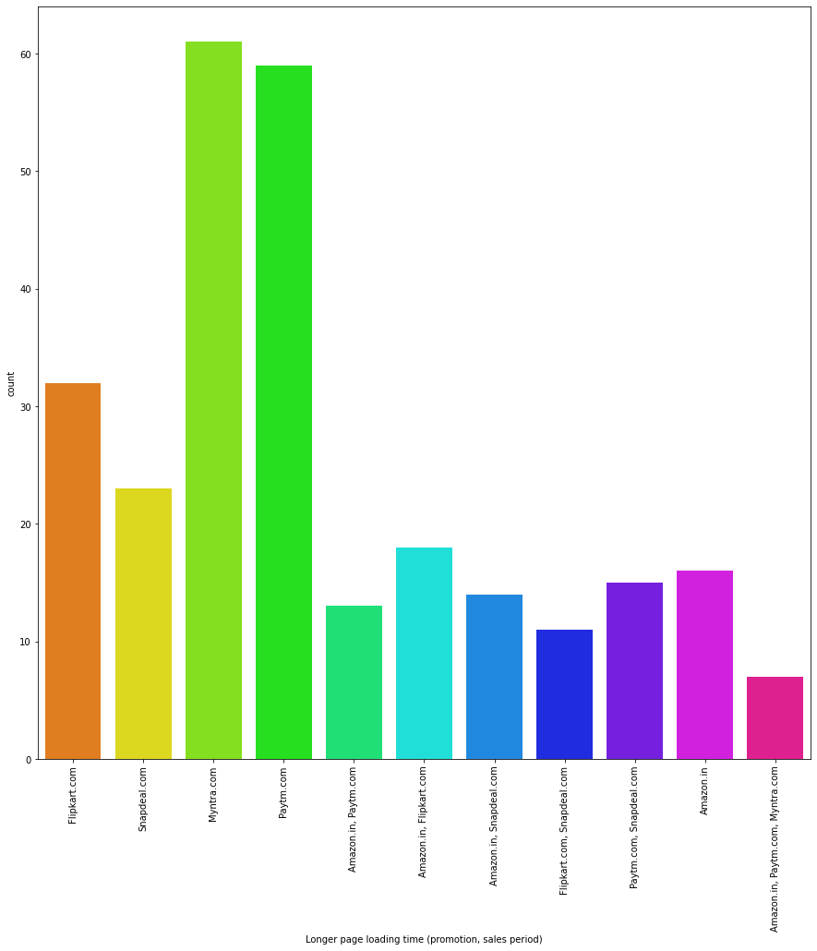

Slide 87
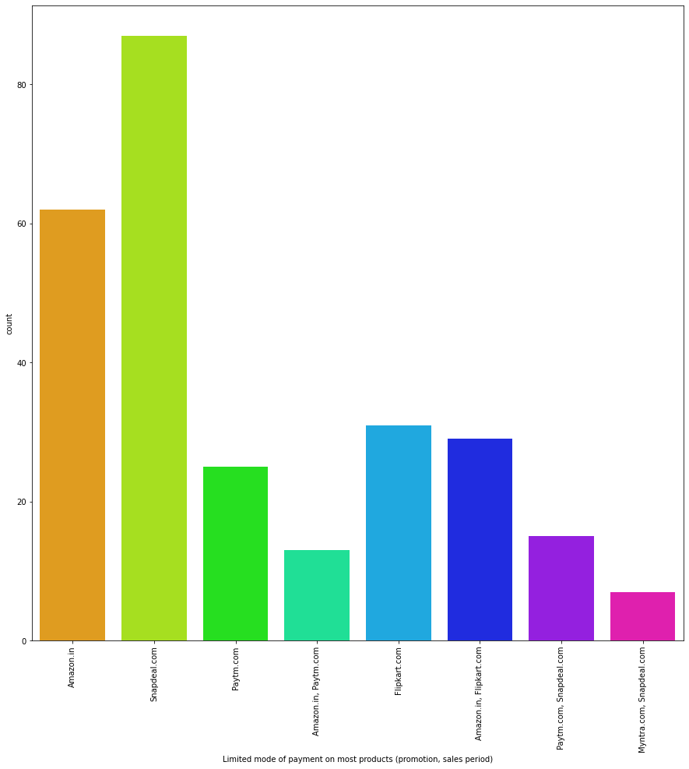

Slide 88
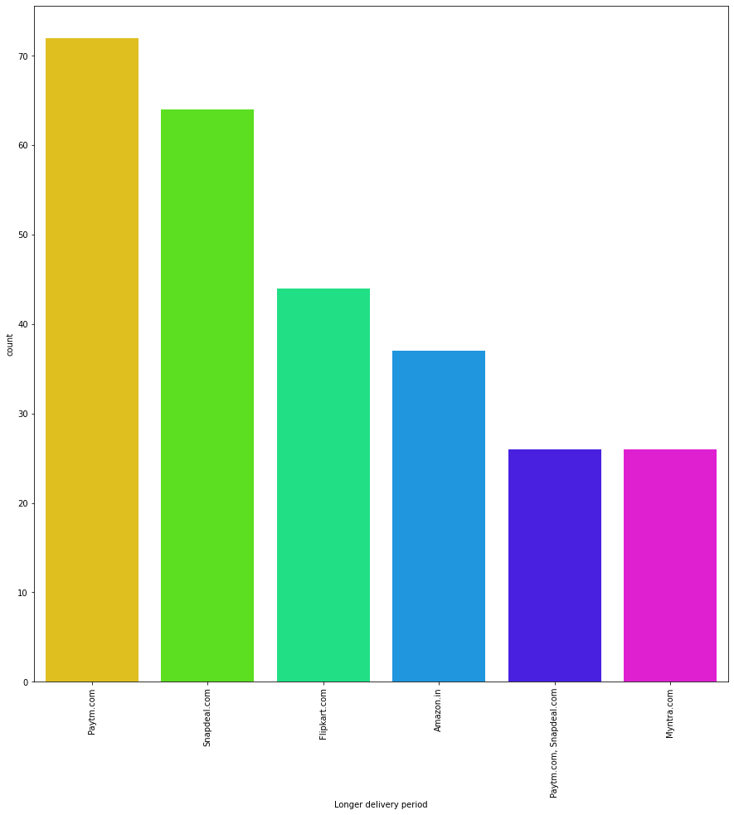

Slide 89
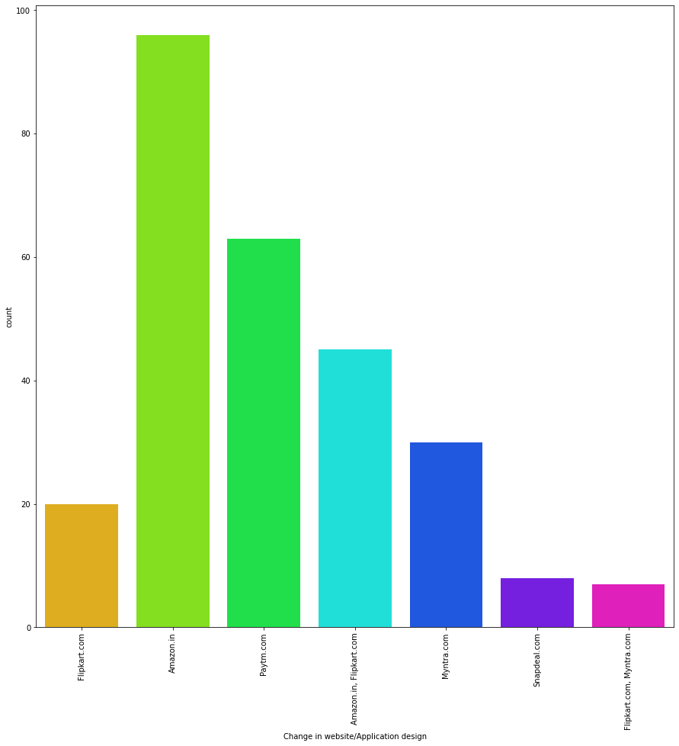

Slide 90


Slide 91


Slide 92


Slide 93
Obervations on Customer Experience
1. 20% of the total participants "Strongly Agree" that Website gives them a sense of Adventure and only 2% of the participants "Strongly disagrees" that Website doesn’t.
2. Surprisingly 40% of the participants Indifferently responsed for the Gratification survey.But 24% of the People Strongly agrees that they felt Gratification shopping on their favourite e - retailer.
3. Nearly 85% of the participants Agrees that they are getting value for the money they spent.
4. 30% of the total participants answered that they from all ie (Amazon Flipkart Myntra Snapdeal Paytm) of the online retailers and 12% of the participants answered that purchased only from (Amazon and Flipkart) and 6% of the participants have shopped only from Amazon.

Slide 94
5. 24% of the participants answered that all the Website/Application has easy to use and 10% of the participants said that only amazon is so easy to access.
6. 32% of the participants said that (Amazon and Flipkart) has Visually Appealing Web page-Layout,16% of the people said that (Amazon) has Visually appealing web-page layout, 5% of the participants said that (flipkart) also has the Visually appealing web-page layout.
7. 48% of the total participants said that (Amazon and Flipkart) has the wide variety of products on offer and 16% of the total participants said that (Amazon) has the wide variety of products on offer.
8. 37% OF THE total participants said that (Amazon and Flipkart) has the Complete information about the product, 16% of the participants said that only (Amazon) has the relevant information and also 5% of participants said that Snapdeal has the complete information about the products and 3% of the particpants said Flipkart is the only one.

Slide 95
9. 19% of the participants said that Amazon's website/application is loading fast than the other and also 16% participants answered that both Amazon and Paytm has fast loading website/application.
10. 23% of the participants said that Amazon is best to reliable and 25% of participants said that one can complete the purchase quickly in Amazon.
11. 24% of the people said that Amazon and Flipkart has the Availability of several payment method.
12. 40% of the participants said that Amazon deleivered their products so quickly and 31% of the participants said that both Amazona nd Flipkart will deleivered their product so quickly.

Slide 96
13. 13. 27% of the participants said that Amazon will kept the privacy of customer's information.
14. 22% of the participants said that Amazon only shows their online assistance through Multi-channel,but also 22% of the total participants answered that both Amazon and Flipkart shows their online assistance through Multi-channel.
15. 22% of the participants has said that (Amazon and Flipkart) has took longer time in displaying the graphics and photos.
16. 27.8% of the participants has said that price declaration in Myntra took longer time. 23% of the participants said that the Myntra Website/App has taken longer time to loading the page.

Slide 97
17. 27% of the participants has said that Paytm has taken longer time to deliver the product followed by Snapdeal.
18. 20% of the participants has said that in "Amazon" and "Myntra" by moving from one page to another there is a frquent disruption in those apps/website.
19. 35% of the participants has said that efficiency of the Amazon Website is as good as before.
20. 30% of the participants has said that they would recommend Amazon to their Friend.

Slide 98
Conclusion
The purpose of this study is to understand the influence of utilitarian values, hedonic values, customer experience and perceived risk on E-commerce customer satisfaction in India.
The analysis shows that the Utilitarian Value significantly influences Customer Satisfaction, meaning that the level of Utilitarian Value of e-commerce customers will affect the level of Customer Satisfaction. In other words, the better (higher) Utilitarian Value given by e-commerce products will lead to satisfaction with customers. Hedonic Value significantly influences Customer Satisfaction, meaning that the high and low Hedonic Value of e-commerce customers will affect the level of Customer Satisfaction. In other words, the higher the Hedonic Value given by e-commerce products will lead to the satisfaction of e-commerce customers. The following factors should be considered by the E-commerce websites to improve the customer satisfaction:

Slide 99
Utilitarian Value •Product offerings •Product information •Monetary savings •Convenience
Hedonic Value •Adventure Shopping •Social Shopping •Gratification Shopping •Idea Shopping •Role Shopping •Value Shopping
Social Value •Feel acceptable •Good impression •I am perceived •Social approval
Perceived Risk •Financial Risk •Functional Risk •Physical Risk •Psychological Risk •Social Risk •Temporal Risk
Customer Satisfaction •Purchasing Experience •Site Selection

Slide 100
On the basis of these factors we could see that,
1. Amazon.in
2. Flipkart.com
are doing great in their performance on customer satisfaction and retention.

Slide 101
The END

