Slide 1

HOUSING_PRICE
PREDICTION
Submitted By
R A J A S E K A R

Slide 2
Business Problem Framing
A US-based housing company named Surprise Housing has decided to enter the Australian market. The company uses data analytics to purchase houses at a price below their actual values and flip them at a higher price. For the same purpose, the company has collected a data set from the sale of houses in Australia. The data is provided in the CSV file below. The company is looking at the prospective properties to enter into the market.
We are required to build a model using machine learning in order to predict the actual values of the prospective properties, and to decide whether to invest in them or not.
For this company wants to know the :-
1. Which variables are important to predict the price of the variable.
2.How do these variables describes the price of the house.

Slide 3
Analytical Problem Framing
Analytic problem framing involves translating the business problem into terms that can be addressed analytically via data and modeling. It’s at this stage that you work backwards from the results / outputs you want to the data/inputs you’re going to need, where you identify potential drivers and hypotheses to test, and where you nail down your assumptions.
Analytic problem framing is the antithesis of merely working with the ready-to-hand data and seeing what comes of it, hoping for something insightful. Typically, the process moves on from here to data collection, cleansing and transformation , Methodology selection and model building, never to return. But if you’re willing to borrow and use a concept from complex adaptive systems – maps and models – you can make repeat use of this stage to improve your overall outcome.

Slide 4
Data Sources and their formats
1. The Data-set seems to be divided into 2 sets, one for training and one for testing.
2. The train data-set seems to have 1168 rows and 81 columns.
3. The test data-set seems to have 292 rows and 80 columns.
4. Both the files were given as csv files.
5. The data-set contains 3- float data types, 35-int data types and 43-object data types.

Slide 5
Data Preprocessing Steps
1. The columns which didn’t give any feature importance have been dropped.
2. The Null values are found and visualized using missing package as follows.
3. After dropping the unnecessary column we can have only 41 columns previously 81 columns.

Slide 6
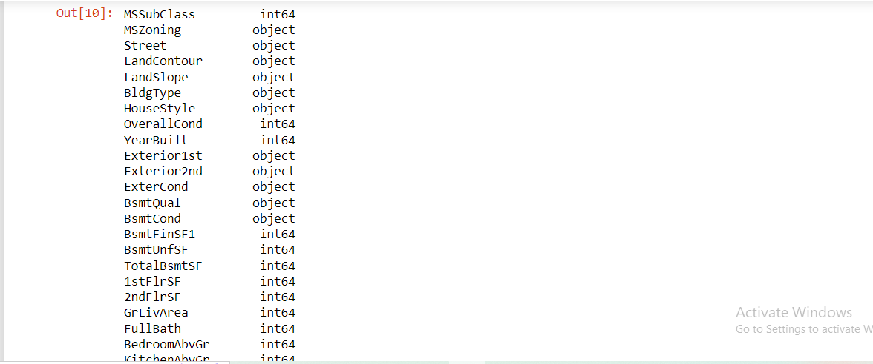
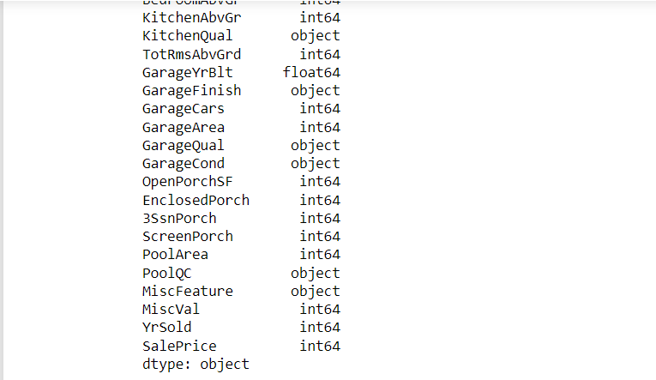

Slide 7
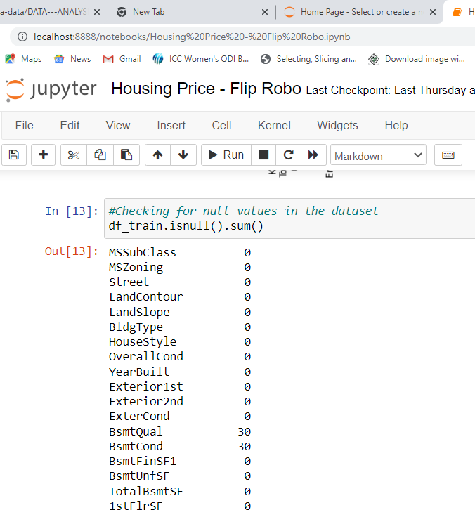
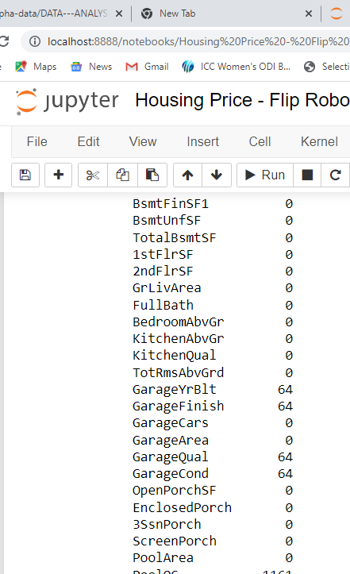

Slide 8
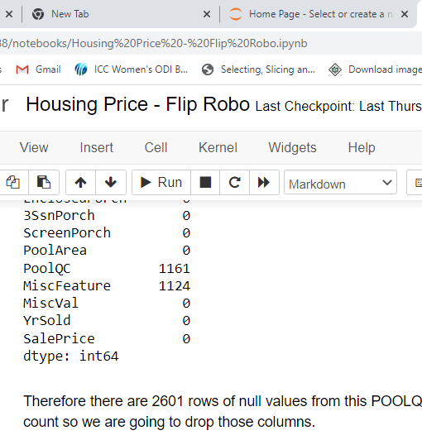
Therefore there are 2601 rows of null values from this “POOLQC” and “Misc Feature” have more null values nearly equal to total count so we are going to drop those columns.
There are 17 OBJECT columns and 13 INT64 columns and 1 FLOAT64 column.
After dropping Misc feature and Poll QC then we can have 39 columns only.

Slide 9
Data Preprocessing Done :-
Data cleaning is usually a necessary steps to build a good dataset for a model for predictions.
“. dropna” function is used to remove the null values.
“LABEL ENCODING” is next step we are implementing here with a Proper code and those steps are useful for transforming the object Data-type to integer data-type.

Slide 10
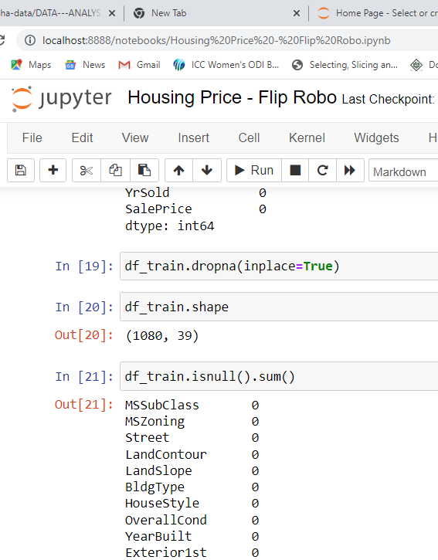

Slide 11
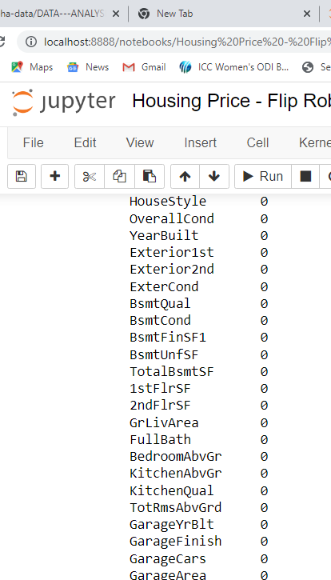

Slide 12
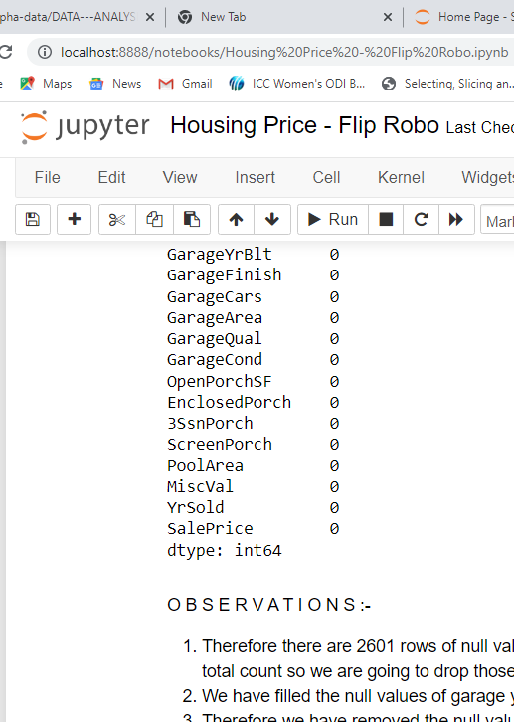

Slide 13
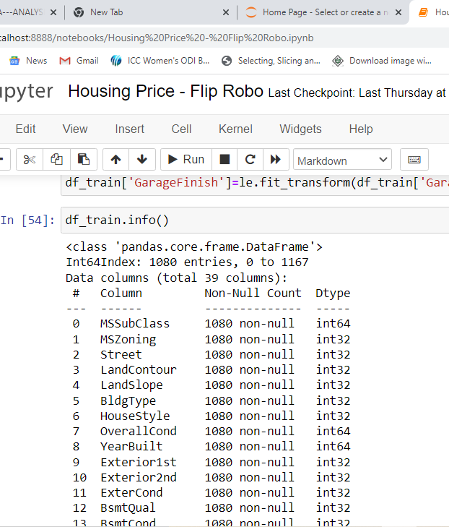

Slide 14
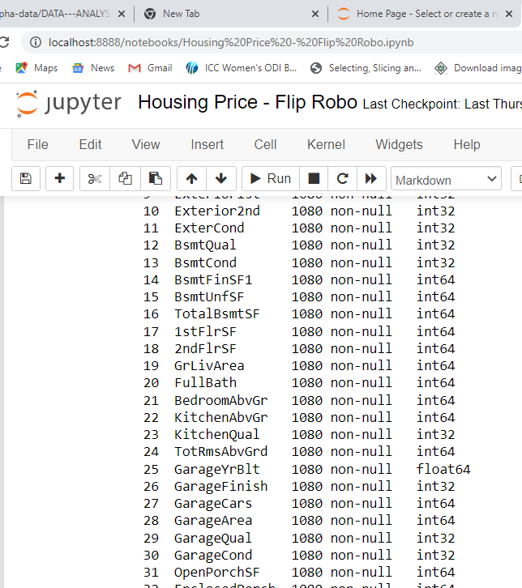

Slide 15
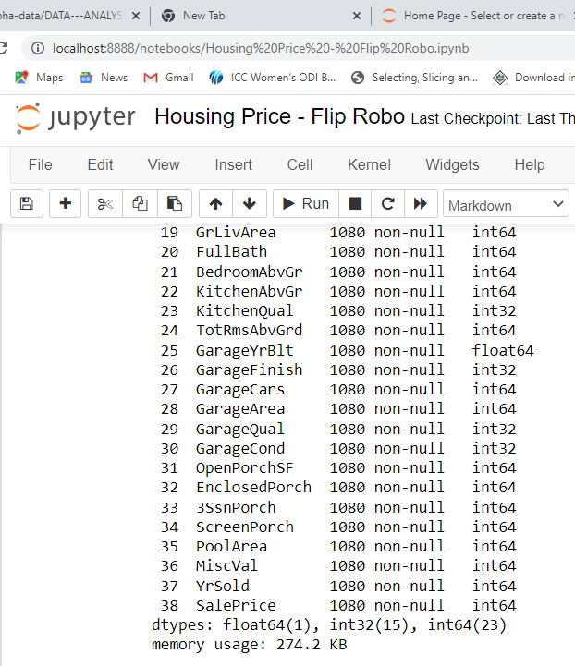

Slide 16
Mathematical/Analytics modeling done
First of all we have transforming the given dataset from .CSV files into the Data Frame by the command, df=pd.read_csv(“Housing _train.csv”).
Before that we have importing the required libraries and are listed below.
1. Pandas 2. Numpy 3. Sklearn etc;
After that we have splitted the dataset into Independent and Dependent variables, By Drop method after knowing the column names.
Describe method shows the Statistical summary of the given dataset and it’s include the total count, mean, Std Deviation, minimum and maximum value, 1st 2nd 3rd quartile.
From quartiles we can found Inter-Quartile range, Quartile range (if necessary).
After some preprocessing we will know the correlation of the variables by using the function “.corr()” in the suffix of dataframe name, so that we will come to know the positive and negative correlation between the variables to understand the necessary variable which influence the house price etc.

Slide 17
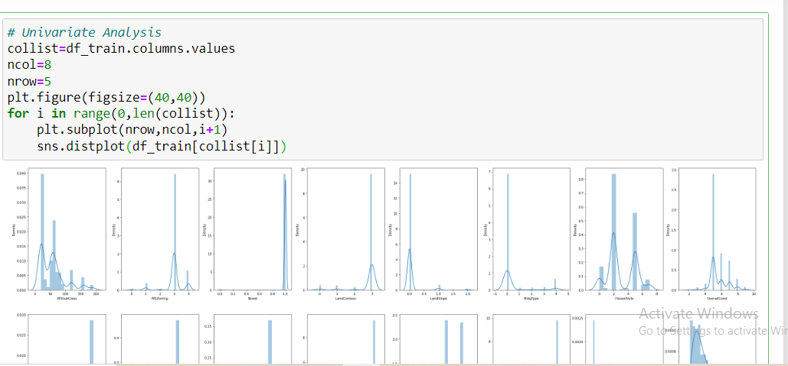
Model Development and Evaluation
VISUALIZATIONS :-
1. Univariate Analysis

Slide 18
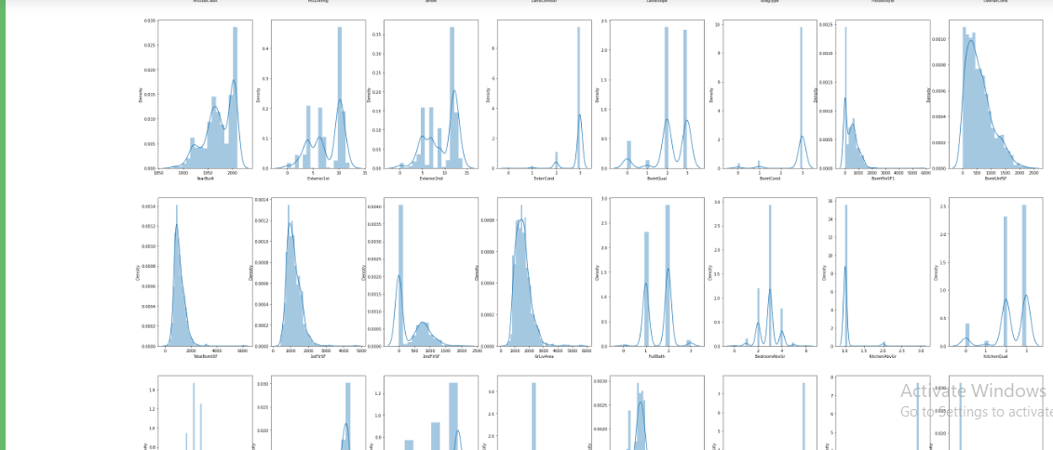

Slide 19
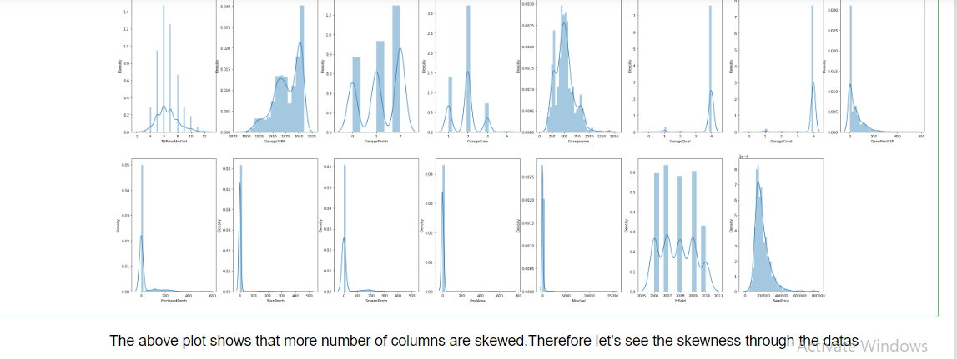

Slide 20
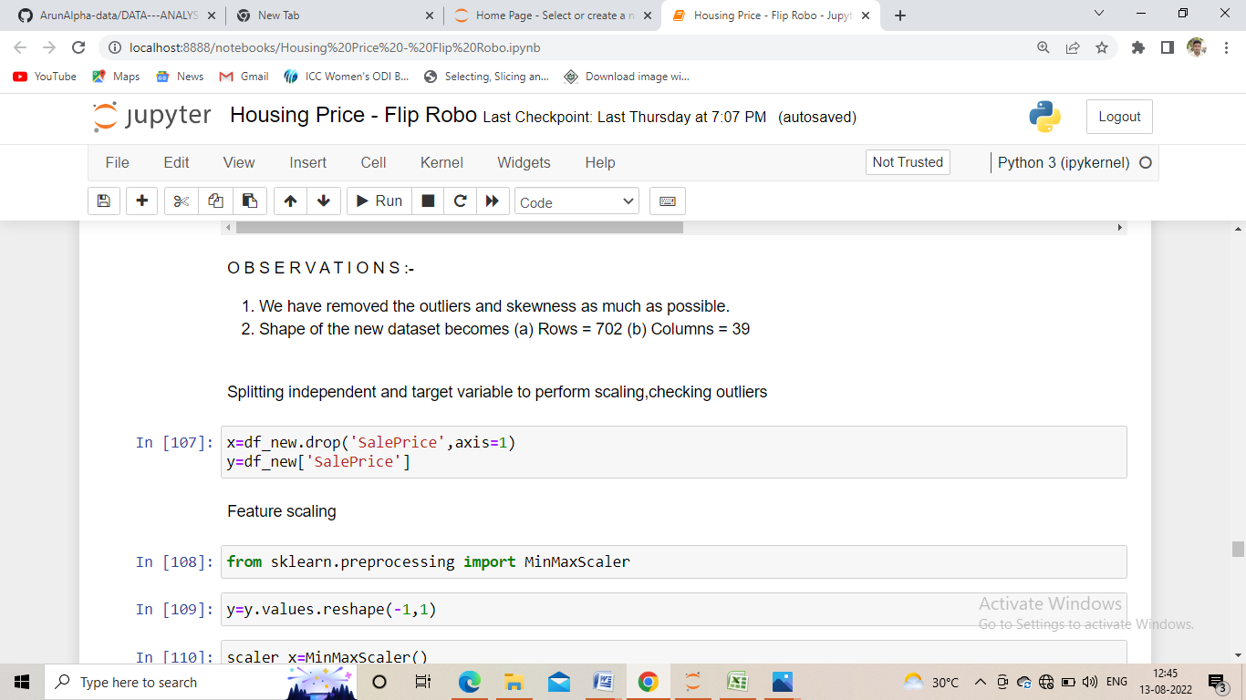
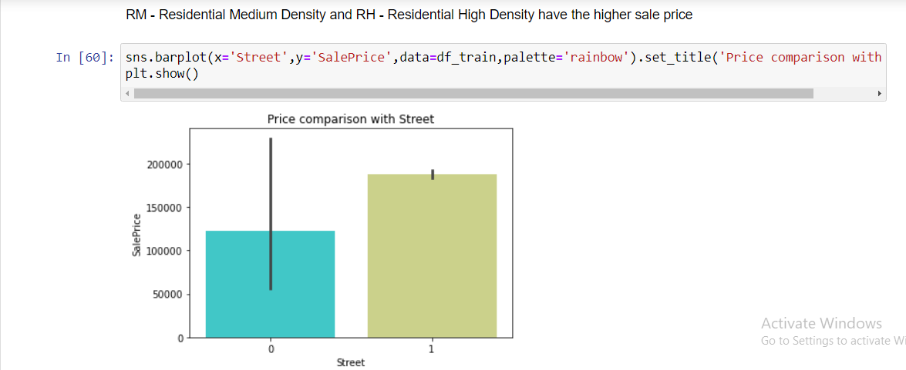
2. Bivariate Analysis

Slide 21
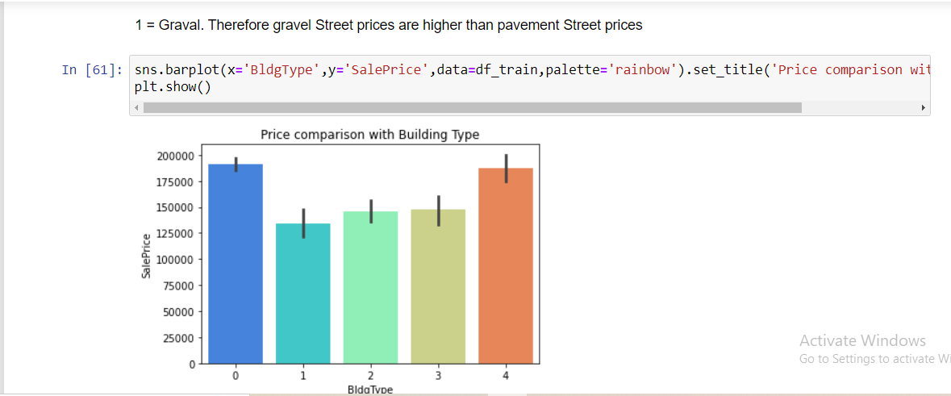

Slide 22
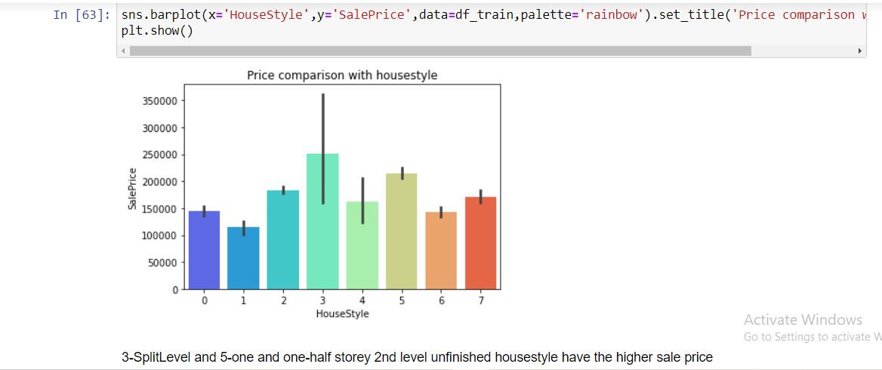
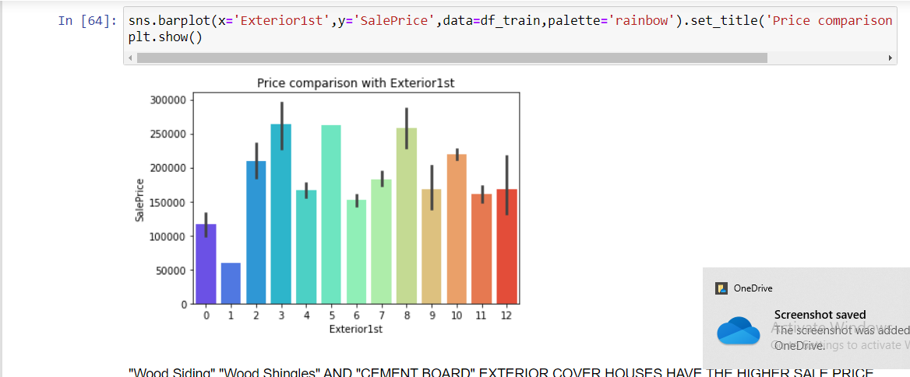

Slide 23
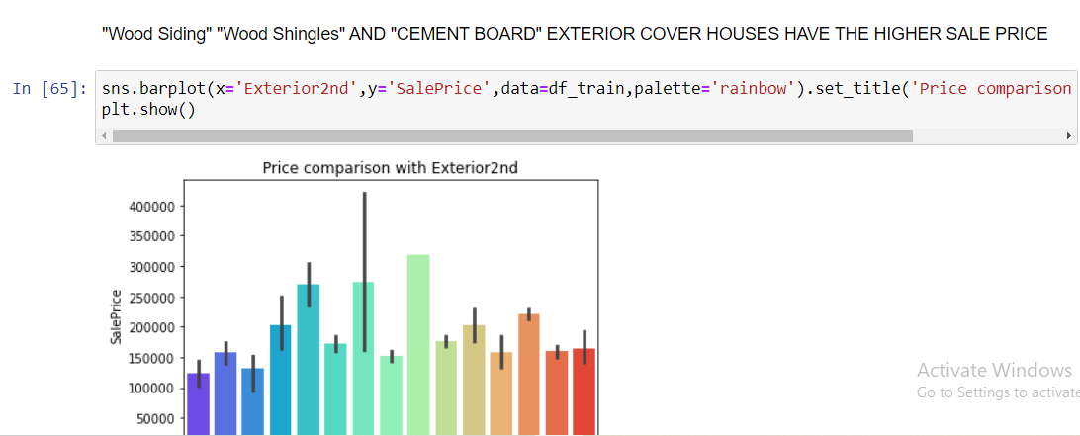
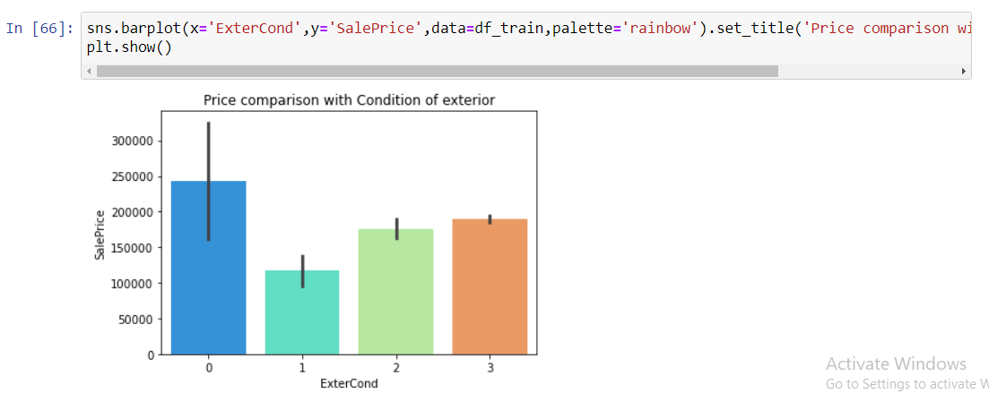

Slide 24
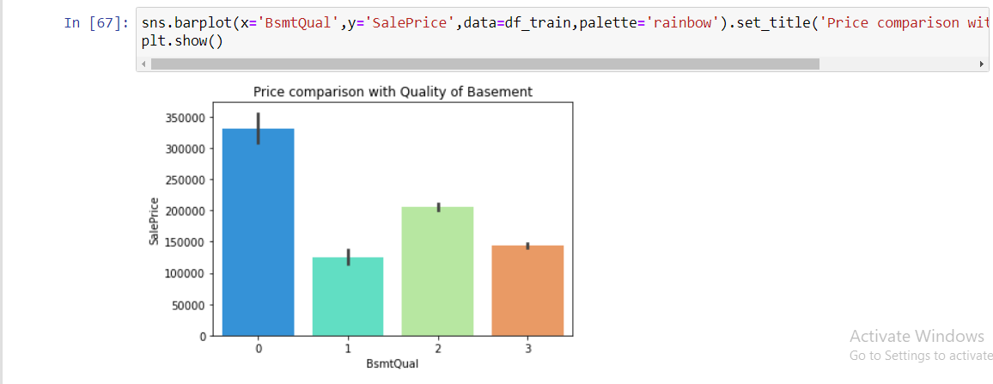
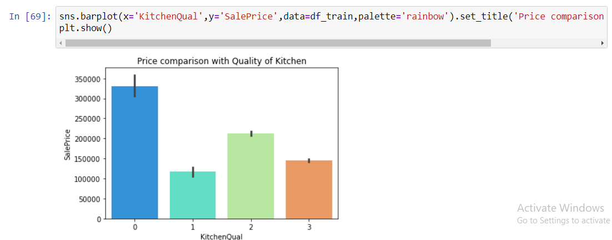

Slide 25
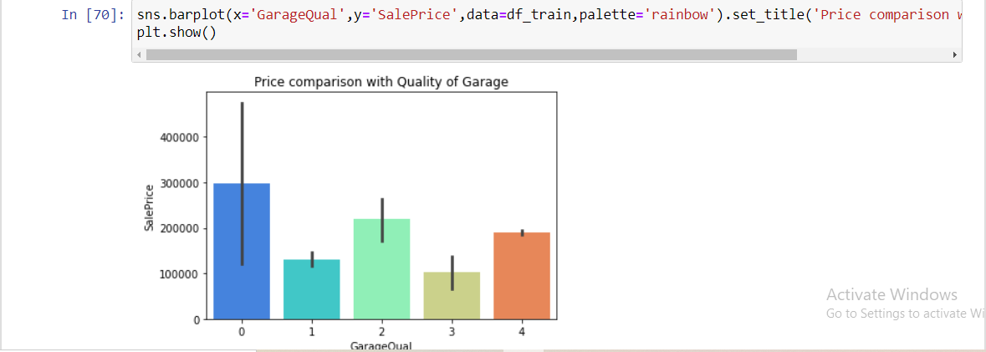
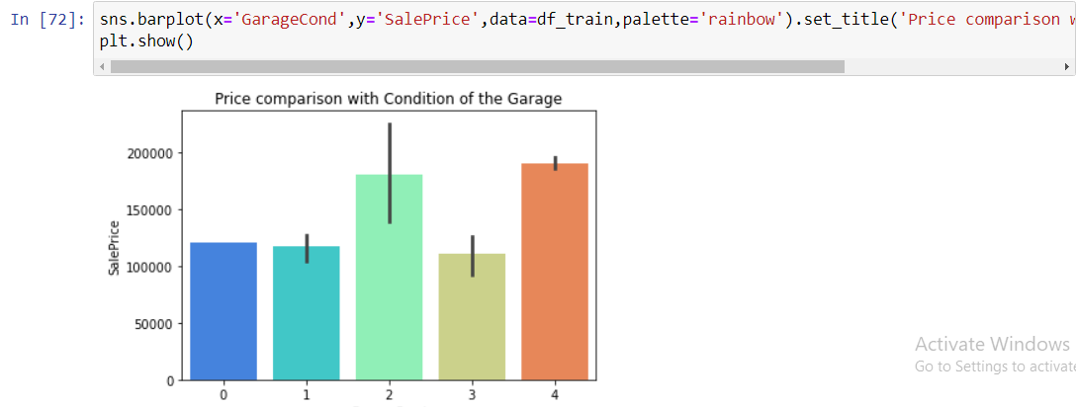

Slide 26
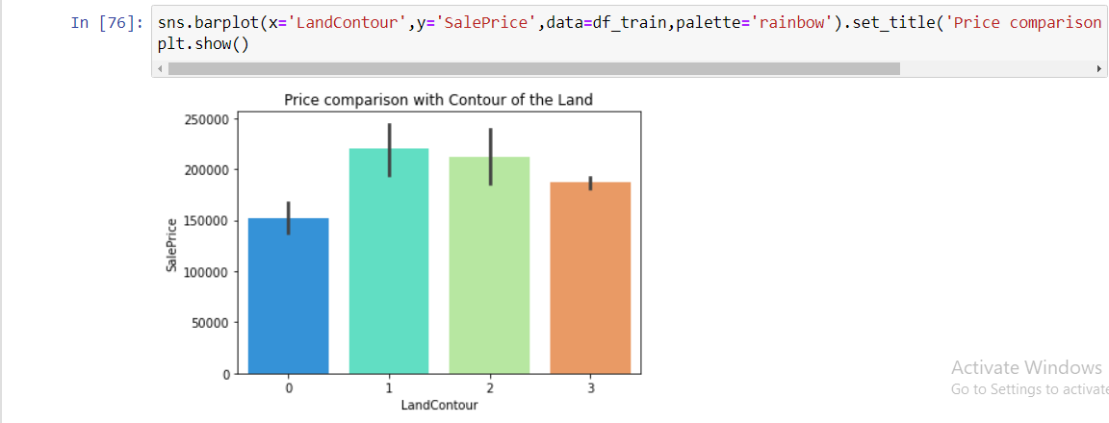
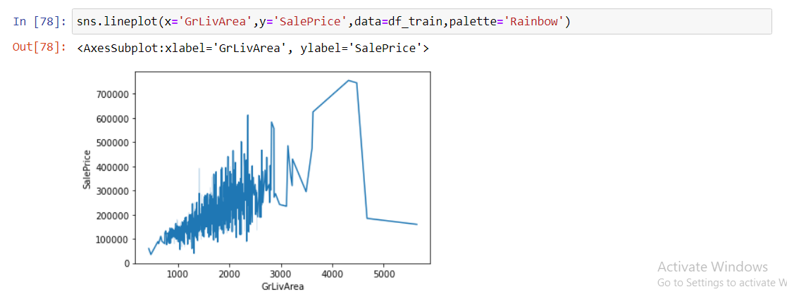

Slide 27
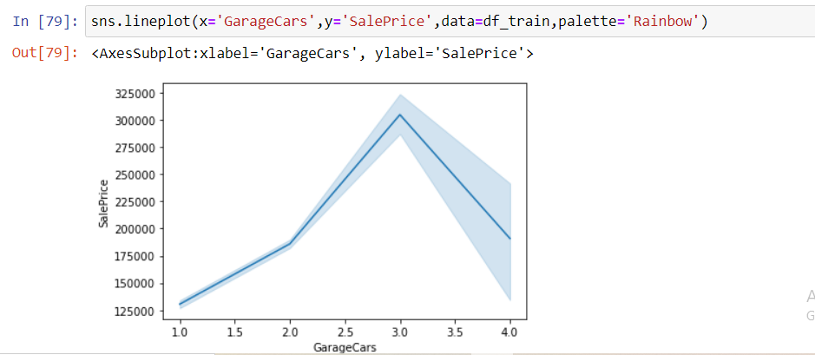
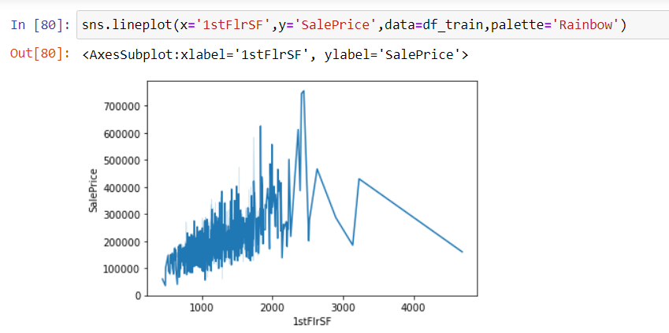

Slide 28
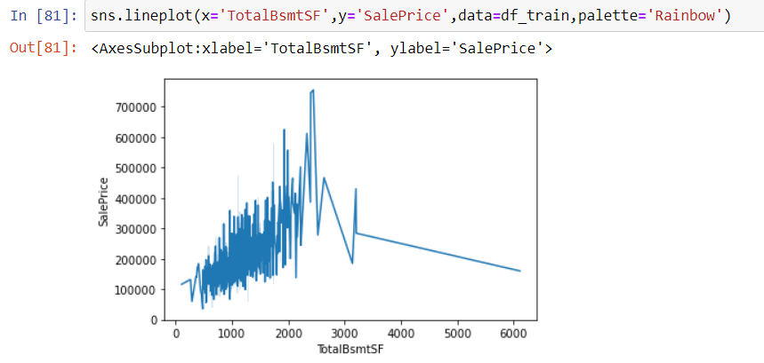
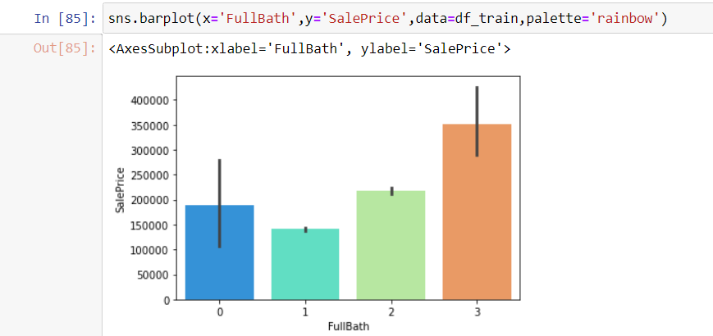

Slide 29
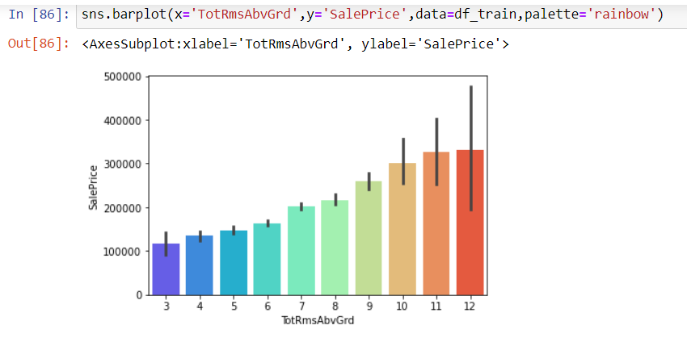

Slide 30
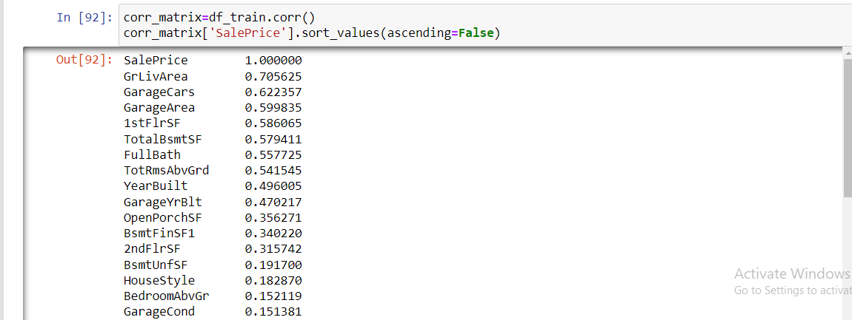
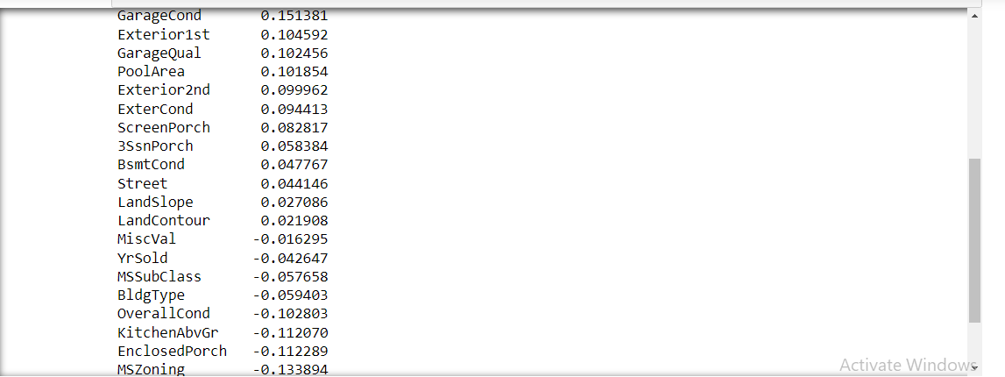
3. Multivariate Analysis

Slide 31
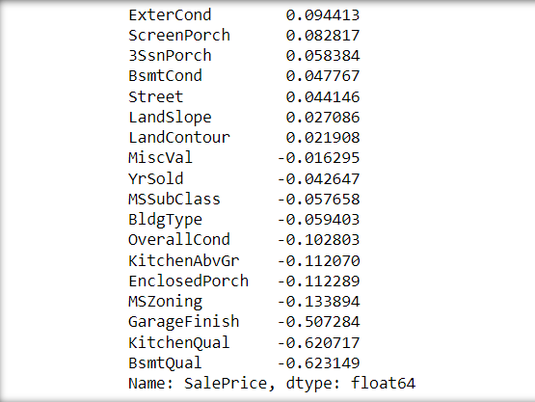

Slide 32
Observations :-
From Univariate analysis we can clearly see that only few columns doesn’t have the skewness. Therefore we should remove that skewness using proper transformation method.
From Bivariate analysis we can see the relation between the Saleprice and the other variable
RM - Residential Medium Density and RH - Residential High Density have the higher sale price.
1 = Graval. Therefore gravel Street prices are higher than pavement Street prices.
1fam = Single family detached and 2fmcon = Two family Conversion(originally built as one-family dwelling) building types have the higher sale price.
3-SplitLevel and 5-one and one-half storey 2nd level unfinished housestyle have the higher sale price.

Slide 33
"Wood Siding" "Wood Shingles" AND "CEMENT BOARD" EXTERIOR COVER HOUSES HAVE THE HIGHER SALE PRICE.
"Brick Face" , "Wood Shingles" AND "Plywood" Exterior covering on house have the higher sale price.
AVERAGE/TYPICAL present condition of exterior material have the higher sale price.
Good Quality of height of the basement have the higher sale price.
GOOD condition of the basement have the higher sale price.
TYPICAL/AVERAGE Quality of the Kitchen have the higher Sale Price.
AVERAGE/TYPICAL quality of the garage have the higher sale price.

Slide 34
GOOD AND EXCELLENT condition of the garage have the higher sale price.
UNFINISHED INTERIOR of the Garage have the higher sale price.
Bnk - Quick AND Significant rise form the street grade to building, HLS - Significant slope from side to side,These Land Contour have the Higher Sale Price.
. (a) GrLivArea - LIVING AREA Square Feet above Ground | GarageCars = Size of Garage in Car Capacity | TotRmsAbvGrd = TOTAL Number OF Rooms ABOVE GROUND | FullBath = FULL BATHROOMS ABOVE GROUND.
(b)IF these variables increases then Value of the houses also increses.

Slide 35
1STFlrSF - 1st floor square feet | TotalBsmtSF - TOTAL BASEMENT AREA IN SQUARE FEET
(c) THESE Variables has the steep increse in square feet upto 2000 - 2500 BUT after that there is a SLUMP in the Sale price of the houses
(d) This shows that People are not preffering the LARGER AREAS IN BASEMENT AND 1ST FLR AREA.
From this correlation values we can clearly see that “GrLivArea” has strong positive correlation with SalesPrice follwed by “GarageCars”,”GarageArea”,”1stFlrSF”,”TotalBsmtSF”,”FullBath”, ”TotRmsAbvGrd”. ”LandContour” has weak positive correlation with “SalesPrice”.
” MiscVal” has strong negative correlation with SalesPrice and “BsmtQual” has weak negative correlation with SalesPrice.

Slide 36
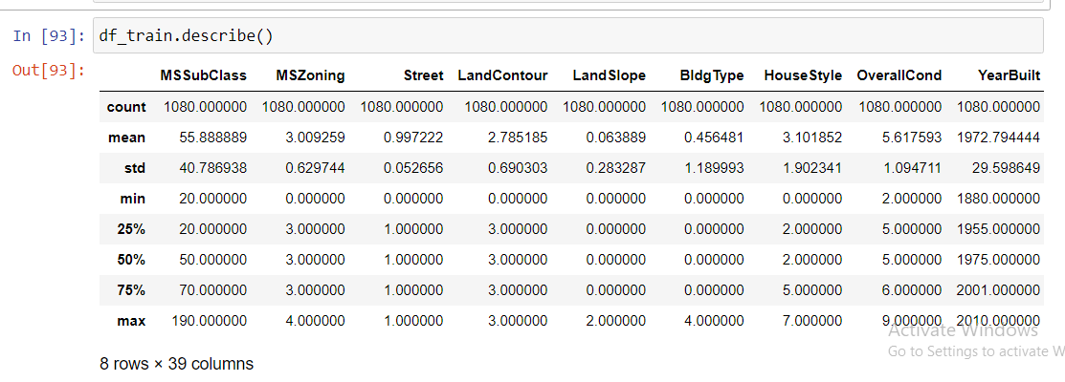
.describe() mini statistical analysis.
OUR next step is to remove the skewness and outliers from our dataset, for this we are using ”LOG transformation” method for removing skewness and and “ZSCORE” for removing outliers.

Slide 37
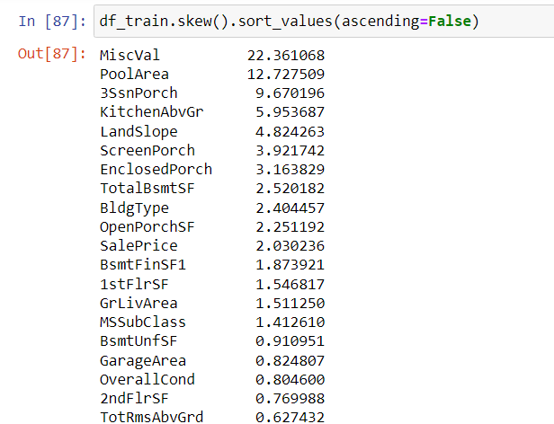

Slide 38
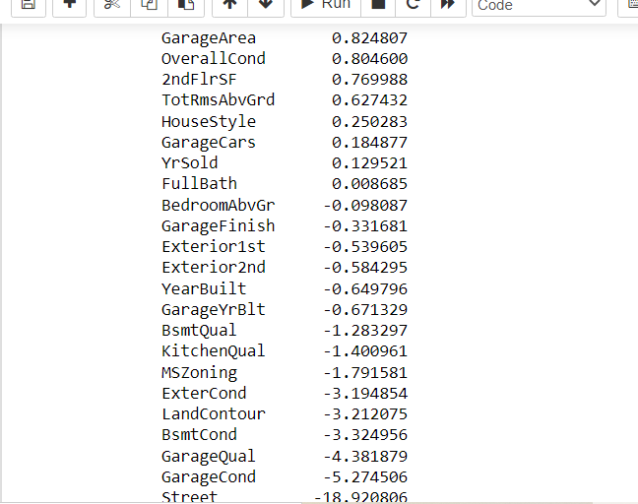

Slide 39
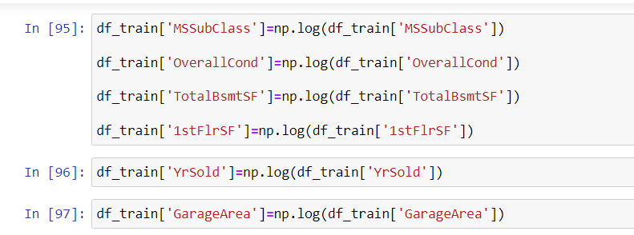
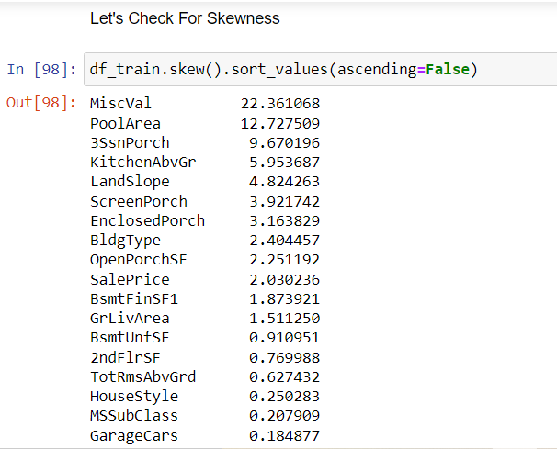

Slide 40
We haven’t removed the negative skewness as it affects the dataset and we have removed only a particular skewness because of comparing the skewness variables with correlation and the variables with negative correlation and has high skewness has been removed from our training dataset.

Slide 41
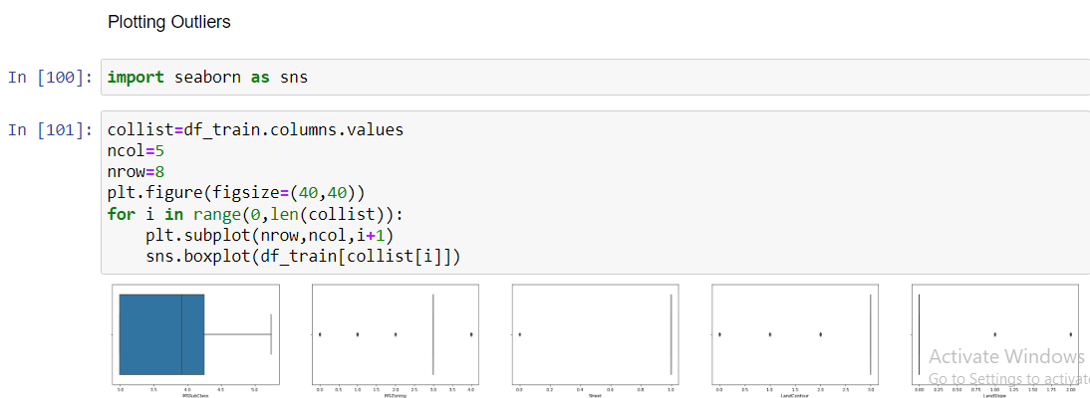
Plotting Outliers

Slide 42
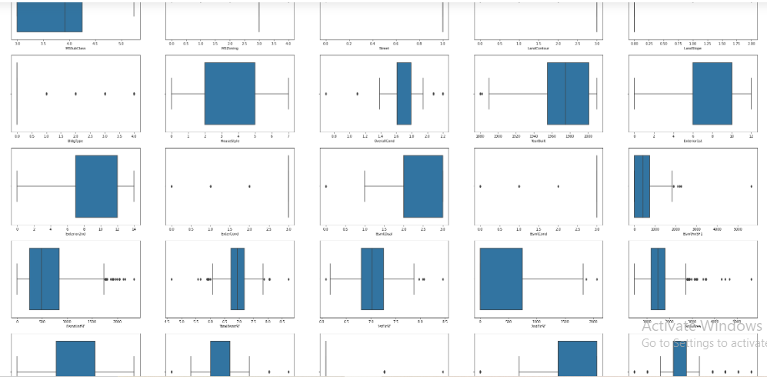

Slide 43
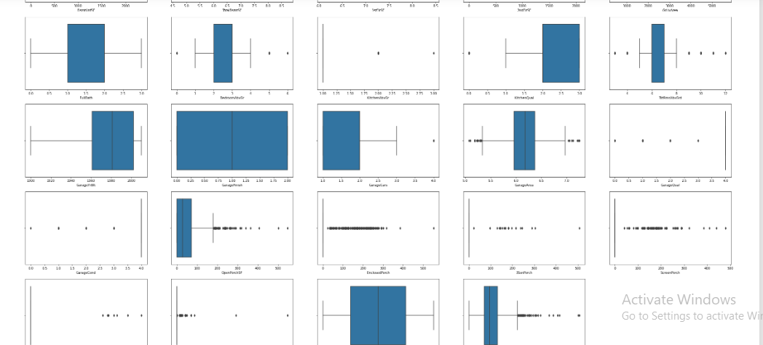

Slide 44
1. Housestyle , FullBath , GarageFinish , YrSold , GarageCars, MSSubclass , GarageFinish, GarageYrBlt, KitchenQual, 2ndFlrSF, Exterior2nd, BsmtQual, Exterior1st, YearBuilt, MSSUBCLASS these columns doesn't have the outliers.
2. Let's remove outliers in upcoming steps.

Slide 45
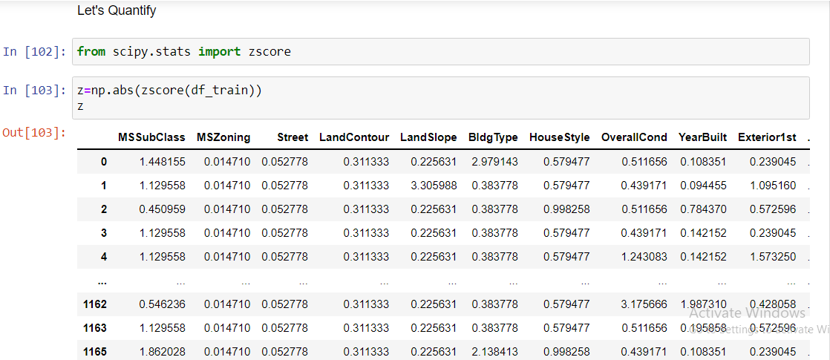
Removing Outliers :-

Slide 46
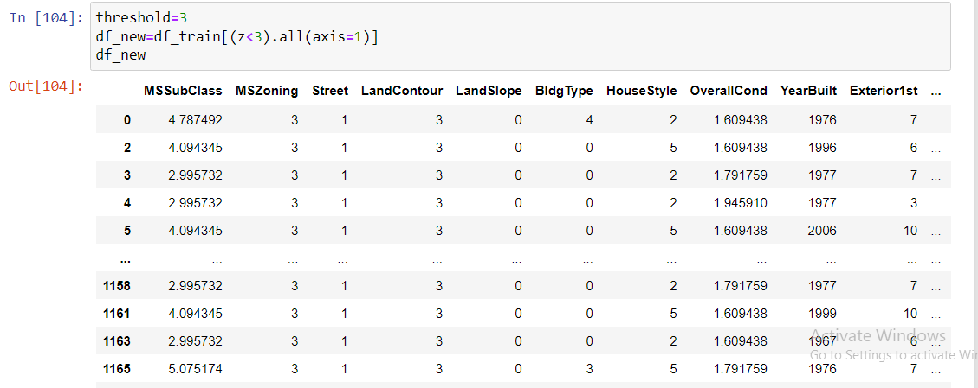
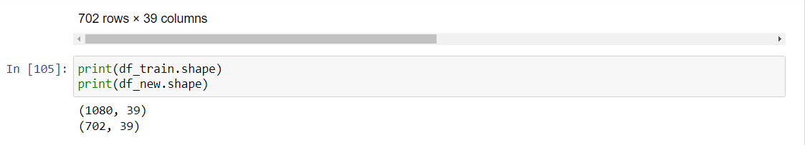

Slide 47
After removing the outliers our dataset becomes
1. Rows = 702
2. Columns = 39
Scaling the dataset is being used to fit the values equally so that we can perform our analysis better.
Objective behind using this Scaling techniques is that the range of data’s in our dataset is varying high. Example if we take the target variable the range starts in lakhs and ends in lakhs but if we see other independent variable its range is within 20.
Here MIN-MAX scaling technique is used because it’s a Regression problem not a classification.

Slide 48
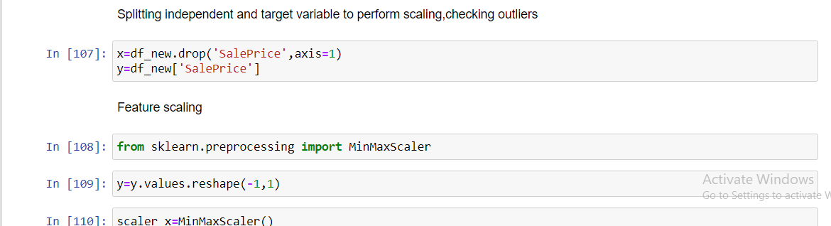
Testing of Identified Approaches (Algorithms)
1. Train_test_split() is used to split the dataset into train and test for model building.
2. Test_size=0.20 and random_state = 1.

Slide 49
Run and Evaluate selected models
Models using here are listed below
Linear Regression.
Random Forest Regressor.
Decision Tree Regressor.
Support Vector Regressor
SGD Regressor.

Slide 50
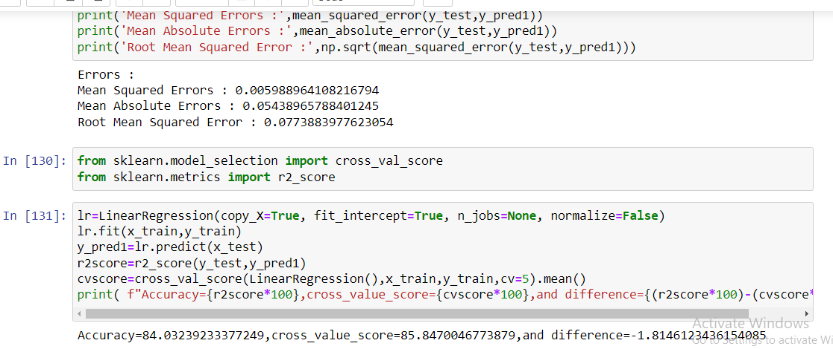
Metrics which are used here is as follows :-
1. Mean Squared Error.
2. Mean Absolute Error.
3. R2 score.
4. Root Mean Squared Error.

Slide 51
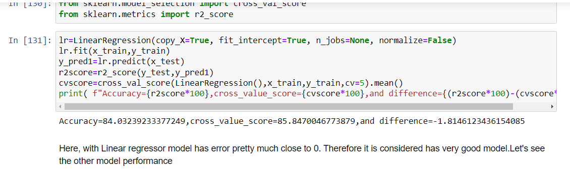
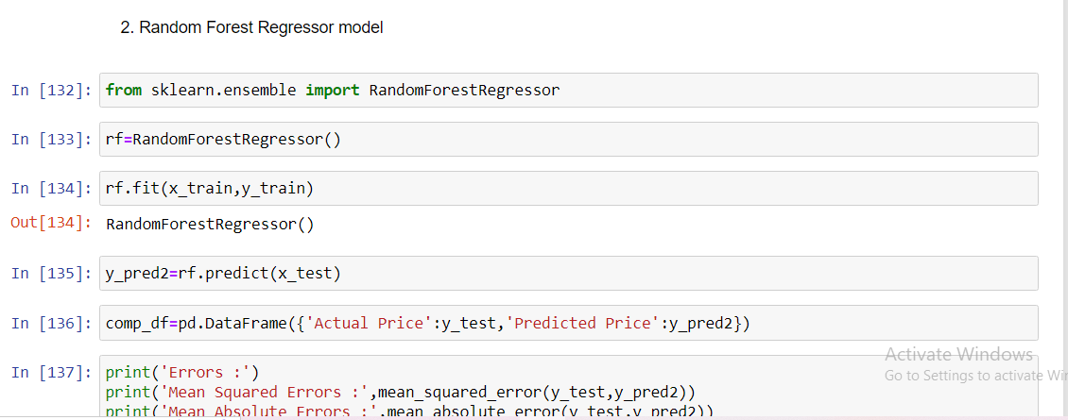

Slide 52



Slide 53



Slide 54
r2score=r2_score(y_test,y_pred4)
cvscore=cross_val_score(svr,x_train,y_train,cv=5).mean()
print( f"Accuracy={r2score*100},cross_value_score={cvscore*100},and difference={(r2score*100)-(cvscore*100)}")
Accuracy=85.32513356452107,cross_value_score=84.16648161246837,and difference=1.1586519520526934

Slide 55



Slide 56

SAVING THE MODEL

Slide 57

Predictions on Test Data

Slide 58


Slide 59
Conclusion Remarks
We could see that using "Support Vector Regression" gives a most promising predictions when compared with all other Models.
Variables which influence the Sales Prices are “GrLivArea”, “GarageArea” , “GarageCars”, “1stFlrSF”, “TotalBsmtSF” ,“FullBath” , “TotRmsAbvGrd” , “LandContour”.

