Slide 1

Automated Network Attack Traffic Simulation
AgentRed:
Rizwan Anver
Jubal Johnson
Jomon Joy

Slide 2

Table of Contents
1.0 Introduction: Network Attack Simulation
2.0 Evolution of Network Traffic Attack Generation
3.0 AgentRed Purpose
4.0 How AgentRed Works
5.0 AgentRed Workflow
6.0 Limitations of Existing Tools
7.0 Why Choose AgentRed
8.0 Financial and Environmental Considerations
9.0 Next Steps
10.0 Conclusion

Slide 3
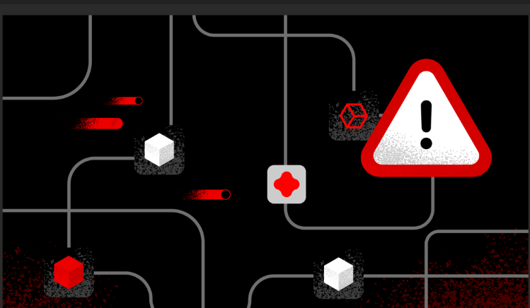
1.0 Introduction: Network Attack Simulation
Network Attack Simulation
Importance of Network Simulation (Organizations)
Challenges of Modern Network Attacks
(Complexity/Encryption/DDos
/Smurf/Ping of Death)
[1]

Slide 4
2.0 Evolution of Network Traffic Attack Generation
Rule-Based
Scripted
ML-Based
Agent-Based
Every input is Manual
Program based, so very efficient since not every input is needed
Machine Learning: System uses data to find the best way in
Agent-Based: The use of LLM/ Reinforcement learning to choose the best situation regardless of problem (AgentRed)
[1][7]

Slide 5

3.0 AgentRed Purpose
Automates Network Attack Traffic Generation
Improves Organizational Security
Replaces Legacy Systems
[1]

Slide 6
4.0 How AgentRed Works
Receives User Commands
Selects or Trains LoRA Adapter(add-on)
Searches For Attack Information
Generates Attack Packets
[1]

Slide 7
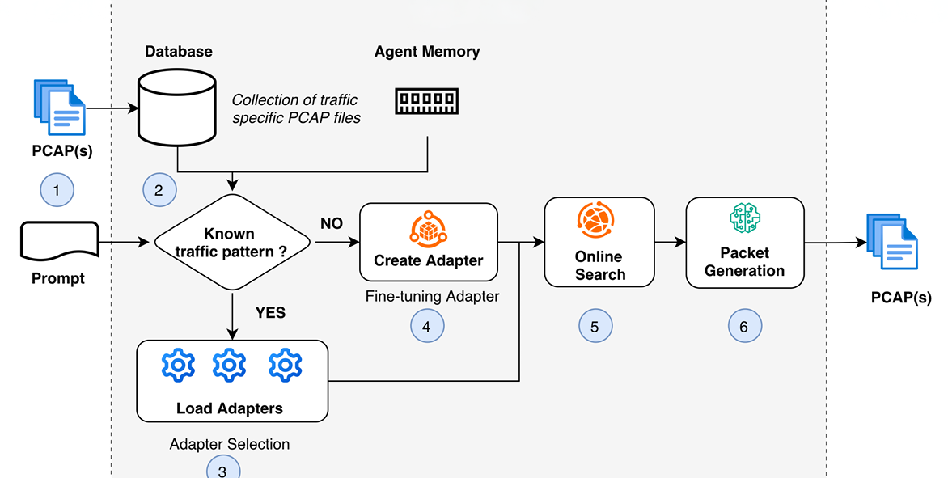
5.0 AgentRed Workflow
Figure 1: Workflow [1]

Slide 8

6.0 Limitations of Existing Tools
Traffic Generation Scope
(Hping3)
High maintenance/manual work (Scrapy)
Static Models (NetGPT)
Complex Setups & Resources
(TrafficGPT)
[1][3][4][6]

Slide 9
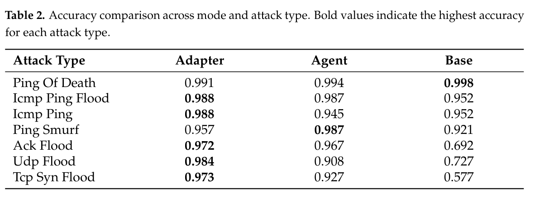
7.0 Why Choose AgentRed?
Lightweight(< 1B parameters)
Minimal Setup
Minimal Human Configuration
Can Autonomously train LoRAs
98% Accuracy with LoRAs
95.2% Accuracy with Base Model
Figure 2: Accuracy Comparison [1]
[1][2]

Slide 10

8.0 Financial & Environmental
Considerations
Cost effective on Hardware (light weight)
No Heavy LLMs integration (GPUs, Electricity, Water)
Small Model = Lower Energy Consumptions
LoRAs adapters = Cheap and Efficient
Reduce Labor Costs
[1][5]

Slide 11
9.0 Next Steps
Simple Attack patterns (explored only)
Multi-stage interactions (not explored)
Long and Realistic Scenarios (struggle)
Goal: More Opportunities for Cyber Security Environment
[1]

Slide 12
10.0 Conclusion
Automates Attack Traffic Generation
Improves Security Testing
Builds a Strong Foundation for Future Development
[1]

Slide 13

ANY QUESTIONS?

Slide 14
References
[1] K. A. Koffi, K. Lucke, E. D. Darko, T. Berhanu, R. A. Borrelli, and C. Kolias, “AgentRed: Towards an Agent-Based Approach to Automated Network Attack Traffic Generation,” Algorithms, vol. 19, no. 1, p. 43, Jan. 2026. [Online]. Available: https://doi.org/10.3390/a19010043. Accessed: Apr. 5, 2026.
[2] S. Sharma, “What is Low Rank Adaptation (LoRA)?,” GeeksforGeeks, [Online]. Available: https://www.geeksforgeeks.org/deep-learning/what-is-low-rank-adaptation-lora. Accessed: Apr. 5, 2026.
[3] X. Meng, C. Lin, Y. Wang, and Y. Zhang, “NetGPT: Generative Pretrained Transformer for Network Traffic,” arXiv:2304.09513 [cs.NI], version 3, Aug. 28, 2025. [Online]. Available: https://arxiv.org/abs/2304.09513. Accessed: Apr. 5, 2026.
[4] GeeksforGeeks, “hping3 command in Linux.” [Online]. Available: https://www.geeksforgeeks.org/linux-unix/hping3-command-in-linux. Accessed: Apr. 5, 2026.
[5] Araz Bozkurt, “AI’s Thirst, AI’s Heat, AI’s Waste: Exposing the Hidden Environmental Impact of Every Artificial Intelligence Interaction.” [Online]. Available: https://openpraxis.org/articles/10.55982/openpraxis.17.4.1058. [Apr. 5, 2026].
[6] S. Sharma, “Developers – How To: Crawling the Web with Scrapy,” Open Source For You, vol. 5, no. 1, pp. 1–5, Sept. 2017. [Online]. Available: https://go-gale-com.stlawrence.idm.oclc.org/ ps/i.do?p=ITOF&u=ko_acd_slc&id=GALE|A502813831 Accessed: Apr. 5, 2026.
[7] Z. Zhang, S. Kong, T. Xiao, A. Yang, “A Network Intrusion Detection Method Based on Bagging Ensemble,” Symmetry, vol. 16, no.7, July 2024,[Online]. Available: https://research-ebsco-com.stlawrence.idm.oclc.org/linkprocessor/plink?id=2e070e15-d142-3aae-88c2-7ebab4966e21. Accessed: Apr.5, 2026.

