Slide 1
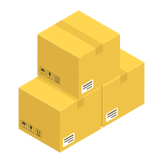



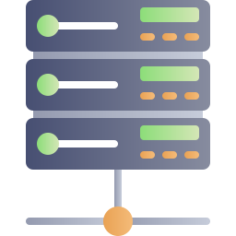

Local Resources
Remote Resources
Dependencies in Local File System
Dependencies Hosted in the Cloud
Get
Get
Local Repository
Fetch
Remote Repository
Access
Fetch
Access
Build
Push/Build
Release
Developer
Dev Environment
CI Server
Production

