Slide 1

Azure Monitor
Stefan Roth | MVP
http://stefanroth.net
@stefanroth_net
Experts Live Café Switzerland:
http://itproch.expertslive.café

Slide 2
Why Should We Care?
AWS
Private
IT environment should deliver optimum performance for end users.
Improve productivity and performance.
Detect problems to prevent disasters.
Reduce downtime and business losses
Plan and budget for IT upgrades.

Slide 3
Monitoring Services on Azure
Azure Monitor
Azure platform’s core inbuilt monitoring and alerting services which includes standard Metrics, Alerts, Autoscale, Email Notifications and Audit Logs.
Application Insights
Provides application monitoring & logging for your Web Apps, Cloud Services and applications.
Log Analytics (OMS)
Log Analytics, part of the Operations Management Suite (OMS) ingests data from your Azure servers and provides rich ‘global’ view & advanced log search based alerting capabilities.

Slide 4

What’s Azure Monitor?
Built-In monitoring support for Azure resources
Out-of-box metrics and logs (Activity logs, Diagnostic Logs, Metrics are part of Azure Monitor)
Alert rules to get notified & take automated actions
APIs for 3rd party integration
Enables advanced monitoring and analytics experiences

Slide 5






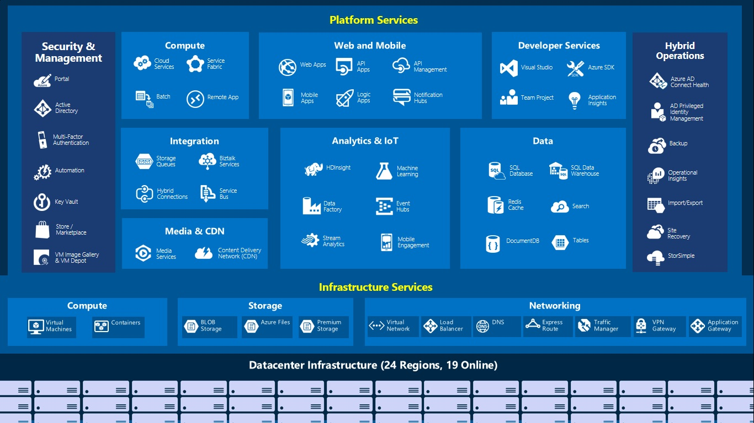
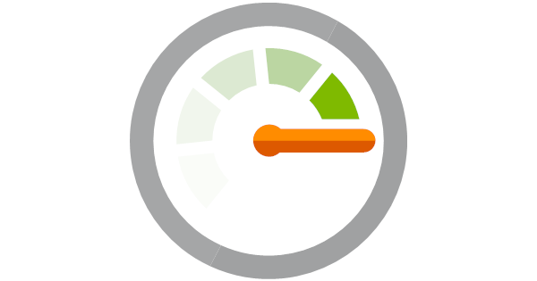
Monitoring Pipeline
Activity Logs
Diagnostic Log
Metrics
Azure Monitor

Slide 6
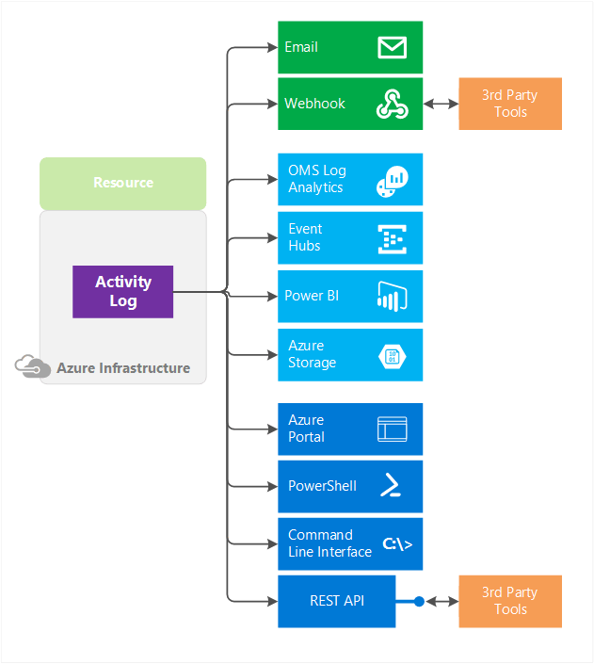
Activity Log
Actions “Who, what, when”
Details on operational write operations (PUT, POST, DELETE)
Contains log of management operations on resources
90-day data retention
Built-in analytics via Log Analytics
Action, caller, status & time stamp (JSON)

Slide 7
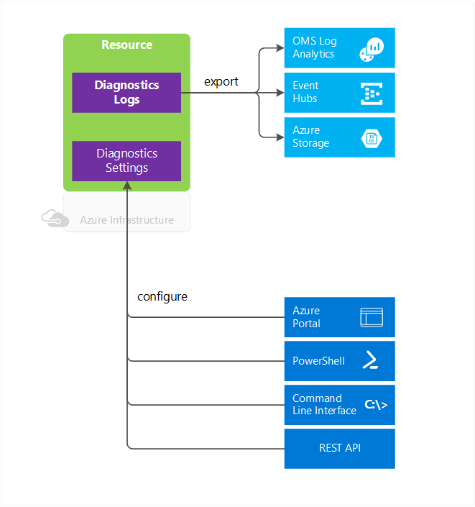
Diagnostic Log
Depending on resource type
VM e.g Windows events, IIS logs
Storage Account e.g blob, table and queue logs
Details of operation
of the resource
No retention time
Route to OMS Log Analytics for advanced analytics
Formats like JSON, CSV…
NEW: Configure Multiple Diagnostic Settings Per Resource
https://azure.microsoft.com/de-de/blog/azure-monitor-multiple-diagnostic-settings/

Slide 8
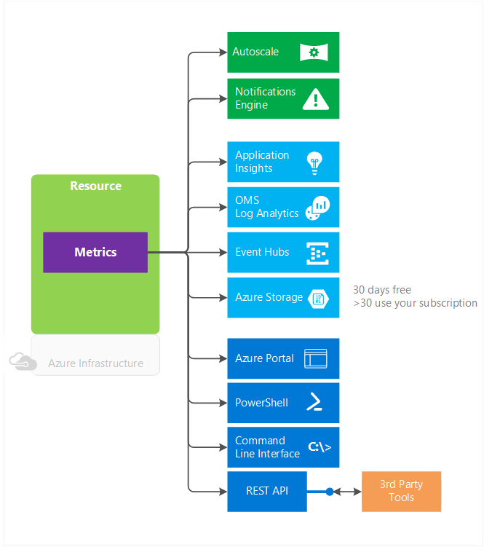
Metrics
More Azure resources now provide metrics
1-minute granularity
30-day data retention
No diagnostics setup (or storage account) required
Consume via Portal or REST API
Counters like % CPU, IOPS, # Messages
NEW: Metrics Explorer
https://docs.microsoft.com/en-us/azure/monitoring-and-diagnostics/monitoring-metric-charts

Slide 9

Azure Diagnostics Extension
Data Source | Description
Performance counters | Operating System and custom performance counters
Application Logs | Trace messages written by your application
Windows Event logs | Information sent to the Windows event logging system
.NET Event Source | Code writing events using the .NET EventSource class
IIS Logs | Information about IIS web sites
Manifest based ETW | Event Tracing for Windows events generated by any process
Crash dumps | Information about the state of the process in the event of an application crash
Custom error logs | Logs created by your application or service
Azure Diagnostic infrastructure logs | Information about Diagnostics itself
Web and Worker Roles
Azure Virtual Machines (Windows)
Service Fabric

Slide 10
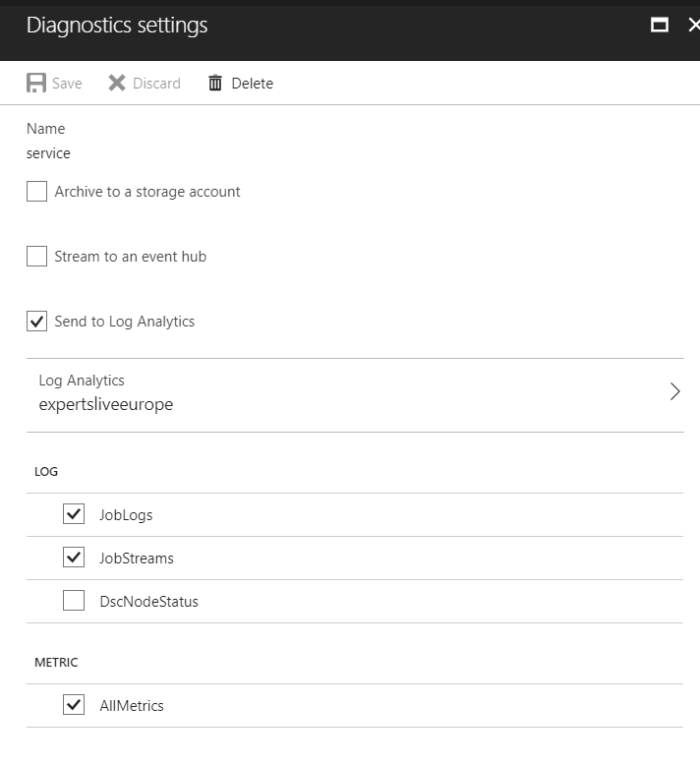
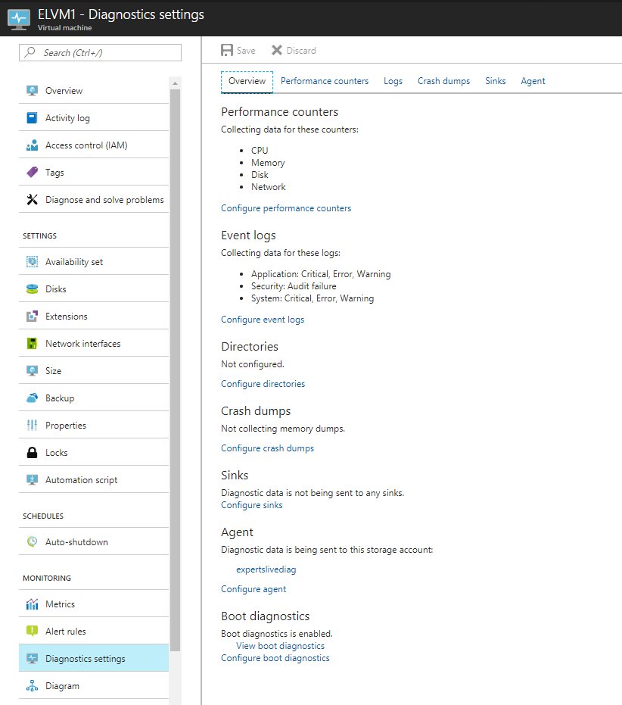
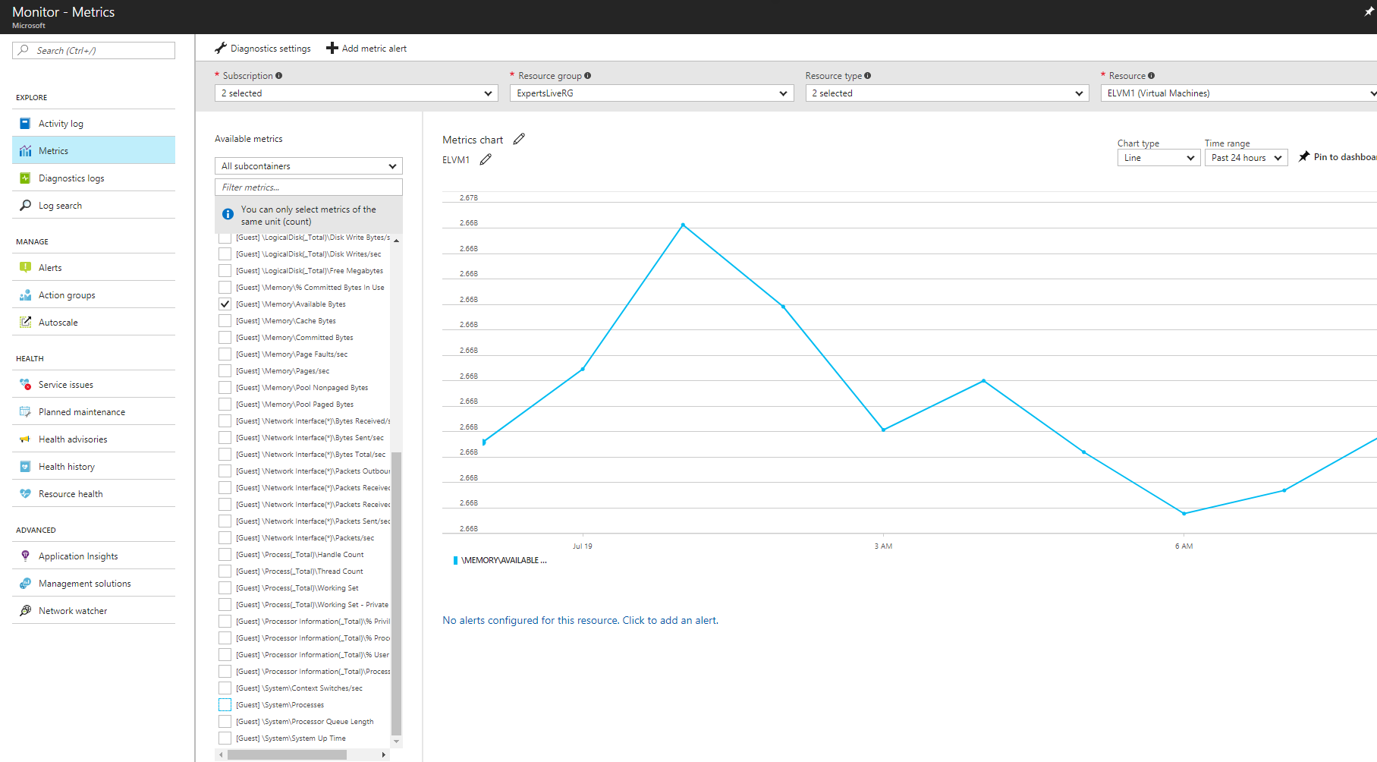
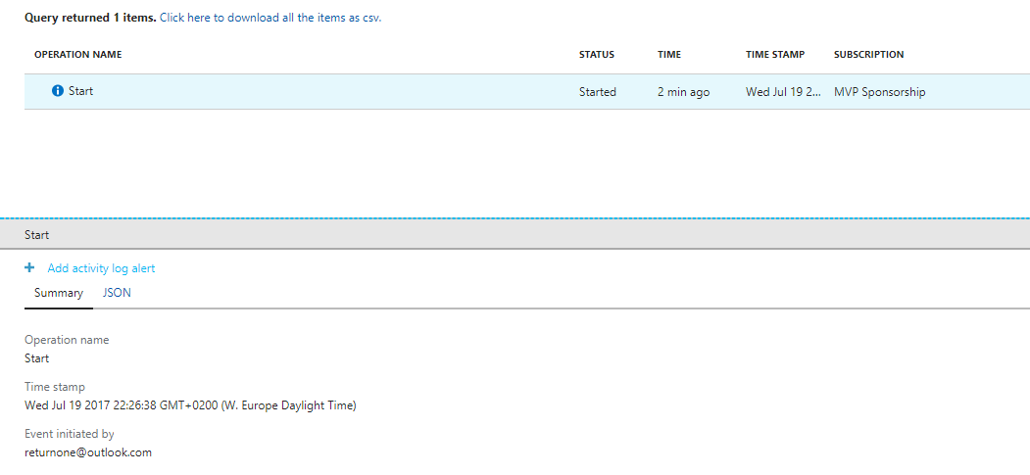
Examples

Slide 11
Metrics Explorer (Preview)
Analysis across different resource types, multiple resource groups, and subscriptions.
Split a metric by dimension to visualize how different segments of the metric compare against each other.
Filter metric with multiple dimensions.
Customize and pin charts to dashboard

Slide 12

DEMO Metrics Explorer

Slide 13
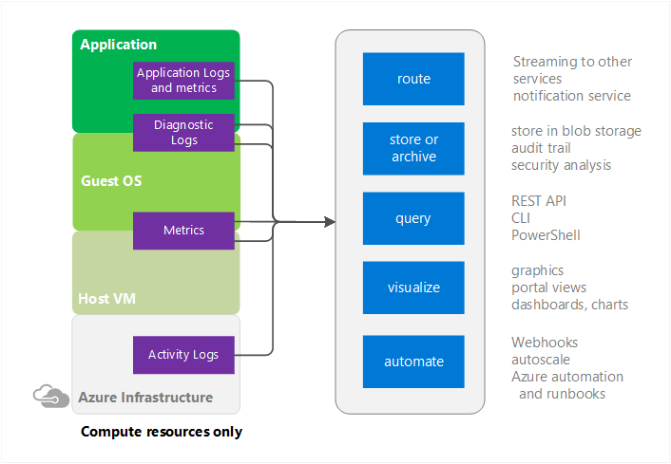
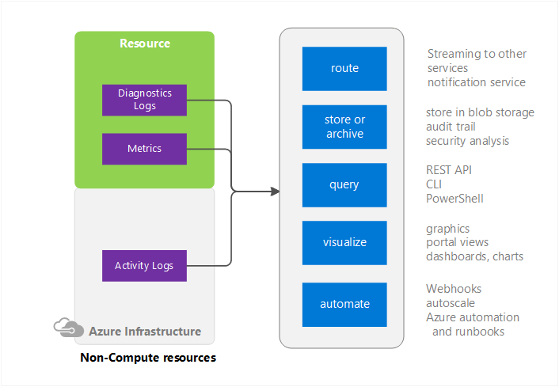
Compute Versus Non-Compute Resources

Slide 14
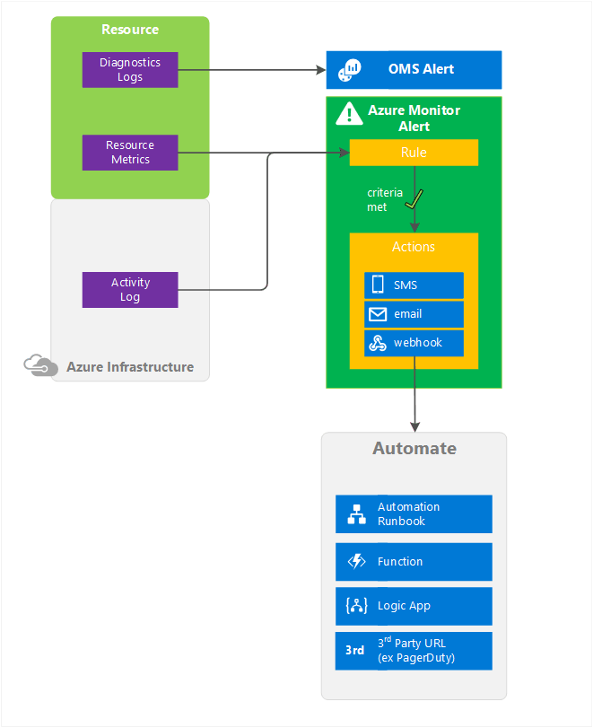
Alert Rules
Manage all alerts in one place
Alert on platform, app and custom metrics with email and webhook notifications
NEW: AzureApp
NEW: ITSM
Alerts on Activity log & Service Health notifications
Manage alerts easily using Action Groups
NEW: Near Real-Time Alerts
https://docs.microsoft.com/en-us/azure/monitoring-and-diagnostics/monitoring-near-real-time-metric-alerts

Slide 15
Near Real-Time Alerts (Preview)
Improved Latency - Near real-time metric alerts can monitor changes in metric values as soon as 1 min.
More control over metric conditions - Near real-time metric alerts allow users to define richer alert rules. The alerts now support monitoring the maximum, minimum, average, and total values of the metrics.
Combined monitoring of multiple metrics - Near real-time metric alerts can monitor multiple metrics(currently two) with a single rule. Alert gets triggered if both the metrics breach their respective thresholds for the specified time period.
Modular notification system - Near real-time metric alerts use action groups. This functionality allows users to create actions in a modular fashion and reuse them for many alert rules.

Slide 16
DEMO Near Real-Time Alert Rule

Slide 17
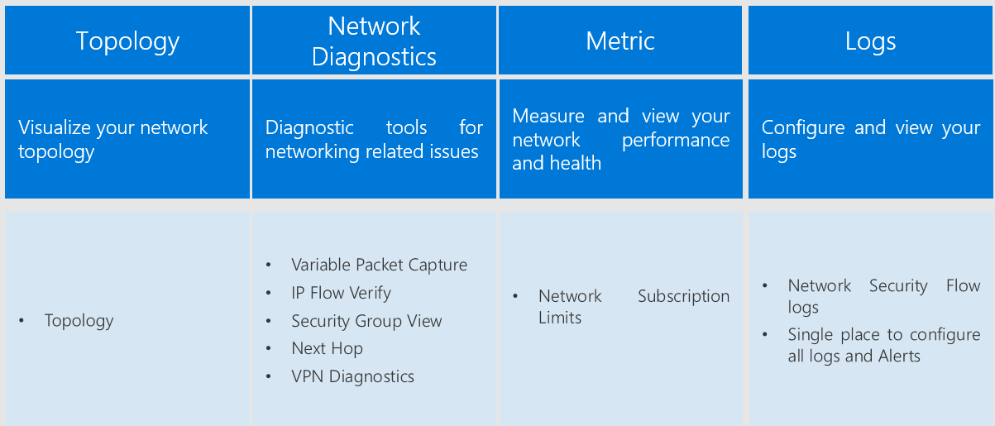
Network Watcher
NEW: Connectivity Check (Preview)
NEW: Connectivity Check Express Route (Preview)

Slide 18
DEMO Network Watcher

Slide 19




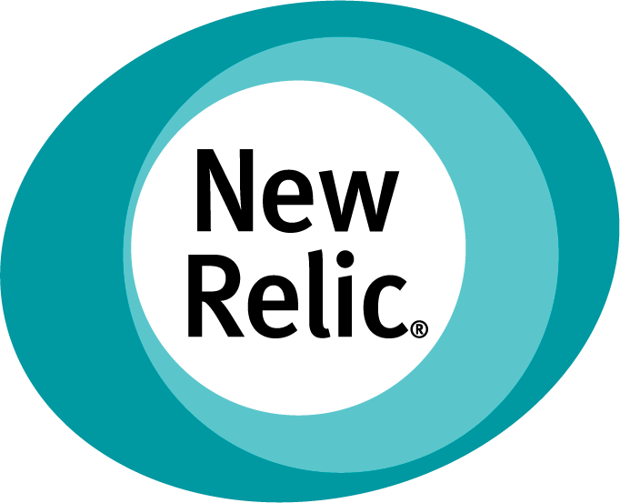







Slide 20

Limitations
100 metric alerts
100 activity log alerts
10 action groups / subscription

Slide 21

Good to know…
Free API calls for Activity Logs. Use Storage Account past 90 days
Diagnostic data route to Storage Account, Log Analytics, Event Hub
Metric data past 30 days route to Storage Account, Log Analytics, Event Hub. API calls to route are charged!

Slide 22
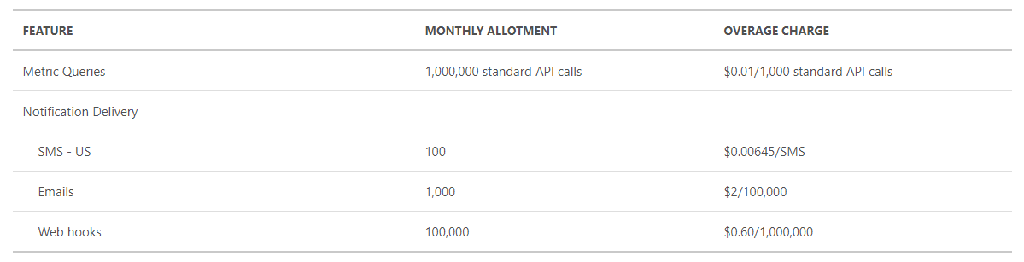
Pricing Azure Monitor
Metrics have 1 minute granularity
1 metric * 24 hours * 60 minutes = 1440 data points
1440 data points = Total number of data points per metric per day
1440 data points = 1 standard API call
5 metrics / 1 min granularity / 100 VMs =720000dp/1440= 500 std API calls per day

Slide 23

Summary
Azure Monitor provides base-level infrastructure metrics and logs for (most) services in Microsoft Azure.
Provides a single pane of glass.
First-stop-shop if you encounter any Microsoft Azure services issues.
API’s for integration into your systems and 3rd party tools.
Azure Monitor is constantly evolving – keep an eye on it.

Slide 24

Q&A

Slide 25















Thanks to our Sponsors!

