Slide 1
PowerShell Multi-Plattform kompatiblen Code schreiben.
Roman Stadlmair
www.powershell.co.at
@powershellat
Notes:
Introduction

Slide 2
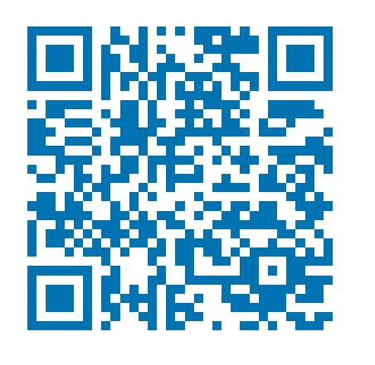
Q&A
https://github.com/RStadlmair/MultiPlatformPSModules
LinkedIn

