Slide 1
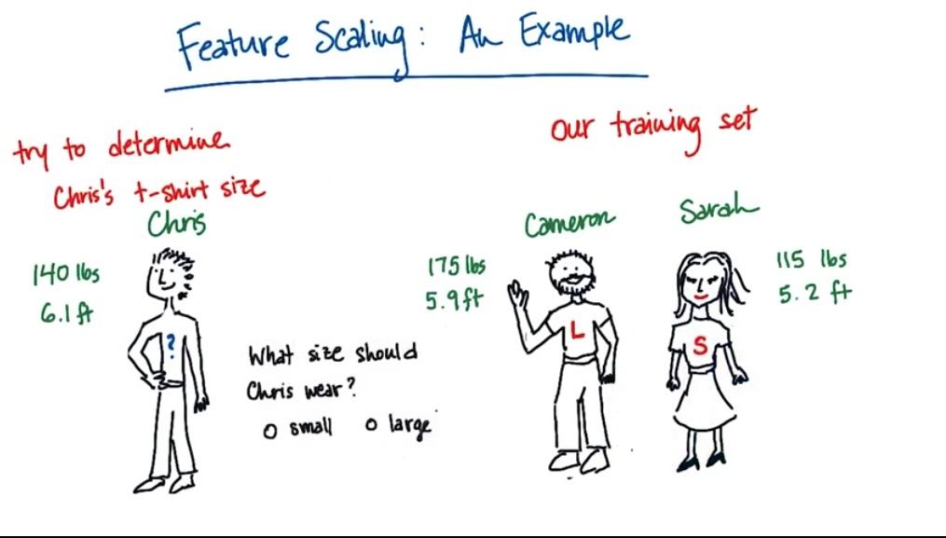

Slide 2
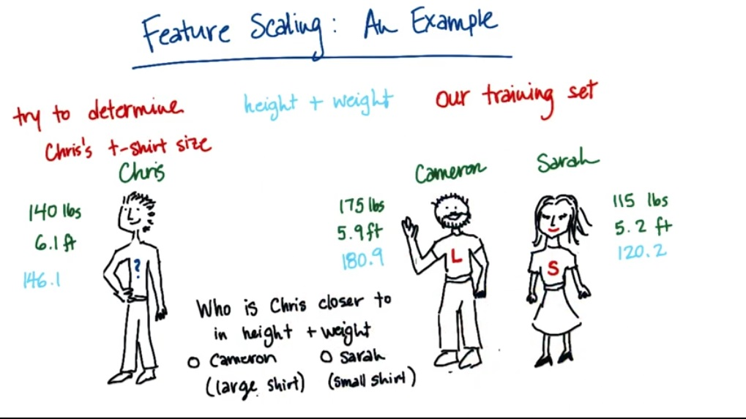

Slide 3
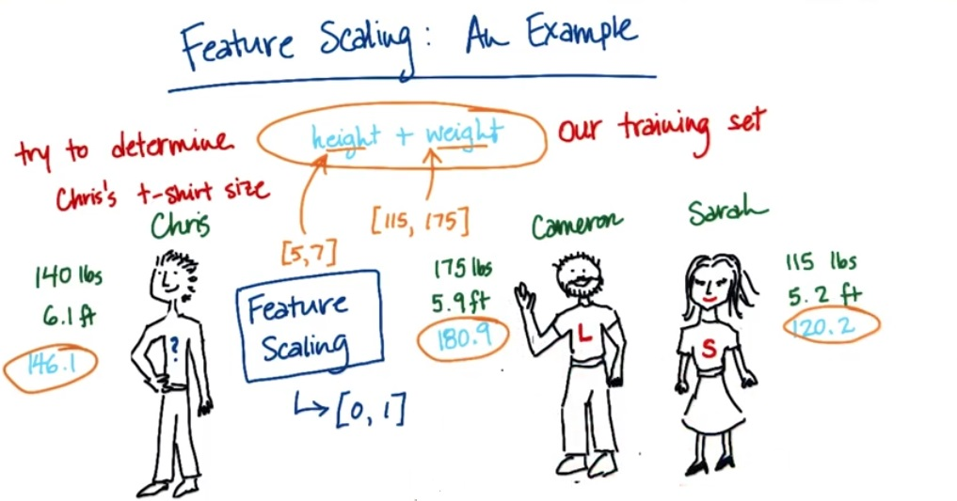

Slide 4
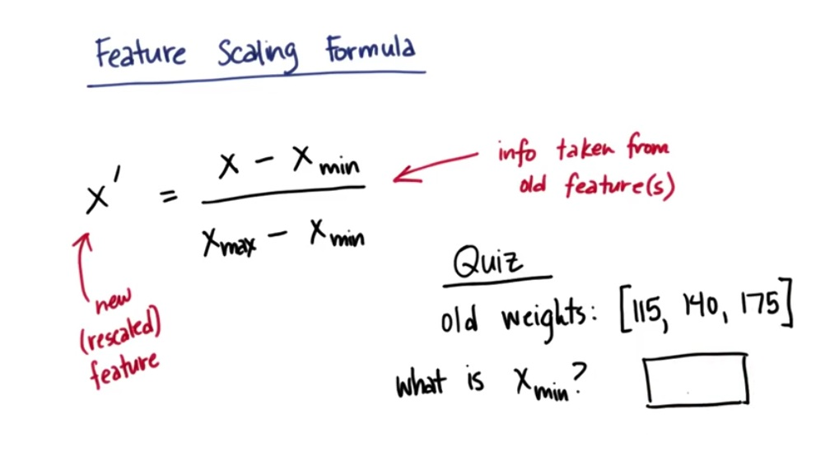

Slide 5
Probability

Slide 6
Conditional Probability
P(A|B)

Slide 7
Joint Probability
P(A,B)

Slide 8
Cancer Example

Slide 9
Lets suppose a population has 1% chance of having some specific type of cancer
Tests are 90% positive if someone has cancer. This is called Sensitivity
Tests are 90% negative if someone does not have cancer. This is called Specificity

Slide 10
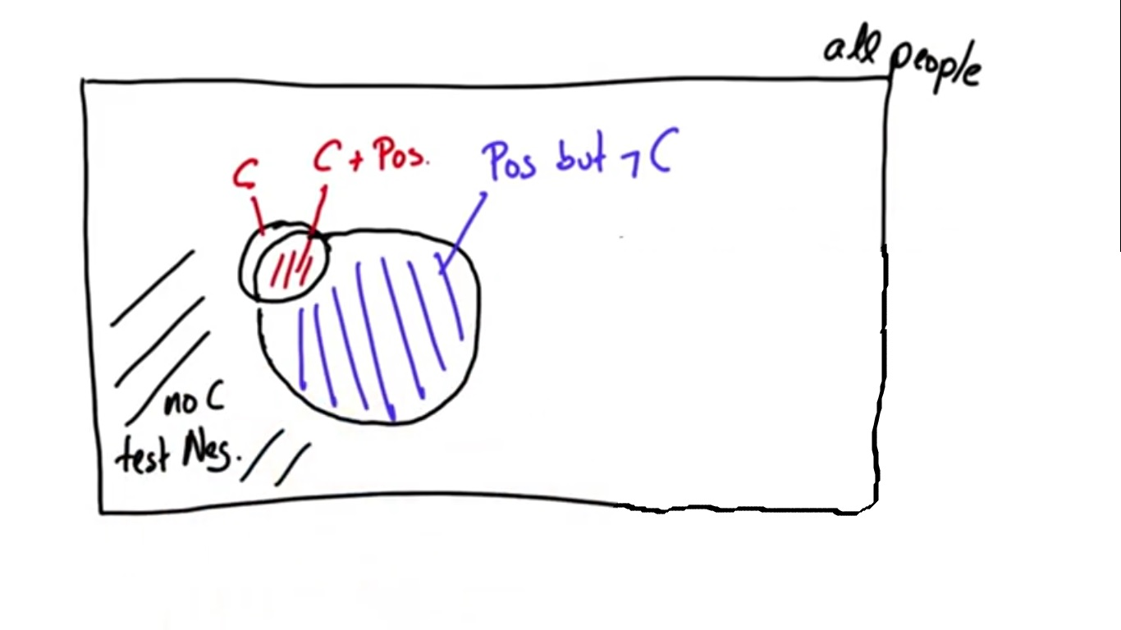

Slide 11
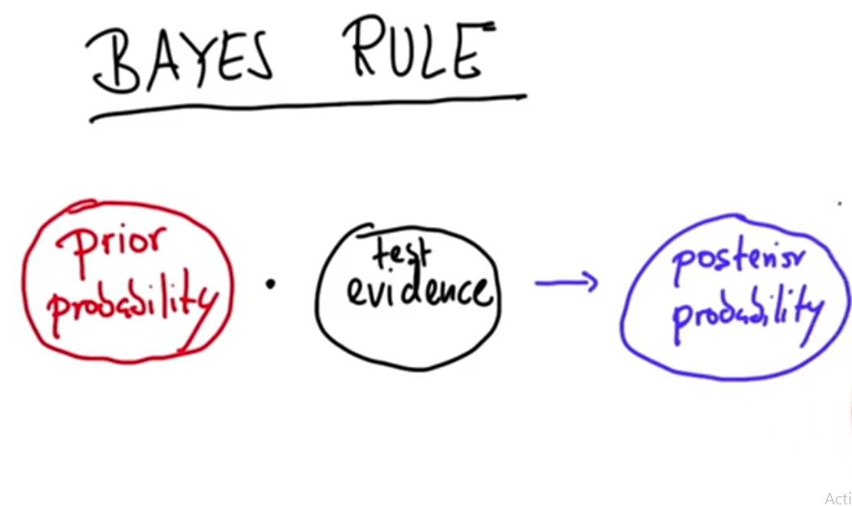
Prior and Posterior Probability

Slide 12
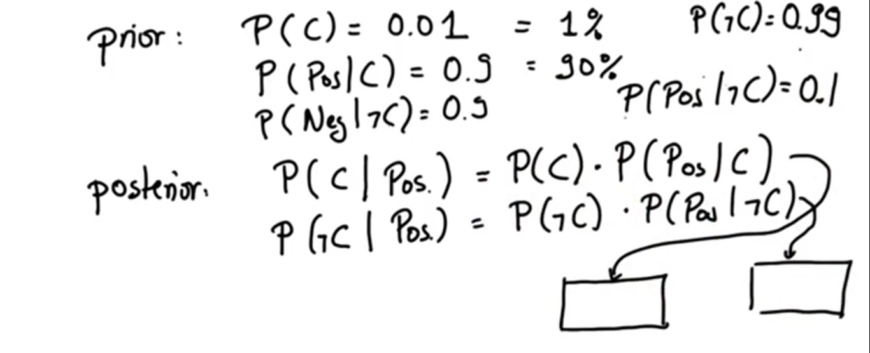

Slide 13
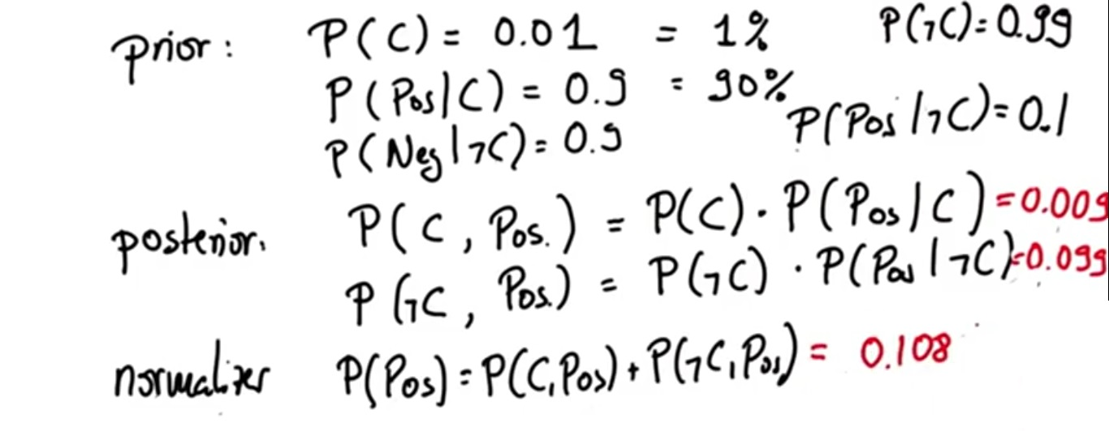

Slide 14
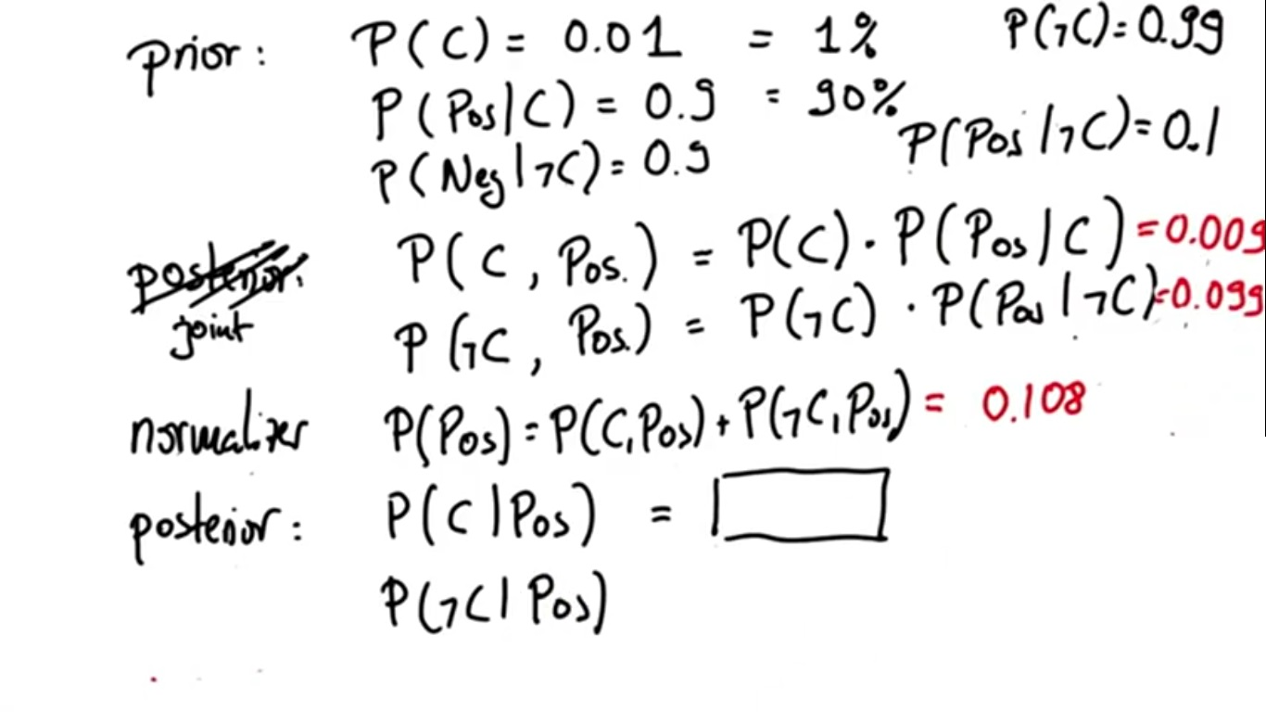

Slide 15
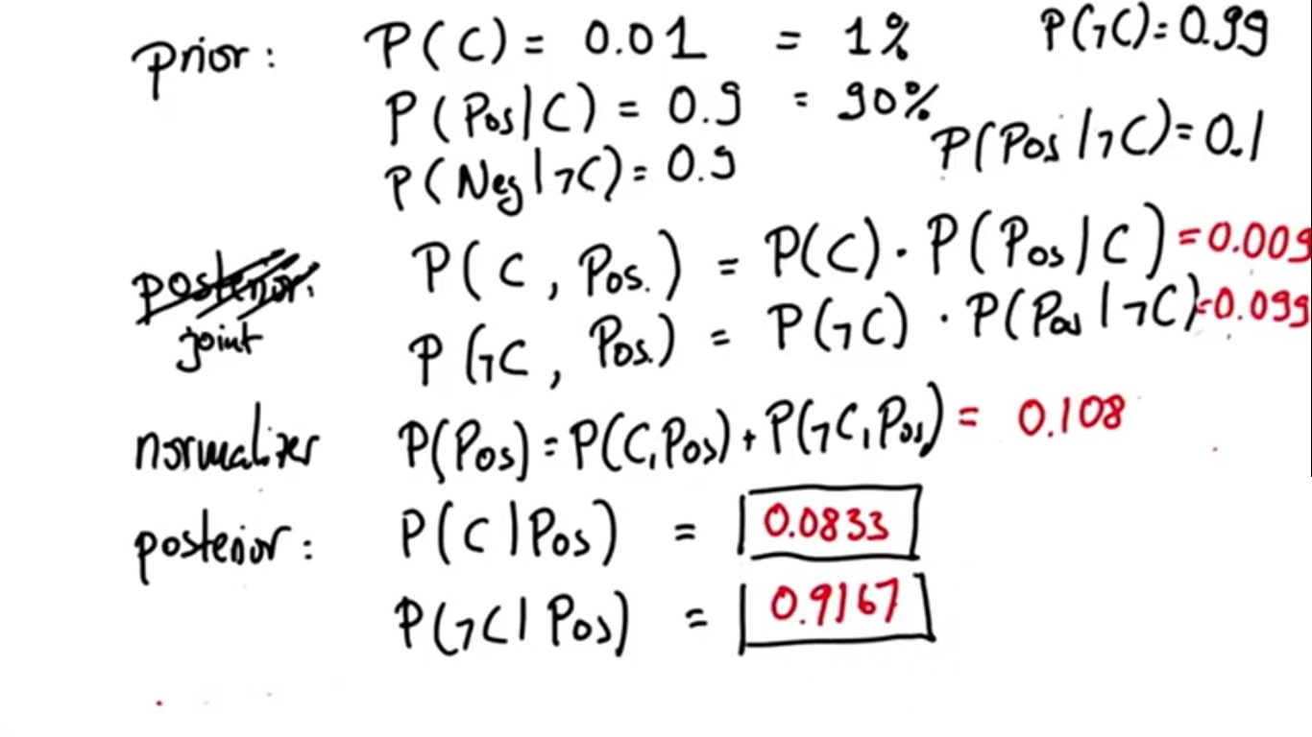

Slide 16
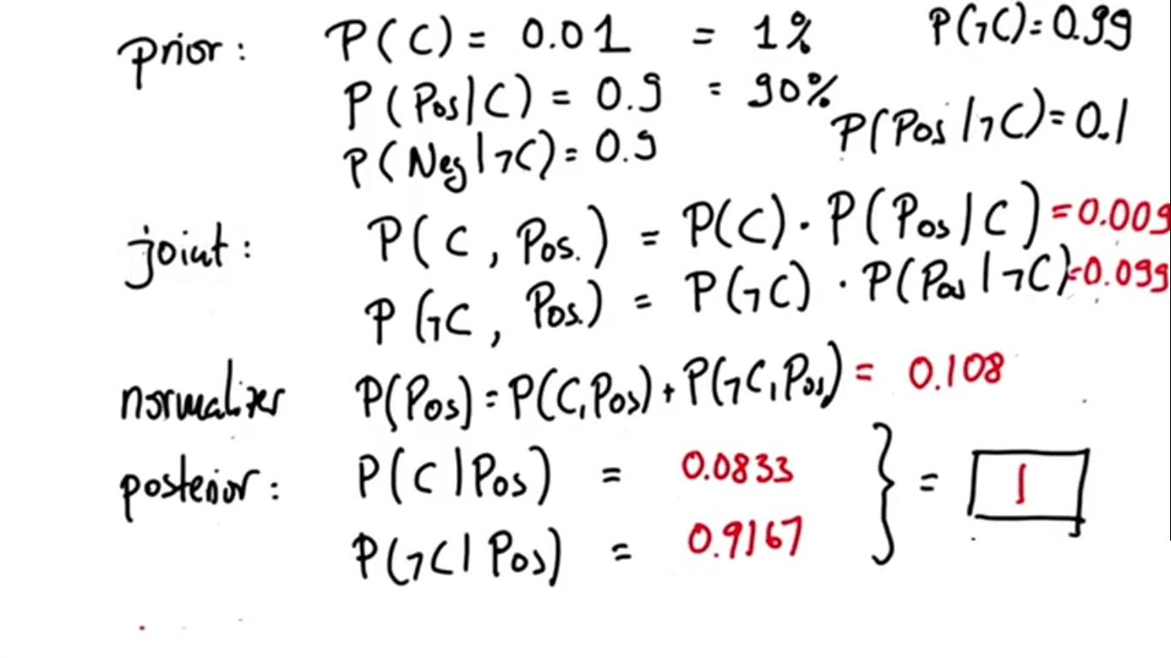
Total Probability

Slide 17
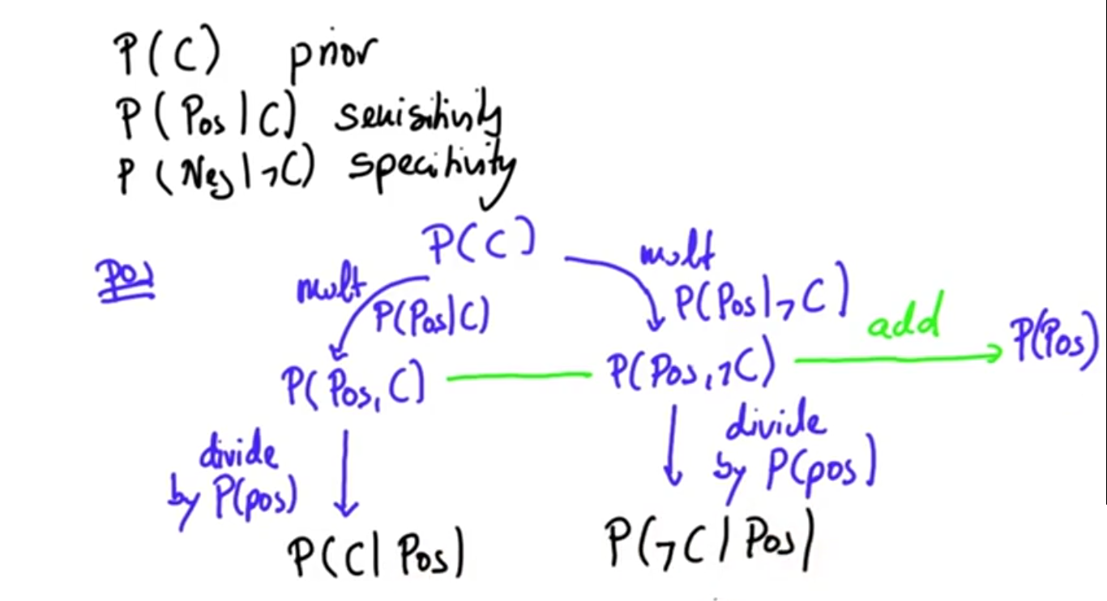
Baysian Rule

Slide 18
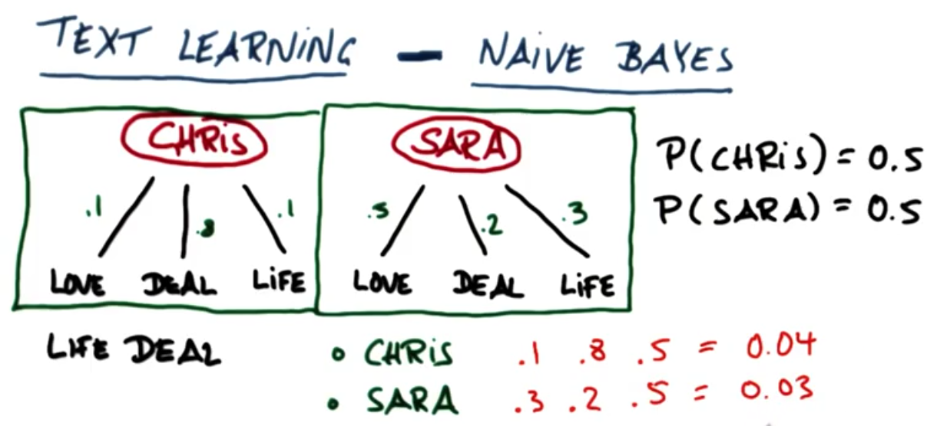

Slide 19
