Slide 1
OS Development 7. Filesystem
Prof. Dr. Michael Schöttner
Dr. Fabian Ruhland

Slide 2
Preview
Physical vs. Virtual Filesystems
Filesystem API
HeineOS Filesystem
Summary

Slide 3
Physical Filesystems
Persistent data is stored on disk drives (HDDs, SSDs, USB-Sticks, etc.)
Problems:
Disk drives are usually organized in sectors (e.g. 512 bytes) and not byte-addressable (also called block storage)
Allocation/Deallocation of sectors for different files
File can be fragmented across multiple sectors
Solution: Filesystems take care organizing files on disks:
Allocate sectors when writing to a file (and deallocating them when files are deleted)
OS provides file API allowing byte-by-byte read/write operations → Must be translated into sector operations
Usually a block cache is used for performance reasons

Slide 4
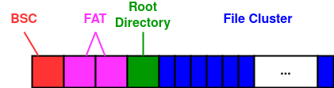
Example: FAT File System
Fat was created in 1977; found widespread usage with the introduction of MS-DOS (1980)
Cluster sizes: 512, 1024, 4096 Bytes, …, 32 KiB
Partition structure:
BSC = Bootsector → Optional Bootcode (not used anymore by UEFI)
FAT = File Allocation Table → Management of free and allocated blocks (fixed size, replicated for reliability)
Root Directory: Fixed size in FAT16, stored in BSC
File Cluster: Blocks containing file data

Slide 5
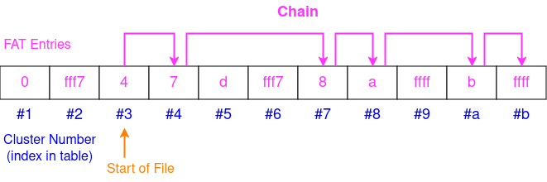
Example: FAT File System
Blocks are indexed via File Allocation Table (FAT)
Blocks are called Clusters in FAT
One entry for each cluster (16 Bit)
Copy of the FAT resides in main memory (for fast access)
Clusters of a file are chained in the FAT
0 = Empty cluster
0xfff7 = Bad cluster
0xffff = Last cluster of a file
Start of a file is stored in directory entry

Slide 6
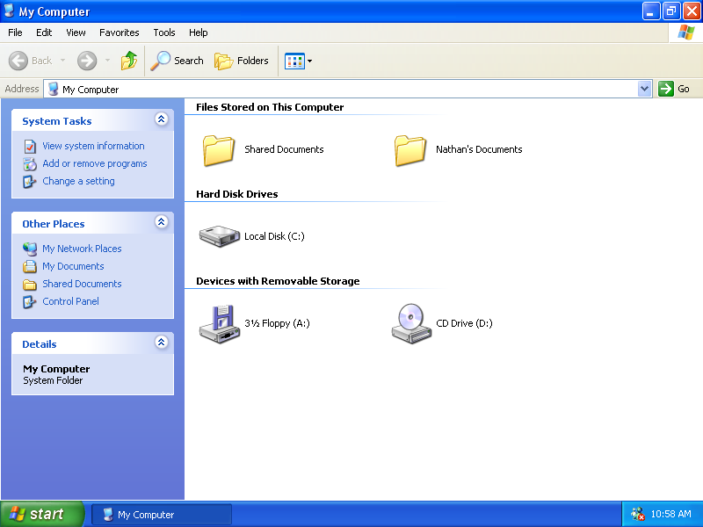
Virtual Filesystems
Multiple devices with physical filesystems can exist at the same time in a machine
Devices can have different filesystems (e.g., ext4 on a fixed SSD and FAT32 on removable USB devices)
Operating systems offer an abstraction over these physical filesystems
Uniform API for all file accesses, regardless of the physical filesystem
Windows: Disks are separate entities, identified by a unique letter (C:, D:, E:, etc.)
Unix: Disks can be mounted anywhere in the filesystem tree (transparent)

Slide 7
Preview
Physical vs. Virtual Filesystems
Filesystem API
HeineOS Filesystem
Summary

Slide 8
Filesystem API
C standard library defines unified API for filesystem accesses (stdio.h)
fopen(): Open a file and returns a FILE pointer for use in other file related functions
fread(): Read data from a file into a block of memory
fwrite(): Write data from a block of memory into a file
ftell(): Get the current read/write position of a FILE pointer
ftell(): Move the read/write position of a FILE pointer
Operating system exposes system calls for file access (e.g., POSIX compatible)
APIs must be implemented separately for each operating system, using specific system calls

Slide 9
Example
const char *write_msg = "Hello, World!"; char read_msg[16]; void main() { // Open file for reading and writing (create if not exists) FILE *file = fopen("hello.txt", "w+"); if (file == NULL) { return; } fwrite(write_msg, 1, strlen(write_msg), file); // Write message to file fseek(file, 0, SEEK_SET); // Seek back to beginning of file // Read file content into buffer memset(read_msg, 0, sizeof(read_msg)); fread(read_msg, 1, sizeof(read_msg), file); // Print read message and close file puts(read_msg); fclose(file); }

Slide 10
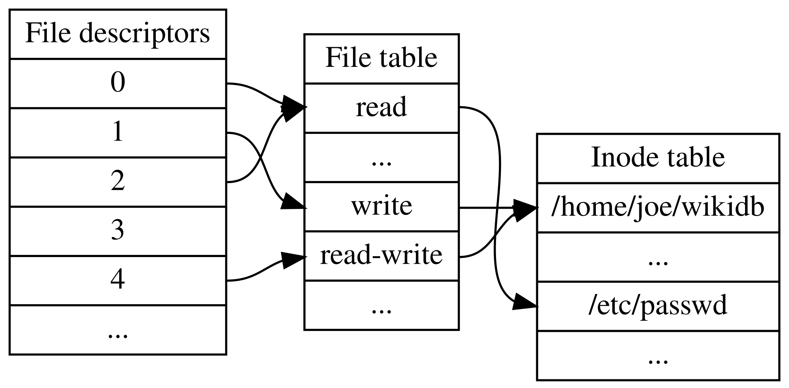
Filesytem System Calls
open() system call on Linux: int open(const char *path, int flags)
Return value is a File Descriptor, used to access the opened file in further system calls
read() system call: ssize_t read(int fd, void *buf, size_t count)
fd must be a valid file descriptor, returned by a former call to open()
All file related system call work on file descriptors
Each process has a table of open files; File descriptors are indices into this table

Slide 11
Preview
Physical vs. Virtual Filesystems
Filesystem API
HeineOS Filesystem
Summary

Slide 12
Multiboot Modules
Bootloader can load additional files (modules) along with the kernel into memory
We use a TAR-archive as basis for our read-only filesystem
Bootloader (towboot) loads the file into memory for us
Access in boot.rs via multiboot.find_tag::<ModuleTag>(TagType::Module)
default = "heineos" loader/towboot.toml
timeout = 0
log_level = "info"
[entries]
[entries.heineos]
name = "HeineOS"
image = "kernel.elf"
modules = [ { image = "initrd.tar", argv = "initrd.tar" } ]
argv = "log_level=debug log_to_terminal=true"

Slide 13
TAR Archive
TAR archives store multiple files sequentially in a single uncompressed archive
Each file is preceeded by a 512 byte header and its length padded to a multiple of 512
We use the crate tar-no-std for parsing TAR archives
Original Unix TAR file header
Field Offset | Field Size | Field
0 | 100 | File path and name
100 | 8 | File mode (octal)
108 | 8 | Owner UID (octal)
116 | 8 | Group GID (octal)
124 | 12 | File size in bytes (octal)
136 | 12 | Last mod. time (octal)
148 | 8 | Header Checksum
156 | 1 | Link indicator
157 | 100 | Name of linked file

Slide 14
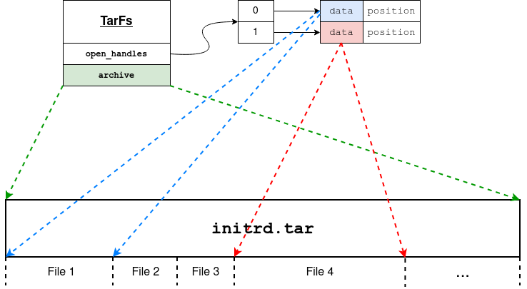
HeineOS Filesystem
API Example:
pub fn open(&self, mut path: &str) -> Result<FileHandle, FsError>
pub fn read(&self, handle: FileHandle, buffer: &mut [u8]) -> Result<usize, FsError>
All files reside inside a TAR archive
Open file handles (descriptors) are managed in open_handles table.
OpenFile struct references data
inside the TAR archive
Conceptually similar to UNIX → FileHandle just wraps usize value
Easily portable to user space via system calls (later!)

Slide 15
Preview
Physical vs. Virtual Filesystems
Filesystem API
HeineOS Filesystem
Summary

Slide 16
Summary
Filesystems store files on (sector/block based) drives
Allocation/Deallocation of sectors on a device
Operating system manages open files (per process)
User API uses system calls to access open files via file descriptors
We do not have persistent storage in HeineOS and resort to a TAR archive
File API is designed similar to UNIX-based operating systems

