Slide 1
OS Development 1. Example - PC Speaker
Prof. Dr. Michael Schöttner Dr. Fabian Ruhland

Slide 2
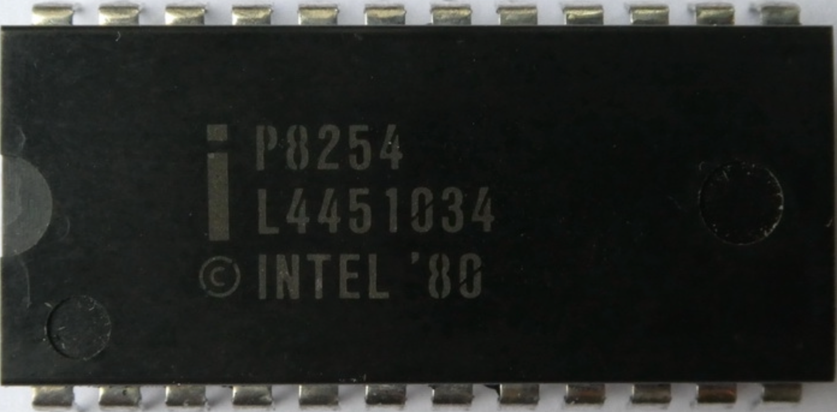
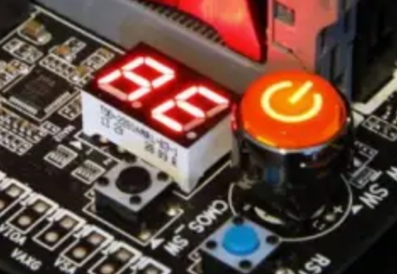
Generating Sounds
The classic PC Speaker was driven by timer chip, which could generate pulses
Timer Chip = Programmable Interval Timer (PIT)
Nowadays integrated inside the motherboards chipset
On older hardware, the motherboard’s firmware used the PC Speaker to generate Beep Codes in case of hardware failures
Nowadays, many motherboards posess a hexadecimal display to show error codes →

Slide 3
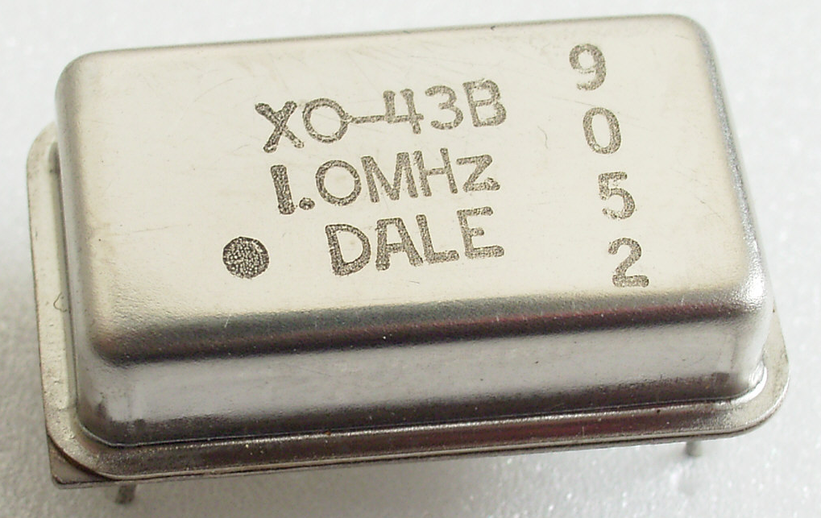
Programmable Interval Timer
PIT runs at a frequency of 1.19318 MHz → Why?
1.19318 MHz = 1/4 of 4.77 MHz = Frequency of the IBM PC XT
Why did the XT run at exactly 4,77 MHz?
4.77MHz = 1/3 of 14.31816 MHz
14,31816 MHz is the base frequency needed to operate NTSC television → Quartz crystal for that frequency were cheap (mass production)
Every computer uses a quartz crystal to generate its base frequency
This frequency is then adapted for different computer parts, using divisiors
Nowadays, the PIT can still be used to implement a monotonic increasing system time, or to distribite CPU time in preemptive multitasking

Slide 4
PIT: Structure
Three counters/channels (16 bits each)
Are decremented with the falling edge of the base frequency
Usage:
Channel 0: Periodic interrupts → Signal OUT0 to IRQ controller
Channel 1: DRAM Refresh → Signal OUT1 to DMA controller (not relevant anymore)
Channel 2: Sound generation → OUT2 to PC Speaker
Programming is done via IO-ports (8 bits each)
Port | Register | Access mode
0x40 | Channel 0 | read/write
0x41 | Channel 1 | read/write
0x42 | Channel 2 | read/write
0x43 | Control register | only write

Slide 5
PIT: Control Register (Port 0x43)
Bits | Wert | Bedeutung
6-7 | Channel Select
 | 00 | Channel 0
 | 01 | Channel 1
 | 10 | Channel 2
 | 11 | Invalid
4-5 | Access Mode
 | 00 | Latch count value command
 | 01 | Low counter byte
 | 10 | High counter byte
 | 11 | First low, then high coutner byte
1-3 | Operating Mode (0-5)
0 | Counter format
 | 0 | Binary counter (16 bit)
 | 1 | BCD counter (four digits)
Writing an 8-bit control word to the control register tells the PIT what to do next
Operating mode determines how the channel operates and whether it triggers external events using its OUT signal

Slide 6
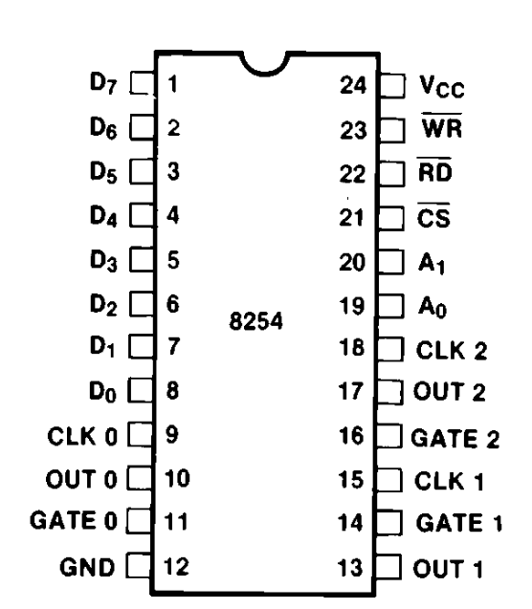
PIT Mode 0: Interrupt On Terminal Count
Counter decrements every 838ns ( 1 s / 1193180 Hz = 838ns)
If the counter reaches 0, the OUTx signal is set to 1, and an interrupt is triggered
x = Channel number
The counter is not automatically reloaded in mode 0
Control word
negated

Slide 7
PIT Mode 3: Square Wave Generator
Rectangular signal is generated using an internal Flip Flop
Time interval is doubled → To compensate, the counter is decremented 2x on each falling edge
Suitable for sound generation (but also system time or preemptive multitasking)
Control word
negated

Slide 8
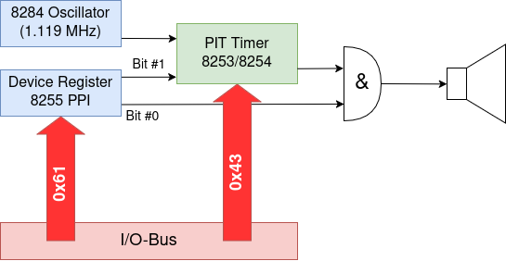
PC Speaker
Programmable via IO-Ports using assembly commands: in, out
Channel 2 needs to be configured via the control register → Control word 0xB6 equals 1011 0110 in binary and means:
Channel 2
Access mode: First low counter byte, then high counter byte
Operating mode 3 (square wave)
Binary counter mode (not BCD)
Write start value for counter
Turn on the PC speaker via the Peripheral Port Interface (PPI 8255, IO-Port 0x61)

Slide 9
Example code in Rust
const PORT_CTRL: u16 = 0x43;
const PORT_DATA0: u16 = 0x40;
const PORT_DATA2: u16 = 0x42;
const PORT_PPI: u16 = 0x61;
pub fn play(frequency: u32) { // Tone frequency in Hz
const base_freq = 1193180; // 1.19 MHz
let counter = base_freq / frequency;
let status: u8;
unsafe {
cpu::outb(PORT_CTRL, 0xb6); // Configure channel 2
cpu::outb(PORT_DATA2, (counter & 256) as u8); // Load channel 2 (low byte)
cpu::outb(PORT_DATA2, (counter >> 8) as u8); // Load channel 2 (high byte)
// Turn on PC speaker via PPI
status = cpu::inb(PORT_PPI); // Read PPI status
cpu::outb( status | 3 ); // Turn on PC speaker
}
}

Slide 10
Why Rust?
Type safe modern und fast programming language
Offers compile time garbage collection
No null pointers
No „broken“ pointers (unless unsafe is used)
Used by Microsoft
https://msrc.microsoft.com/blog/2019/07/why-rust-for-safe-systems-programming/
https://msrc.microsoft.com/blog/2019/07/we-need-a-safer-systems-programming-language/
Linux allows writing kernel modules in Rust
https://www.heise.de/news/Rust-Code-im-Linux-Kernel-Merge-steht-laut-Linus-Torvalds-ab-Linux-5-20-bevor-7154453.html

