Slide 1
Isolation and Protection in Operating Systems 3. System Calls in x86-64
Prof. Dr. Michael Schöttner
Dr. Fabian Ruhland

Slide 2
Goal
Until now all user mode threads (Ring 3) can just call all kernel functions directly
The CPU triggers an General Protection Fault (GPF) if a privileged instruction is used inside one of the called kernel function
Usually, kernel code is protected from direct execution in ring 3 via paging
We now want to implement System Calls, which expose kernel functions for indirect and controlled execution in ring 3
3. System Calls

Slide 3
System Call Mechanisms in x86
Call Gate
Descriptor in the GDT
Access via a call or jmp instruction
Stack is switched via the TSS
Interrupt Trap Gate
Descriptor in the IDT
Access via a int instruction
Stack is switched via the TSS
Fast System Calls
Configured through MSRs (Model Specific Register)
Access via a syscall/sysret instruction
Stack must be switched manually by the operating system
3. System Calls

Slide 4
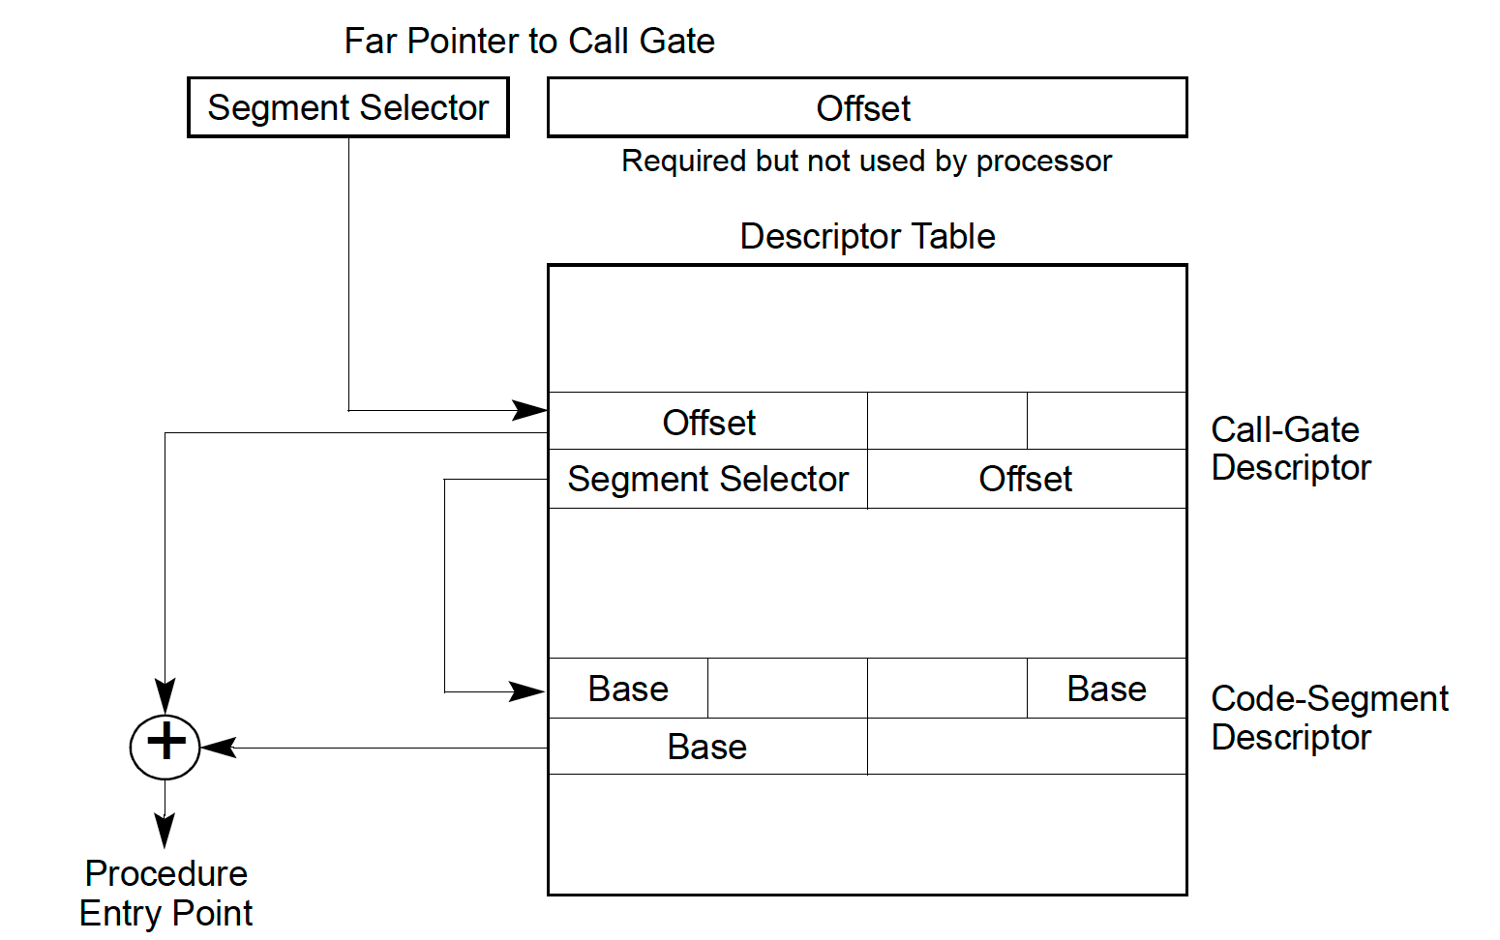
Call Gate
Offset in register and code segment descriptor are ignored
DPL=3
DPL=0
3. System Calls

Slide 5
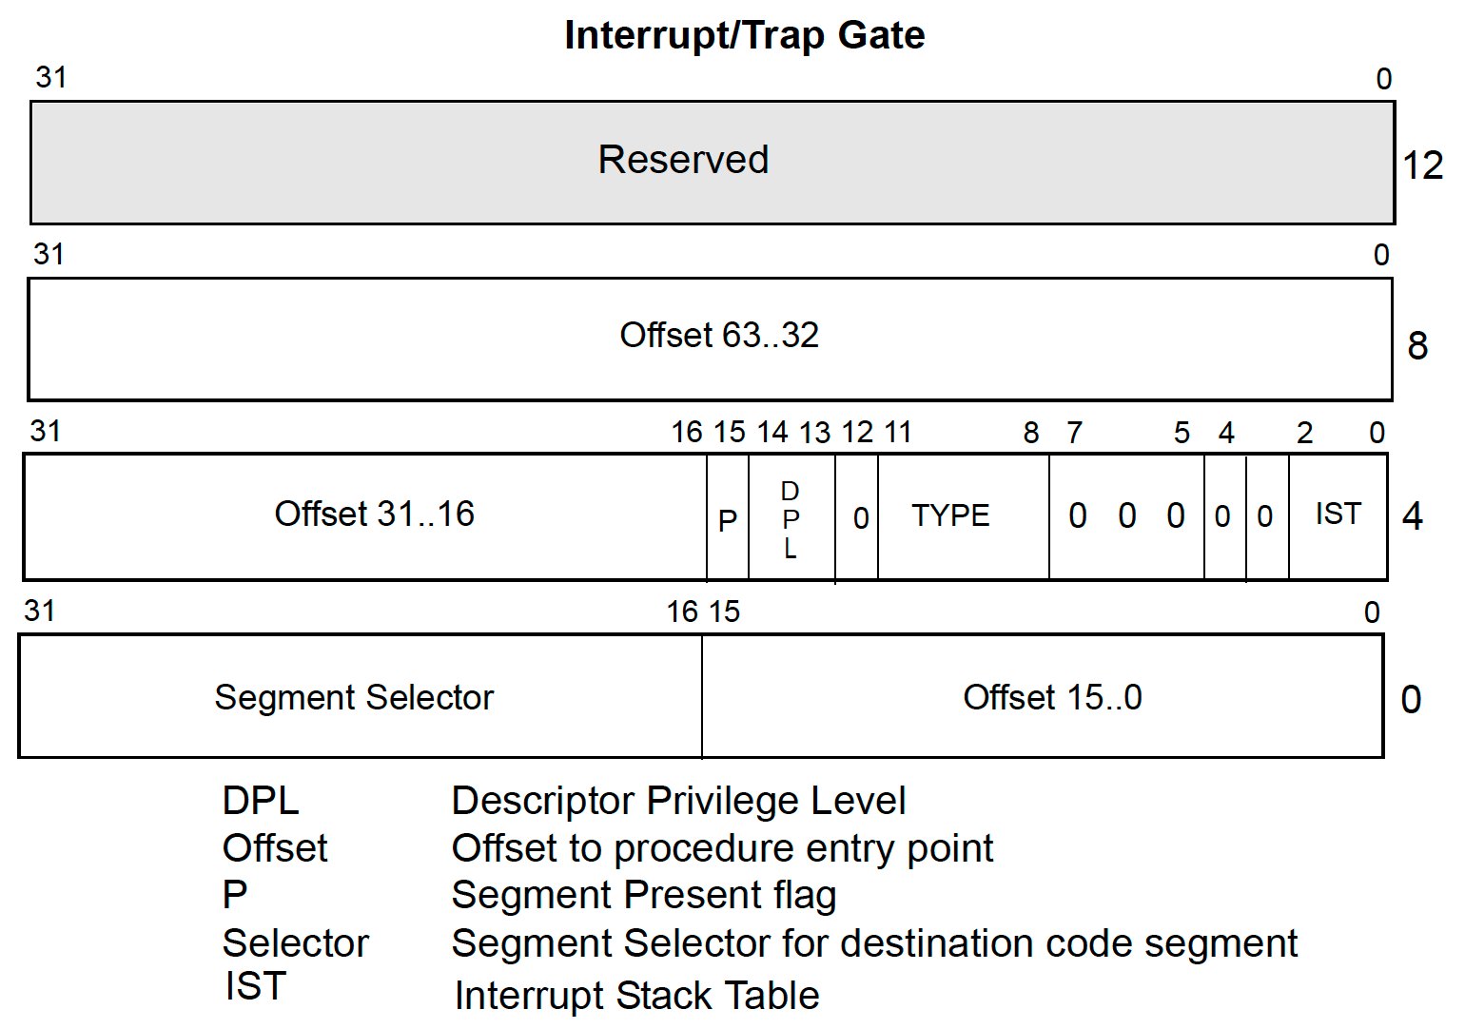
Interrupt/Trap Gate
Access via int instruction
Example: int 0x80
References a Trap Gate with index 0x80 in the IDT
Offset = Handler address
Segment selector chooses a segment descriptor in GDT
3. System Calls

Slide 6
Interrupt/Trap Gate
Interrupt Gate
Interrupt Enable flag is deleted
Used for interrupt handlers → sequential execution (on single core CPUs)
Trap Gate
Interrupt Enable flag is not deleted
Used for system calls
3. System Calls

Slide 7
Interrupts
External/Hardware interrupts
Triggered by a device (e.g., timer)
Come from the outside (from the CPU’s point of view)
Internal/Software interrupts
Triggered by the CPU itself
Exceptions (see next slides)
Assembly instruction INT <nr>
Used for System Calls (Linux, Windows NT, MacOS, MSDOS)
3. System Calls

Slide 8
Exceptions
Fault
Operating system can handle and recover from faults (e.g., Page Fault)
CPU state and the address of the fault triggering instruction are stored
Trap
Triggered by a special instruction (e.g., INT 3 - Breakpoint)
Program can be continued
Abort
Unrecoverable error
Triggers are hard to localize exactly
Cause a reboot (e.g., Double Fault)
3. System Calls

Slide 9
Vectors
Interrupts and exceptions are identified via a Vector Number
0 – 31 are reserved for exceptions
32 – 255 are freely available
Examples for exceptions:
Vector | Exception | Vector | Exception
0 1 2 3 4 5 6 8 | Division by 0 Debug NMI Break Overflow Bounds range exceeded Illegal instruction Double fault | 11 12 13 14 16 18 … | Segment not present Stack overflow General protection fault Page fault - Machine check . . .
3. System Calls

Slide 10
Stackup Buildup without Ring Change
If the privilege level is not changed, the CPU does not switch the stack
The interrupt handler operates on the stack of the interrupted thread
This happens in HeineOS (all our code runs in ring 0)
Only some exceptions push an error code
Stack of the interrupted thread
RSP before transferring control to handler
RFLAGS
CS
RIP
(error code)
RSP after transferring control to handler
3. System Calls

Slide 11
Stack Buildup with Ring Change
New stack is read from Task State Segment (see last chapter)
Stack of the interrupted thread
Handler Stack
SS
RSP before transferring control to handler
RSP
RFLAGS
CS
RIP
(error code)
RSP after transferring control to handler
3. System Calls

Slide 12
IDT: Typical Example
Entries 0-31 are reserved for x86 CPU exceptions
Either DPL=0 or DPL=3, depending on use case
Entries 32-47 for external interrupts
IRQs have DPL=0
IRQ 0 != Vector 0
System calls via trap gate (entry 0x80)
DPL=3
Replaced by SYSENTER/SYSEXIT in modern operatings systems → faster, avoids interrupt overhead
0x80
0x20
3. System Calls

Slide 13
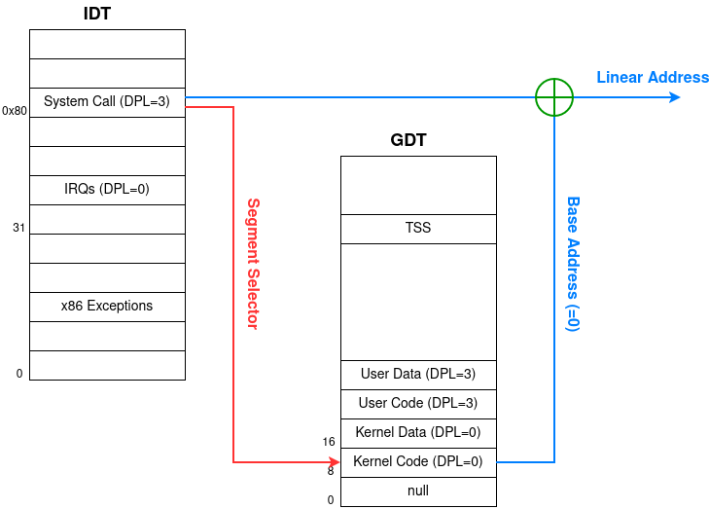
System Call via Trap Gate
3. System Calls

Slide 14
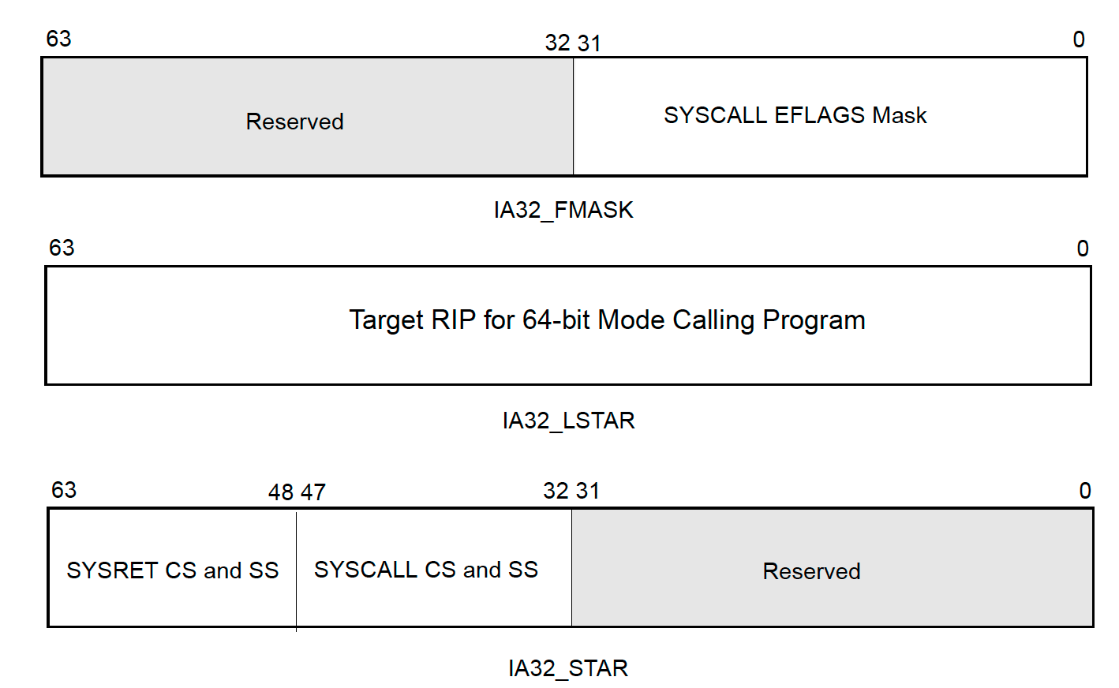
Fast System Calls (syscall/sysret)
Use Model Specific Registers (MSRs)
Require specific GDT layout
Stack muste be switched manually in syscall handler
Use FS und GS registers
Only base address is used
Typically the GS base address points to the kernel stack
3. System Calls

