Slide 1
Isolation and Protection in Operating Systems 5. Kernel Isolation in x86-64
Prof. Dr. Michael Schöttner
Dr. Fabian Ruhland

Slide 2
Address Space Layout before Meltdown
Each process has its own address space = User Space
The kernel is mapped into every address space = Kernel Space
Protection via segmentation = Privilege Level
Protection via paging = Kernel is protected via U/S bit in page tables
User Space
Kernel Space
0

Slide 3

Meltdown
Discovered in July of 2017
Affects CPUs from Intel, AMD and ARM
Undected for ~20 years
What happens?
Bypasses isolation betwen operating system (kernel mode) and application (user mode)
Enables access to protected kernel memory from user mode and to the memory of other processes
Naming: Melting hardware/operating system security barriers

Slide 4
Meltdown
Meltdown is a sidechannel attack
Attackers cannot directly access the data
Idea: Use independent events for communication (e.g. light on/off)
Extraction via a secret information channel (originates from embedded systems)
Exploit is based on a combination of different acceleration functions in hardware and operating systems
Parallel and speculative execution of instructions
Caching and TLB
Address spaces

Slide 5
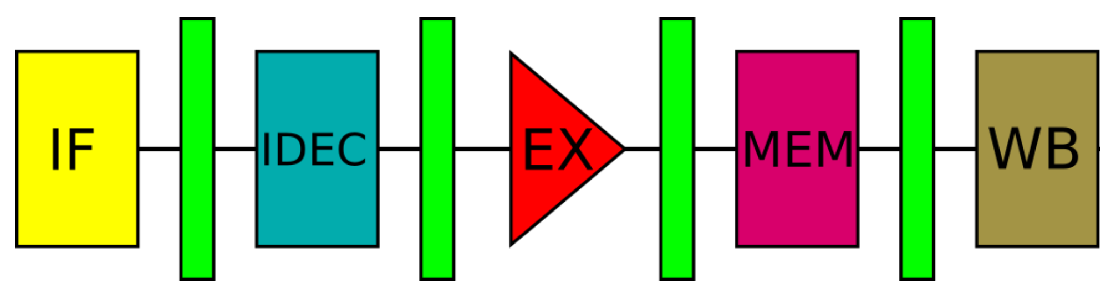
CPU: Pipelining
Problem: Instructions are complex and accessing memory is slow
Solution: Pipelining
Decode instructions into micro operations (μOPs) and load data beforehand
Instruction execution workflow:
1. Instruction Fetch (IF)
2. Instruction Decode (IDEC)
3. Instruction Execute (EX)
4. Memory Access (MEM)
5. Result Writeback (WB)

Slide 6
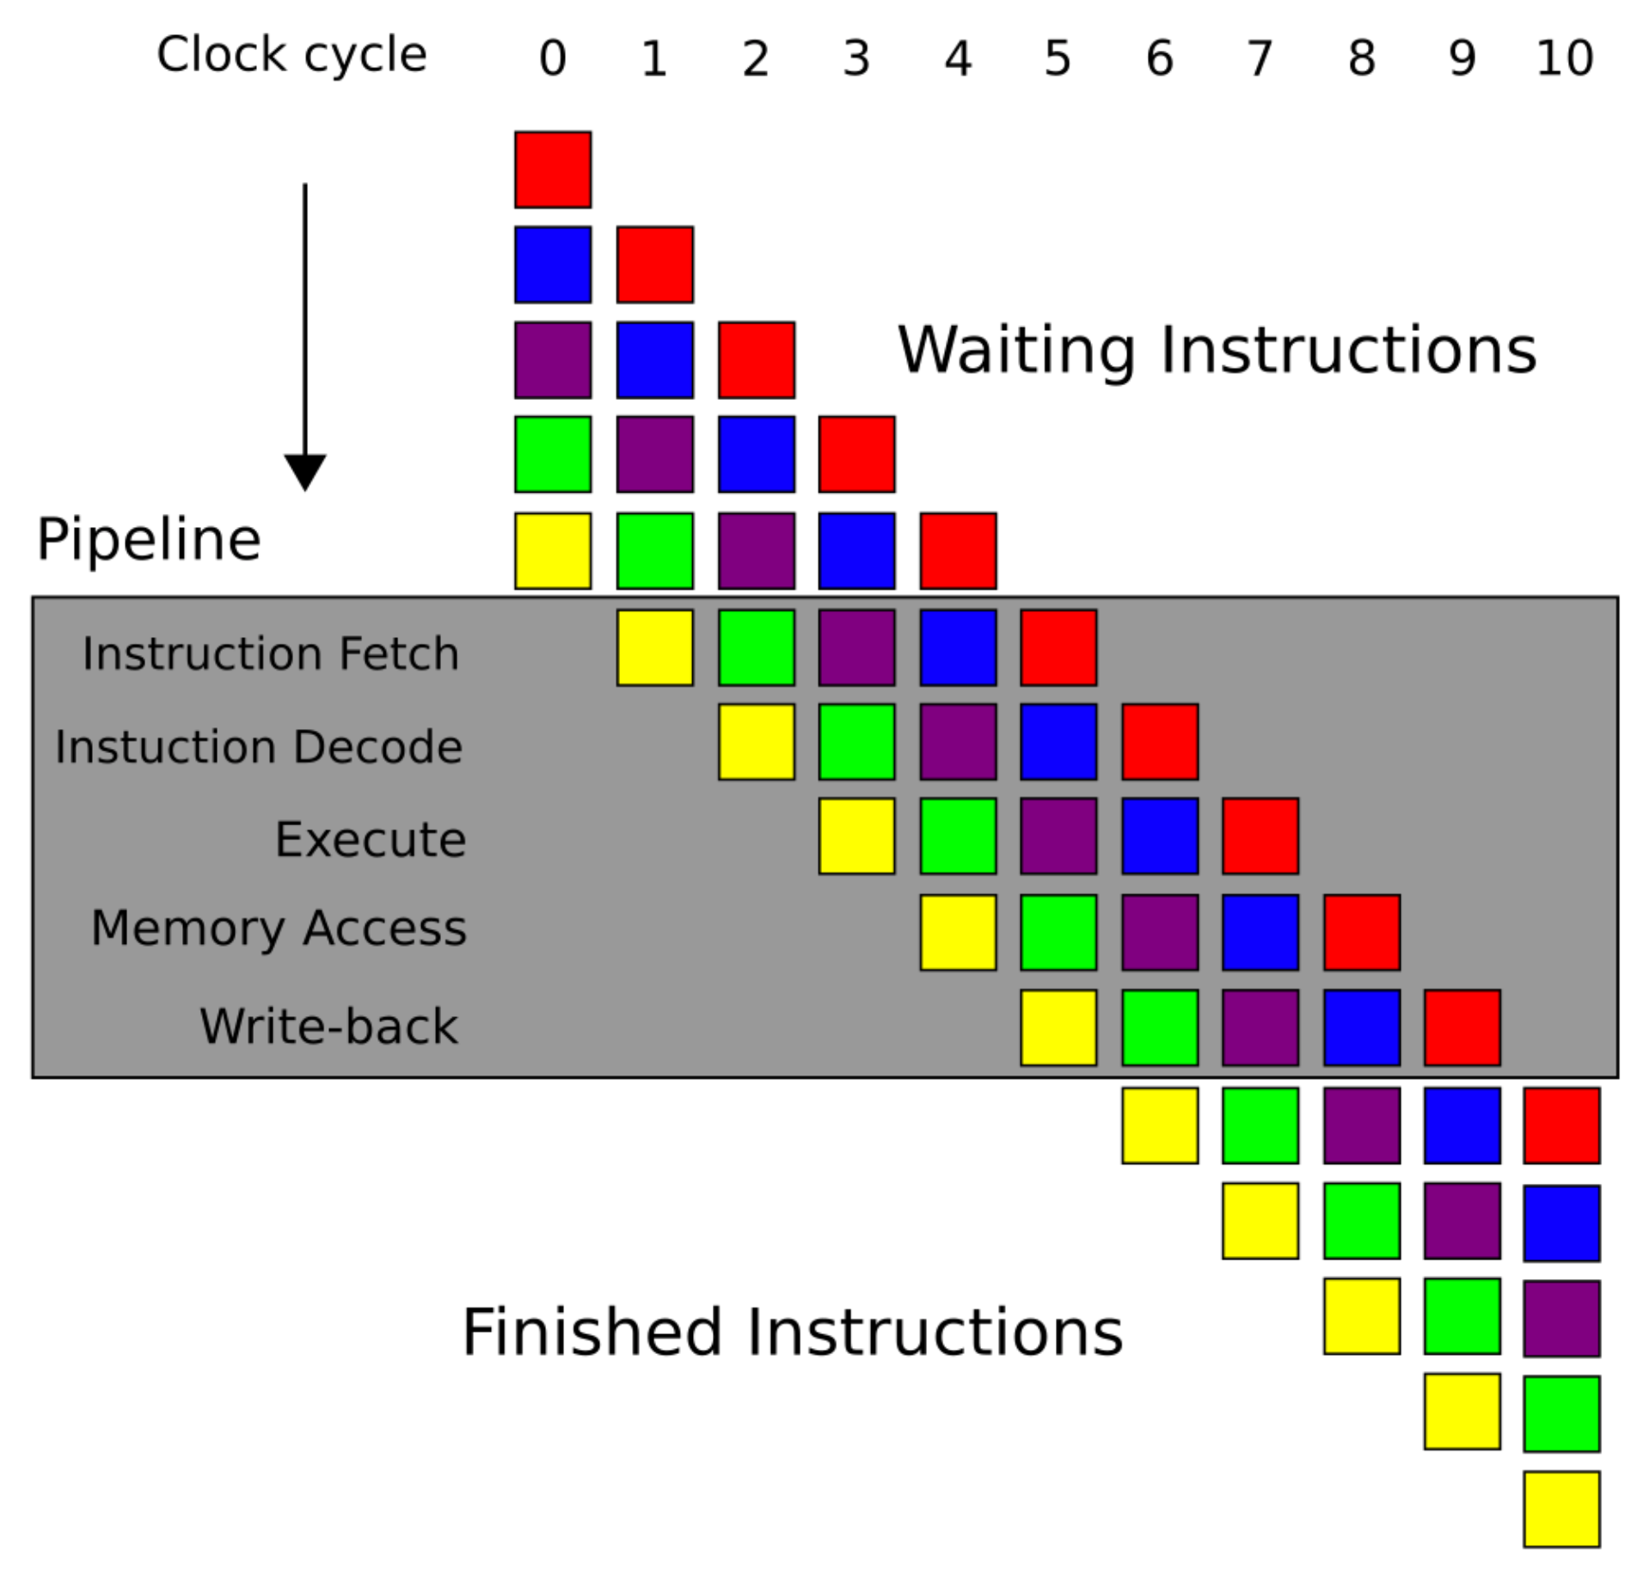
CPU: Pipelining

Slide 7
CPU: Branch Prediction
Pipelining → Decode instructions and load data beforehand
Problem: When the code branches, it is unclear where the execution path continues
Solution: Branch Prediction and Speculative Execution
Changes done by executed code only become visible if the speculation was right
Works well with loops → High probability for another iteration

Slide 8
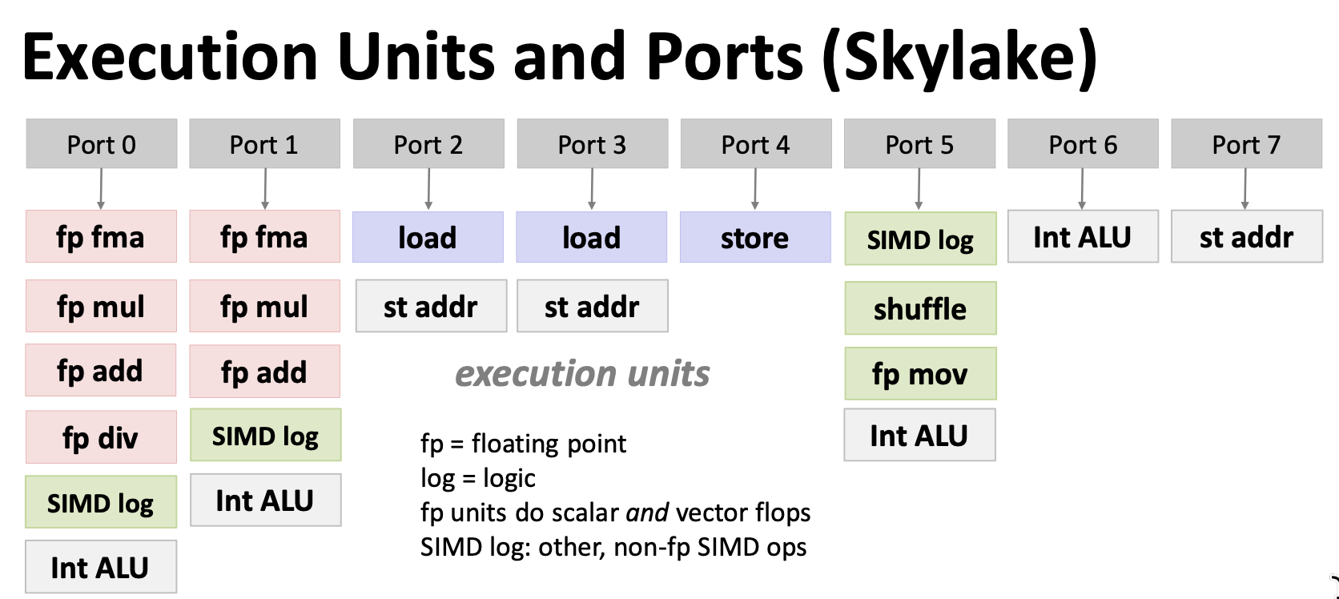
CPU: Out-of-Order Execution
Problem: Clock rates come near physical limits → Parallel execution for better scalability
Moste CPUs since 1998 are superscalar:
A superscalar CPU has multiple execution units → Can execute multiple instruction per clock
Picture: https://acl.inf.ethz.ch/teaching/fastcode/2023/slides/03-architecture-core.pdf

Slide 9
CPU: Out-of-Order Execution
Goal: use as all execution units if possible
Distribute all sequential instructions of one thread on multiple execution units → Instruction Level Parallelism (ILP)
x86 CPUs use a RISC-microarchitecture internally, decomposing assembly instructions into multiple μOPs
Example:
ADD EAX, [MEM2] is decomposed into two μOPs
CPU fetches [MEM2] while imul is being executed
; Example 2.1. Out of order processing
mov eax, [mem1]
imul eax, 5
add eax, [mem2]
Beispiel aus: https://www.agner.org/optimize/microarchitecture.pdf

Slide 10
CPU: Out-of-Order Execution
Register Renaming: Registers are renamed by the microarchitecture
Internally a Register Alias Table (RAT) is used
Example:
[MEM1] is multiplied by 6
[MEM3] is increased by 2
Both operations are independent from each other and can be execute out of order through automatic register renaming
; Example 2.3. Register renaming
1: mov eax, [mem1]
2: imul eax, 6
3: mov [mem2], eax
4: mov eax, [mem3]
5: add eax, 2
6: mov [mem4], eax
Beispiel aus: https://www.agner.org/optimize/microarchitecture.pdf

Slide 11
CPU: Retire in Order
At the end the changes done by the assembly instructions must become visible in the correct order (as dictated by the program) → Retire in Order
This is done by the Reorder Buffer (ROB):
Monitors correct order of assembly instructions
Manages exception processing (in the right order)

Slide 12
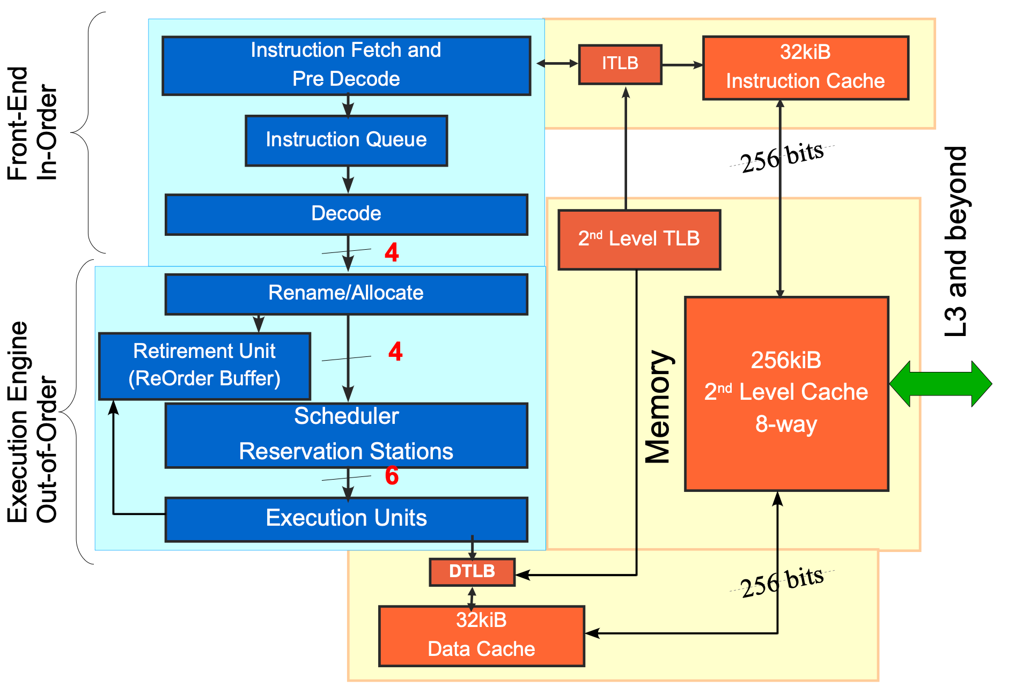
Example: Nehalem Core Pipeline
High-level diagram of a Nehalem core pipeline, Michael E. Thomadakis, Ph.D., https://progforperf.github.io/nehalem.pdf

Slide 13
Example: Out-of-Order Execution
Cache is completely replaced (e.g., by reading a very large array)
Afterward the following program is executed:
Line 2 is obviously independent from line 1
1: *(volatile char*) 0; // raise_exception();
2: array[84 * 4096] = 0; // access 84 page from array start
Code from: https://www.usenix.org/conference/usenixsecurity18/presentation/lipp

Slide 14
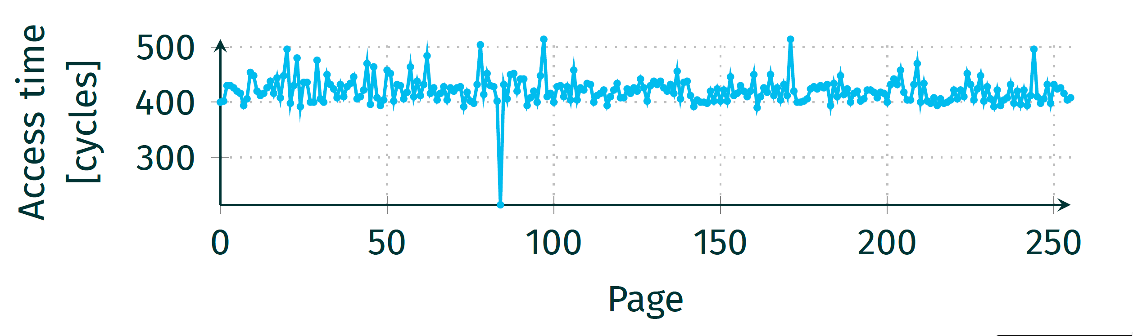
Example: Out-of-Order Execution
Read the elements of array and measure the access times
One access is much faster than the others
→ Instruction in line 2 has been executed
→ Exception (caused by line 1) was thrown afterward
→ Cache is not reset by the exception
→ We can indirectly observe the execution of a volatile instruction
Picture: https://www.usenix.org/conference/usenixsecurity18/presentation/lipp

Slide 15
Meltdown Attack (Principle)
Step 1: Delete the cache by allocating (and reading) a large array in user space (user_addr in the picture)
Kernel Space
read
user_addr
User Space

Slide 16
Meltdown Attack (Principle)
Step 2: Execute the following code
Accessing kernel_addr is forbidden
But accessing user_addr is allowed
kernel_addr
rax
user_addr
; user-mode code
1: mov rax, [kernel_addr] ; access address in kernel space
2: and rax, 0xff ; use lowest byte
3: mov rbx, [rax*128+user_addr] ; as index in an array in user-space
; align the access with cache lines
; here 128 bytes per cache line
Code from: https://www.usenix.org/conference/usenixsecurity18/presentation/lipp

Slide 17
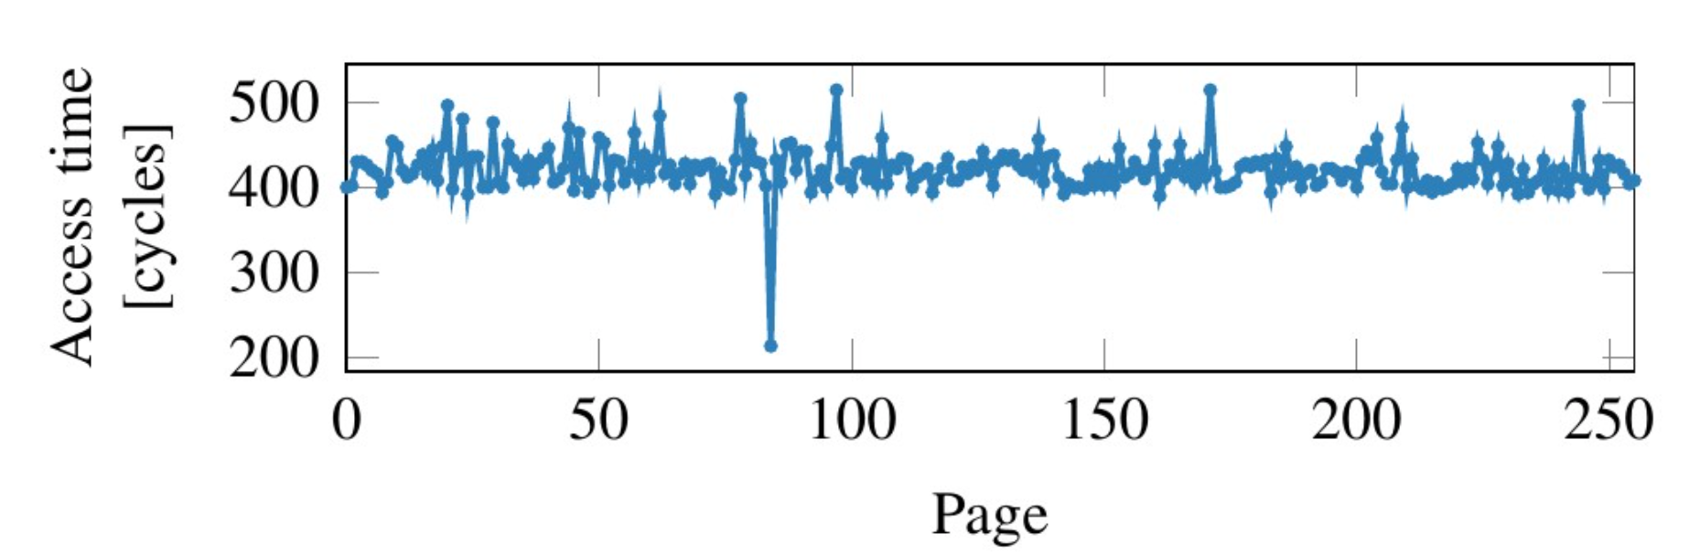
Meltdown Attack (Principle)
Step 3: Use a loop to read single bytes with a stride of 128 byte (size of a cache line), starting at user_addr
One access will be much faster than the others
This is exactly the cache line that was loaded by the forbidden access
This way, we can determine the number of the cache line and thus the index used to access the array → This is the byte in rax
We just read a byte from kernel space!
This can be continued indefinetly to read any memory from kernel space
Picture from: https://www.usenix.org/conference/usenixsecurity18/presentation/lipp

Slide 18
Meltdown Attack (Principle)
Step 4: Prevent the process from being terminated when the forbidden memory acces is recognized
Simply register a signal handler for SIGSEV
This prevents termination of the process
Determine the index via time measurements (see step 3) inside the handler
Read the desired data from kernel space byte by byte

Slide 19
Meltdown Attack (Principle)
Why does this work?
Lines 2 and 3 depend on line 1
Speculative Execution
The μOPs for lines 2 and 3 are probably already waiting in the reservation station until data from line 1 is available
As soon as the data from [kernel_addr] is available on the internal data bus, the wating μOPs are executed
In parallel, the result from line 1 is being processed in the retirement unit, where the exception is thrown
In the meantime (before the exception is thrown) the cache has already been filled for the μOPs of line 3
The exception resets the CPU state, but not the cache
1: mov rax, [kernel_addr]
2: and rax, 0xff
3: mov rbx, [rax*128+user_addr]

Slide 20
Remarks
Most operating systems map the whole physical address space into the kernel space
This allows attackers to read the whole memory via meltdown attacks
Example: Private keys of NTFS filesystems were kept in kernel space memory and could be read via meltdown attacks
SIGSEV is expensive, but on fast systems kernel memory can be read at about 500 KB/s → Highly critical security flaw

Slide 21
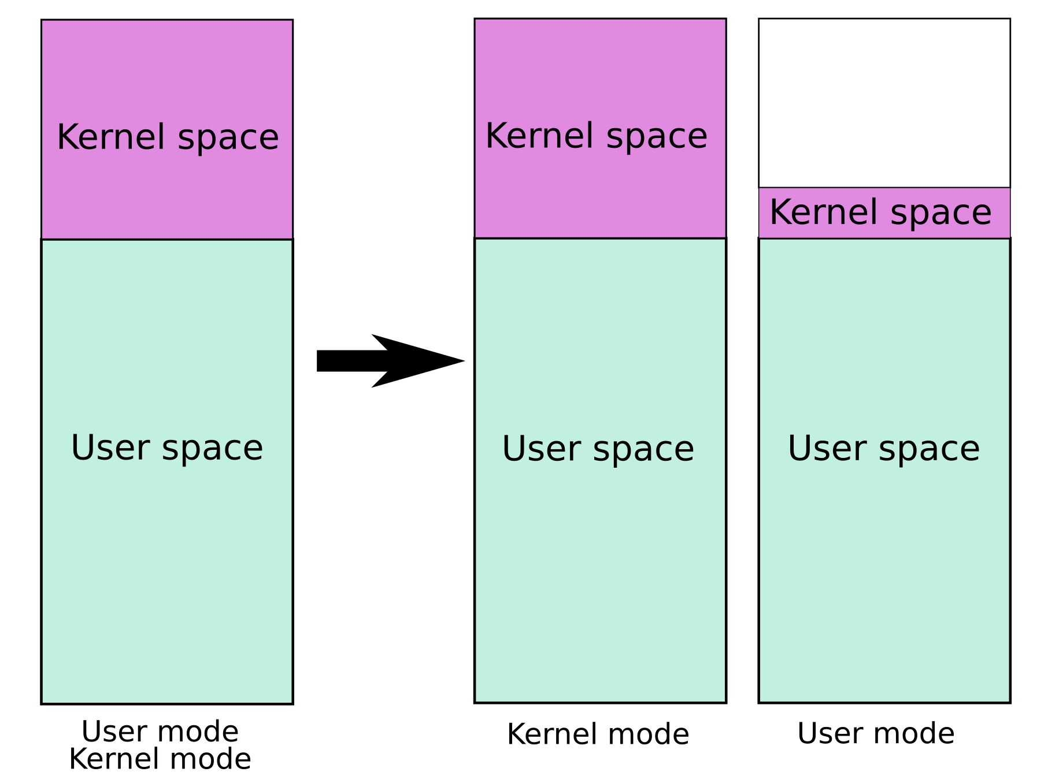
Solution: Kernel Page Table Isolation (KPTI)
KPTI (formerly KAISER) realizes a fully separated address space for the Linux kernel →
When a user application is active, only a minimal portion of kernel code, needed to switch to the kernel space (e.g., for system calls), is mapped
During a system call the kernel is fully mapped
This is done by setting page directory entries
When returning from kernel code the TLB must be flushed
To make sure kernel pages are no longer accessible
This is expensive (up to 30% slower)
Picture from: https://de.wikipedia.org/wiki/Kernel_page-table_isolation

Slide 22
TLB with PCIDs
Modern CPUs offer Process Context Identifiers (PCIDs)
12 Bit → 4096 possible PCIDs
Must be activated in CR4
Current PCID is stored in bits 11:0 of CR3
Allow the MMU to differentiate between TLB entries of multiple address spaces
When accessing the TLB, only entries with the current PCID (in CR3) are used
This way, returning from kernel code does not require flushing the whole TLB anymore!

Slide 23
Literature
Lipp et.al., „Meltdown: Reading Kernel Memory from User Space“, USENIX Security Symposium, USA, 2018.
Gruss et.al., „KASLR is Dead: Long Live KASLR”, Engineering Secure Software and Systems, Germany, 2017.
Gruss et.al., „Kernel Isolation - From an Academic Idea to an Efficient Patch for Every Computer“, USENIX, 2018, Vol. 43, No. 4
Comprehensive information on Meltdown and Spectre: https://meltdownattack.com

Slide 24
Exchanging Data in System Calls
Many system calls take a pointer to a buffer on the user heap as parameter
Reading: Input buffer (empty, for new data)
Writing: Output buffer (already filled with data)
The kernel must allocate a same-sized buffer and copy the data (see next slides)
Reason: At the time the user mode buffer is accessed, an other process may be active and the user mode addresses invalid

Slide 25
System Call: Reading
If no data is available to read, the caller is bloked
At a later point in time, an interrupt signals the device driver that new data is available → The waiting thread is deblocked
At the time the interrupt occurs, another process may be active and the user mode addresses (i.e., the target buffer) are invalid
Process 1
Process 2
Puffer
sys_read(…)
sys_read(…)
isr(…)
0
0
Zeit
Thread blocked, as no data is available
Scheduler has switched to another thread; An interrupt occurs → Address of user mode buffer is invalid

Slide 26
System Call: Reading
If no data is available to read, the caller is bloked
At a later point in time, an interrupt signals the device driver that new data is available → The waiting thread is deblocked
At the time the interrupt occurs, another process may be active and the user mode addresses (i.e., the target buffer) are invalid
Process 1
Process 2
Process 1
Buffer
copy
sys_read(…)
sys_read(…)
sys_read(…)
isr(…)
Buffer’
0
0
0
Zeit
Thread blocked, as no data is available
Scheduler has switched to another thread; An interrupt occurs → Address of user mode buffer is invalid
Copy data

Slide 27
System Call: Writing
As with reading, it may not be possible to write the data directly to the device
For example, the device may currently be busy with other data
Because of that, the kernel also creates a buffer and copies the user data into it
This way, it does not matter whether the process is still active when the target device is ready to receive data

Slide 28
Avoid Double Buffering
Solution 1: Two mappings (UNIX/Linux)
Drive implements the mmap function
If an application calls mmap in the driver, it allocates a kernel space buffer and creates an additional mapping in user space
Physikalischer Adressraum
Seitentabellen
frei
User-Space 2
Kernel-Space

Slide 29
Avoid Double Buffering
Solution 2: Kernel uses physical addresses (Windows DirectIO)
I/O-Manager creates a Memory Description List:
A list of frames that is occupied by the buffer
The driver operates directly on the physical addresses
Usually the whole physical address space is mapped 1:1 in kernel space
This way, the address calculation is trivial (without page tables):
Lower Half kernel: physical address = virtual address
Higher Half kernel: physical address = virtual address - kernel_offset

