Slide 1
Isolation and Protection in Operating Systems 4. Paging in x86-64
Prof. Dr. Michael Schöttner
Dr. Fabian Ruhland

Slide 2
Current State
We use segmentation to differentiate between kernel and user code
User mode threads cannot execute privileged CPU instruction
We also blocked accesses to I/O-ports for user mode threads via the TSS
We now implement paging to restrict memory accesses
This enables us to isolate user mode processes...
...and protect the kernel’s memory area from being accessed by user mode code

Slide 3
Paging
Virtual address space is divided into equal sized pages
Virtual address space is divided into equal sized page frames
Usually 4 KiB pages and thus 4 KiB page frames are used
One page frame stores exactly one page
Special case: Huge Pages, e.g. 2 MiB or 1 GiB
Memory protection can be specified with a 4 KiB granularity
Read only
Execute
User mode access allowed/forbidden

Slide 4
Virtual vs. Physical Addresses
Virtual/Logical addressesare differentiated from physical addresses
Virtual addresses use up to 57 bit, depending on the CPU
Addressable physical memory depends on the installed DRAM
A block of virtual memory can be mapped to arbitrary page frames
Virtual Address Space
Page Table
#PF
Physical Address Space
...
4
3
2
1
0
...
...
...
2
0
4
A
B
C
B
C
A
#Page 0 1 2 3 4
#Page
0 1 2 3 4 #Page-Frame (=PF)

Slide 5
Process Isolation
Each process has its own page tables describing its virtual address space
We map the kernel memory into every address space
Page frames can be mapped arbitrarily
Process 1
Page Tables for Process 1
Physical Address Space
User Space 1
User-Space 1
Kernel-Space
available
Kernel Space
Page Tables for Process 2
Process 2
User Space 2
User-Space 2
Kernel-Space
Kernel Space

Slide 6
Process Isolation
Each thread runs in a process address space and can only access virtual addresses on pages that are allowed by the corresponding page table entries
This is controlled by bits in the page table entries (see next slides)
If a page is not present, it is either swapped out or unused
Accessing it causes a Page Fault
The page tables themselves must be protected from user space accesses (just like the kernel)
This is controlled by a specific bit in the page table entries (see next slides)

Slide 7
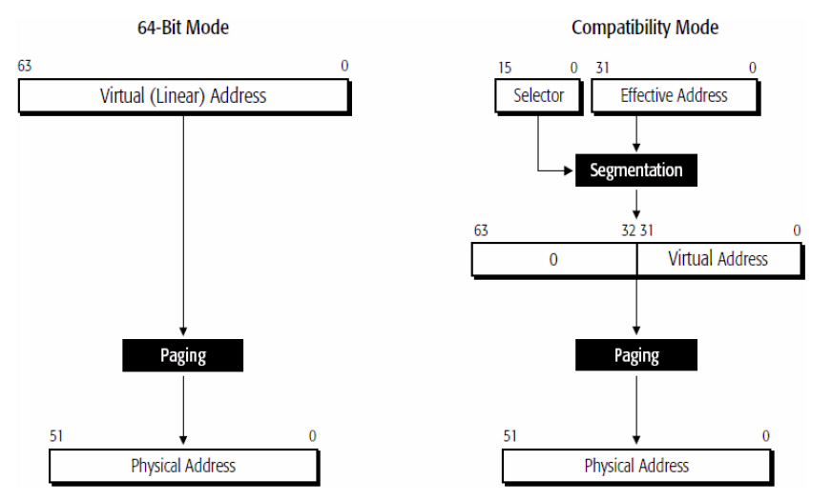
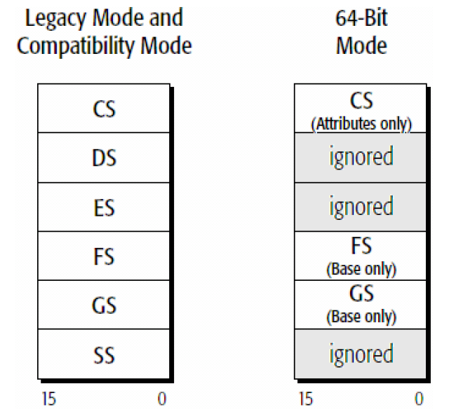
Long Mode: Segmentation
16-bit selectors
Start addresses are ignored (except FS and GS)
FS: For thread-local storage (used by thread libraries)
GS: Linux uses it to retrieve the stack address for fast system calls
No limit checks
Only the ring number in CS remains relevant

Slide 8
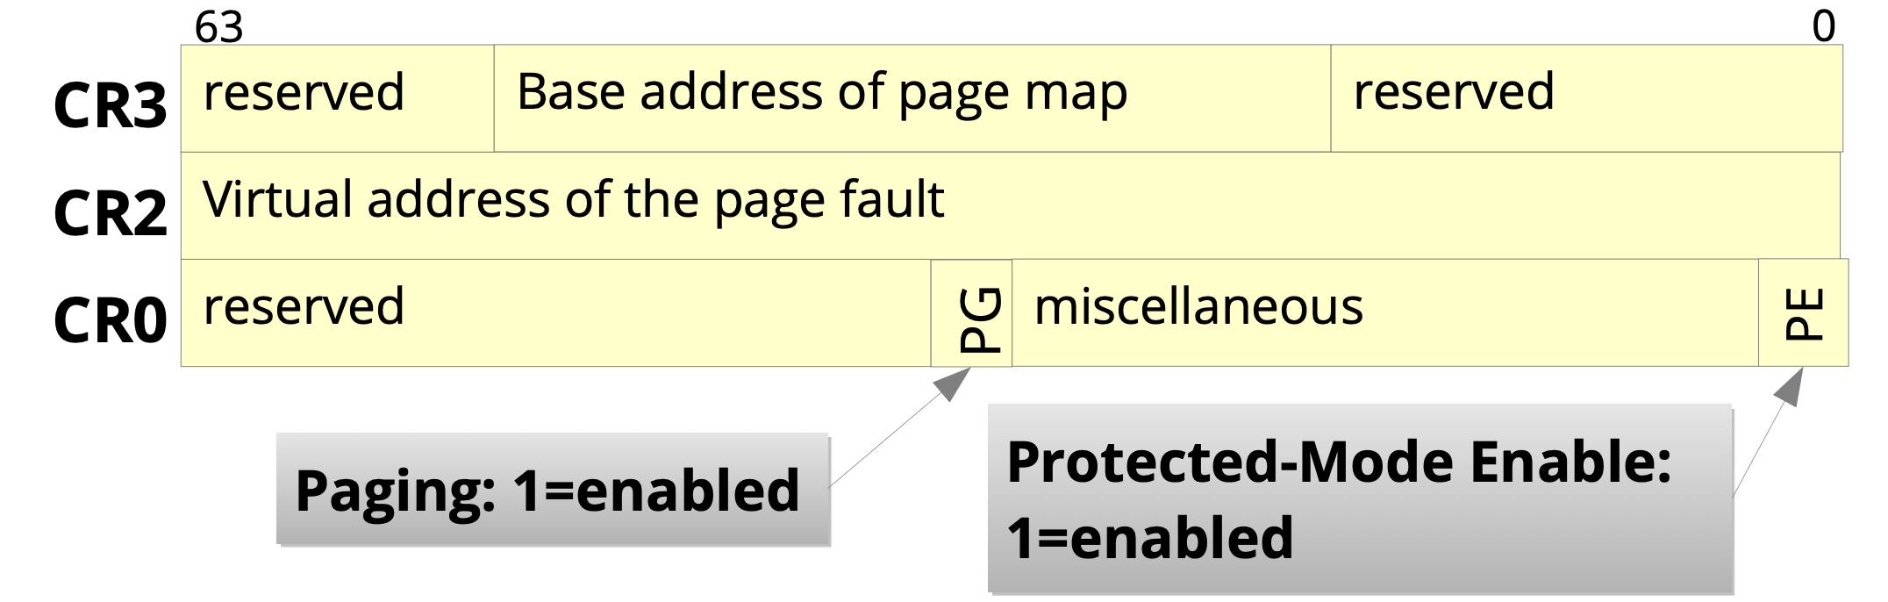
Long Mode: Paging
Paging is mandatory in Long Mode
The basic paging configuration is handled by the CRx Control Registers
Physikalische Adresse
Picture: Horst Schiermeier, TU Dresden

Slide 9
Long Mode: Page Tables
Four level Paging
Modern CPUs may support five levels
Index: 9 Bit
4 KiB per table
8 byte per entry
512 entries per table
Picture:James Mickens, Harvard

Slide 10
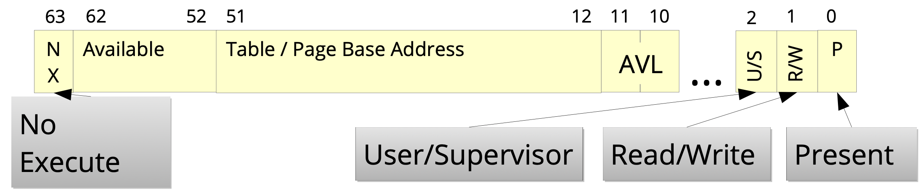
Page Table Entry
Configuration is possible on all level of the page table hierarchy
Protection bits:
R/W = Read/Write → Protection agains write accesses
NX = NoeXecute → Prohibit code execution in memory that only contains data
U/S = User/Supervisor → Access allowed for everyone or only in ring 0
Available = AVL = Bits that are freely usable by the operating system
Picture: Horst Schirmeier, TU Dresden

Slide 11
Bemerkungen
Warum gibt es so viele Stufen?
I.d.R. wird der virtuelle Adressraum nur spärlich und verstreut genutzt
Allenfalls großer Heap bei Big-Data-Systemen
Aber Stacks und Code benötigen nicht Gigabytes
Es werden nur notwendige Tabellen angelegt
Ein Eintrag in PML4E beschreibt 512 GB
Falls dieser Adressbereich komplett ungenutzt ist, so wird PML4E.present bit = 0 gesetzt
Und entsprechend werden nicht alle zugehörigen Tabellen PDP/PD/PT Tabellen in diesem Unterbaum angelegt

Slide 12
Example: 1 GiB Pages
Picture: James Mickens, Harvard

Slide 13
Example: 1 GiB Pages
Picture: James Mickens, Harvard

Slide 14
Long Mode: TLB
Problem: Paging requires address translation by the Memory Management Unit (MMU) → One MMU per core
Address translation is slow because of the four/five levels of page tables
Long Mode requires paging
Solution: Translation Lookaside Buffer (TLB) → One TLB per core:
Buffers translated addresses
Fully associative cache → Lookup in O(1)
Tag: consists of page table indices
Data: page frame address

Slide 15
Long Mode: TLB
Picture: James Mickens, Harvard

Slide 16
Long Mode: TLB
Picture: James Mickens, Harvard

Slide 17
Long Mode: TLB
Before raising page fault exception, HW sets cr2 to faulting address, and pushes an error code onto stack
Ex1: User thread tried to read a non-present page
Ex2: User thread tried to write a present but read-only page
Picture: James Mickens, Harvard

Slide 18
Long Mode: TLB
TLB is small: ~32-100 entries (depending on the CPU)
In usual application the TLB reaches a hit rate of up to 98%
Why? → Principle of locality
Arrays, Loops, etc.
Remarks
Writing the CR3 register (address space switch) fully invalidates the TLB
Whenever protection/access bits in a page table are modified, the corresponding TLB entry must be invalidated manually (INVLPG instruction)
On multicore CPUs, this may be necessary on all cores!

Slide 19
To Be Continued...
Kernel isolation after Meltdown
Process Context Identifiers
Memory protection keys

