Slide 1
OS Development 2. Introduction to OS development
Prof. Dr. Michael Schöttner
Dr. Fabian Ruhland

Slide 2
Preview
Classification
Compiling and Linking
Boot process
Debugging
Summary

Slide 3
OS development (often a struggle)
First steps: How to bring your OS to the target hardware?
Compiling
Boot process
Testing and Debugging: What to do in case the system is stuck?
„println()“ debugging
Emulation
Debugger
Remote debugger
Hardware support

Slide 4
Preview
Classification
Compiling and Linking
Boot process
Debugging
Summary

Slide 5
Compiling – Hello, World?
Assumption:
The development environment runs on Linux, macOS or Windows
The target system is a x86_64 system
Does this program also run on directly on naked hardware?
Can an operating system even be developed in a high-level language
fn main() {
println!("hello world");
}
$ rustc hello.rs
$ ./hello
hello world

Slide 6
Compiling: Problems and Solutions
No dynamic linking available → All required libraries must be linked statically
Runtime environment std expects OS functions for threads, memory management, network, etc.
Cannot be used, as well as other libraires (crates) requiring std
But we can use the Rust core crate (and alloc, once we have implemented a heap allocator)
All generated addresses are referring to virtual memory
We cannot use the linker’s default settings
We need a special linker file with our configuration
High-level code has requirements
Address translation, Runtime environment, Stack, ...
Separate startup code has to prepare the execution of high-level language code

Slide 7
Preview
Classification
Compiling and Linking
Boot process
Debugging
Summary

Slide 8
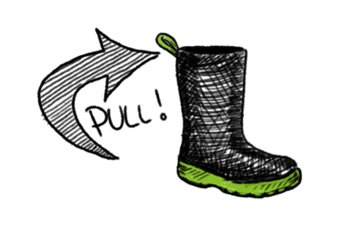

Bootstrapping
Bootstrapping: A simple system starts a more complex system
Name is derived from Münchhausen, who supposedly pulled himself out of a swamp by his on hair
Picture: https://de.wikipedia.org/wiki/Münchhausen-Trilemma

Slide 9
BIOS: Boot process
BIOS = Basic Input Output System
Firmware on motherboard → Initializes hardware and allows access to devices
Provides many functions per software interrupt (only in Real Mode)
Stored on a single chip
formerly: ROM, later: EEPROM, today: NAND flash memory
The term BIOS was introduced by the CP/M operating system in 1975
Starts with a POST = Power On Self Test
CPU check → built-in self test of the CPU
Initialization of chipset & main memory
Initialization of different mainboard components

Slide 10
BIOS: Real Mode
Default CPU mode after power-on / reset
16-bit register, 64 KiB segments
Only 20-bit physical adresses (max 1 MiB main memory)
Effective adress = (segment << 4) + offset
Intel 8086

Slide 11
BIOS: Bootstrapping
­Determine first/next boot device
Check for signaute 0x55AA in sector 0 = Master Boot Record (MBR)
In case of wrong signature or read error → next device
If found, the BIOS loads the first sector to a special memory address and jumps to it
First loader (Stage 1) must fit into 512 Byte → Assembler
If the loaded code returns → next device
The loader in the MBR loads the real boot loader (Stage 2) using the BIOS
May show a menu interface, if multiple operating systems are installed
Loads the kernel image into memory and jumps to it

Slide 12
BIOS: Boot process
Kernel has an entry function (usually written in assembly)
Switches the CPU to Protected Mode (32 Bit)
Afterward to Long Mode (64 Bit)
Performs basic setup (Stack, 1:1-Paging, etc.)
Calls a function written in a high-level language (often C)
HW Start
BIOS POST
Stage 1 Bootloader (MBR)
Stage 2 Bootloader
Kernel

Slide 13

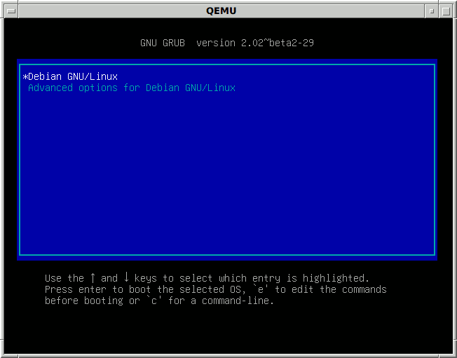
Boot process using GRUB
GRUB = GNU GRand Unified Bootloader
Offers a boot menu and allows defining boot parameters
Reference implementation of the Multiboot protocol
https://www.gnu.org/software/grub/manual/multiboot/multiboot.html
Kernel images are ELF files with a Multiboot record at the beginning
Grub switches to Protected Mode (32-bit), loads the kernel image defined in grub.cfg and jumps to it
If specified by the Multiboot record, GRUB switches to a desired graphic mode and can provide system information
GRUB supports classic BIOS and the modern UEFI BIOS
Pictures: https://en.wikipedia.org/wiki/GNU_GRUB

Slide 14
Boot process on UEFI
Unified Extensible Firmware Interface (UEFI)
Software interface between operating system and hardware
64-bit code instead of 16-bit real mode
Device drivers for pre-boot environment (including a network stack)
Bootmanager, supports disks with a GUID partition table
Filesystem support (FAT32), textual und graphical console
Extensions: can be loaded from persistent memory devices
Supports pre-boot applications
Additional information: http://software.intel.com/en-us/articles/about-uefi/

Slide 15
Boot process using Towboot
Bootloader developed by Niklas Sombert (HHU, Department: Operating Systems)
Written in Rust, as a UEFI application → Only works on modern UEFI BIOS
Supports Multiboot and Multiboot2 protocols
Kernel images are ELF files with a Multiboot record or some Multiboot2 tags at the beginning
Parses the configuration file towboot.toml and loads the specified kernel image
Can also switch to a desired graphics mode, if specified in the Multiboot/Multiboot2 header
Open Source: https://github.com/hhuOS/towboot
HeineOS uses Towboot as its bootloader
Pictures: https://en.wikipedia.org/wiki/GNU_GRUB

Slide 16
Preview
Classification
Compiling and Linking
Boot process
Debugging
Summary

Slide 17
println!-Debugging
Not trivial, as println!() is part of the Rust runtime environment (not in core)
Furthermore calls to println! impact execution speed (slow!)
Some errors may not occur anymore after inserting println!() calls into the code
This is especially true for OS development
Oftentimes errors lead to immediate reboot, causing the screen to be erased
Resorts
Serial port
PC Speaker
Blinking LED

Slide 18
Emulators
Emulate specific hardware in software
Most emulators support attaching a debugger, to pause the system and inspect variables and CPU registers
May also influence system behaviour, but is very helpful nonetheless
Caution: Emulator and real hardware may differ in details
Virtual Machines and Emulators are not the same
Example: VMware does not emulate an x86 CPU, but uses a real CPU to directly execute code in the VM

Slide 19

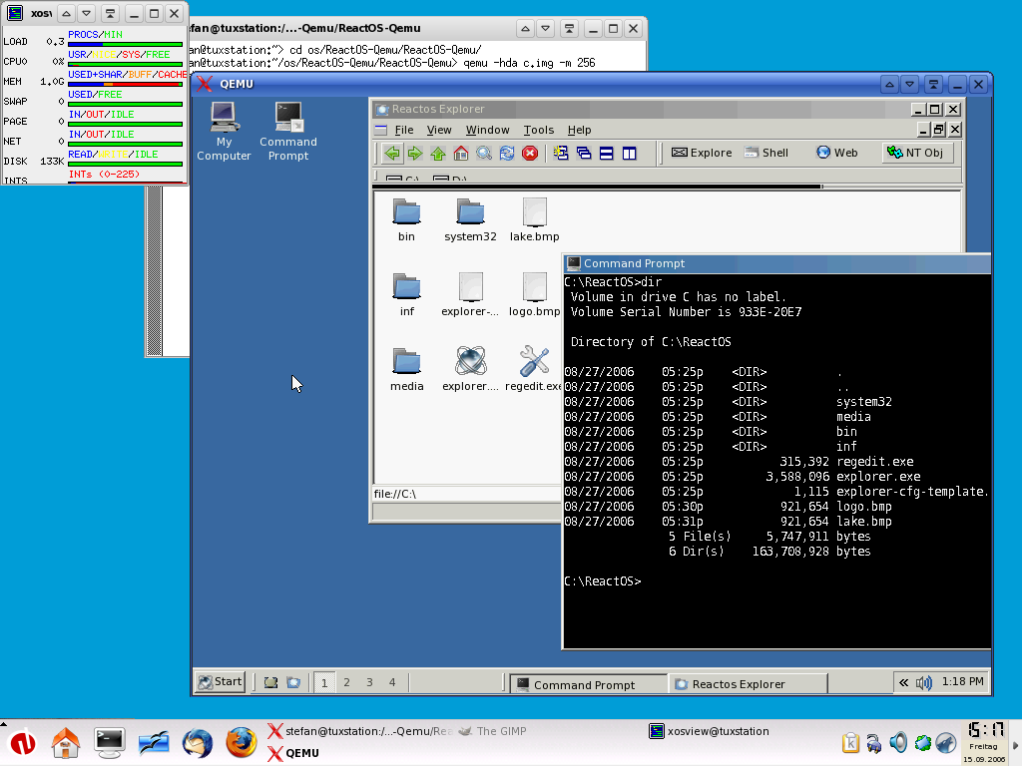
Example: QEMU
Emulates differenct CPU architectures, e.g. x86 (also supports multiple cores)
Emulates a full PC
Memory, Devices (even sound and network cards)
Written in C
Useful for OS developers
Debugger support (GDB)
CPU/Memory dump on crash
Used for HeineOS development
Pictures: https://en.wikipedia.org/wiki/QEMU

Slide 20

Example: gdb
gdb = GNU Debugger
Again: Hello, World
Notice: Compilers distinguish between Debug und Release builds
The Debug version includes debug information in the program image
For example names of parameters or local variables, etc.
Release code is usually much faster (compiler optimizations)
fn main() {
println!("hello world");
}
$ rustc –g hello.rs

Slide 21
Hardware debugging support in x86
INT3 triggers a breakpoint interrupt (TRAP)
Is placed inside the code specifically by the user level debugger (e.g., gdb)
TRAP hadler inside the kernel moves control flow to the debugger
Setting Trap Flags (TF) inside the status register (RFLAGS) triggers a debug interrupt (INT 1) after every instruction
Useful for implementing a single step mode in the debugger
The debug registers DR0-DR7 (introduced with the i386) can monitor up to 4 breakpoints without manipulating code
Sustantial advantage if code is stored in ROM/FLASH or non-writable memory segments
Used by kernel level debuggers (e.g., kdb)
Only accessible in Ring 0

Slide 22
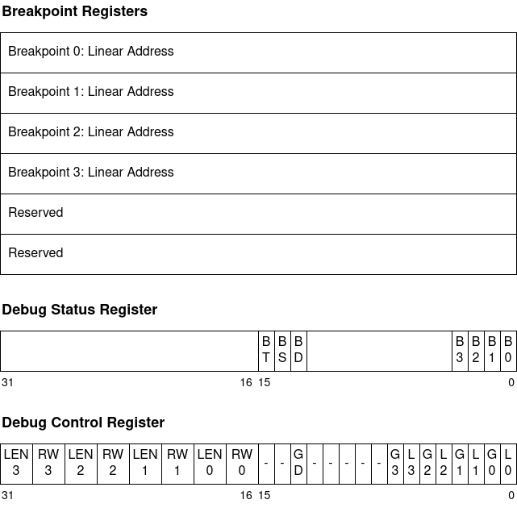
Debug registers in x86

Slide 23
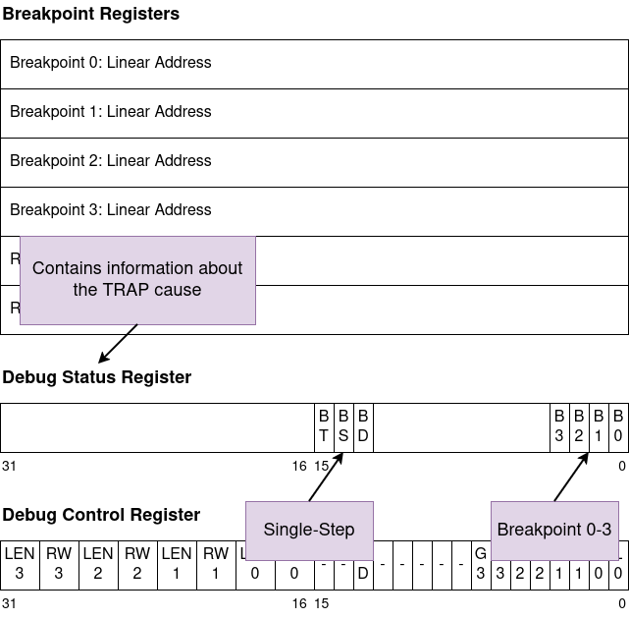
Debug registers in x86

Slide 24
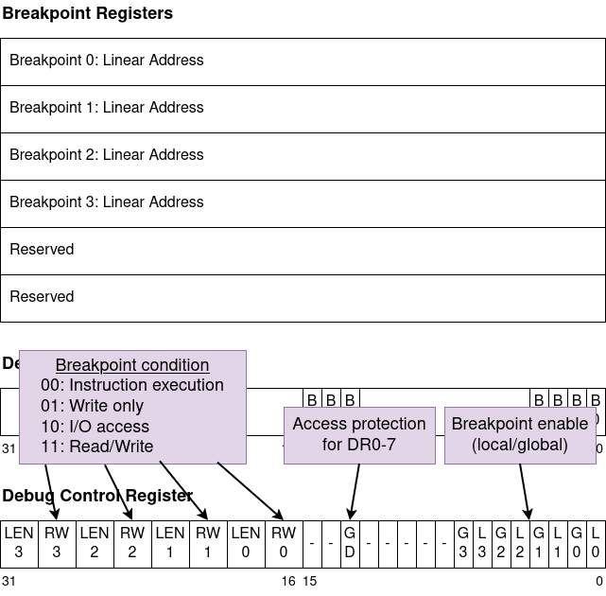
Debug registers in x86

Slide 25
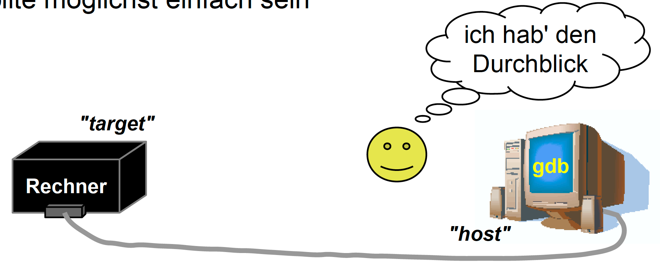
Remote debugging
Allows debugging on platforms, that do not offer an interactive user interface
Requires a communication connection (Serial port, Ethernet, etc.)
A device driver for the communication device is needed
Target platform may also be an emulator (QEMU → TCP)
The debugging component on the target platform should be as simple as possible
PC
Picture: Volkmar Sieh / Daniel Lohmann, University Erlangen

Slide 26
Remote debugging
Communication protocol: GDB Remote Serial Protocol (RSP)
Defines the communication interface (GDB stub)
Only uses ASCII strings
Message format: $<Command/Response>#<Checksum>
Messages are immediately answered with + (OK) or - (Error)
Examples:
$g#67 → Read all register contents
Answer: + $123456789abcdef0...#... → register 1 is 0x12345678, register 2 is 0x9ab...
$G123456789abcdef0...#... → Set all register contents
Answer: + $OK#9a → Success
$m4015bc,2#5a → Read 2 byte at memory address 0x4015bc
Answer: + $2f86#06 → Value is 0x2f86

Slide 27
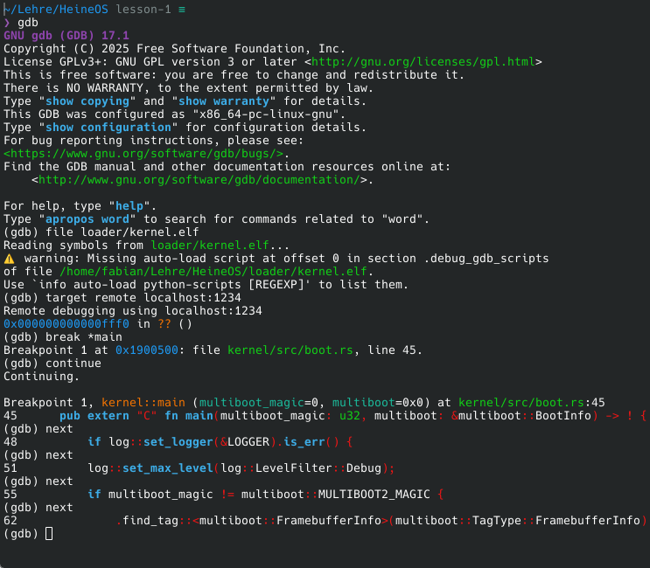
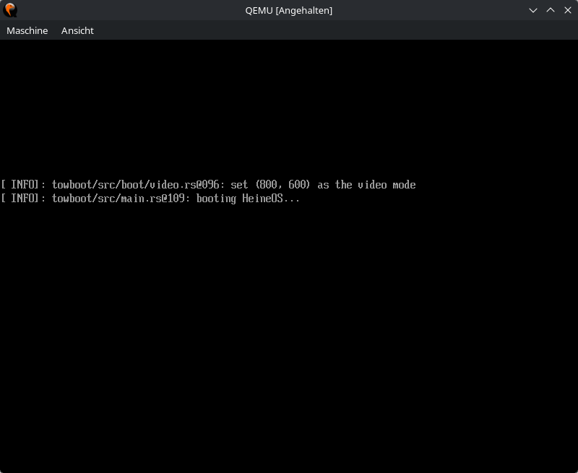
Remote debugging using QEMU

Slide 28
Preview
Classification
Compiling and Linking
Boot process
Debugging
Summary

Slide 29
Summary
OS development differs significantly from application development
(Most) libraries are missing
Foundation is formed by the naked hardware
First steps are hard
Compiling & Linking
Boot process
System initializatzion
Debugging requires infrastructure
Display driver für print!-Debugging
GDB stub and communication device (and driver) for remote debugging
Hardware debugging support

